Slide 1

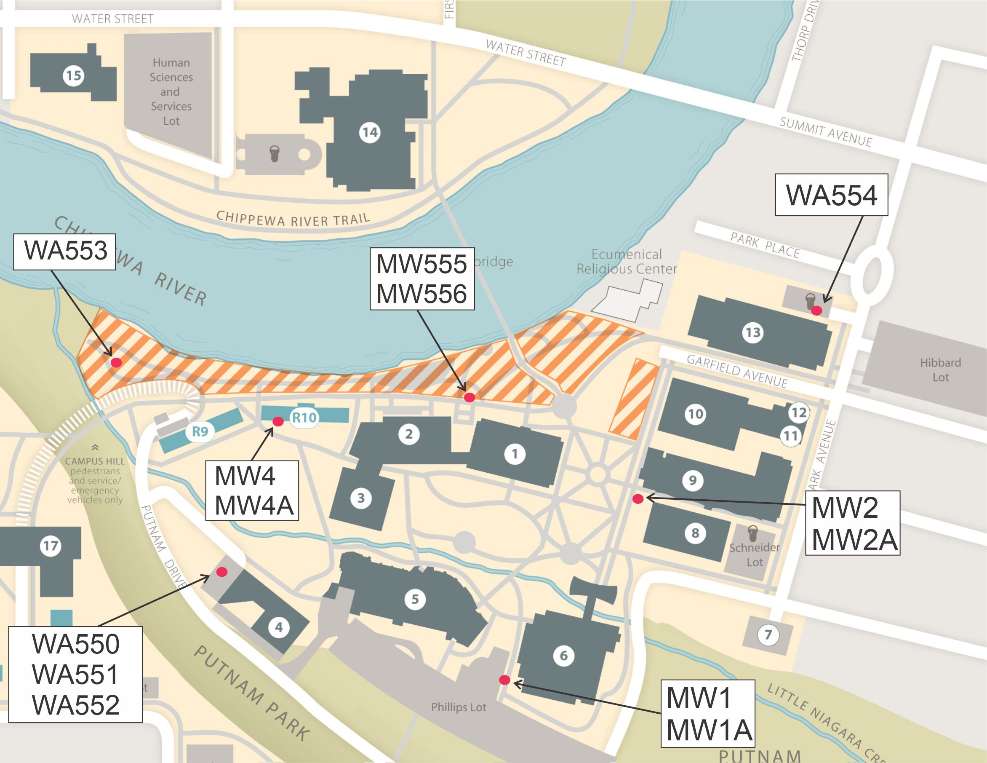
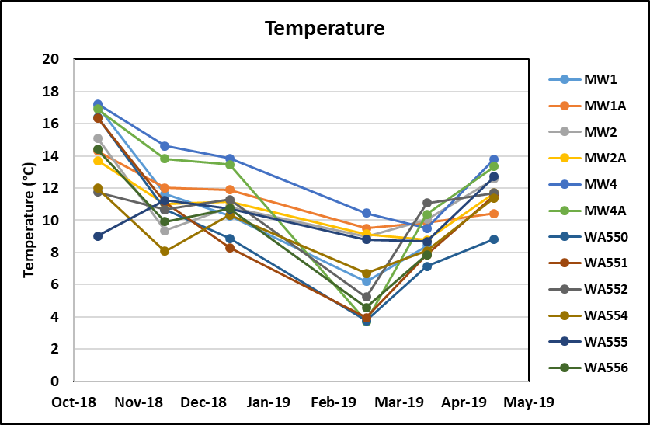
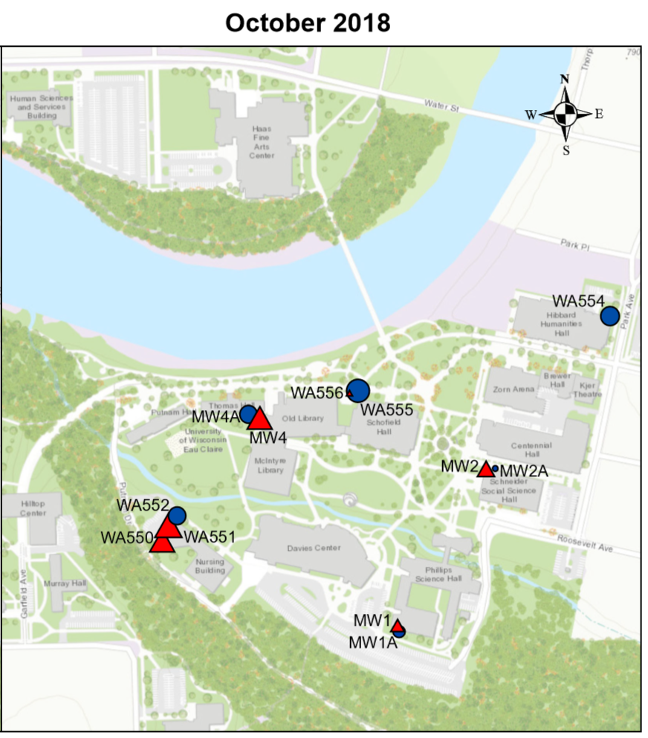
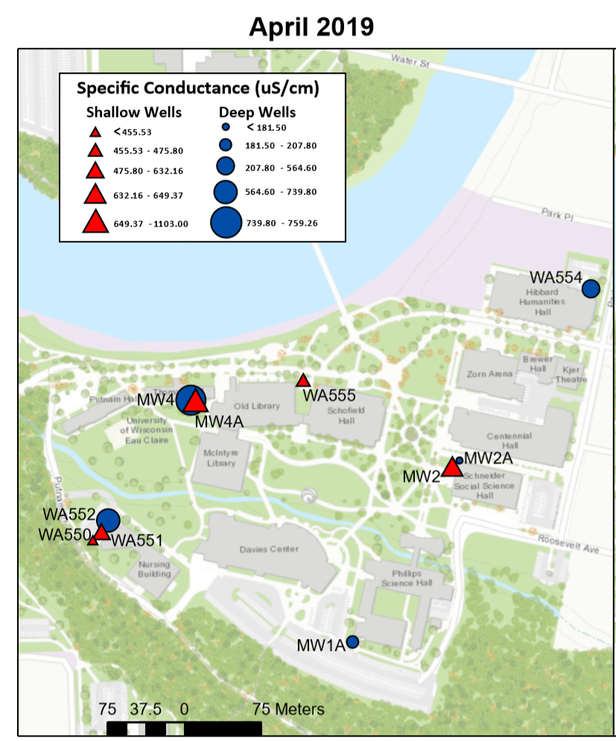
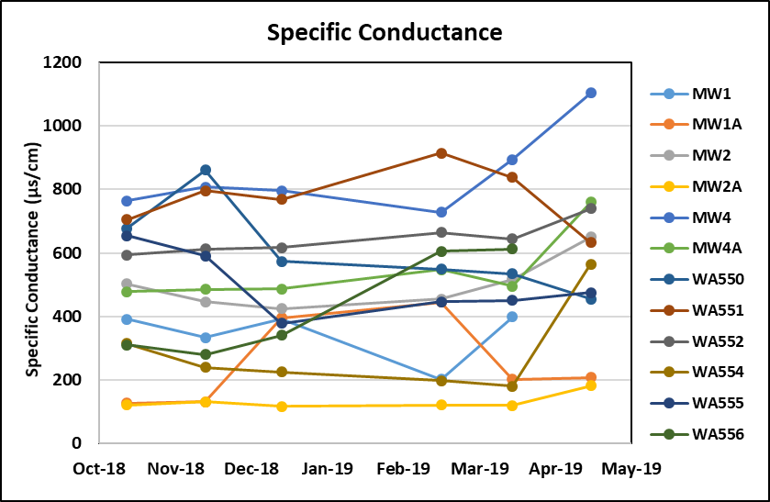
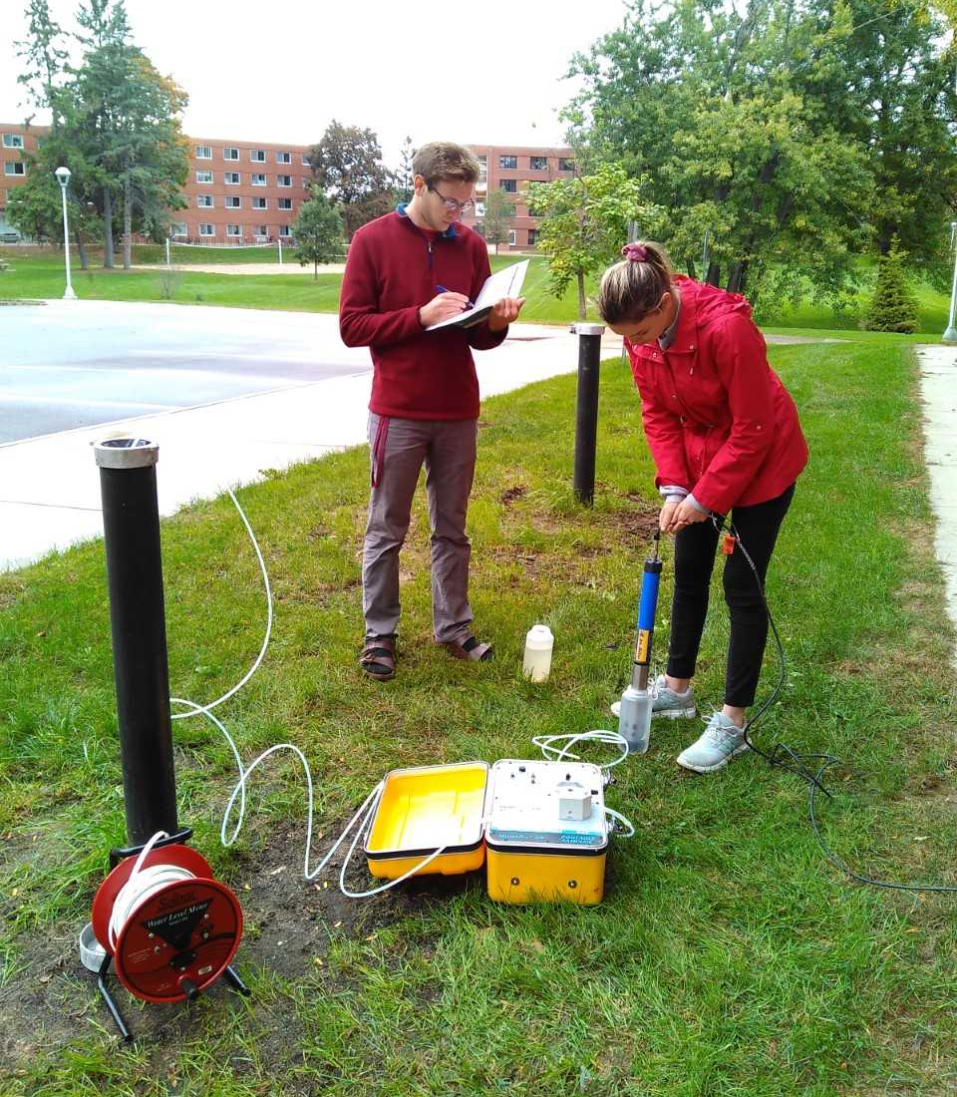
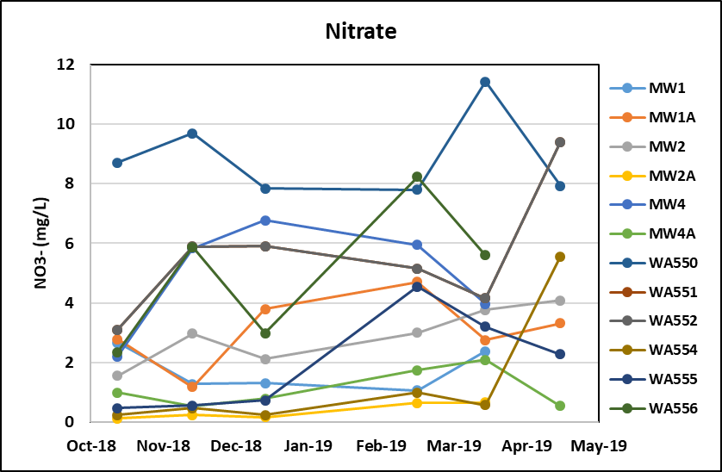
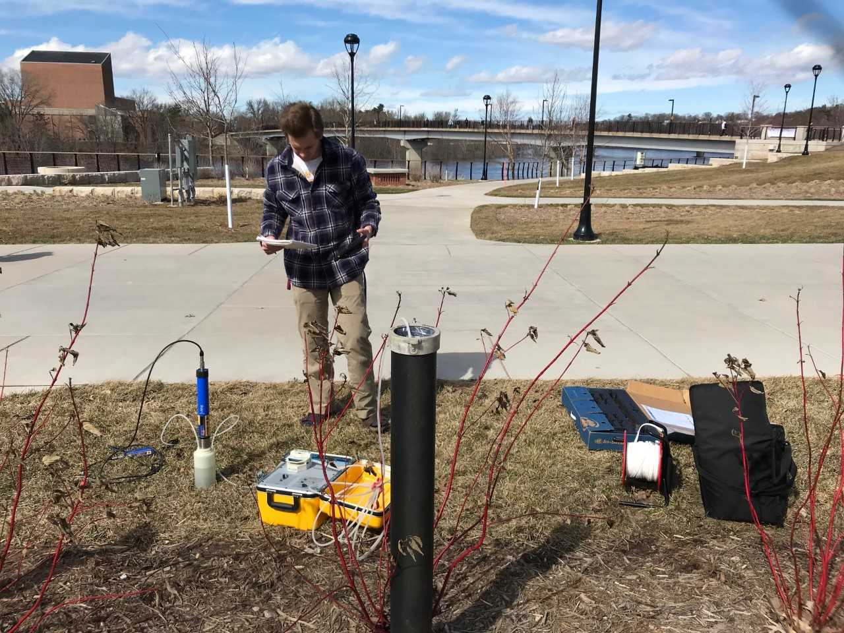
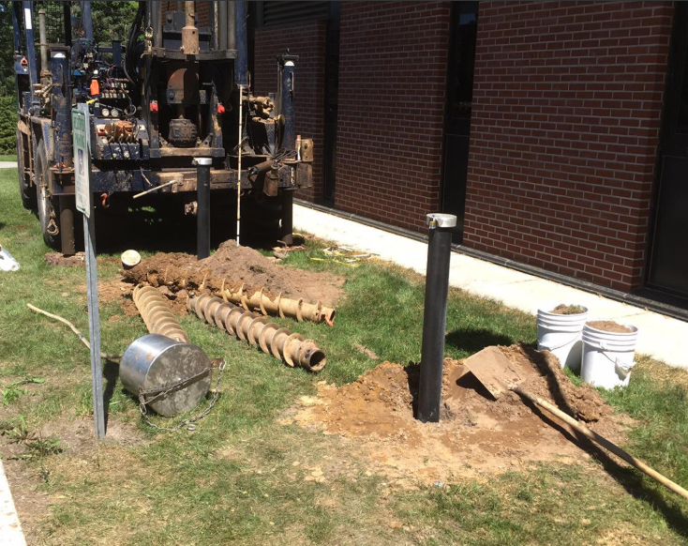
Evaluating Groundwater Quality and Behavior at UWEC Campus
Madelynn Gorg, Glen Hook, and Dr. Sarah Vitale, Geology Department
Introduction
Results and Discussion
Water Quality
To garner a better understanding of groundwater flow and water quality on the University of Wisconsin – Eau Claire campus, we collected monthly measurements in fourteen (13) monitoring wells across lower campus, including seven (7) wells installed over the summer of 2018. The parameters measured included temperature, pH, dissolved oxygen,
Temperature | Decreased with winter temperatures and increased with spring temperatures (graph below)
pH | Data ranged between 5.7 and 7.1, which is consistent with the sand and gravel aquifer present on lower campus
Specific Conductance | Specific conductance was higher in shallower wells, and increased during the late winter, likely associated with de-icing salt application on campus (graph and maps below)
ORP | Data are consistent with groundwater age and well depth, and provide evidence for nitrate removal (dropping a reduction level) in groundwater between WA 550 and WA 551
Nitrate | Slightly elevated levels were recorded over typical background levels (2 mg/L), and once exceeding the EPA standard of 10 mg/L (graph below)
Dissolved oxygen | Data are consistent with groundwater age and well depth, and provide evidence for nitrate reduction in groundwater between WA 550 and WA 551
oxidation-reduction potential, specific conductance, and nitrate, measured. Pressure transducers were also installed in two wells near the Chippewa River to continuously monitor hourly changes in water level.
Fig 1. Map of campus monitoring wells
This project was a directed study integrated with a field-based laboratory component in the Contaminant Hydrogeology course in the Geology Department.
Methods
WATER QUALITY
Low flow sampling was used to monitor the thirteen campus wells.
Tubing was positioned near the well screen.
The multi-parameter sonde (InSitu AquaTROLL 600) was used to measure all water quality parameters.
Data was recorded and analyzed using Excel and ArcGIS.
Map created by Elliot Draxler, Trevor Nelson, and Salvatore Kass (GEOL 416)
Fig 4. Map of Specific Conductance distribution in October 2018 and April 2019, for shallow and deep wells. Specific conductance is an indicator for chloride- mainly attributed to deicing salt.
Water Levels and Hydrologic Influences
Fig 2. Measuring water quality
WATER LEVELS
Water levels were measured in each well monthly using a water level meter.
Hourly water level measurements were recorded in two wells next to the Chippewa River using Solinst Levelogger pressure transducers.
Fig. 5, 6, 7. Water quality trends of 12 of the 13 campus wells measured monthly.
Acknowledgements
We would like to thank Chris Hessel and UWEC Facilities for working with us to coordinate and carry out well drilling. We would also like to acknowledge the Fall 2018 and Spring 2019 Hydrogeology students for contributing to data collection.
Fig 8. Wells WA 555 and 556, where water levels were continuously monitored.
Fig 9. Water levels for monitoring wells WA 555 and WA 556, Chippewa River stage (USGS gauge), and temperature/precipitation data in Eau Claire, WI.
Shallow groundwater levels are influenced primarily by precipitation (rain) events exceeding 0.78 inches (2 cm). The deep aquifer is sensitive to precipitation, snow melt, and subsequent increases in river stage. While groundwater typically flows into the river, river water begins discharging into the groundwater system when river stage exceeds 769 feet AMSL.
Fig 3. Summer 2018 551 well drilling

