Slide 1
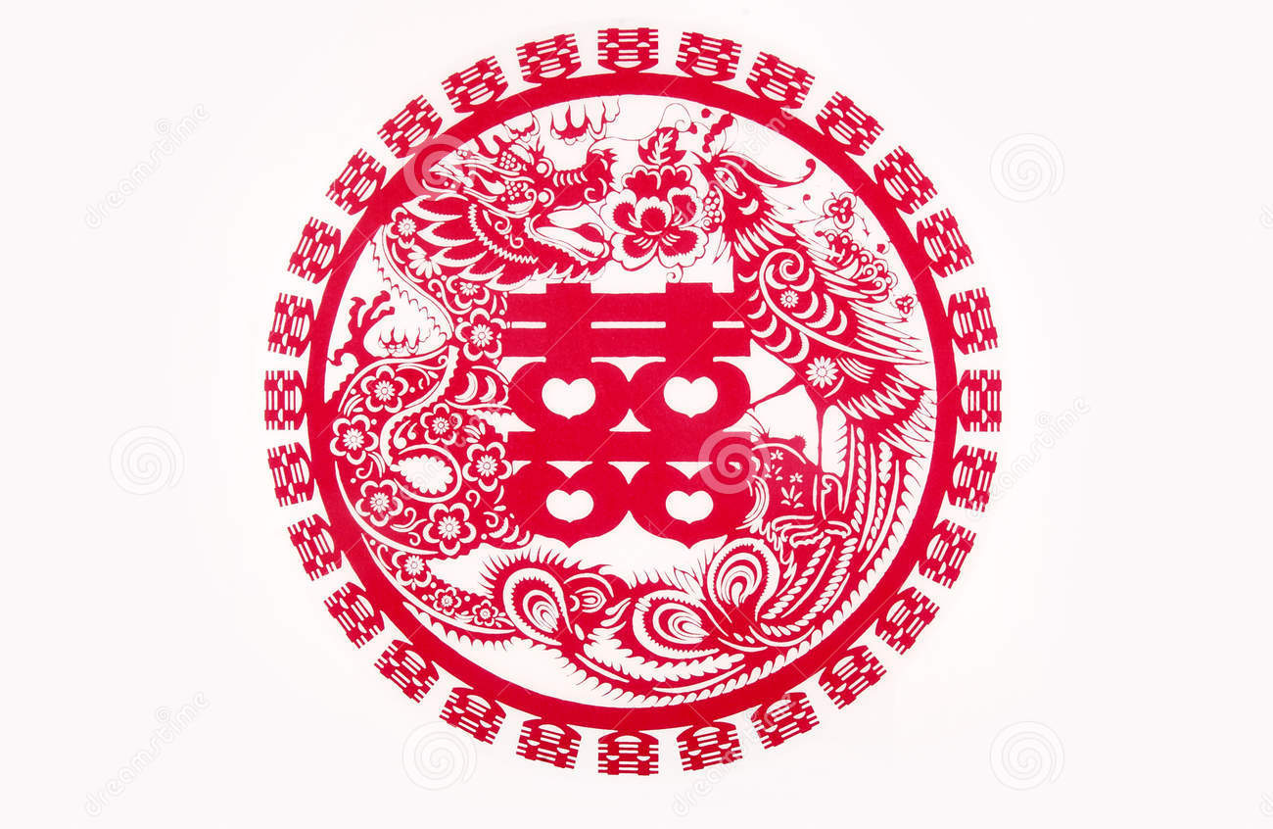

Are Chinese Happy (幸福)?
Evidence from The World Value Survey (2012)
Zhao Yang and Dr. Yan Li | Department of Economics
Introduction
Results-Traditional Factors
Results-New Factors
Happiness, or life satisfaction, or well-being has become a hot and hotter topic in not only psychological study but also behavioral economics.
In 2012, a national survey was conducted by asking Chinese respondents “are you happy?” during the Mid-Autumn Day and National Day in China. Since then, the issue of happiness has drawn wide public attention in China.
Happiness is a critical factor to influence human behaviors, which will in turn affect the efficiency of the workplace or even the whole labor force. Therefore, our study on happiness is important and relevant.
Most happiness studies so far have been done in developed countries, but this work just got started in China. The previous research on Chinese happiness tended to be qualitative. In this project, we use the empirical evidence to do a quantitative investigation about Chinese well-being.
Independent Variables | Explanation | Coefficient | Significance
Sex | Are you male or female? Male Female | -0.050 0ª | (0.069)* 0ª
Age² | How old are you? (The impact of age to happiness shows a U-shape in graph, which means that the person will be unhappier in his/her middle age) | 0.0001 | (0.000)***
Health | How would you describe your state of health these days? Very good Good Fair Poor | 0.669 0.306 0.215 0ª | (0.000)*** (0.000)*** (0.001)*** 0ª
Marital Status | What’s your marital status? Married Living together as married Divorced Separated Widowed Single | 0.241 -0.31 0.108 0.343 0.083 0ª | (0.000)*** (0.824) (0.390) (0.235) (0.362) 0ª
Financial Satisfaction | How satisfied are you with the financial situation of your household? Completely dissatisfied Moderately satisfied Completely satisfied | -0.361 -0.144 0ª | (0.000)*** (0.000)*** 0ª
Education | What is the highest educational level that you have attained? No formal education, primary school, secondary school and technical/vocational type Senior high school University-level education Graduate degree | -0.117 -0.043 -0.059 0ª | (0.018)** (0.324) (0.184) 0ª
Employment | Are you employed now or not? Full time employee (30 hours a week or more) Part time employee (less than 30 hours a week) Self employed Unemployed Retired/pensioned Housewife not otherwise employed Full-time student Other | 0.067 0.150 0.219 0.131 0.070 0.117 0,245 0ª | (0.441) (0.096)* (0.051)* (0.259) (0.464) (0.232) (0.029)** 0ª
Children | Have you had any children? 0-8 Number of Children | -0.023 | (0.178)
Independent Variables | Explanation | Coefficient | Significance
Family | How important family is in your life? Very important Rather important Not very important | -0.109 -0.114 0ª | (0.538) (0.529) 0ª
Work | How important work or job is in your life? Very important Rather important Not very important Not at all important | -0.219 -0.203 -0.202 0ª | (0.011)** (0.017)** (0.024)** 0ª
Religion | How important religion is in your life? Very important Rather important Not very important Not at all important | 0.147 0.028 0.006 0ª | (0.126) (0.596) (0.836) 0ª
Environment | Are you the person who think looking after the environment is important to this person or care for nature and save life resources? Very much like me Like me Somewhat like me A little like me Not like me Not at all like me | 0.257 0,226 0.172 0.192 0.128 0ª | (0.080)* (0.115) (0.233) (0.188) (0.400) 0ª
Competition | How do you think of competition? (Scale from 1 to 10) Competition is good 2 - 9 … Competition is harmful | 0.181 … 0ª | 0.210 … 0ª
Hard work | How do you think of hard work? (Scale from 1 to 10) In the long run, hard work usually brings a better life 2-9 … Hard work doesn’t general bring success—it’s more a matter of luck and connections | -0.068 … 0ª | 0.502 … 0ª
Democracy | How democratically is China being governed today? Not at all democratic 2-9 … Completely democratic | -0.278 … 0ª | (0.021)** … 0ª
Belief in hell | Do you believe in hell? Yes No | -0.077 0ª | (0.178)
Living with parents | Do you live with your parents? Yes No | 0.043 0ª | 0.040** 0ª
Social stratification | Would you describe yourself as belonging to the which class in society? Upper class Upper middle class Lower middle class Working class Lower class | -0.036 0.135 0.109 0.042 0ª | 0.900 0.059* 0.005*** 0.274 0ª
Objectives and Contributions
Our goal is to study and explain Chinese happiness. We will explore new factors affecting Chinese well-being in addition to the traditional indicators.
First, traditional variables contributing to happiness will be examined, such as age, employment, health, income, marital status, education, number of children and etc. Second, new factors will be considered, including environment, living with parents, religion, politics, belief in hard work, importance of competition, socioeconomic class and so on.
Not in the labor force
Data Source
The data is derived from the World Value Survey Wave 6 for China in 2012. The survey was conducted by the Research Center for Contemporary China (RCCC) at Peking University.
There are 2,300 respondents living in 31 provinces (China has 34 provinces totally). They are aged from 18 to 75. They answered 249 questions about their demographic information and their thoughts on a specific topic including happiness.
Major Conclusions
In this research, we verified the impact of traditional factors on happiness. We contributed to the literature by studying new factors which may explain happiness in China, such as environment, family, religion, competition, democracy, and social stratifications.
Our future work may have two directions. First, we will run a linear probability model in EViews to compare with our results obtained in SPSS. Second, we will keep tracking the WVS in the future to observe the evolution of happiness in China over time.
Methodology
Policy Suggestions
The Chinese government may pay more attention to the happiness of its people, and continue collecting the data of happiness nationwide on a regular basis.
The fact that middle-aged people tend to be unhappier might be caused by the stress of financial conditions, employment and marriage. Hence, government could try to reduce income / social inequality, and create a more healthy and diverse working environment, for example, encouraging the self-employed, e-commerce and supporting more / better recruitment websites.
Calling for a happiness-driven society rather than a materialism-driven one.
Selected References
$$H_{i}=c_{i}+a_{1j}T_{j1}+b_{1k}N_{k1}+ε_{i}$$
Easterlin, R. (1974). Does Economic Growth Improve the Human Lot?
Some Empirical Evidence. New York: Academic Press
Knight, J. and Guanatilaka, R. (2011). Does Economic Growth Raise
Happiness in China? Oxford Development Studies. Vol. 39, No.1,
March 2011.
Blanchflower, D. and Oswald, A. (2011). International Happiness: A New
View on the Measure of Performance. Academy of Management
Persectives. Vol 25. Iss. 1, pp. 6-22.
We used the software SPSS and conducted a Generalized Linear Regression to analyze the data. The dependent variable is the feeling of happiness (H), which is a categorical variable with four levels from 1 to 4. The independent variables are factors associated with happiness in China, including traditional factors (T) and new factors (N), which are either categorical or continuous.

