Slide 1

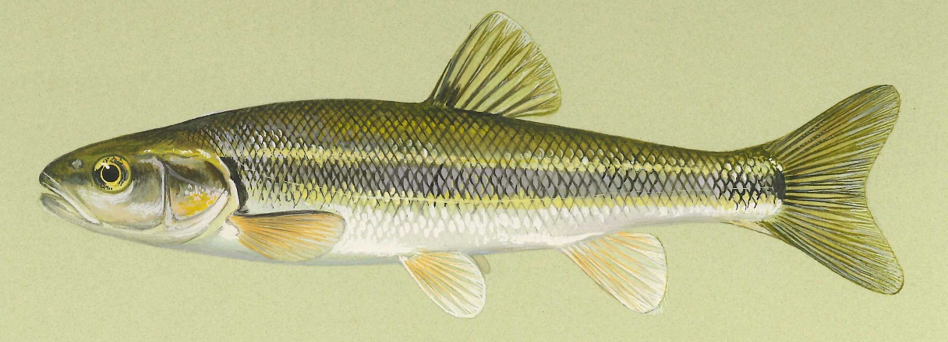
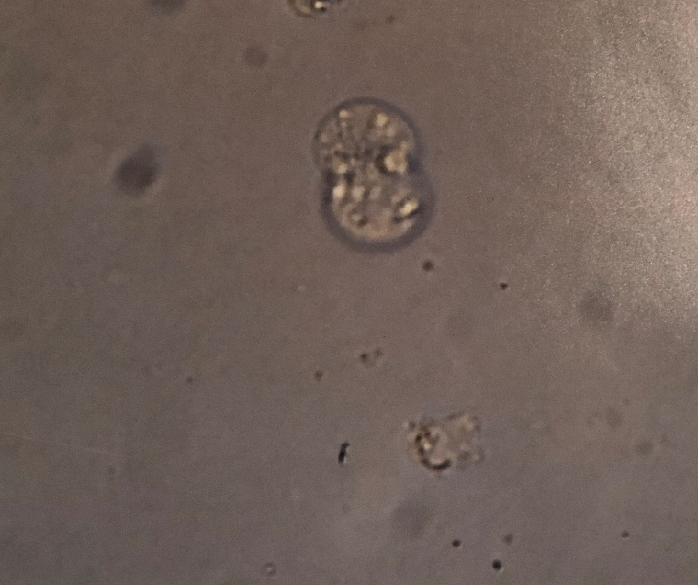
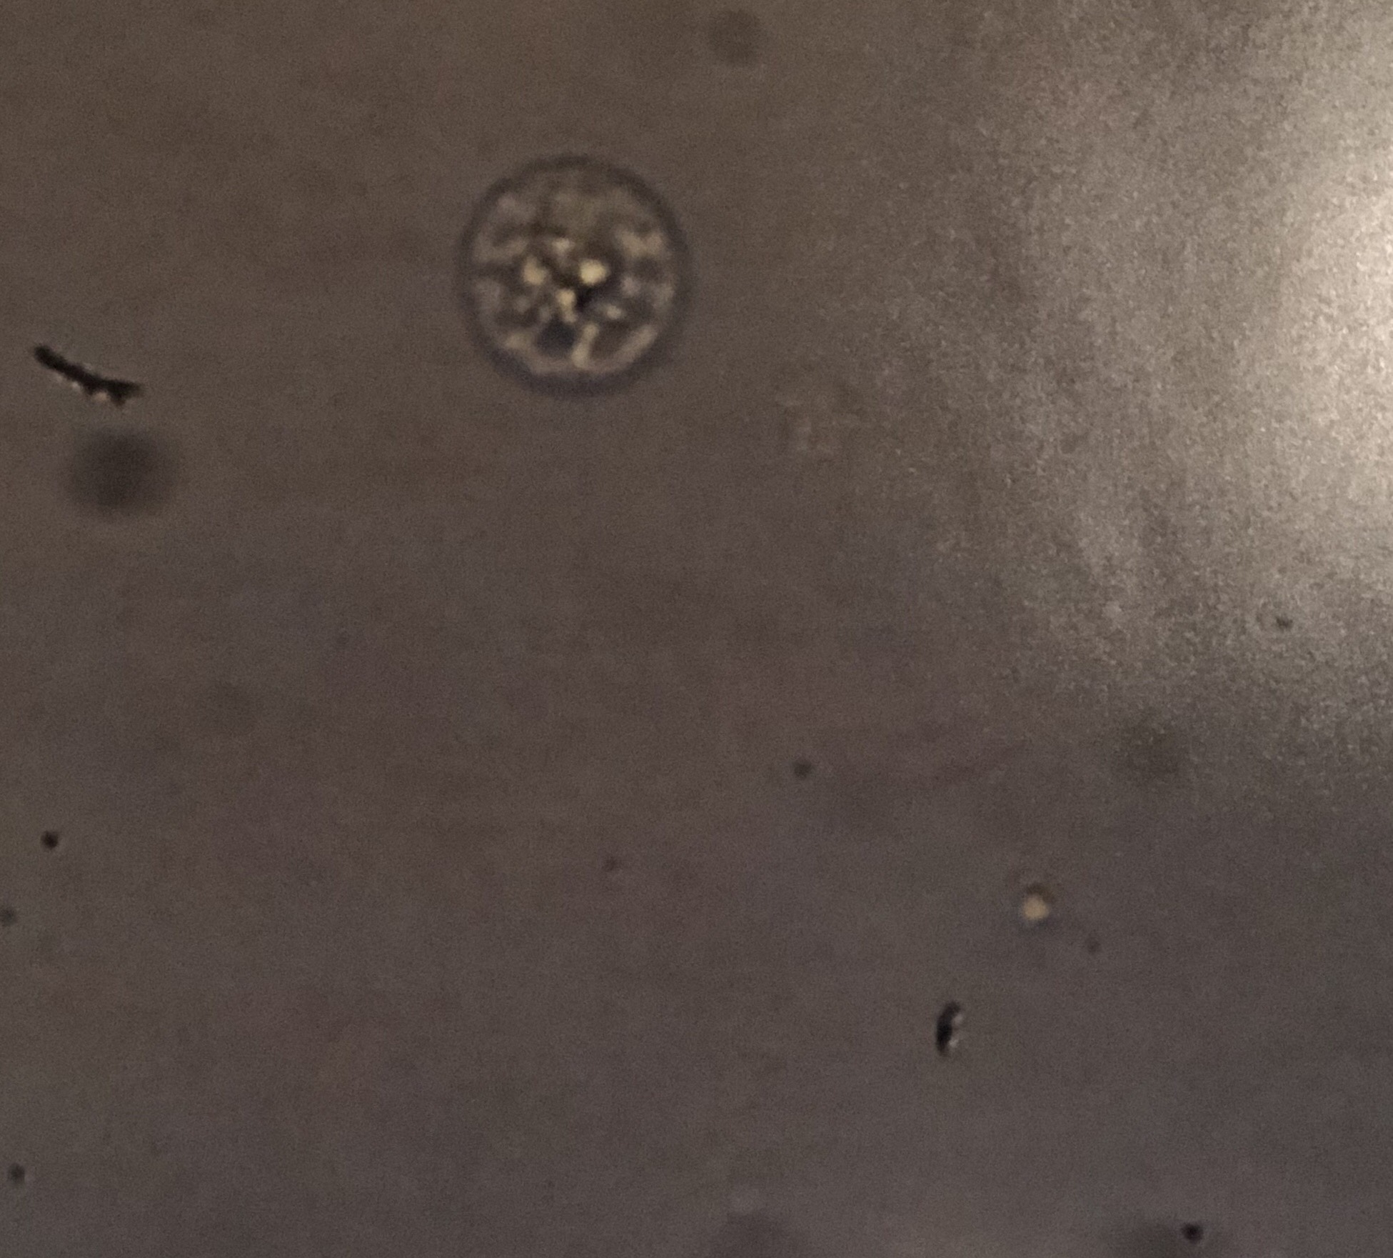
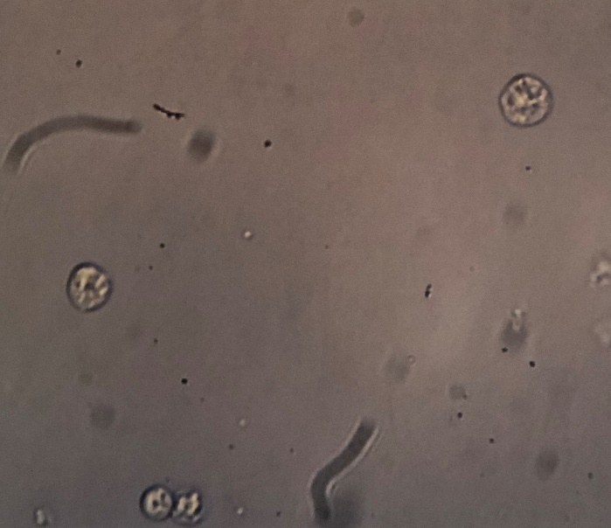
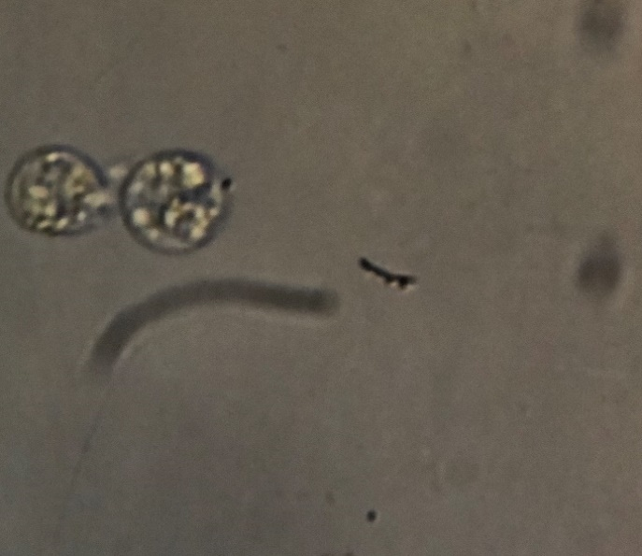
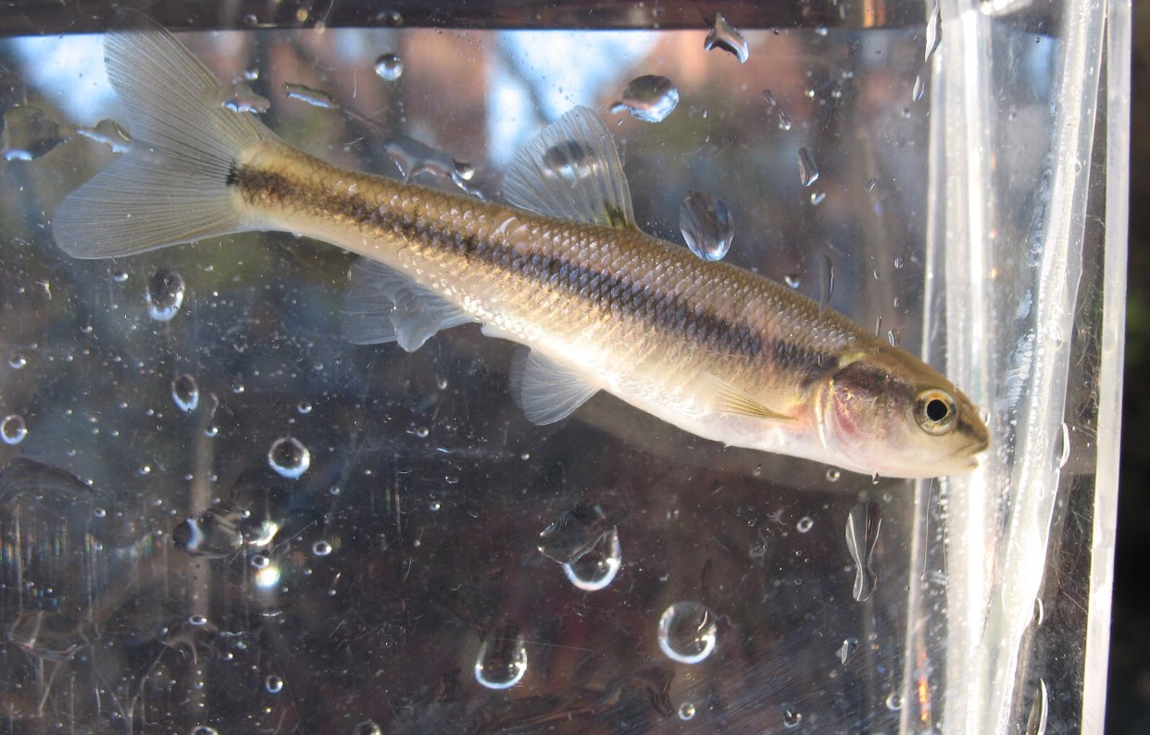
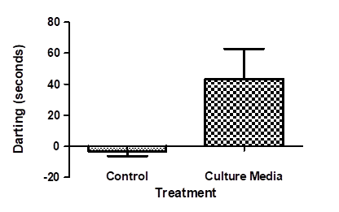
Cultured Fish Epithelial Cells are a Source of Alarm Substance Rachel Bayer, Courtney Weihing, and Winnifred Bryant Department of Biology University of Wisconsin - Eau Claire
Abstract
Results
Cell Cultures
In various species of fishes, chemical cues play an essential role facilitating predator avoidance. Damage to the skin during a predation event releases an alarm substance (AS), which diffuses through the water column and binds to olfactory receptors of conspecifics. This causes fish to engage in several anti-predator behaviors that may include darting, schooling, or hiding. Behavioral responses to AS and physiological mechanisms that underlie those responses is an active area of study. The goal of this project was to demonstrate 1) a non-invasive primary cell culture protocol to obtain alarm substance and 2) the demonstration of anti-predatory behaviors in fish exposed to alarm substance.
Figure 1. Creek Chub (Semotilus atromaculatus) is the model organism for our study. Photo credit: http://www.iowadnr.gov/idnr/Fishing/Iowa-Fish-Species/Fish-Details/SpeciesCode/CRC.
Figure 5. Alarm cells after 0 hours. Washed with buffer and placed in media.
Figure 6. Alarm cells after 24 hours. Fibroblasts and mucus cells are still viable.
Developed Method
Behavioral Trials
Housing:
Sexually immature creek chub (Semotilus atromaculatus) were used for they have been observed to express more club cells than adults. The animals were wild caught and kept in glass aquaria at 20C with a 12:12 light cycle. Food pellets were provided daily. Filters and aeration maintained water quality and fish were visually inspected daily for normal behavior and obvious signs of infection.
Cell collection:
Fish were removed from their tank and placed in 1.5 L of water containing 400 ml of an oil of cloves solution (1:10 clove oil in 95% ethanol). The solution provides a light plane of anesthesia in fish in approximately 5 minutes. Once induced, fish were placed on their ventral side on a wet paper towel and gently abraded with a sterile scalpel blade with focus on not removing scales if possible. Epithetical cells were then placed in a 15mL vial containing 10 mL room temperature phosphate buffered saline (PBS). Sample collection took less than 60 seconds and fish afterwards were placed the fish back into their tank.
Primary cell culture:
The conical vial containing cells was vortexed for approximately 15 seconds at the highest speed. Cells were then centrifuged at 5000 rpm for 5 minutes. Supernatant was then removed and discarded. An additionally 10.0 mL of fresh supplemented PBS was added and the wash was repeated twice. After the final wash, much of the PBS was removed without disruption of the pellet of cells in the bottom of the tube. The cells were then placed in 6.0 mL Leibovitz L-15 culture medium. This supplied the cells with nutrients to stay alive. Cells needed to be washed daily, by the same procedure depicted above, to ensure protection against infection. Cells were viable if washed and kept in medium for a max of three weeks.
.
Figure 7. Alarm cells after 48 hours. Alarm cells after 24 hours. Small contamination shown.
Figure 8. Alarm cells after 72 hours. Alarm cells after 24 hours. Fibroblasts and mucus cells are still viable.
Conclusions
Figure 3. Behavioral trials: darting and feeding behaviors were immediately observed when administered 1.5mL media from 24 hour cell culture.
We developed minimally invasive methods for tissue collection and optimized culture conditions for cells from organisms living in cold water environments.
We recorded the fish for 3 minutes in natural conditions, another 3 minutes in the presence of a control solution (distilled water), and finally, in the presence of 1.5mL media, which was taken from epithelial cells after 24 hours of culture.
Darting, feeding, and schooling behavior were observed out of the nine trials that were completed.
Darting behavior in fish was significantly increased following addition of cell culture media as compared to darting behavior after addition of distilled water.
Responses were acute, beginning immediately after addition of the media to the tank and lasting approximately 40 seconds.
*
Figure 4. Primary cell culture media induces darting behavior in Creek Chub. Juvenile Creek Chub was observed in the absence of treatment, in the presence of a control solution (distilled water), and in the presence of 1.5 mL media from cultured epithelial cells (after 24 hours). Observation time was 180 seconds. Seconds of darting behavior was averaged for 9 trials; means were compared using a t-test. *, significantly different from control, p<0.05.
Acknowledgments
We would like to thank the Office of Research and Sponsored Programs for the finding for this project, Dr. Sasha Showsh for the antibiotic screening of the cells, and Dr. David Lonzarich for technical assistance and assistance in behavioral assays.

