Slide 1
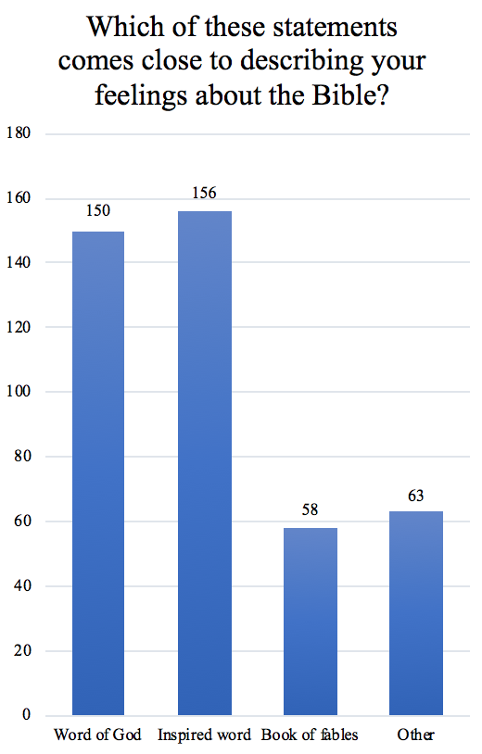
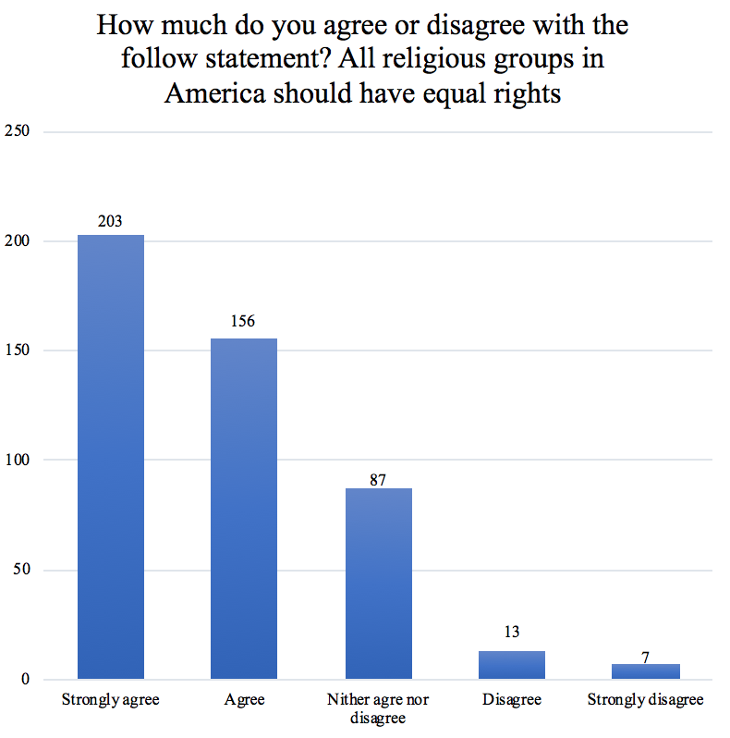
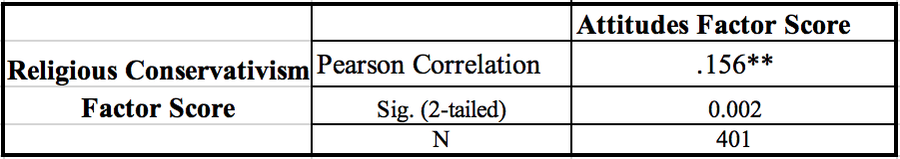
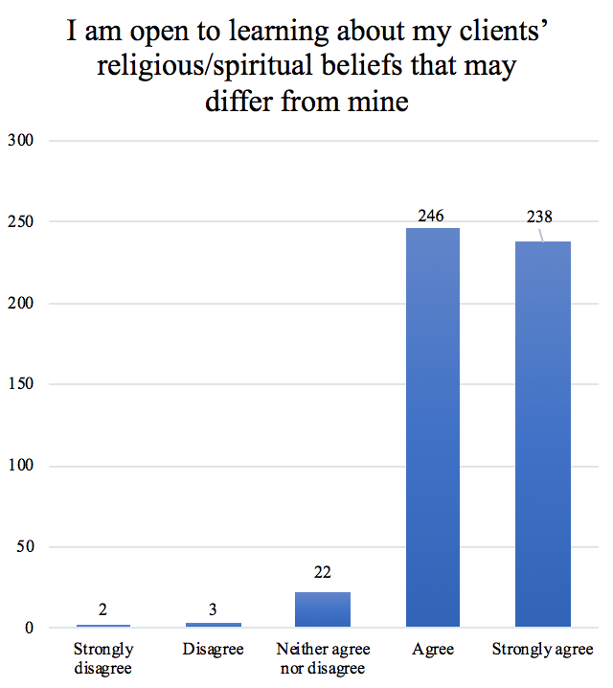
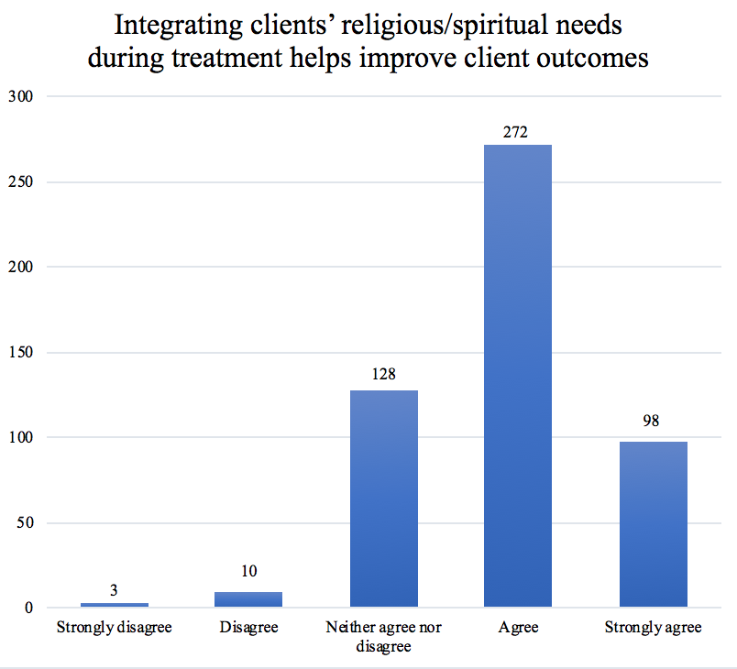
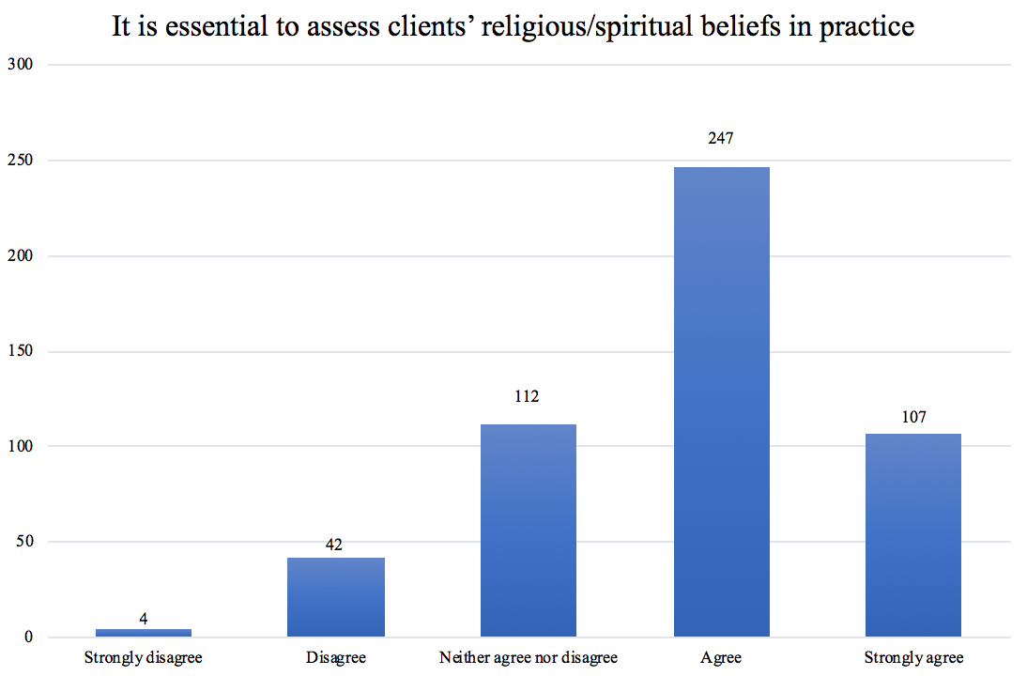

Department of Sociology
and Social Work
The Role of Religion in Social Work Practice
Marisa Skajewski
Faculty Advisors: Dr. David Barry and Jess Bowers
Religious Conservativism
Introduction
Methods
It is important for social workers to have a holistic approach in the treatment of their clients, including the implementation of religion. 3,836 Wisconsin state certified social workers were surveyed to explore the social work practitioner’s self-efficacy and behaviors regarding the use of the client’s religiosity/spirituality in clinical practice. This research investigates the relationship between religiosity/spirituality of the practitioner and organization, as well as the intent to use religious sources in providing services to clients. Training is another aspect that is investigated through the amount and type of training that is received by practitioners. The results of this study increase the training and knowledge of religion within the social work profession. This leads to a better understanding of the way social workers address religion within practice to allow their clients to have the best possible outcomes.
The cross-sectional study is surveying Wisconsin state certified social workers. This nonprobability sample was purposively selected to consist of social workers who are state certified. It incorporates social workers who are current practicing and are no longer practice but are still certified though Wisconsin. A list of all of the Wisconsin state certified social workers was obtained through the Wisconsin Department of Safety and Professional Services. This list consisted of 3,836 social workers. A Qualtrics survey of 68 questions was emailed to all of the 3,836 social workers. Two weeks after the initial invitation to participate was sent out, another invitation to participate was emailed to all of the 3,836 social workers. Of the 3,836 social workers who received the survey 578 responded resulting in a 15.07 response rate.
Literature Review
Results
Discussion
The research by Oxhandler and Parrish (2016) created the Religious/Spiritually Integrated Practice Assessment Scale. Their research was aiming to develop and validate a scale for others to use to test aspects of religion/spirituality within helping professions (Oxhandler and Parrish, 2016). Oxhandler, Parrish, Torres and Achenbaum (2015) studied licensed clinical social workers from across the United States utilizing the religious and Spiritually Integrated Practice Assessment. This research wanted to obtain a national view of social worker’s behaviors and views about incorporating religion/spirituality. They found that many of the social workers are not integrating religion/spirituality into their practice. However, many of the social workers that had some religious training had increased views of the possibility of incorporating religion into their practice. Oxhandler and Giardina (2017) also did a national sample of licensed clinical social workers looking at the integration of religion/spirituality into their practice and possible barriers to incorporating it. This study expands on the existing research by focusing exclusively on a smaller population of social workers. Instead of completing a national study, our research focuses exclusively on the experiences of social workers in Wisconsin. It expands on topics that the previous research did not incorporate such as the formal and informal religious status of the organization that social workers are working. In addition, it incorporates measurement items about the current continuing education opportunities that include religion/spirituality and the social worker’s current religious beliefs, allowing for a deeper understanding of this topic.
Age was positively associated with the self-efficacy, feasibility and frequency of incorporating religion/spirituality into practice as seen through correlations. This shows that younger social workers are less likely to integrate religion/spirituality into practice. The social workers who have been in the field longer incorporate religion/spirituality more into their practice. Highlighting how trainings and more experience within the field could be changing the social worker’s comfort with including religion/spirituality.
There was a positive association between training opportunities and the social workers frequency of integrating religion/spirituality indicated through correlations. Social workers who identified receiving some training felt more comfortable integrating religion/spirituality into practice. This could mean that through providing trainings related to religion/spirituality social workers might feel more comfortable knowing how to incorporate it into their practice.
The religious conservativism factor score is positively associated with supportive attitudes towards including religious/spiritually in practice. More research needs to be done to better understand the dynamic between these variables. Further research could investigate if religious conservatives are more likely to incorporate religion into their practice. This could mean that there is an increased risk of proselytizing. Proselytizing religion would contradict the social work code of ethics.
The research conducted investigated many of the ways that social workers use religion/spirituality within their practice. Overall, there was identified to be a lack of training opportunities for social workers relating to religion/spirituality. This impacts the social worker’s ability to incorporate a holistic approach to treatment for their clients when they do not feel comfortable including religion. There needs to be more training opportunities for the social workers in regard to religion/spirituality so that the clients can get the best possible services.
Attitude Factor Questions
Conceptualization
Through the ethical standards in the NASW code of ethics, social workers have a commitment to cultural awareness and social diversity. It includes social worker’s commitment to seek education and understanding with issues of social diversity, including aspects of religion (National Association of Social Workers, 2017). The people that social workers serve exist in a social context. Outside social forces can interact and influence individuals throughout their lives, potentially shaping their beliefs and behaviors. The context of social workers’ clients is an important aspect to take into consideration. Religion may be an aspect of a person’s social context that can create a sense of identity and common values for that person. If social workers are not incorporating religion, resources could be overlooked or excluded that could otherwise provide meaningful support to the client (Askeland and Dohlie, 2015).
Works Cited
Askeland, A. Gurid and Dohlie, Elsa. 2015. Contextualizing International Social Work: Religion as a Relevant Factor.” International Social Work, 58(2), 261-269.
Greeley, Andrew. and Michael Hout. 2006. “The Truth about Conservative Christians: What they think and what they believe.” University of Chicago Press: Chicago, IL
National Association of Social Workers. 2017. Code of ethics of the National Association of Social Workers.
Oxhandler, K. Holly, and Ellor, W. James. 2017. “Christian Social Workers’ Views and Integration of Clients’ Religion and Spirituality in Practice.” Journal of the North American Association of Christains in Social Work, 44(3). 3-24.
Oxhandler, K. Holly, and Giardina, D. Traber. 2017. “Social Workers’ Perceived Barriers to and Sources of Support for Integrating Clients’ Religion and Spirituality in Practice.” Social Work, 62(4), 323-332.
Oxhandler, K. Holly, and Parrish, E. Danielle. 2016. The Development and Validation of the Religious/Spiritually Integrated Practice Assessment Scale.” Research on Social Work Practice, 26(3), 295-307.
Oxhandler, K. Holly, Parrish, E. Danielle, Luis R. Torres, and Achenbaum, W. Andrew. 2015. “The Integration of Clients’ Religion and Spirituality in Social Work Practice: A National Survey.” Social Work, 60(3), 228–237.

