Slide 1
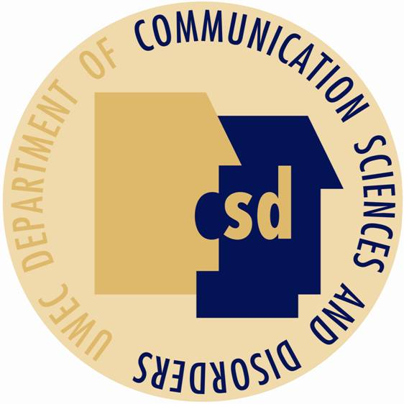
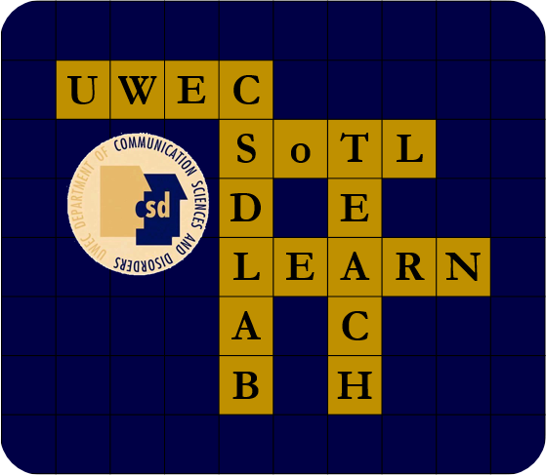
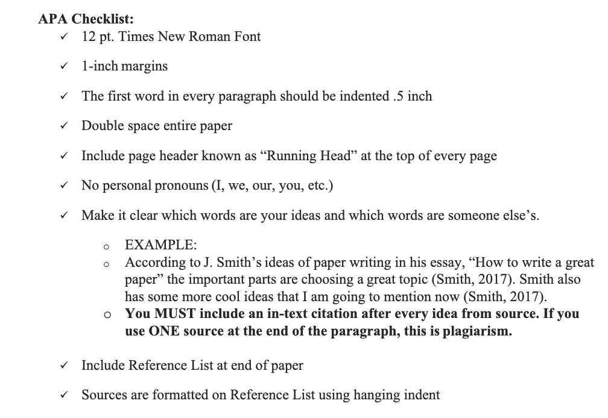
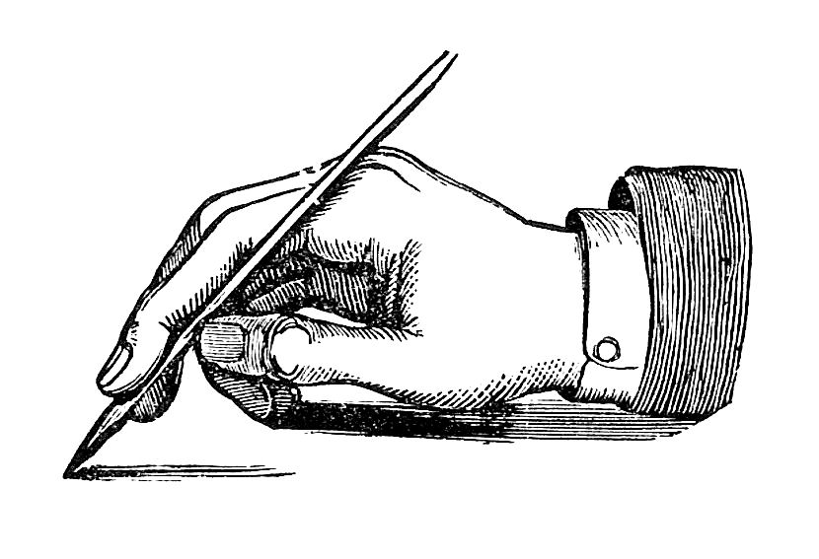
Writing Across the Curriculum within Communication
Sciences and Disorders:
A Focus on American Psychological Association Formatting
Emma Flottemesch, Alison Jozwiak, Noah Terrell | Communication Sciences and Disorders
Faculty Mentor: Abby Hemmerich, Ph.D., CCC-SLP
Introduction
Writing Rubric
Lane & Johnson (2017) discovered that many students were not learning about writing after their required, freshman year writing course​
Various disciplines have adopted writing across the curriculum (WAC) as a method to address writing needs for upper level students (Horton & Diaz, 2011)
A rubric is used in a class for both teaching and grading (Horton & Diaz, 2011)​​
Incorporating a standardized rubric helps students understand expectations and faculty score consistently across students (Luthy, Peterson, Lassetter, & Callister, 2009; Minnich, et al., 2018)​
Accuracy and consistency when using a rubric is imperative (Luthy, Peterson, Lassetter, & Callister, 2009; Minnich, et al., 2018)​
By utilizing a structured set of outcomes, such as an APA checklist, students will know their expectations (Hudd, Smart & Delohery, 2011) ​
Rubrics can be used to write papers in the future (Horton & Diaz, 2011)
Writing Across the Curriculum
"WAC maintains that writing is a valuable learning tool, helping college students to better synthesize, analyze, and apply knowledge specific to their discipline" (Lashley & Wittstadt, 1993)​
WAC recognizes that "literacy in a discipline is the same as learning in a discipline" (Harper & Vered, 2016)
Strategies for Teaching Writing
Methods
Results
Conclusion
Previous Assignment 9 submissions from CSD 726: Organic Voice and Speech Disorders
Created rubric, APA checklist, and screencast resources for current CSD graduate students
Compared previous Assignment 9 with current Assignment 9 that used APA resources
Students asked to complete checklist with Assignment 9 submission
A model of a writing workshop or a supplementary piece of writing material is beneficial to support students’ writing ​
(Sallee, 2011) ​
​
Integrating writing lessons along with the typical lesson plan is important to increase comfort with writing in the profession and curriculum (Lane & Johnson, 2017)​
Use of a direct teaching method for specific skills improves student writing (Horton & Diaz, 2011)​
​
The expressive mode, using formative writing exercises and informal writing tasks to help students think through and about content are emphasized in the literature on WAC (Harper & Vered, 2016)
Significant decrease in the number of APA errors within the Assignment 9 submissions
The accurate use of Times New Roman font increased by 71% after intervention​​
Use of 1-inch margins increased to 100% correct use
Total number of errors per assignment before the implementation of APA resources was 3.86, after the intervention, the total number of errors dropped to 1.05 per assignment​
The number of APA errors decreased per paper after explicit instruction ​
APA resources were provided to the students to increase their knowledge of APA ​
The provided APA resources and checklist had a positive effect on altering graduate student performance within the guidelines of APA, similar to previous research (Hudd, et al., 2011; Luthy, et al., 2009; Minnich, et al., 2018)
Additional resources and explicit instruction should be encouraged to use across target areas in the future
Incentivize checklist to improve checklist submission rate
Development of writing workshop geared towards academic disciplines
Consider potential new targets for intervention
Future Considerations
This Photo by Unknown Author is licensed under CC BY-SA-NC
References
Acknowledgements
Luthy, K. E., Peterson, N. E., Lassetter, J. H., & Callister, L. C. (2009). Successfully Incorporating Writing Across the Curriculum with Advanced Writing in Nursing. Journal of Nursing Education,48(1), 54-59. doi:10.3928/01484834-20090101-07​
Minnich, M., Kirkpatrick, A. J., Goodman, J. T., Whittaker, A., Chapple, H. S., Schoening, A. M., & Khanna, M. M. (2018). Writing Across the Curriculum: Reliability Testing of a Standardized Rubric. Journal of Nursing Education, 57(6), 366-370. doi:10.3928/01484834-20180522-08​
Horton, E. G., & Diaz, N. (2011). Learning to Write and Writing to Learn Social Work Concepts: Application of Writing Across the Curriculum Strategies and Techniques to a Course for Undergraduate Social Work Students. Journal of Teaching in Social Work,31(1), 53-64. doi:10.1080/08841233.2010.539141​
Lane, A. B., & Johnston, K. A. (2017). Bridging the writing gap between student and professional: Analyzing writing education in public relations and journalism. Public Relations Review, 43(2), 314-325. doi:10.1016/j.pubrev.2017.02.008​
Sallee, M., Hallett, R., & Tierney, W. (2011). Teaching Writing in Graduate School. College Teaching, 59(2), 66-72. doi:10.1080/87567555.2010.511315​
Harper, R., & Vered, K. O. (2016). Developing communication as a graduate outcome: Using ‘Writing Across the Curriculum’ as a whole-of-institution approach to curriculum and pedagogy. Higher Education Research & Development, 36(4), 688-701. doi:10.1080/07294360.2016.1238882
This project’s research mentor, Dr. Abby Hemmerich, for her insight and support
The Communication Sciences and Disorders (CSD) department and the Scholarship of Teaching and Learning (SoTL) research lab
The Office of Research and Sponsored Programs (ORSP)
Learning and Technology Services (LTS)

