Slide 1

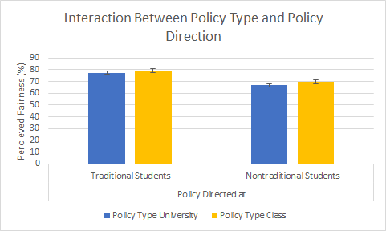
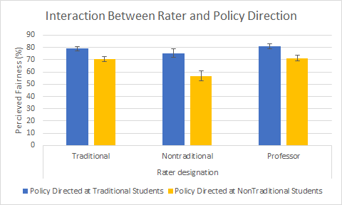
How Do Traditional and Non-Traditional Students at UW-Eau Claire View School Policies Related to Class Performance?
Karin Knapp and Austin Van Cleave | Research Mentor: Jarrod Hines | Psychology
This study was supported by the UW-Eau Claire Blugold Fellowship Program which is jointly funded by Differential Tuition and The Foundation
Purpose
Results
Other reasons for cited for excused absences
The goal of the current exploratory study was to become better-informed about the potential disparities that exist between traditional and non-traditional students and professors in terms of their opinions about university and classroom policies implemented on campus. For example, attendance policies may place non-traditional students at a disadvantage given their often greater traveling distance.
University Definition of Nontraditional Student Criteria
Took a year or more off between high school and college
Is married
Is a parent
Served in the military
Live off-campus (more than a 5 mile distance from campus)
Participant Category | Illness/Injury w/o doctor’s note | Family Emergency | Weather
Traditional | 75 (82%) | 91 (99%) | 78 (84%)
Non-Traditional | 16 (73%) | 21 (96%) | 18 (82%)
Professor | 49 (80%) | 60 (98%) | 48 (79%)
Many professors strictly follow the University Excused Absences Policy, even though many participants agreed that additional reasons would be appropriate for excusing an absence.
Hypothesis
We predicted that non-traditional students would express more dissatisfaction with various university and classroom policies (such as the policy regarding excused absences) when compared to traditional students and professors.
We also predicted that the perceived degree of fairness of university and classroom policies toward traditional and non-traditional students would differ such that non-traditional students would view the policies as being less fair than would traditional students.
University Excused Absences Policy
Illness or injury with a doctor's note
University-related field trip or activity
Labor Day employment
Active military service
Accommodation for a student's religious beliefs
Jury duty
For our study we conducted a 3(Rater: Traditional, Non-Traditional, Professor; Between-Subjects) x 2 (Policy Type: University, Classroom; Within-Subjects) x 2 (Policy Direction: Traditional, Non-Traditional; Within-Subjects) Mixed ANOVA. We found main effects in our within-subject variables of Policy Type Fairness and Policy Direction Fairness, as well as our between-subject analysis of our Raters. We also found two interaction effects between Policy Type and Policy Direction, as well as between Policy Direction and our Raters.
Classroom policies are perceived as being more fair in comparison to University Policies (University: M=70.05, SD=19.11)(Classroom: M=74.45, SD=19.95), (p<.001).
Policies towards non-traditional students are viewed as less fair compared to traditional students (Traditional: M=78.37, SD=18.18), (Non-traditional: M=66.12, SD=21.58), (p<.001).
Non-traditional students believe that policies towards non-traditional students are less fair compared to the beliefs of both traditional students and professors (Traditional: M=74.83, SD=15.39),(Non-traditional: M=65.94, SD=15.35), (Professor: M=75.98, SD=15.37), (p=.038).
Method
A random sample of 1500 students and every professor and instructional academic staff at University of Wisconsin-Eau Claire was asked to complete our online anonymous survey. Of the 177 viable student responses, 142 classified as traditional students and 35 classified as nontraditional, by university policies. There were an additional 61 viable professor responses.
Using Qualtrics Survey software, we designed a survey in which we asked questions that were targeted at observing attitudes towards university and classroom policies such as excused absences, attendance, and grading of attendance.
 | Participant Status | N | Mean
Gender | Nontraditional | 22 | 1.71 (SD=.825)
 | Traditional | 94 | 1.73 (SD=.44)
 | Professor | 61 | 1.80 (SD=.401)
Grade | Nontraditional | 22 | 3.54 (SD=1.330)
 | Traditional | 94 | 2.90 (SD=1.243)
Years Teaching | Professor | 61 | 13.46 (SD=7.972)
Only Non-traditional students felt that classroom policies are more fair than university policies. Traditional students rated them more similarly.
Discussion
One of the reasons that classroom policies are perceived as more fair than university policies is because classroom policies are less rigid and have more flexibility. Policies in general are perceived as less fair towards non-traditional students than traditional students because there are no exceptions made for those who may have to commute, have to take care of sick children, or for a variety of other reasons.
References
Future Directions
Non-traditional students rated policies as being less fair toward non-traditional students than toward traditional students, but Traditional students and Professors rated the policies as being similarly fair regardless of the type of student in question.
Jenkins, R. (2012). The new “traditional student.” The Chronicle of Higher Education. Retrieved from http://www.chronicle.com/article/The-New-Traditional-on/135012
A potential future project could be to analyze how different class structures affect the necessity of attendance. Responses from our study suggest that attendance grades should be based on whether it is lecture only or discussion dependent course. Some participants indicated that lecture based courses should have a more lenient attendance policy, while discussion and colloquia courses should be stricter.
Notes:
Interesting stuff to students and professors
Coded qualitative responses
More graphics, less text
Mental health days
Labor day – pointless
Illness w/o doctors
5 miles is much too small of a distance to be considered non trad
42% of profs say discussion and interaction is vital to learning, but the majority of classes are lecture based.
Attendance should be based on course structure. Lecture -> less strict. Discussion -> more so

