Slide 1
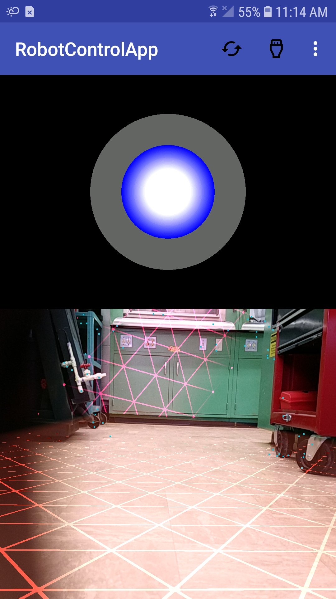
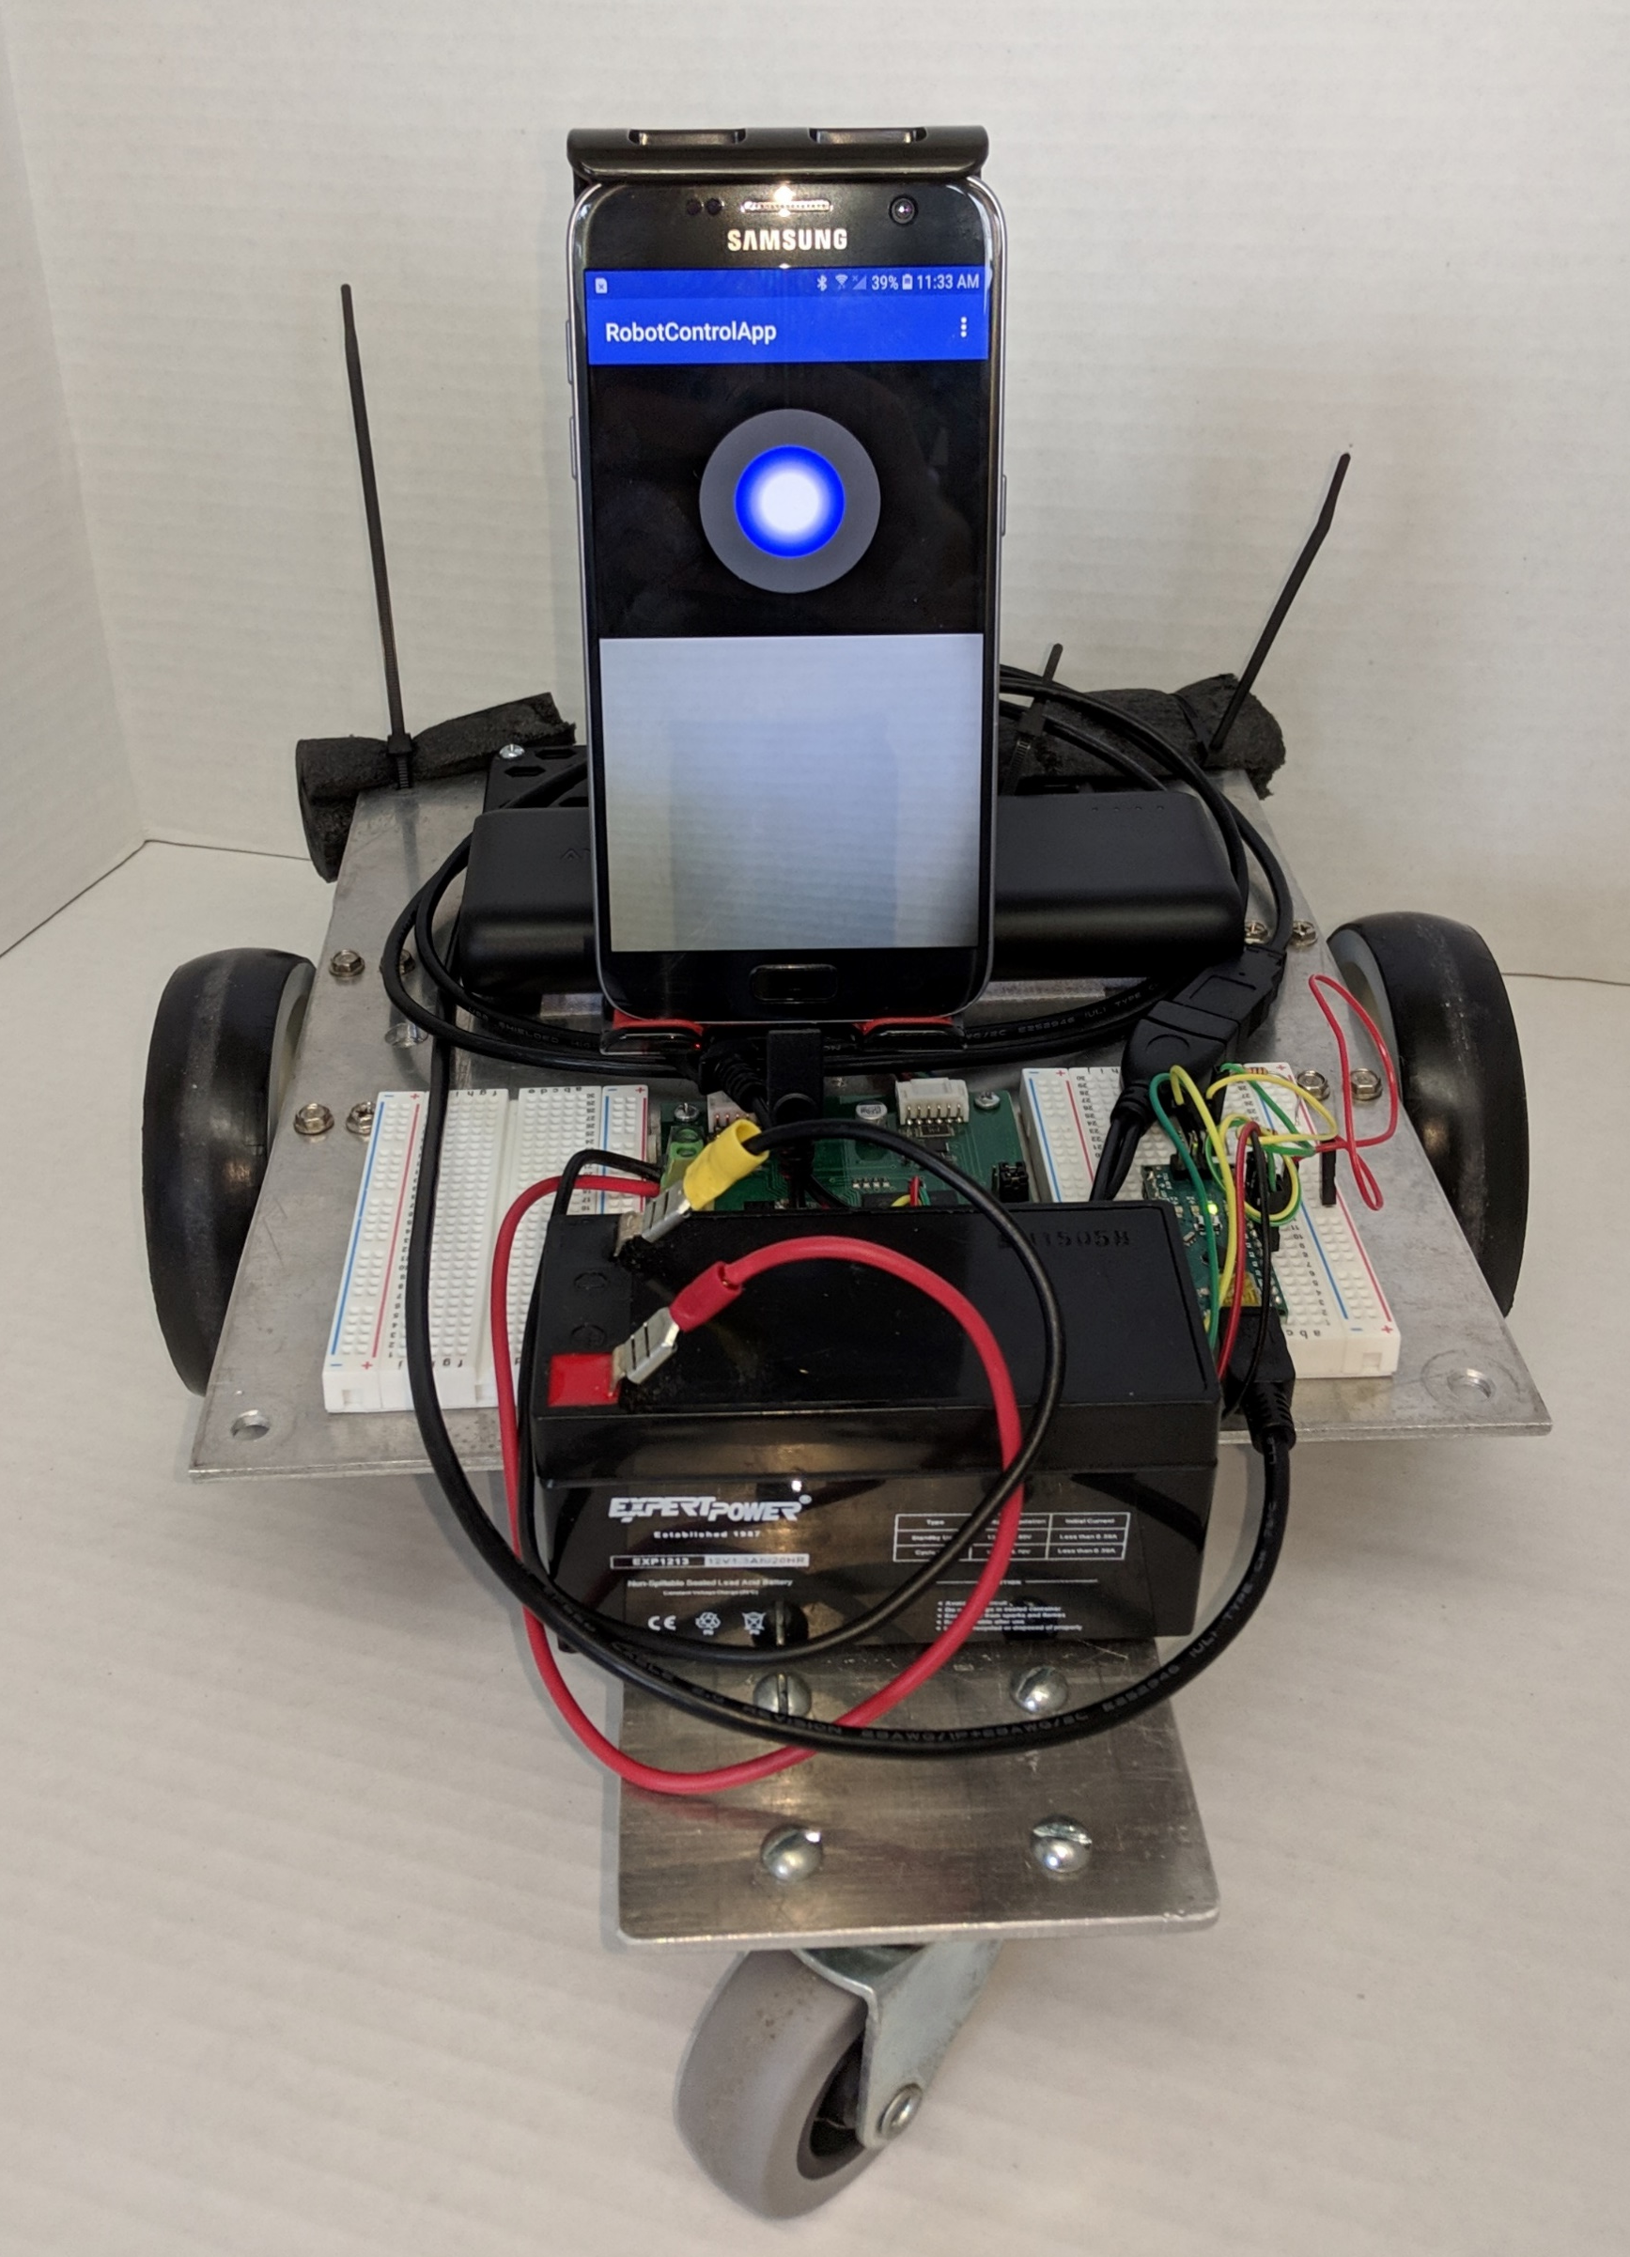
Smart Phone Controlled Robot
Griffin Beck
Mentor: Dr. Kim Pierson | Department of Physics & Astronomy, UW-Eau Claire
Introduction
Software System Design
Robots with advanced capabilities are currently controlled almost exclusively by specialized expensive hardware and sophisticated programs. Smaller simpler system can use inexpensive “instances” of this hardware such as the widely used open-source Arduino or Raspberry Pi, but these systems offer limited capabilities and no long range communication. This project explored using the computational power and long-range communication capabilities of widely available smart phones
The Software is currently split into three different programs, A Robot App for interfacing directly with the robot hardware, a Controller App for sending commands to the robot through a remote connection, and Server program which handles the network connections from each app and exchanges commands and data between them.
The Robot App is the main app and handles direct communication with the robot’s controls, as well as calculations for autonomous control. It communicates with an Arduino on the robot using a serial connection and the library USBSerial, this allows it to control how and when the motors run. This app also runs ARCore, a library made by Google for Augmented Reality Apps. ARCore allows the app to make sense of the real world using its camera and decide where surfaces exist in the real world. Finally, it runs a network connection to allow remote control.
This network connection is connected to the Server Application. This application allows for two phones to connect to the server and then exchange commands and data in parallel. Having the Server Application allows the robot to be connected to from anywhere there is an available internet connection. The application is able to manage the two network connections and automatically disconnect and reconnect individual apps as they lose and gain an internet connection. This is an improvement over some other robots as they will drop out of network range while navigating, and since I have the server constantly communicating it is able to determine when this occurs and pause communication until the app can reconnect.
The final app is the Controller app which uses the same networking code used in the server and robot apps to connect to and control the robot. The controller app utilizes the network connection to receive a feed from the robot’s camera and send movement commands. The images it receives are bytes in a bitmap format and are compressed using WEBP. Lastly, a virtual joystick is used to receive user input at about 5 time a second and then send that to the robot.
All of the code for these applications can be found on GitHub at github.com/GriffinBeck
Purpose
The purpose of this project is to use a smart phone to remotely control a robot. A set of specialized communication and control programs called “Apps” can be developed and downloaded to a smart phone that is connected to the robot. Using a smart phone as the control system of the robot, allows for access to powerful and flexible hardware at a lower cost. The flexibility of the phone’s hardware allows it to be used for remote control over the internet using built in Wi-Fi and Cellular antennas. A smart phone also offers access to a variety of sensors such as gyroscopes and cameras. These sensors can be utilized not only to monitor the robot remotely, but with the powerful processing power of the smart phone, they could be utilized for autonomous control. The combination of the size of a smart phone and its flexibility, could be used to develop a modular system to connect to robots and allow different robots to be controlled simply by plugging the phone in.
Hardware System Design
The hardware used for testing the developed Apps, includes an Arduino, and a Galaxy S7 smart phone. The Arduino uses serial over USB to communicate with the Smart phone. This serial connection is used for transmitting commands to the Arduino. The Arduino’s purpose is to determine what hardware needs to to be controlled, based on the commands sent over the serial connection. The Arduino in the test robot communicates using the I2C bus to control the motors based on the commands received from the phone.
Conclusion
Figure 2: App used to Control Robot
The App UI has several components, the first is the joystick which can be moved to drive the robot. The second part is the hamburger menu, this menu allows for serial communication as well as remote control to be turned on or off.
The Controller app looks similar to this with the difference of no access to the USB or Serial connection
With this app, robots can now be controlled from far greater distances by using any available internet connection. Furthermore, This app also allows for different robots to be easily controlled and switched between, since the app’s communication to the robot is not restricted to specific hardware. Finally, due to the vast array of sensors and processing power of smart phones, this software enables robots to run autonomously using more advanced algorithms.
Future Improvements
Modularity to allow easy and quick switching between robot types.
Improved Autonomous.
Acknowledgements
UW-Eau Claire Blugold Fellowship Program
Department of Physics & Astronomy
Figure 1: Smart Phone Controlled Robot

