Slide 1
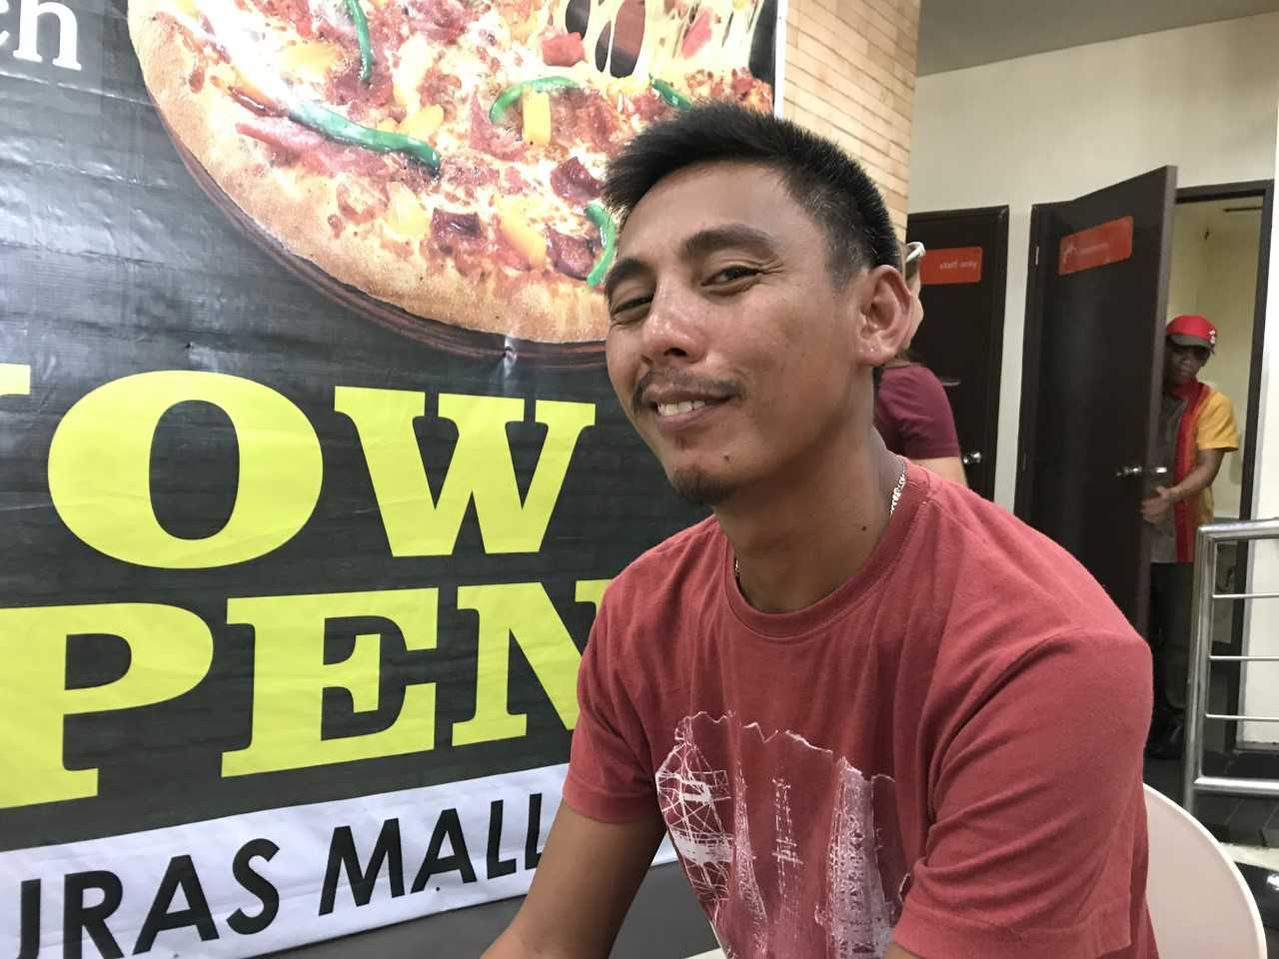
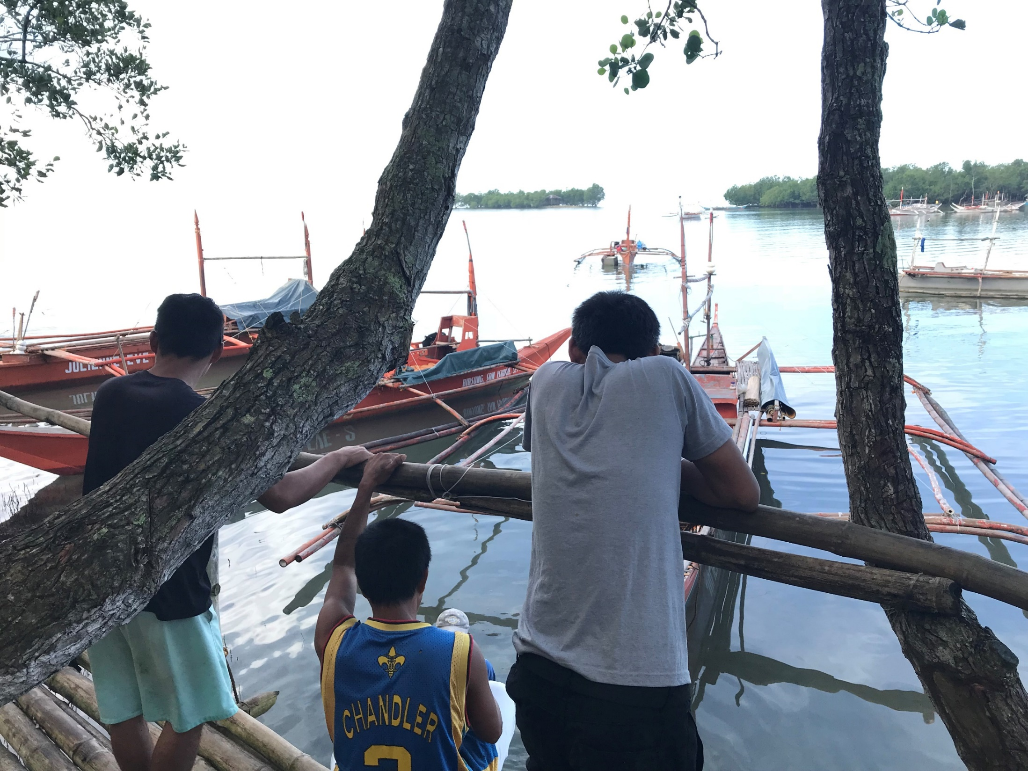
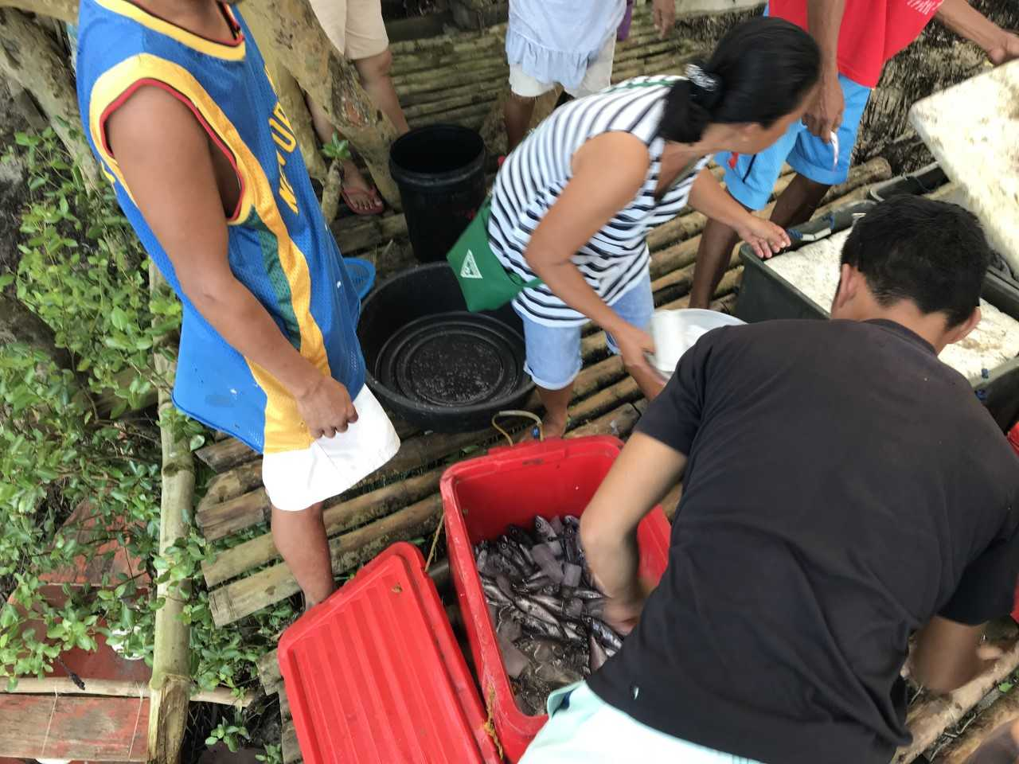
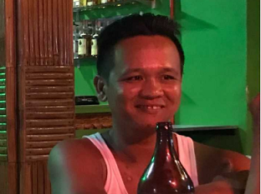
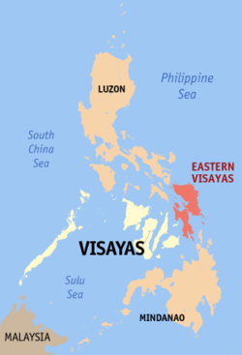
“Is that the house of someone working abroad?”:
Neocolonialism, Exploitation, and Transnational Ties
Zach Madison, Economics | Faculty Mentors: Dr. Rose-Marie Avin, Economics | Dr. Kong Pheng Pha, Women’s, Gender, and Sexuality Studies
Introduction
Methodology and Methods
Critical Insights
This project focuses on the Philippines, a place with centuries of settler/colonial suffering. More specifically, I use storytelling as a method to gain a better understanding of the socioeconomic realities of Filipinos/as, especially in respect to the Philippine State’s particular position as one of the leading institutions which traffic peoples, through its Overseas Filipino Worker (OFW) programs and incentives.
Standpoint theory
Anti-white supremacist and decolonial framework
Oral Histories
Ethnography
Participant Observation
Travelogue
According to my conversations with some specific peoples, I gained the following subjective understandings:
The centrality of whiteness in a neocolonial society
The Philippine State has attempted to erase colonial histories and acts of genocide from Filipinos/as’ memory
The Philippine State supports colonized ideologies of capitalism that reproduce and project violence onto its own people
The significance of English to the Philippine State
Leading to an erasure of Indigenous languages in formal settings
Objectives
Contemporary Political Context
Use data that comes in the form of narratives and stories to capture the realities of marginalized peoples’ stories
Decolonize my research by challenging and questioning the supposed divides between theory and practice
3,100 Philippine peoples leave their country each day as migrant workers¹
At any given time, 5 to 10 percent of the country’s population are working as overseas contract laborers, amounting to a total of 5 to 10 million peoples
Estimates suggest between 30 to 50 percent of the peoples living within the Philippines depend on income sent from an overseas worker²
“approximately 70 percent [of those overseas] are woman working as domestic servants in middle- and upper-class homes in Europe, Japan, the Middle East, the United Kingdom, and the United States”
“there are 100,000 registered nurses in the Philippines, but almost none actually reside in the country”
“the representation and hypercommodification of Filipina workers as ideal care workers is a product of a highly coordinated process that [employment agencies] initiate through the construction of their added export value, a unique Filipina labor power that serves as their global comparative advantage”³
“The Philippines is currently the top supplier of shipping labor. Filipino seamen comprise about 20 percent (one-fifth) of the 1.2 million international ship workers.”⁴
External debt of the Philippines is projected at 73.2 billion U.S. dollars for 2018, according to the IMF⁵
“The remittances that Filipino seamen and other OFWs contribute generate the foreign revenue needed to finance these massive international debts.”
Areas of Future Inquiry
Description
Exploring tourism as an economic development model deployed by the Philippine State to complement its OFW model
Listening to how native Filipinos/as are negotiating tourism for their own purposes and ideas
Investigating how travelers, especially those in the Philippine diaspora, partner with native Filipinos/as to engage in projects that promote environmental justice
In the coastal lowlands of the Eastern Visayas, I conducted an academic and political inquiry to hear about the everyday experiences of the families to those who are OFWs. Neoliberal globalization, in conjunction with neocolonial state governments, has pushed many Philippine peoples, especially Filipina mothers, to migrate out of mere socioeconomic necessity. As a result, many transnational and transpacific relationships have been formed and maintained.
Works Cited
[1] Grace Chang and Kathleen Kim, “Reconceptualizing Approaches to Human Trafficking: New Directions and Perspectives from the Field(s),” in Stanford Journal of Civil Rights and Civil Liberties
[2] Grace Chang, “Global Exchange, The World Bank, ‘Welfare Reform,’ and the Trade in Migrant Women,” in Disposable Domestics: Immigrant Women Workers in the Global Economy.
[3] Anna Guevarra, “Selling Filipinas’ Added Export Value,” in Marketing Dreams: Manufacturing Heroes: The Transnational Labor Brokering of Filipina Women.
[4] Kale Bantigue Fajardo, Filipino Crosscurrents: Oceanographies of Seafaring, Masculinities, and Globalization
[5] International Monterey Fund, “2017 Article IV consultation with the Philippines,” in IMF Country Report No. 17/33
To identify participants for this project, I made use of personal relationships to direct me towards locations where I could meet peoples that would share their stories. Mainly, conversations that compose the analysis of this project took place on street corners and at people’s homes, while making connections between the histories of our respective countries. As a result of the topics we discussed, this work in progress has evolved into a critical reflection on whiteness, subjectivities, positionalities, and memories.
Acknowledgements
Support for this project came from the University of Wisconsin-Eau Claire Economics Department
I thank those who participated in this project, most importantly, as they taught me more than I could ever express
Many thanks to my faculty mentors, Dr. Avin and Dr. Pha, for all the direction and support they have provided for this endeavor

