Slide 1
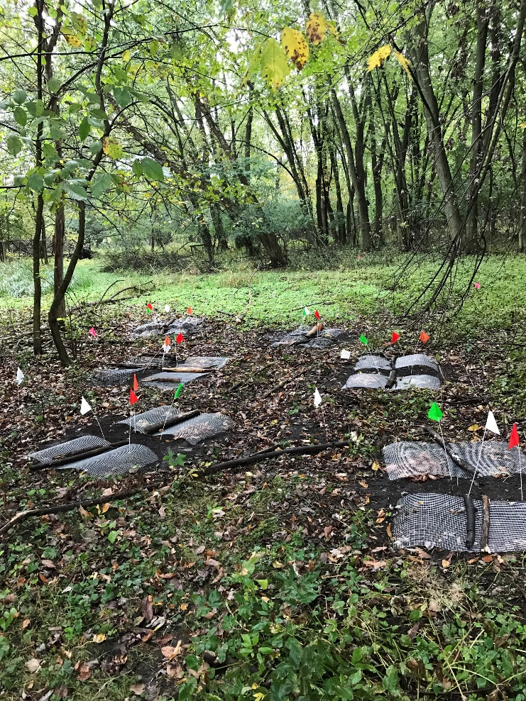
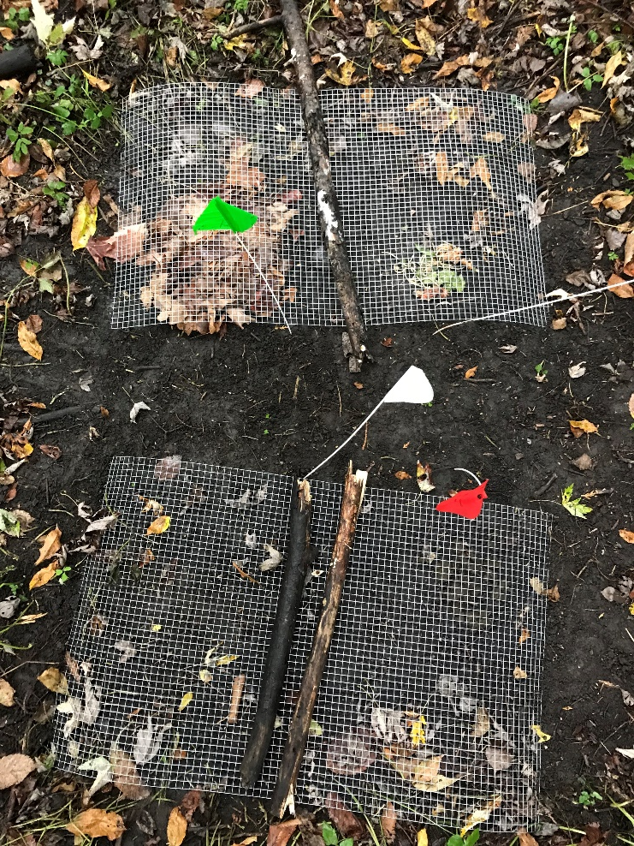
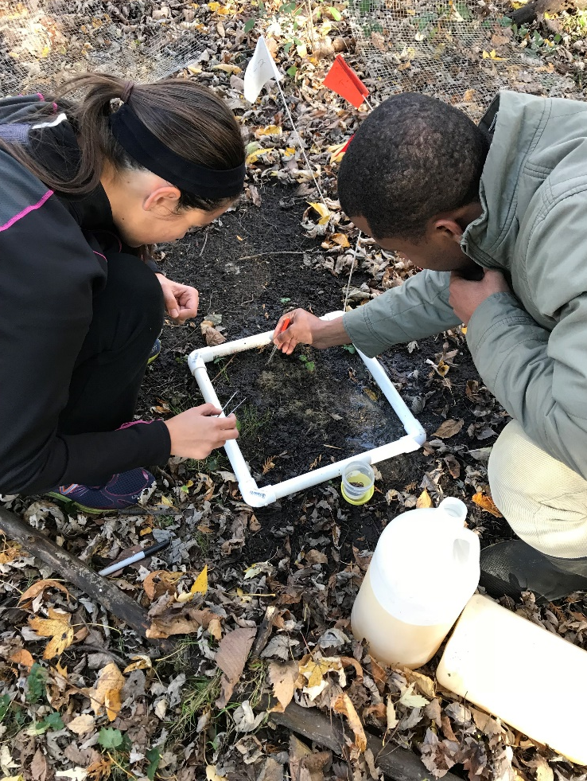
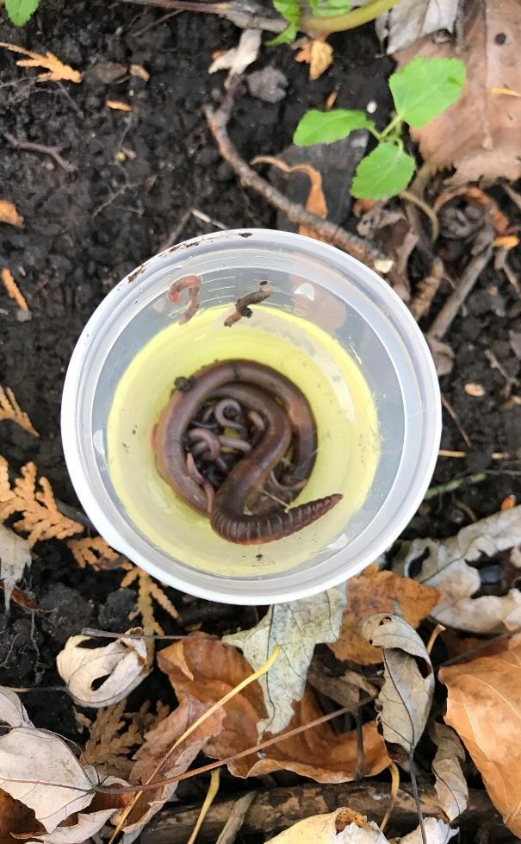
Effects of Organic Substrates on Earthworm Behavior: Do Worms Show a Preference?
Alanna Post, Naomi Plack, Sorfina Suzali, Komi Modji | Dr. Todd Wellnitz, mentor
Introduction
Laboratory Experiments
Discussion
From the time of the last glaciation, earthworms were absent from northern soils, until non-native species were accidently imported from Europe in the 1600’s. Earthworms are “ecosystem engineers” that can modify soil structure, alter soil chemistry, and accelerate nutrient cycling^{1,2,3,4}. These activities increase the fertility of agricultural soils^{5,6}, but can also bring irreversible changes to natural ecosystems³. In each case earthworms play an important role, but while many studies have focused on earthworm impacts, fewer have investigated the factors that influence their movement.
We conducted field and laboratory experiments to study how food influences earthworm aggregation and burrowing. The field experiment examined the effect of food quality on earthworm aggregation; the laboratory experiment examined how the presence or absence of food affected earthworm burrowing.
Hypotheses:
H2. Given a side-by-side choice, earthworms will choose high-quality over low-quality food.
H3. In the absence of surface food (leaf litter), earthworms will create more burrows as they search for food in the soil.
Experimental Design:
H2 was addressed with a choice experiment conducted in replicate (n = 8), 6 L plastic aquariums. Each aquarium was filled with 3 L of soil, half of which was covered with dead leaves (low quality food), half with horse manure (high-quality food). One Lumbricus terrestris earthworm was added to the aquarium’s center and after 24 h the worm was dug up and the side chosen was recorded (Figure 2).
H3 was addressed using wood frames and plastic panels to create narrow mesocosms (20 x 20 x 4 cm; n = 8) that were filled with soil. Two L. terrestris worms were placed in each mesocosm and half had dead leaves covering the soil surface, the other half had none. After 2 weeks, burrow density was assessed by drawing 5 horizontal lines across the plastic panels and counting the number of burrows encountered (Figure 3).
Our results suggest that earthworms in general, and L. terrestris in particular, respond to the presence or absence of food, but they do not discriminate between foods of different quality.
The field experiment created a gradient of food quality that ranged from no food (controls) to added leaves (low-quality) and manure (high-quality). We found more worms in plots having added food, but no difference between the food quality treatments, thereby rejecting H1.
The laboratory choice experiment confirmed what we found in the field experiment, that worms did not discriminate between food of difference quality, even when given a clear choice, thereby rejecting H2. However, there was a non-significant trend favoring the the high-quality manure food, suggesting there might be a slight preference.
The laboratory burrow experiment showed there were more worm burrows in the absence of food, suggesting that burrowing activity increased as earthworms searched for food in the soil. These results support H3.
Field Experiment
Hypothesis:
H1. Earthworms will respond to food quality such that their abundance will be greatest around food having the greater nutritional value.
Experimental Design:
We set up a replicated (n =6) plot experiment in Putnam Park with each plot having 4 treatments: a control (no food), leaf litter (low quality food), horse manure (high-quality food), and food scraps (premium quality food -- not used because animals ate it). The experiment ran 3 weeks, after which earthworms were collected, counted, dried and weighed (Figure 1).
Lumbricus terrestris earthworms, commonly known as “night crawlers”
Conclusion
The experimental set-up in Putnam Park. Colored flags denote different treatments.
A plot showing the 4 treatments covered with wire screen to keep out animals.
After 3 weeks worms were extracted using mustard-water solution.
Earthworms were preserved in in a methyl alcohol/ formalin solution
Earthworm burrows seen through the clear plastic of one of the soil-containing mesocosms. Horizontal dotted white lines were used to access burrow density. Each time the line encountered a burrow, it was counted.
Earthworms can detect food and aggregate around it, but they do not appear to strongly discriminate between foods of different quality. In the absence of of food, their burrows increase in number, indicating that earthworms may mix and aerate soil more in areas having less available organic matter.
Results:
Results:
References
Archer K. 2012. The introduction of exotic earthworms by European colonists. impact on agriculture and forestry: the earthworm invasion. Megadrilogica 15: 201-214.
Jouquet P, Dauber J, Lagerlof J, Lavelle P, Lepage M. 2013. Soil invertebrates as ecosystem engineers: Intended and accidental effects on soil and feedback loops. Applied Soil Ecology 32 (2): 153-164.
Bohlen PJ, Scheu S, Hale CM, McLean MA, Migge S, Groffman PM, Parkinson D. 2004. Non-native invasive earthworms as agents of change in northern temperate forests. Frontiers in Ecology and the Environment 2: 427–435.
Snyder BA, Callaham MA, Lowe CN, Hendrix PF. 2013. Earthworm invasion in North America: food resource competition affects native millipede survival and invasive earthworm reproduction. Soil Biology and Biochemistry 57: 212-216.
Van Groenigen JW, Lubbers IL, Vos HMJ, Brown GG, De Deyn GB, Van Groenigen KJ. 2015. Earthworms increase plant production: a meta-analysis. Scientific Reports 4: 6365. doi:10.1038/srep06365
Pérès G, Cluzeau D, Curmi P, Hallaire V. 1998. Earthworm activity and soil structure changes due to organic enrichments in vineyard systems. Biology and Fertility of Soils 27 (4): 417-424.
*
Figure 2. Lumbricus terrestris worms showed a non-significant preference (X² = 1.29, p = 0.25) for horse manure (high-quality food) over dead leaves (low-quality food).
Figure 3. Mean (± SEM) earthworm burrow density was greater in mesocosms lacking leaves than in those that had leaves (t = -3.38, p=0.01).
Figure 1. More earthworms (mean ± SEM) were found in the food treatments than in the controls (F= 5.27, p=0.02; Tukey’s p < 0.05), but there was no difference in the response between food of high (horse manure) and low-quality (maple leaves).

