Slide 1
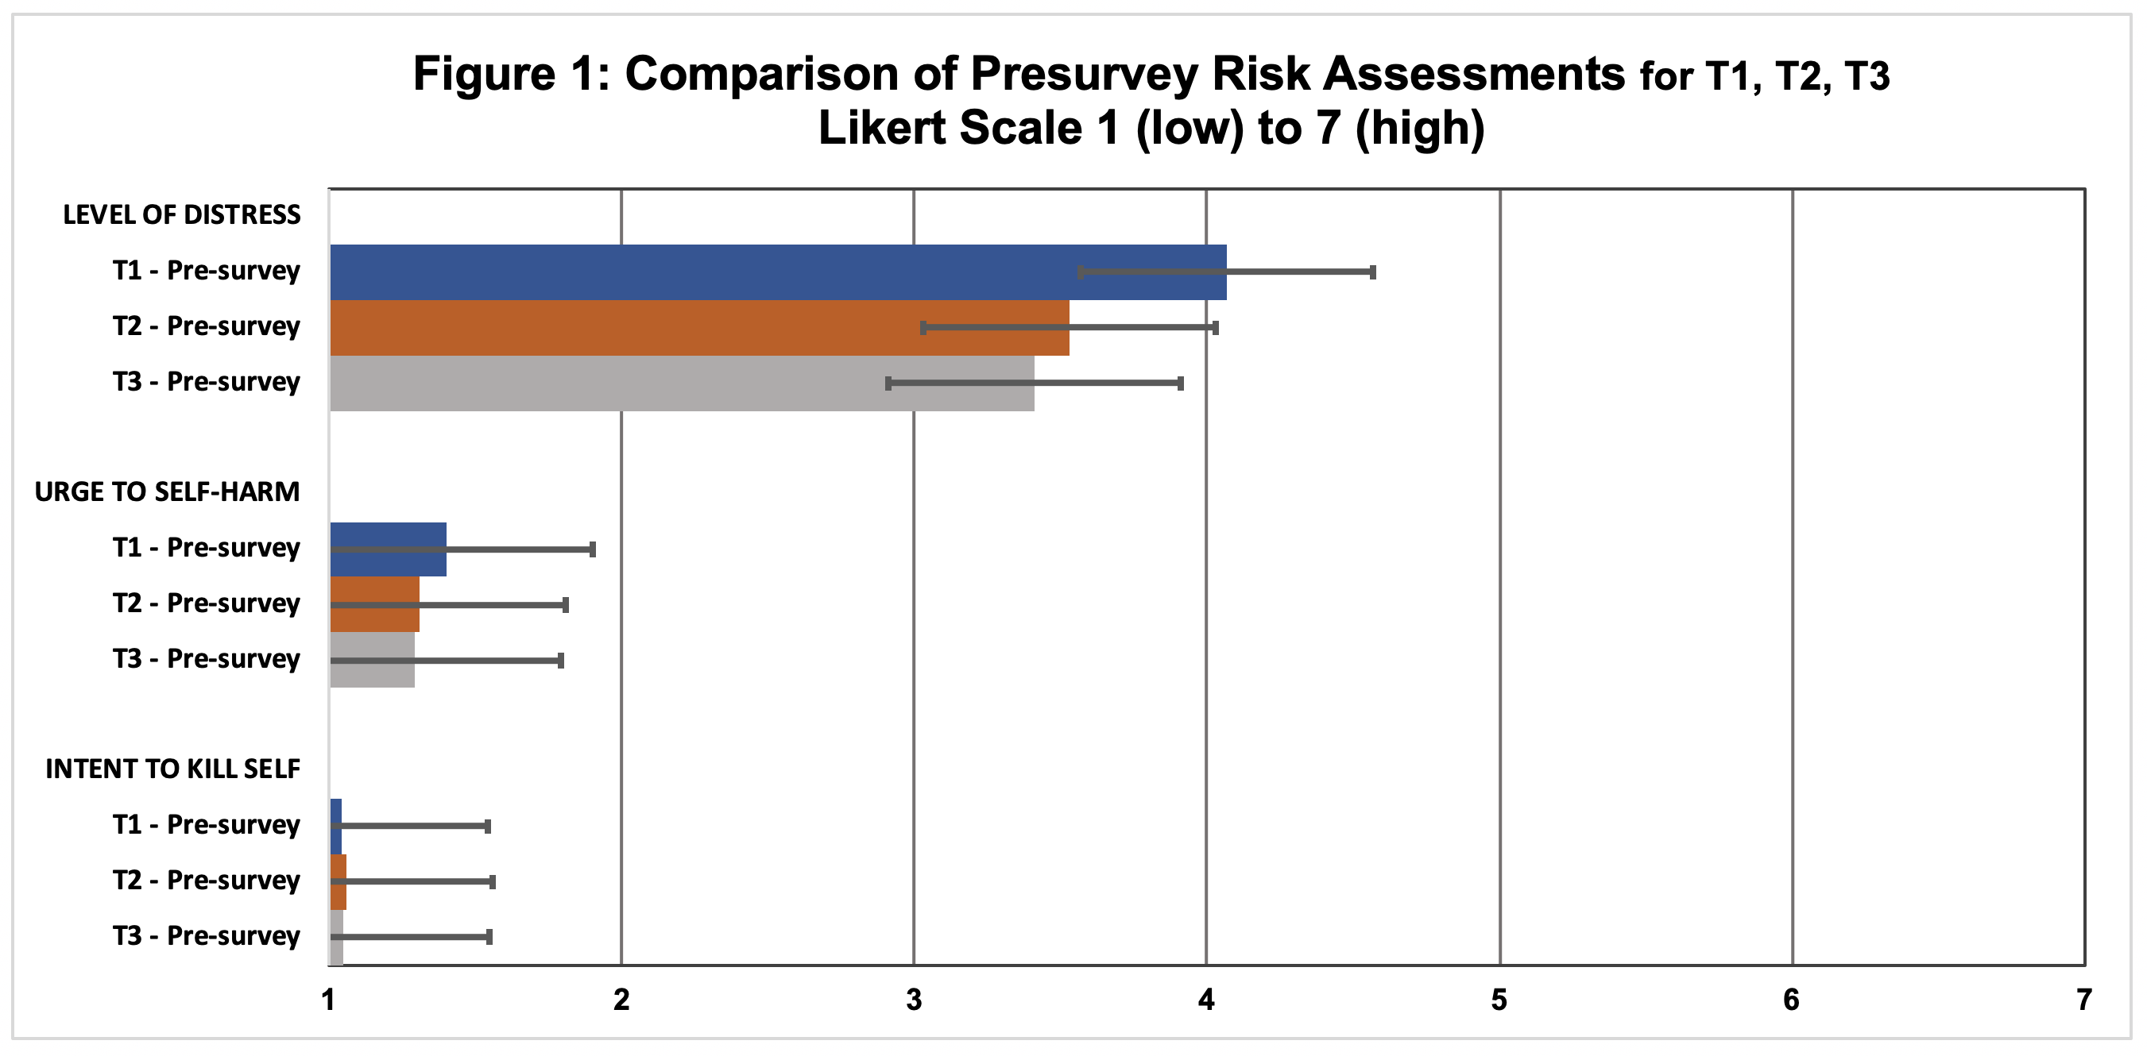
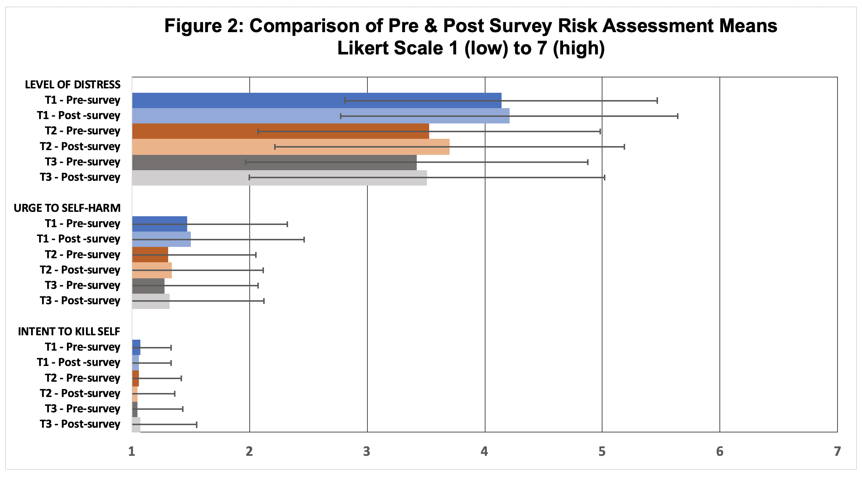
Changes in Distress and Iatrogenic Effects while Participating in Longitudinal NSSI Research
Dortch, S.D., Olson, K. K., Owens, C. A, Hagan, C. R., Muehlenkamp, J.J, Brausch, A. | Department of Psychology
Introduction
Results
Non-suicidal self injury (NSSI) is the intentional damage to bodily tissues without the intent to the die. NSSI research is necessary because long term NSSI is linked to increased suicidal ideation (Hamza & Willoughby, 2016).
Previous literature shows that survey-based NSSI research does not lead to iatrogenic effects (Muehlenkamp, Swenson, Batejan, & Jarvi, 2015). However, exposure to some sensitive stimuli particularly images of NSSI, could lead to lead to short term increased distress (Jackson, Malmstadt, Larson, & Davidson, 2000)
Continuous exposure to potentially unpleasant stimuli can decrease distress compared to the initial exposure (Podnia, Koster, Philippot, Deither, & Daniel, 2013). However, this effect may depend on sample characteristics (Meyer, Farrell, Kemp, Blakey, & Deacon, 2014), and it is unclear how participant distress to repeated exposure to NSSI-specific stimuli may change over the course of longitudinal studies. Given the growth of longitudinal NSSI research, it is important to test how repeat exposure to NSSI stimuli affects participants.
Distress
T1 Pre
t = -1.07, p= 0.29
t = 4.27, p< 0.001
T1 Post
T2 Pre
t = 0.85, p= 0.40
T3 Pre
Hypotheses
Urge to self-harm
Iatrogenic effects, measured by comparing the means on distress, “urge to self-harm”, and “intent to kill self” between the before and after self-reported risk assessments, will not occur from viewing potentially upsetting stimuli (i.e., simulated, realistic images of NSSI) and responding to sensitive questions about mental health and NSSI history during this study.
Participants’ initial distress during their second lab visit (6 months after the first visit) will decrease compared to their initial distress during their first visit, due to previous exposure to the study stimuli.
T1 Pre
t = --0.57, p= 0.57
t = 1.34, p= 0.18
T1 Post
Methods
T2 Pre
Participants consisted of 243 Midwestern undergraduates (M_{age} = 18.87, SD = 0.96, 83.5% female; 29.2% non-heterosexual; 91.4% White) recruited from a campus-wide online screening to take part in an 18-month longitudinal study. All participants had engaged in NSSI within the past year, but have never attempted suicide.
167 of these participants have returned to the lab for the second visit and 123 also completed the third study visit.
Self report data collected in the lab, measured levels of distress, urge to harm themselves, and intent to kill themselves before and after completing computer administered surveys and reaction time tasks containing simulated images of NSSI.
Discussion
t = 0.00, p= 1.00
Participating in longitudinal detailed, sensory-rich studies of NSSI does not appear to cause harm to participants regarding self-reported distress, urge to harm oneself, or intent to kill oneself. We observed that pre-study ratings of distress decreased from the first to second visit, whereas the other variables remained unchanged, suggesting that researchers can have some confidence that longitudinal NSSI research is unlikely to harm participants (Figure 1).
Participants entered the study knowing they qualified due to their engagement in NSSI behaviors, but the measurement techniques and what they would encounter was not known. The stress level decrease between T1 and T2 could be a result of entering the next survey with foreknowledge. A non-significant decrease in distress was seen between the second and third visit, but to a lesser degree; along with non-significant decreases in the other variables across visits.
Consistent with some previous literature, we saw a small immediate increase in the distress variables after participation, although the effects were small and non-significant (Figure 2). Therefore, we suggest researchers still consider implementing post-study protocols to help decrease any distress that may occur. The limitations of the study are the lack of participant diversity (e.g., age and race) and the pre- and post- assessment protocol being self-report. Additionally, the length between assessments (6 months) could have affected the results.
T3 Pre
Intent to kill self
T1 Pre
Statistics
t = 0.30, p = 0.76
Paired t-tests were used to analyze
The difference between initial self-report ratings for distress, urge to self-harm, and intent to kill selves before completing the computerized task (T1 Pre) and after completing the study protocol during their first visit (T1 Post) as well as their second visit (T2 Pre and T2 Post).
The difference between initial self-report ratings for distress, urge to self-harm, and intent to kill selves during their first (T1 Pre) and second visits (T2 Pre)
The difference between initial self-report ratings for distress, urge to self-harm, and intent to kill selves during their second (T2 Pre) and third visits (T3 Pre)
t = -1.00, p = 0.32
T1 Post
T2 Pre
Conclusion
t = 0.71, p= 0.48
NSSI research using a combination of sensory-rich stimuli and detailed NSSI questions does not appear to cause immediate or lasting iatrogenic effects from repeated exposure during a longitudinal study. However, researchers should to attend to the fact that some participants may have a negative response. Thus, ethically sound NSSI longitudinal research should have post-study support protocols in place to reduce any resulting distress, such as having someone available to conduct risk assessments, create a safety plan, and perform a follow up phone call check in if needed.
T3 Pre
Notes:
Dr. M and Dr. H said the signficance for the stats in red are okay as long as they match the bar graph. I left it in red just as a reminder to double check them

