Slide 1
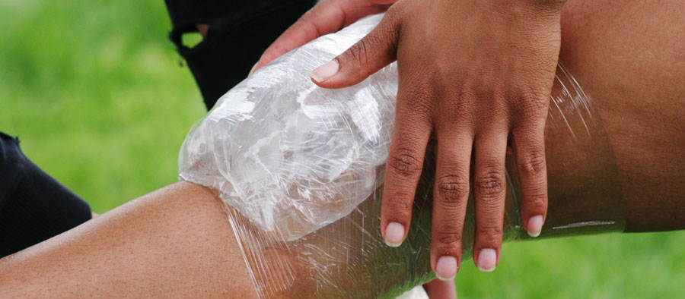
Concussion as a Precursor to Musculoskeletal Injuries in Male and Female College Athletes
A Data Analysis of Concussions
Broden Schock, Maria Mueller, Lucas Kohls, Samantha Matuszak | Department of Kinesiology Mentor Dr. Katherine Breedlove, PhD
Introduction
Results
Discussion/Conclusion
Previous work by Kerr et al. noted that college athletes that sustain a concussion will have a higher probability of sustaining a musculoskeletal injury six months post-concussion, as compared to non-concussed athletes.
The purpose of this study was to examine the impact of a concussion on the risk for musculoskeletal injuries for collegiate female and male athletes, six months post-concussion.
This is different than previous studies. This study looked at all musculoskeletal injuries that occur within six months of their last concussion. Other studies have only focused on either the upper or lower extremity injuries.
Data Analysis
In current studies there has been a link connecting differences in gait when performing level walking and being challenged with different tasks while concussed (Catena, Donkelaar, & Chous, 2007).
After compiling the findings, the researchers suggest an increased sensitive testing protocol with balance exercises following concussions (Catena, Donkelaar, & Chous, 2007).
In a study by Lynall, Mauntel, Padua, & Mihalik, it was shown that athletes who sustained concussions were 2.02 times more likely to experience a lower extremity injury within six months compared to non-concussed athletes.
Our data found no statistical significance in musculoskeletal injury rates between concussed and non-concussed athletes.
A relative risk ratio (RR) was used to determine statistical significance and increased likelihood of sustaining a musculoskeletal injury in concussed verses non-concussed athletes.
Relative risk ratios were computed using the statistical software R. The relative risk ratio compares the number of injuries in concussed athletes to the number of injuries in non-concussed athletes.
Multiple relative risk ratios were conducted to compare the different sports injury rates.
A RR equal to 1 means that there is no difference between the concussed and non-concussed individuals, a RR <1 means that athletes in the non-concussed group are more likely to sustain an injury, and a RR >1 means that athletes with concussions are more likely to sustain an injury.
A limitation of the study is the non-concussed injury data is also collected from Sportware, so the athletes who sustained a concussion were removed from the total number of injuries in each sport.
Methods
Participants
The research subjects were male or female college athletes (Age ±) at Division III University in the Midwest collected anonymously from an electronic medical records program (SportsWare Database, 2018).
Injury data was examined for occurrences of concussions and the number of musculoskeletal injuries for the subsequent six months were counted.
Data included history of injuries for student-athletes participating in: men’s and woman’s basketball, men’s and woman’s ice hockey, and women’s soccer.
The total sample size was 103 concussed athletes.
Table 1 Relative Risk Ratios Among College Sports
Sport |  | Injury | No Injury | Relative Risk Ratio
M Basketball | Concussed | 2 | 4 | 0.66
 | Non-concussed | 107 | 104
W Basketball | concussed | 13 | 15 | 0.81
 | Non-concussed | 85 | 63
M Ice Hockey | Concussed | 8 | 16 | 0.70
 | Non-concussed | 100 | 109
W Ice Hockey | Concussed | 13 | 15 | 0.95
 | Non-concussed | 79 | 83
W Soccer | Concussed | 18 | 17 | 0.96
 | Non-concussed | 141 | 123
References
Catena, R. D., Donkelaar, P. V., & Chou, L. (2006). Cognitive task effects on gait stability following concussion. Experimental Brain Research, 176(1): 23–31.
Kerr, Z. Y., Marshall, S. W., Dompier, T. P., Corlette, J., Klossner, D. A., & Gilchrist, J. (2015). College sports-related injuries--United States, 2009-10 through 2013-14 academic years.
Centers for Disease Control and Prevention Morbidity and Mortality Weekly Report, 64(48), 1330-1336. Retrieved April 10, 2018, from https://www.cdc.gov/mmwr/pdf/wk/mm6448.pdf
Lynall, R. C., Mauntel, T. C., Padua, D. A., & Mihalik, J. P. (2015). Acute lower extremity injury rates increase after concussion in college athletes. Medicine & Science in Sports & Exercise, 47(12), 2487-2492. doi:10.1249/mss.0000000000000716
Marar, M., McIlvain, N. M., Fields, S. K., & Comstock, D. R. (2012). Epidemiology of concussions among united states high school athletes in 20 sports. The American Journal of Sports Medicine, 40(4), 747-755.
SportsWare Online. (2018, January). Retrieved February 21, 2018, from http://www.csmisolutions.com/products/injury-tracking/SportsWare-online
Figure 1: Knee Injury. (2017, October 5). Why ice packs aren’t the only answer to injury recovery. Power Play Blog. n/a.

