Slide 1

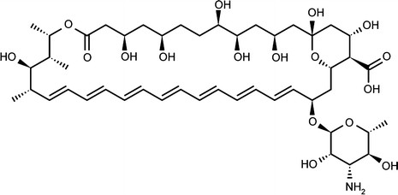
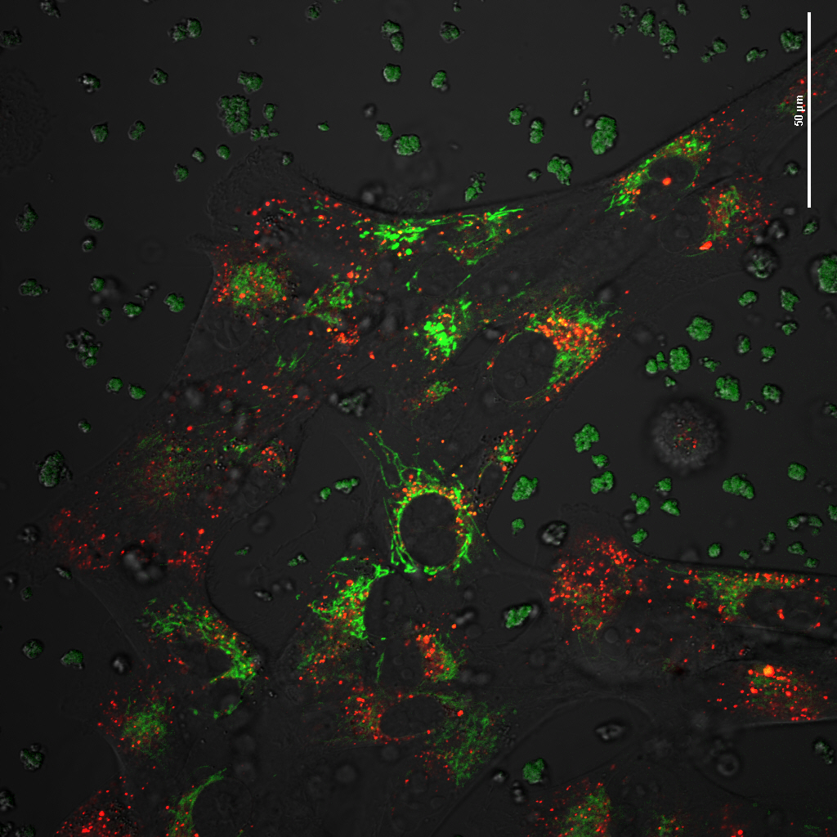
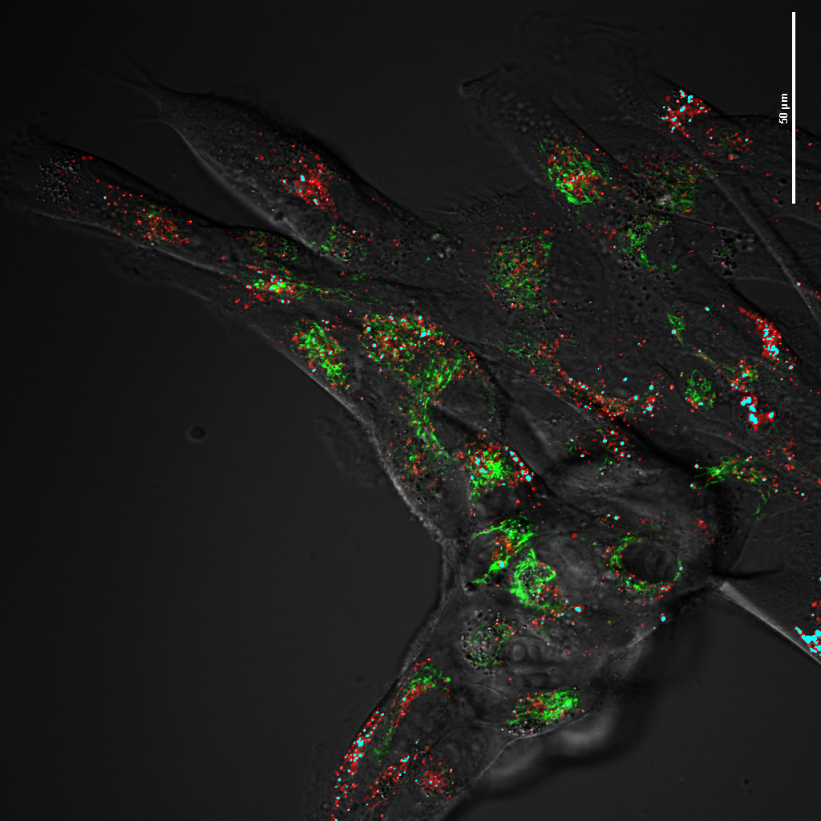
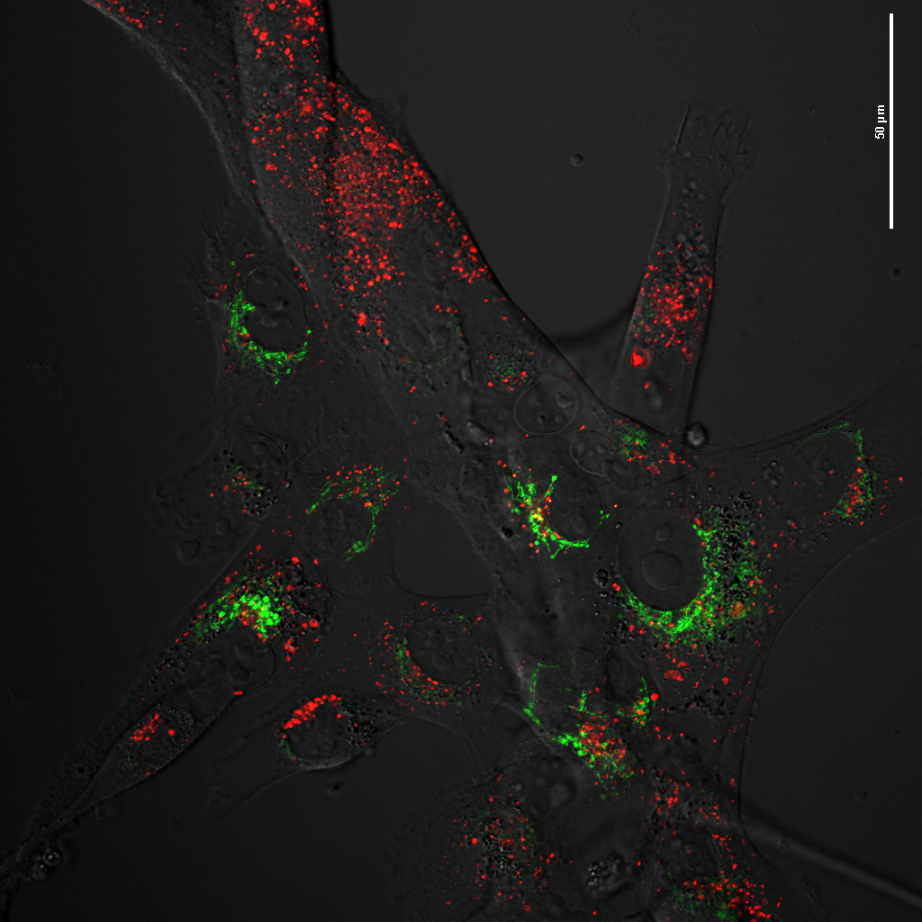
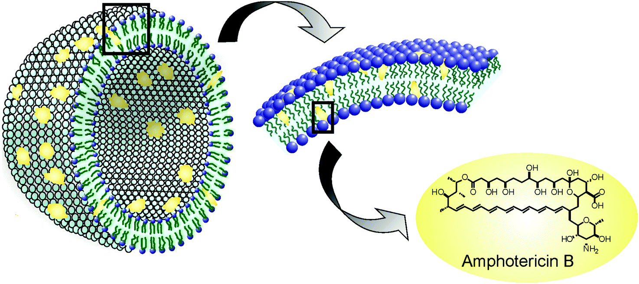
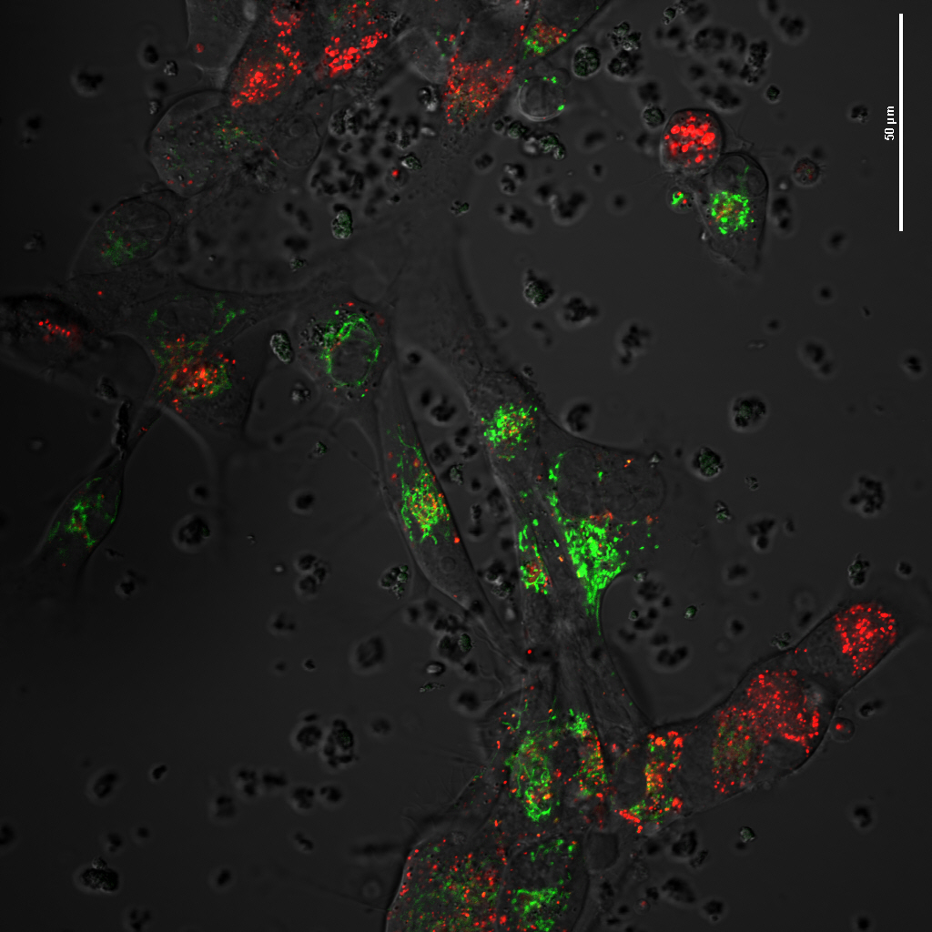
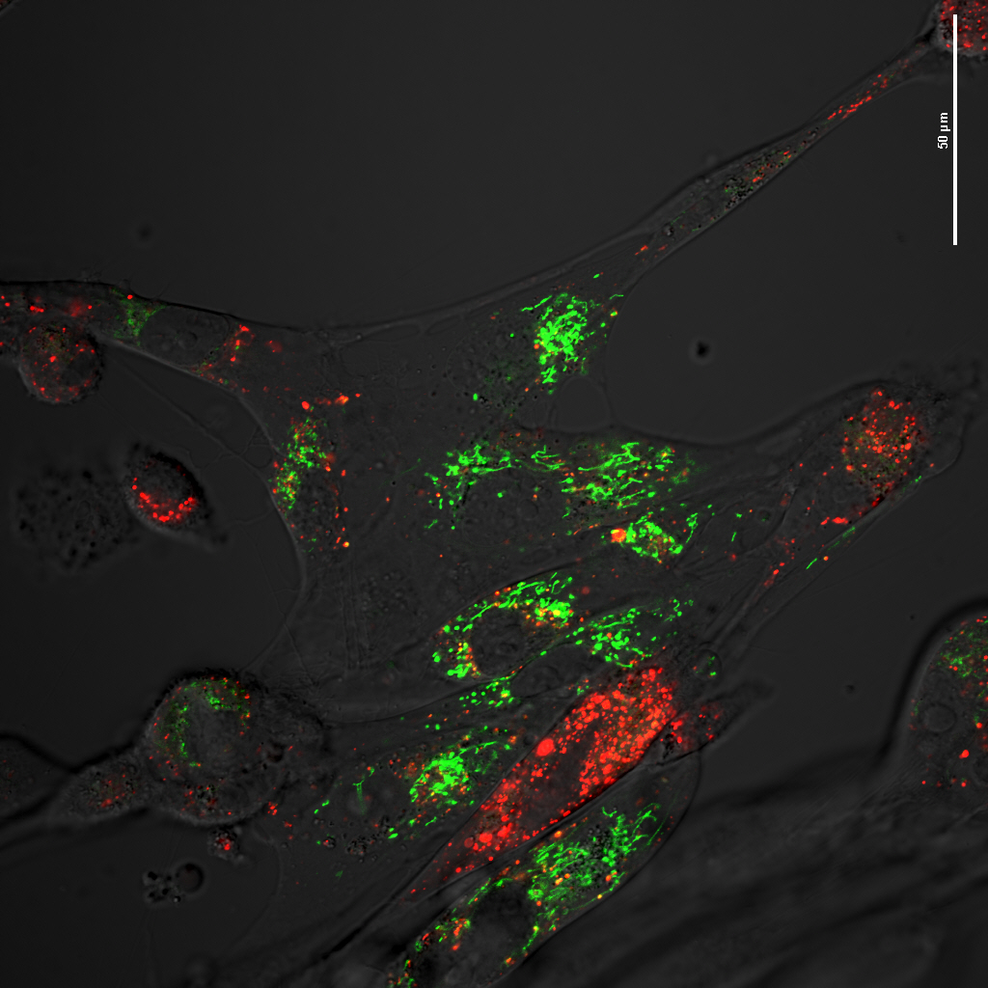
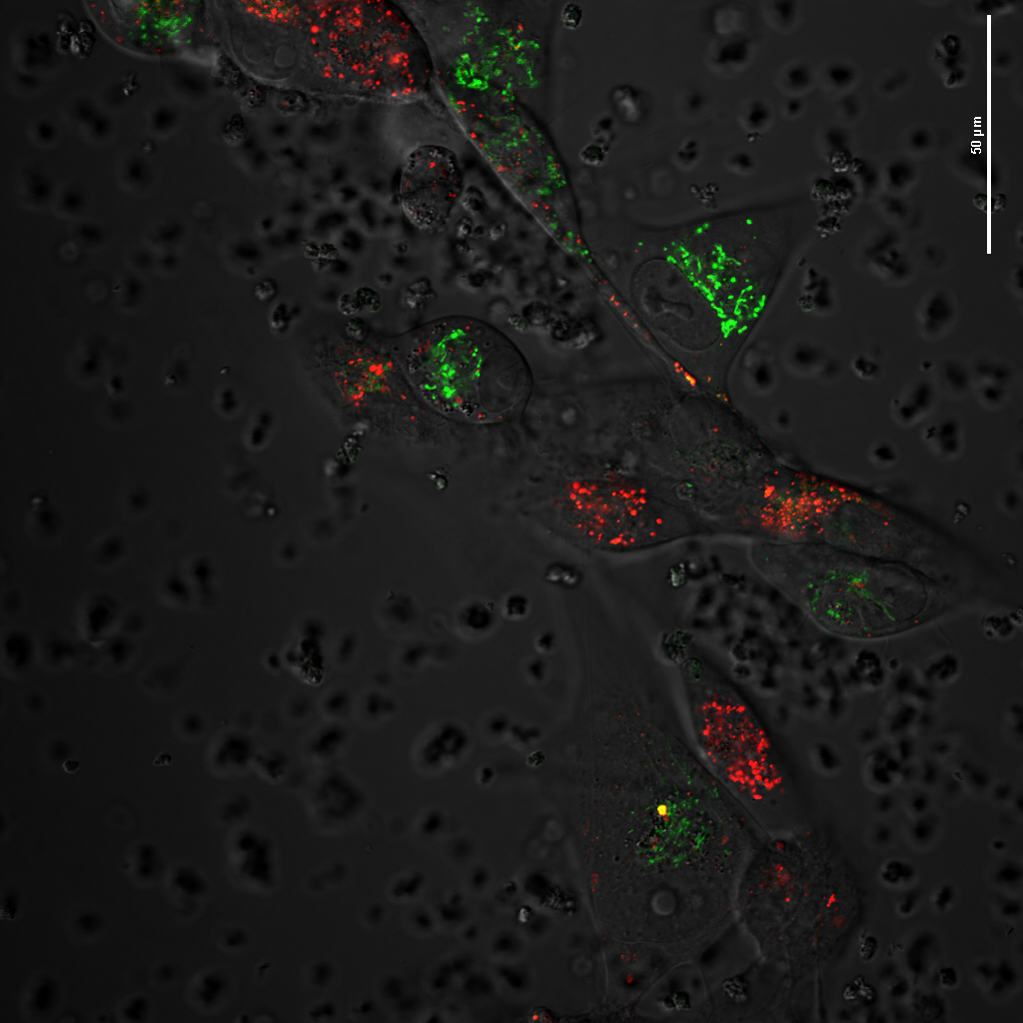
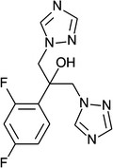
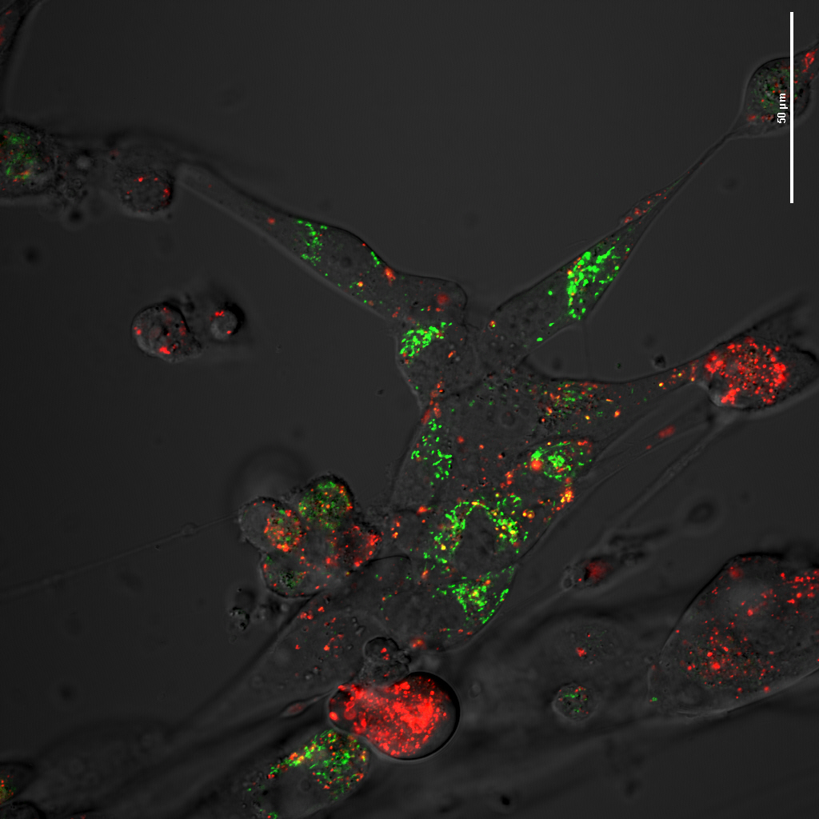
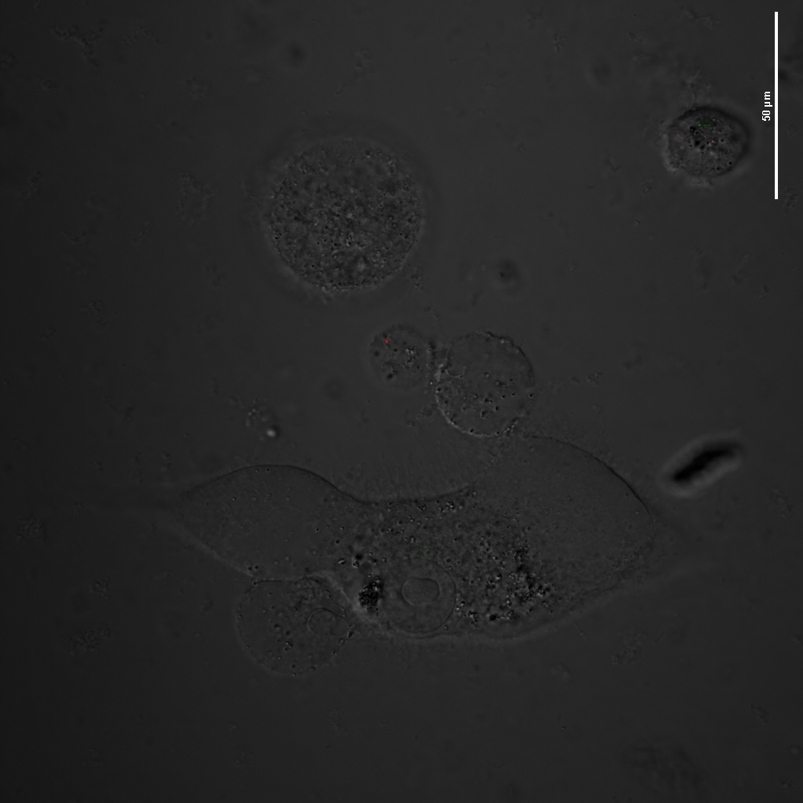
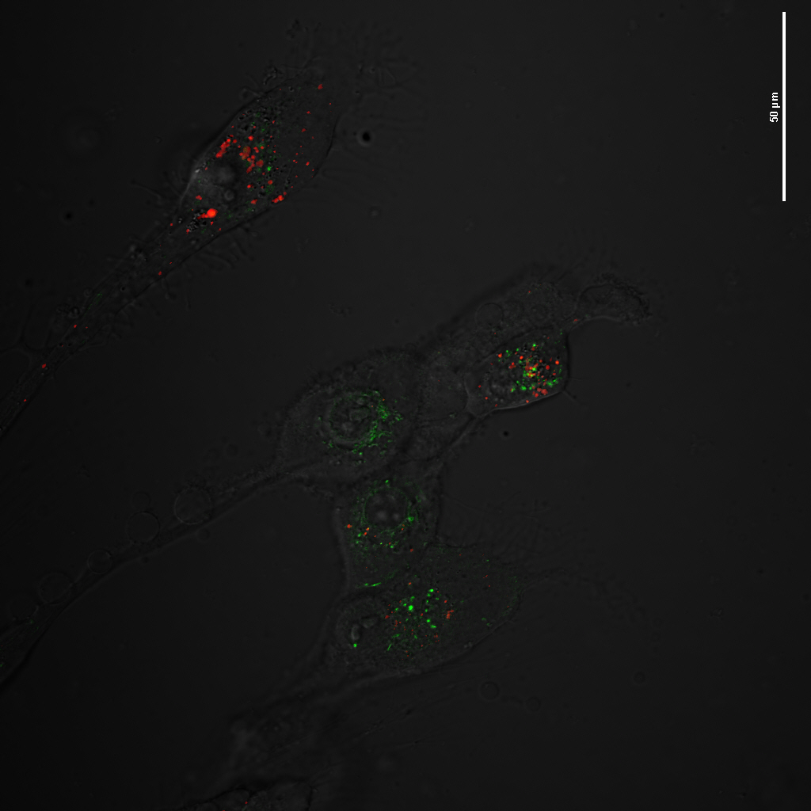
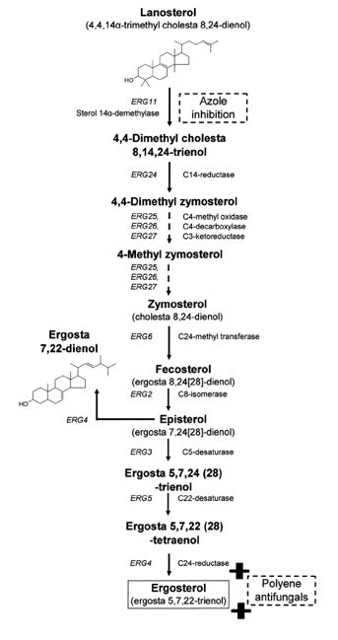
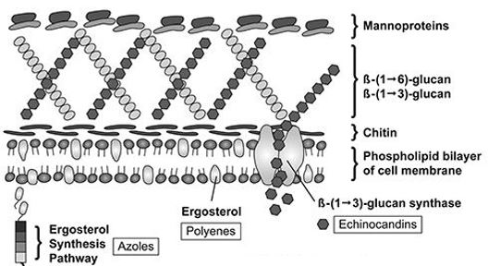
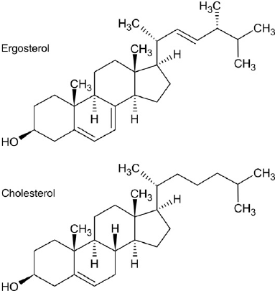
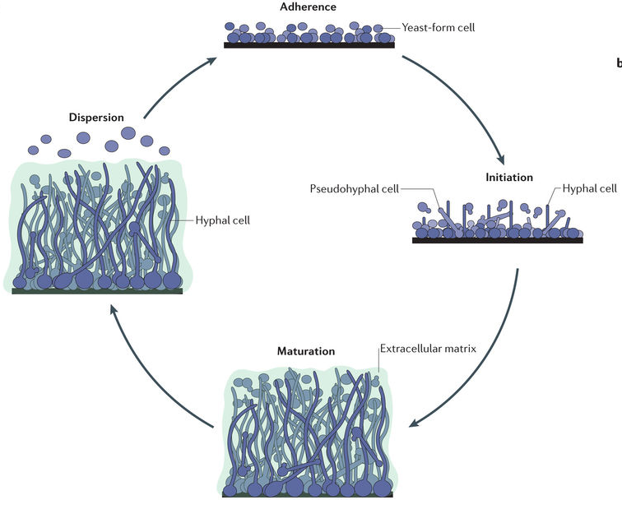
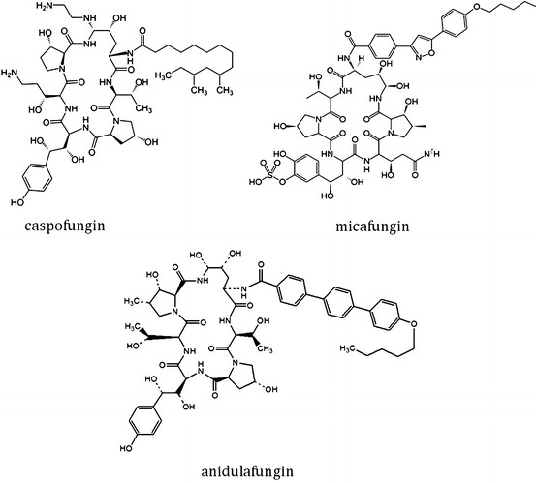
The side effects of popular antifungal drugs Gabrielle Rigden, Claudia Tourville, and Dr. Scott Bailey-Hartsel
❖ Chemistry Department  University of Wisconsin-Eau Claire
Abstract
Polyenes
Mammalian Cells Exposed to Antifungals
Antifungal drugs such as Amphotericin B, Fluconazole, and Caspofungin have specific mechanisms of action which selectively eliminate fungal pathogens with lesser toxicity to the host. While antifungal drugs indeed target fungal cells, different antifungal drugs have varying levels of undesirable human toxicity based on their mechanisms of action. For example, Amphotericin B is known for its nephrotoxicity, while the steroid synthesis inhibitor, Fluconazole, has shown liver toxicity. With the use of a series of organelle-specific fluorescent probes, the effects of varying antifungal drugs on human cell lines can be visualized in real time with confocal microscopy. We have successfully monitored the mitochondrial damaging effects of Amphotericin B on human fibroblast cell lines using our own and other commercial fluorescent organelle probes. We will expand these studies to more relevant kidney and other human cell lines with Amphotericin B, Fluconazole, and Caspofungin as well as other commercial antifungal drugs.
In the 1950s, polyenes were the first class of antifungal drugs to become available for clinical use. They are produced naturally by different strains of Streptomyces bacterial species, so polyenes are non-synthetic molecules. They are characterized as amphiphilic macrocyclic organic molecules known as macrolides; macrolides contain a 20 to 40 Carbon macrolactone ring conjugated with a d-mycosimine group. They are fungicidal due to their mechanism of action. The polyene drug directly binds to ergosterol which leads to the formation of membrane pore, so there is a loss of ionic balance, membrane integrity (Figure 8). This leads to fungal cell death. Polyenes are potent proinflammatory agents that stimulate an innate host immunity response via its interaction with the CD14 receptor.
Human Foreskin Fibroblast, HFF, were imaged via confocal microscopy with Instant Mito1 (IM1) and Lysotracker Red (LTR) as sold by Life Technologies to indicate the morphology and viability of the mitochondria and lysosomes, respectively. IM1 is shown by the green overlay and LTR is shown by the red overlay on the bright field micrographs. Intense fluorescence indicates live organelles while faded or no fluorescence indicates dying or dead organelles. Fungizone and Abelcet were administered at 50µM and imaged for 4 hours; pictures were taken every hour. This revels the subtitle effects of different AmB formulations on mammalian cells; Fungizone shows a higher level of toxicity to HFF when compared to the AmB lipid formulation, Abelcet.
Types of polyenes include natamycin, nystatin, and Amphotericin B (AmB) (Figure 3). Natamycin and nystatin are preferred for topical infections due to their low absorption levels while AmB is preferred for systemic invasive fungal infections such as candidiasis. AmB was isolated from Streptomyces nodosus in 1955, and it is known for its broad spectrum antifungal activity It is known for its dose-limiting nephrotoxicity, hepatoxicity, severehypersensitivity reactions, and infusion-related toxicities. Additional side effects of AmB include the following: fever, chills, headache, nausea, vomiting, low blood Potassium ion levels, hypotension, and bronchospasm.
Due to the extreme side effects of AmB, lipid formulations were discovered to decrease the toxicity but retain the same level of antifungal activity. AmB lipid formulations include Amphotericin B colloidal dispersion (ABCD), Amphotericin B lipid complex (ABLC), and Liposomal Amphotericin B (L-AmB) (Figure 4)..
Control (IM1 + LTR)
50µM Fungizone (IM1 + LTR)
50µM Abelcet (IM1 + LTR)
Introduction
Figure 3
A fungus is any group of unicellular, multicellular, or syncytial spore-producing organisms feeding on organic matter. Fungi contain both a cell wall and a cell membrane. The cell wall contains mannoproteins, chitin, and β-glucans; β-glucans are the major component that strengthens the cell wall. D-glucose monomers are attached to each other by β-(1,3) glucan and β-(1,6) glucan linkages. The cell membrane contains a phospholipid bilayer with ergosterol instead of cholesterol which is within the phospholipid bilayer of a human cell (Figure 1). Ergosterol is a bioregulator of fluidity, asymmetry, and integrity; it also takes on a hormone like role in a fungal cell which stimulates growth. Damage or elimination of ergosterol damages the cell membrane.
A fungal infection is any invasion of the body by an opportunistic pathogen which may be endogenous to the body or acquired from the environment. They are classified in the following three ways: allergic reactions to fungal proteins, toxic reactions to toxin present in certain fungi, and mycoses. Invasive fungal infections are commonly produced in individuals with increased vulnerability such as neonates, cancer patients receiving chemotherapy, organ transplant patients, burn patients, immunocompromised individuals. The rate of systemic fungal infections has increased 207% from 1979 to 2000. Invasive fungal infections are associated with at least 1.5 million deaths worldwide each year with a 30-40% mortality rate for invasive candidiasis. Candidiasis and aspergillosis account for 80-90% of systemic fungal infections in immunocompromised patients.
Candidiasis is a fungal infection in many tissues and body sites caused by the Candida species which are ubiquitous yeasts that occur worldwide and are associated with humans. Candidiasis can range from a minor, self-limiting infection to a serious, life-threatening infection. The severity of the infection increases with prolonged hospitalization, neutropenia, antibiotic use, immobility, mucositis, radiation therapy, catheterization, abdominal surgery, parental nutrition, and renal failure. There are more than 17 different pathogenic Candida species in humans, and six Candida species in particular are the most common isolates which include: Candida tropicalis, Candida glabrate, Candida parapsilosis, Candida stellatoidea, Candida krusei, Candida kyfer, and Candida albicans. Candida albicans is inhabits the mucosal surfaces of the oral cavity and gastrointestinal tract of humans, but it can cause chronic, superficial infections in healthy individuals.
Candida albicans, along with many other fungal species, is able to form a biofilm, a highly organized structure, which is a protective response of the fungal cells. Biofilms form on living surfaces or medical devices such as catheters or dentures. Biofilm formation increases resistance to antifungal drugs and antibiotics. Persister cells within a biofilm remain alive after a treatment with antifungal drugs or antibiotics due to being protected with by the extracellular matrix, and once the concentration of the antifungal drugs or antibiotics decreases, the persister cells begin growing again to repopulate the biofilm. There are five stages in which a biofilm is produced as shown in figure 2. Stage 1 is the initial attachment of the microbial cells to the surface; in stage 2, the extracellular matrix is produced thus resulting in a firmly adhered “irreversible” attachment; in stage 3, early biofilm architecture is developed; in stage 4, the biofilm reaches maturation; in stage 5, single planktonic cells are detached from the mature biofilm leading to the formation a new biofilm elsewhere in the body.
Fungal infections are treated with three different classes of antifungal drugs: polyenes, azoles, and echinocandins in which the mechanisms of action have been studied excessively to understand the spectrum of activity, toxicity profiles, bioavailability, formulation, drug interactions, and pharmacokinetic properties.
Figure 4
http://pubs.rsc.org/en/content/articlehtml/2016/CS/C5CS00674K
Time: 0 hours
Azoles
In the 1960s, azoles were the second class of antifungal drugs to become available for clinical use. They are synthetic molecules that are fungistatic in nature. Azoles have a broad spectrum of activity similar to the polyenes, and they can be used for the treatment of superficial and systemic fungal infections. Azoles inhibit the ergosterol biosynthesis pathway by the inhibition of cytochrome P450-dependent enzyme 14 α-lanosterol demethylase which converts lanosterol, a 14 α-methyl sterol, to ergosterol (Figure 7) (Figure 8). This enzyme contains an iron protoporphyrin unit within its active side which azoles bind to thus causing a blockade within the enzyme. This results in an accumulation of 14 α-methyl sterols leading to membrane stress. The tertiary structure of cytochrome P450-dependent enzyme 14 α-lanosterol demethylase determines the characteristics and side effects of azole antifungal drugs.
Time: 2 hours
Figure 5
There are two subcategories of azoles, imidazoles and triazoles. Imidazoles consist of 2 Nitrogen atoms in an azole ring, and they are most common in the treatment of mucosal fungal infections. Imidazoles have a large number of side effects as well as numerous interactions with other drugs. For this reason, triazoles were synthesized. Triazoles consist of 2 Nitrogen atoms in a cyclic ring, and they are administered for both systemic and mucosal fungal infections. A first generation triazole is Fluconazole which came into clinical use in the 1980s (Figure 5).
Time: 4 hours
Conclusions
-Polyenes: disrupt the fungal cell membrane by binding to ergosterol
-Echinocandins: non-competitive inhibitor of β-(1,3) glucan synthase
-Azoles: the inhibition of cytochrome P450-dependent enzyme 14 α-lanosterol demethylase in the ergosterol biosynthetic pathway
-The side effects of antifungal drugs can be visualized at the organelle level using organelle-specific fluorescent probes.
-Different mammalian cell lines should exhibit different organelle effects when antifungal drugs are used. For example, AmB is known for its nephrotoxicity, so it is predicted that organelle effects would be different between HFF cells and kidney cells
Fluconazole has minimal side effects. The most well-known side effect is gastrointestinal intolerance. It is also recommended to carefully review a patient’s medication for possible interactions with Fluconazole. Due to the fungistatic rather than fungicidal nature of Fluconazole, resistance toward this antifungal drug is one the rise. Fungal cells modify the target enzyme of Fluconazole causing the drug to be less effective.
Figure 5
https://rd.springer.com/article/10.1186%2Fs12864-016-2943-4
Figure 8
https://basicmedicalkey.com/antifungal-drugs-mechanisms-of-action-drug-resistance-susceptibility-testing-and-assays-of-activity-in-biologic-fluids/
Echinocandins
Future Directions
Since the early 2000s, echinocandins were a class of antifungal drugs to become available for clinical use. They are semisynthetic lipopeptide derived from fungal natural products that are fungicidal in nature. Their basic structure is a cyclic hexapeptide with a different side chain at position R5. Their use is favored in patients with moderate to severe fungal infections and in those who have had prior exposure to an azole drug. Echinocandins act as a non-competitive inhibitor of β-(1,3) glucan synthase which is required for the synthesis of β-glucan which accounts for 30-60% of the cell wall in Candida species (Figure 8). The inhibition of this enzyme results in osmotically sensitive fungal cells.
-HFF and kidney cells will be exposed to varying concentrations of AmB, Flucanazole, and Caspofungin as well as organelle specific probes to determine the concentration at which these antifungal drugs begin exhibiting toxic effects on the organelle in question.
-The creators of Caspofungin claim it has no effect on mammalian cells because it targets β-(1,3) glucan synthase which is only found in fungal cell walls. Although the drug itself may not be toxic to mammalian cells, the byproducts of the breakdown of the drug may have toxic effects. We will be able to visualize the effects Caspofungin have on the organelle level.
-In general, we want to determine which organelles are effected the most by AmB, Fluconazole, and Caspofungin.
Figure 1
https://www.researchgate.net/figure/Structure-of-the-sterols-ergosterol-and-cholesterol_fig1_221704629
Figure 2
https://www.nature.com/articles/nrmicro.2017.107
At this point, they begin to form into pseudohyphae, reduce ergosterol concentration, and thicken the cell wall as a survival response. Once the integrity of the cell wall is stress, the cell wall will lyse causing fungal cell death. These antifungal drugs are non-toxic to mammalian cells because β-(1,3) glucan synthase is only present in the cell wall of fungi. Types of echinocandins include micafungin, anidulafungin, and caspofungin (Figure 7). Caspofungin was the first echinocandins to be available for clinical use, and it has shown to be as effective as AmB.. Although Caspofungin is well tolerated in by the body, it is not free of side effects which include: mild-to-moderate headache, fever, nausea, diarrhea, abdominal pain, rash, a reversible elevation of hepatic enzyme levels, and phlebitis at the side of infusion.
References
Campoy, S., and Adrio, J. L. (2017) Antifungals, Biochemical Pharmacology 133, 86-96.
Carmona, E. M., and Limper, A. H. (2017) Overview of Treatment Approaches for Fungal Infections, Clinics in Chest Medicine 38, 393-+.
Fuentefria, A. M., Pippi, B., Dalla Lana, D. F., Donato, K. K., and de Andrade, S. F. (2018) Antifungals discovery: an insight into new strategies to combat antifungal resistance, Letters in Applied Microbiology 66, 2-13.
Kathiravan, M. K., Salake, A. B., Chothe, A. S., Dudhe, P. B., Watode, R. P., Mukta, M. S., and Gadhwe, S. (2012) The biology and chemistry of antifungal agents: A review, Bioorganic & Medicinal Chemistry 20, 5678-5698.
Moudgal, V., and Sobel, J. (2010) Antifungals to treat Candida albicans, Expert Opinion on Pharmacotherapy 11, 2037-2048.
Prasad, R., Shah, A. H., and Rawal, M. K. (2016) Antifungals: Mechanism of Action and Drug Resistance, In Yeast Membrane Transport (Ramos, J., Sychrova, H., and Kschischo, M., Eds.), pp 327-349, Springer-Verlag Berlin, Berlin.
Sorbera, L. A., Aravamudan, J., and Rosa, E. (2011) Therapeutic Targets for Candidiasis, Drugs of the Future 36, 627-630.
Zacchino, S. A., Butassi, E., Cordisco, E., and Svetaz, L. A. (2017) Hybrid combinations containing natural products and antimicrobial drugs that interfere with bacterial and fungal biofilms, Phytomedicine 37, 14-26.
Acknowledgements
.
University of Wisconsin – Eau Claire Office of Research and Sponsored Programs (ORSP)
Figure 7
University of Wisconsin – Eau Claire Chemistry Department
University of Wisconsin – Eau Claire Learning and Technology Services

