Slide 1
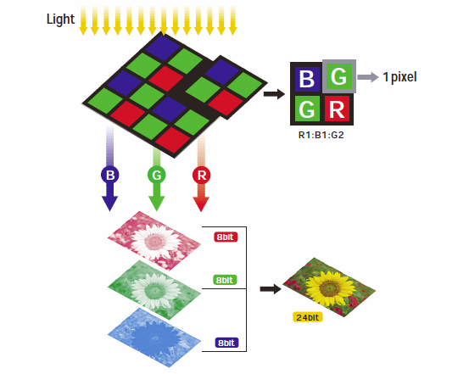
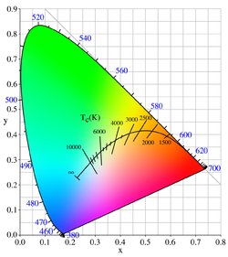



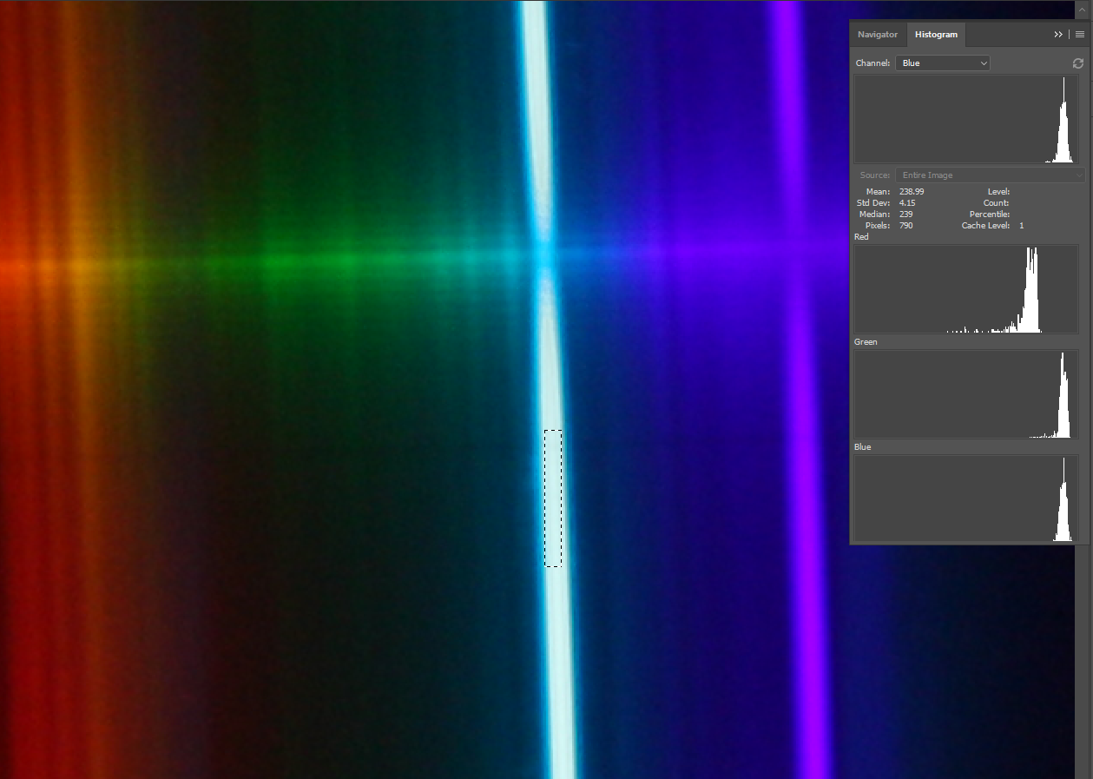
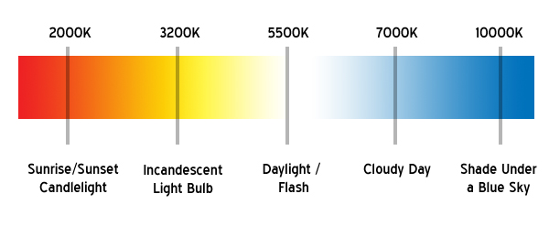
Exploring the Chromaticity Diagram
Re creation using blackbodies and atomic spectral lines
Dan Becken and Nathan Miller| Department of Physics and Astronomy
Breaking Down the chromaticity diagram
A chromaticity diagram is a 2-D plane where X and Y are normalized intensity values of red and green respectively.
Though blue does not have its own axis in the diagram, it is accounted for in the equations for X and Y:
How digital cameras record RGB values.
Spectral colors around outside and blackbody curve through the center.
Spectral line curve from atomic gas lights and lasers. Wavelengths in nanometers (same as diagram).
An illustration of points on the chromaticity diagram corresponding to RGB colors of an incandescent filament passed through diffraction grating in front of our DSLR camera.
Blackbody photos
Spectrally Pure Colors
Non-saturated Colors
White paper illuminated by incandescent bulbs with different filament temperatures (increasing left to right).
By using diffraction grating, we can produce a rainbow spectrum.
Advantage: We are able to extract many data points from the spectrum.
Disadvantage: Wavelengths unknown.
We also use lasers and atomic gas lights to produce atomic spectral lines.
Advantage: Known wavelengths.
Disadvantage: Only certain colors are produced from these spectral lines so we need several atomic gas lights.
Blackbody Radiation
A blackbody is a theoretically ideal radiator and absorber of energy at all electromagnetic wavelengths.
Blackbodies get their name from the fact that an ideal blackbody would absorb all wavelengths of light and reflect no light.
As temperature increases, blackbodies emit energy and the color changes.
We used 4 light bulbs (25W, 60W, 100W, and 60W LED) as well as the sun.
Incandescent bulbs were hooked up to DMMs as we varied the voltage form 20-140 volts.
We also incremented exposure times to capture visible RGB values.
By aiming a light temperature sensor at the bulbs, we tracked the change in temperature of the light source as the voltage changed.
Points on chromaticity diagram generated by illuminating a white sheet of paper with various light sources. Because they are unsaturated, their points lie in the interior of the diagram.
Moving Forward
References
Perform error propagation to atomic lines and blackbodies using standard deviations of RGB values from Adobe Photoshop.
Gather images of higher temperature blackbodies to extend the curve using a high temperature cavity blackbody.
“Blackbody Spectrum.” PhET, 22 Feb. 2016, phet.colorado.edu/en/simulation/blackbody-spectrum.
Falk, David S., et al. Seeing the Light: Optics in Nature, Photography, Color, Vision, and Holography. Wiley, 2008.
“File:CIE1931xyY PlanckianLocus-Fr.svg.” File:CIE1931xyY PlanckianLocus-Fr.svg - Wikimedia Commons, commons.wikimedia.org/wiki/File:CIE1931xyY_PlanckianLocus-fr.svg.
“File:CIE1931xyY PlanckianLocus-Fr.svg.” File:CIE1931xyY PlanckianLocus-Fr.svg - Wikimedia Commons, commons.wikimedia.org/wiki/File:CIE1931xyY_PlanckianLocus-fr.svg.
Grotta, Daniel, et al. “Digital Camera Basics: Mastering Color Controls.” PCMAG, 6 Sept. 2005, www.pcmag.com/article2/0,2817,1855803,00.asp.
“How Digital Cameras Work.” HowStuffWorks, 29 Nov. 2006, electronics.howstuffworks.com/cameras-photography/digital/digital-camera.htm.
Used Adobe Photoshop to extract mean R,G, B values for Hydrogen, Helium, Mercury, Krypton, Neon, and Xenon bulbs.
Light sources vary in temperature.

