Slide 1
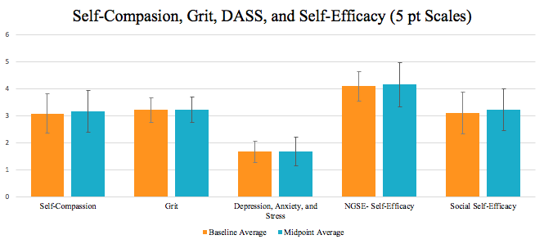
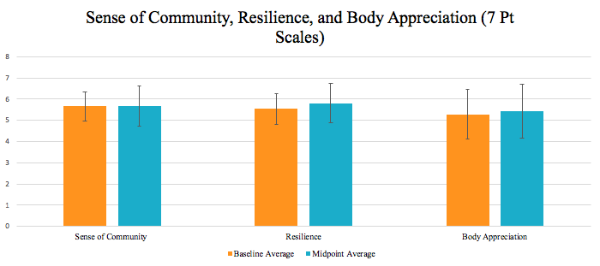
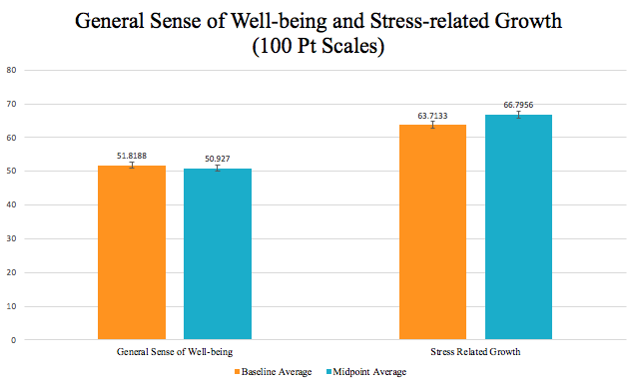
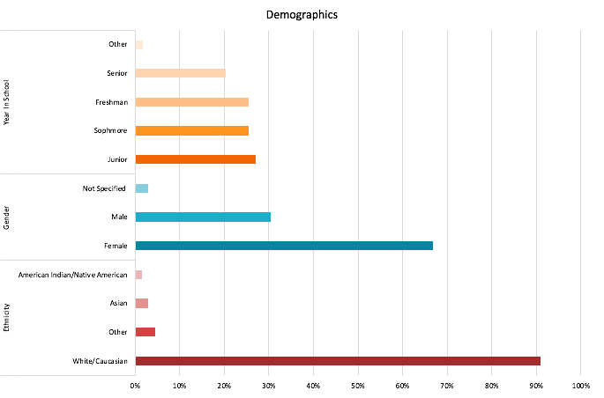
Running Towards Mental Well-Being
Examining the Effects of a long distance running class on mental well-being
Maggie Foltz, Samantha Kollman| Psychology
Faculty Mentor: Jennifer J. Muehlenkamp, PhD
Introduction
Results
As college students’ mental health continues to decline (Xiao et al., 2017), many universities are looking for both creative and cost effective solutions to combat this downward trend.
Strong, positive mental health is associated with higher retention rates and success in college overall (Eisenberg, Golberstein, & Hunt, 2009).
Increased physical activity in college students has been linked with overall better mental well-being (Vankim & Nelson, 2013).
Individuals who participate in a long-term exercise program show higher self-efficacy; the belief one is capable of doing a challenging task (Neupert, Lachman, & Whitbourne, 2009).
Self-compassion is an important coping mechanism (Mosewich, Crocker, Kowalski, & DeLongis, 2013) and has been linked with well-being within the context of exercise in young women athletes (Ferguson, Kowalski, Mack, & Sabiston, 2009).
Research also suggests that exercise is associated with decreases in anxiety (LeBouthillier, & Asmundson, 2017), depression (Blumenthal et al., 2007), and stress (Vankim & Nelson, 2013).
Although there is a moderate amount of research dedicated to the benefits of exercise, specifically running, there is limited research on the effect of exercise on newer constructs such as body image, grit, and social connection; especially in a formal class setting that also integrates mental health promotion topics.
Purpose: The purpose of this study is to explore the effect of a marathon running class on many of these constructs focusing heavily on grit, body image, and social connect within college students in order to inform decisions regarding possible ways to achieve better mental well-being in college students and therefore improve retention rates and overall success of students.
Repeated measures MANOVAs were conducted to test for changes in the outcome variables from the start of the semester through mid-terms.
*
Methods
We sampled from the UWEC Long Distance Running Class (IDIS 131). Participants were emailed an online survey using Qualtrics at the beginning of the spring semester and the midpoint, with scales to measure the list of outcome variables seen below.
Discussion
From the start of the semester to the mid-point we saw very stable scores, with slight but insignificant increases in scores. The only significant difference documented was for resilience, but the effect was small. There are many potential reasons for why scores may not have changed:
* It is possible that the outcomes being assessed represent psychological traits rather than states. Traits are more likely to remain static and do not fluctuate as easily due to environmental factors whereas psychological states are more likely to change due to outside circumstances.
* The constructs we are measuring may need more time to experience change, and the short duration of only 8 weeks of the class may not have been enough to produce a change. We will be conducting a final assessment at the end of the semester and hope to see changes at that time, after the full class has been completed.
* The mid-point assessment was also taken during midterms, which is a stressful time for most students. The stress of midterms may have been a confound or masked real changes due to a temporary increase in stress.
* It is also possible that the long continuation of snow and cold weather influenced responses, especially if the weather impeded opportunities to run.
We also need to consider the limitations of the study. One limitations is our lack of awareness regarding how much our participants are actually running. It is possible that if they are not running consistently (due to weather) that the positive effects will not be realized. We also had nearly 40% attrition from the study so it is possible that there may be a sampling bias affecting results. The sample is also homogenous and uses self-report questionnaires.
Future research may want to include how much participants are actually running, and to increase the length of the study, to follow participants more than 8 weeks.
While our preliminary results suggest little effect, other studies demonstrate positive effects on mental health. Providing courses similar to the distance running class may be a creative and cost-effective way of promoting overall mental well-being in college students; therefore improving retention rates and academic success of all students involved.
Average age was 23.18 with a SD of 9.13
Outcome Variables
Self-Compassion | Self-Efficacy (Social Self-Efficacy)
Anxiety, Stress, and Depression | Body-Appreciation
Resilience | Grit
Sense of Community | Stress-Related Growth
General Sense of Mental Well-Being
Baseline:
N= 69
Retention Rates
Midpoint:
N= 43
62.3%

