Slide 1
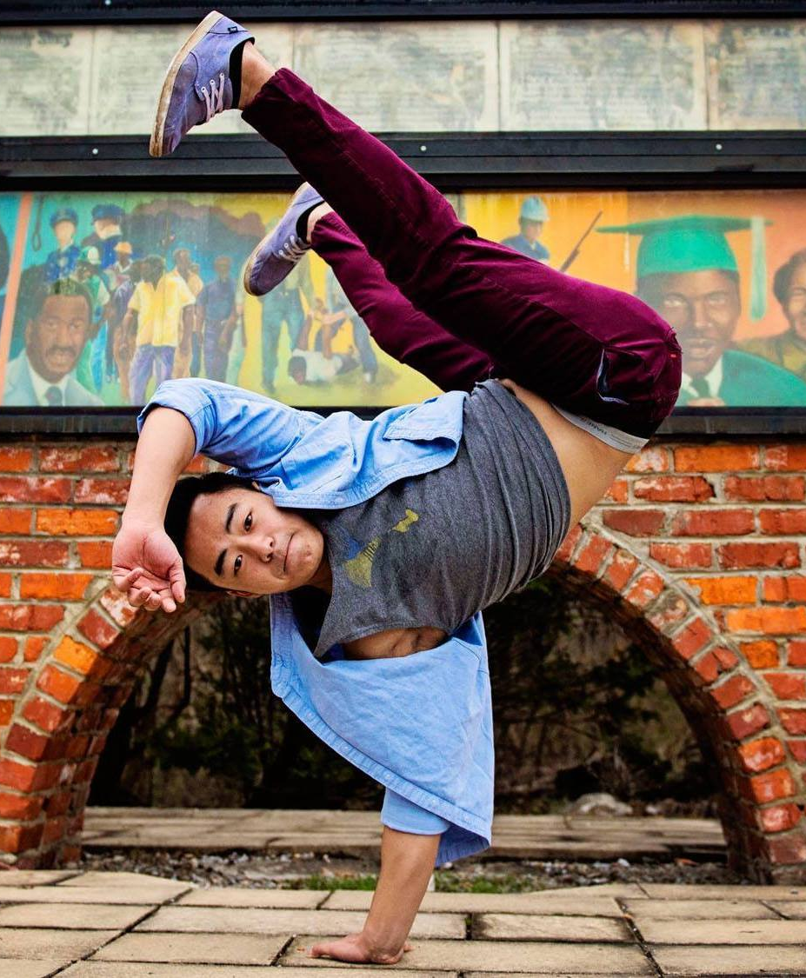

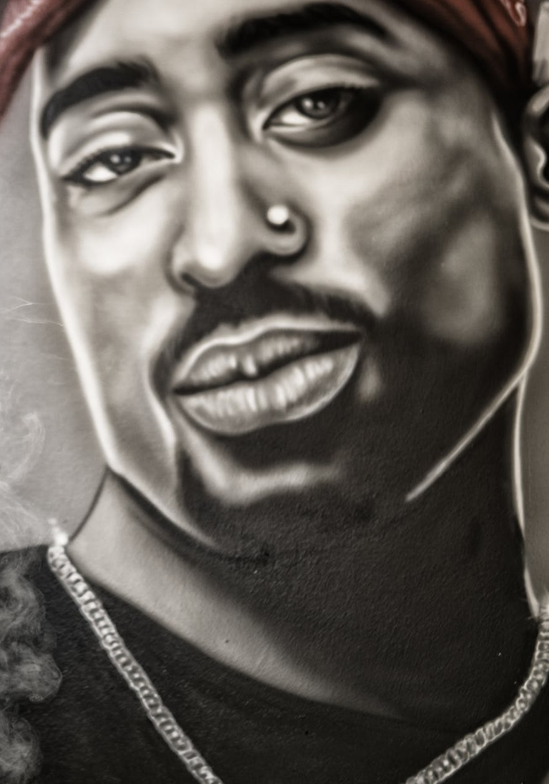
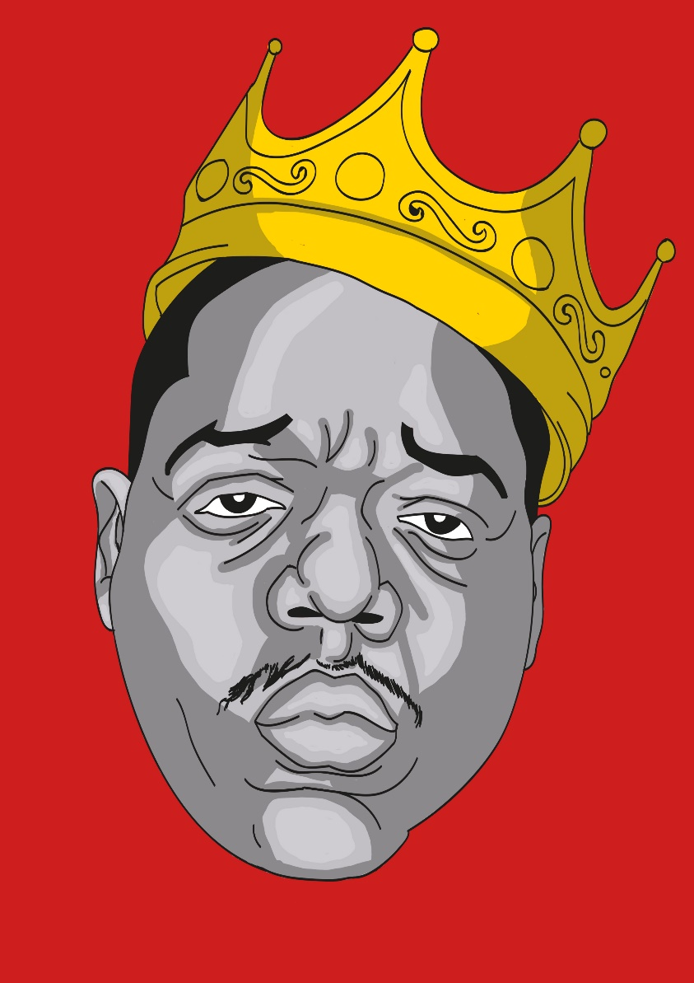
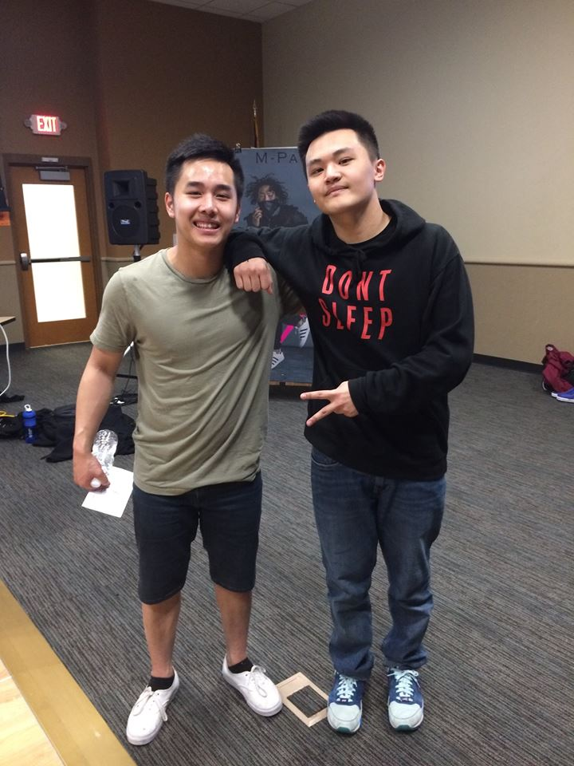
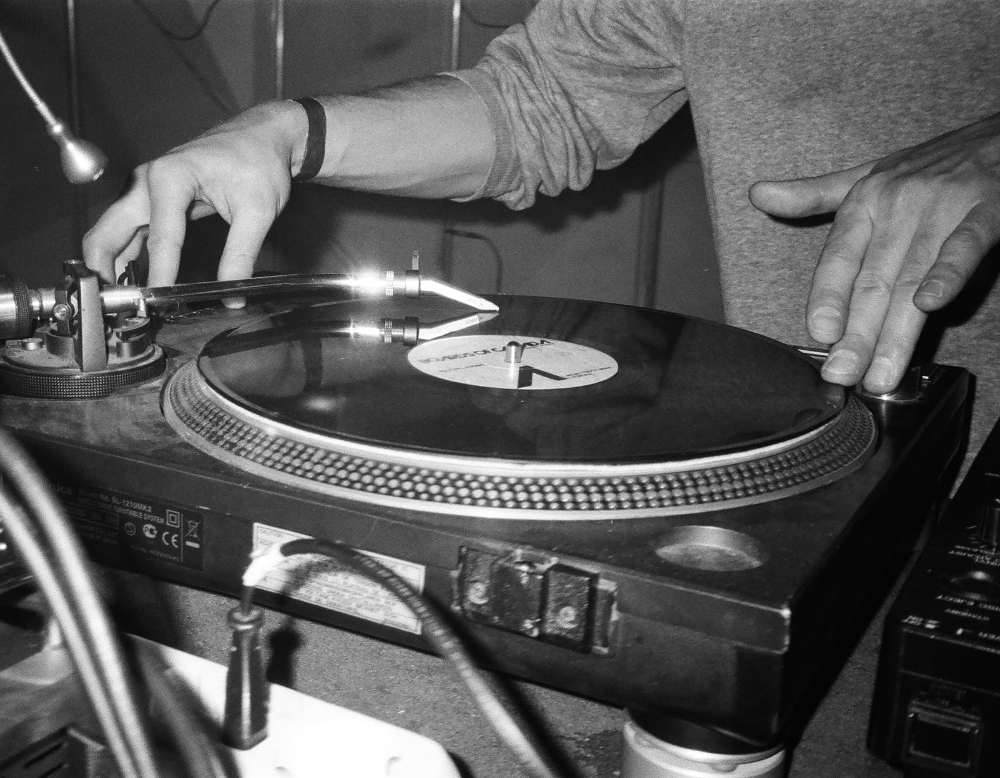
Sustaining Hmong Identity Through Hip-hop
McNair Scholar: Fue Khang | McNair Mentor: Dr. Anjela Wong
Introduction
Rap as resistance (Martinez, 1997)
Political Rap: Used to call out social institutions that contribute to oppression.
Distrust of the Police
Fear of a Corrupt System that Plans Genocide
Disillusionment with the health care system
Anger at Racism and Lost Opportunities
Action in the Face of Oppression
A Plea for Recognition
Gangsta Rap: Used as a form of story telling which illustrates the lives of Black individuals affected by criminalization, surveillance, incarceration, and immiseration.
Methodology
Hip-hop has been an integral part of my life. From a young age, Hip-hop has influenced the way I dress, talk, and interact with others. However, the most powerful effect Hip-hop has had on me is helping me sustain and maintain my Hmong Identity through appreciation and validation. From this experience, I have become interested in understanding how Hip-hop continues to influences the Hmong Identity of other Hmong Hip-hop artists.
Community Cultural Wealth (Yosso, 2005)
Skills and abilities possessed and inherited by one’s family.
Aspirational
Navigational
Social
Linguistic
Familial
Resistant
Validation and invalidation of cultural capital
Critical Race Theory (CRT)
Qualitative (Creswell, 2012)
Case study of individual lived experiences
Location: Eau Claire, WI
Personally contacted Hmong hip-hop artists between the ages of 18-30
Number of participants: 2-4
Interview Questions Topic
Demographic questions
General questions about themselves
Influence of Hip-hop on self
Effects of hip-hop on family/community/society
Reflection
Research Question:
What role and impact does hip-hop in the form of rap and dance play in validating, sustaining, and supporting Hmong American youth identity?
Blackened Identity (Lee, 2005)
Whiteness represents all that is “good” in America and Blackness represents all that is “bad”. Thus, Hmong identities are Blackened due to their high poverty rates.
Hip-hop in the Hmong Community (Lee, 2005; Vue, 2012)
Low socioeconomic status forces Hmong individuals to live in impoverished areas.
Often times includes Black American communities.
The Hmong community has picked up Hip-hop as a form of self-expression.
Language, clothing, and expression through music and dance.
Hmong youth were drawn to Hip-hop due to the parallels in which the Hmong and the Black community have been oppressed.
Early Hmong MCs and Bboys were associated with gangs. This caused racial profiling of Hmong individuals by law enforcement.
Asian rappers also face issues from the Hip-hop community due to the view of Asian Americans as forever foreigners.
Hip-hop tool kit spreads awareness and appreciation of the Hmong culture and Identity through the platform of Hip-hop.
Social Institutions of Oppression (Ore, 2003)
Institutions such as family, education, and policies that contribute to the oppression of minorities in America.
Literature Review
Plans For Study
History of Hip-hop (Martinez, 1997)
Born in Bronx due to the relocation of Black and Latin(x) communities.
Made its first appearance in early 1970’s with DJ Kool Herc.
Consisted of Emceeing, Disc Jockey, Break Dance, and Graffiti.
Born from disparities that include social isolation, economic fragility, truncated communications media, and shrinking social service organizations
Prominent Figures
Disc Jockeys
Kool Herc
Afrika Bambaataa
Grand Master Flash
Emcees
Public Enemy
NWA
Ice Cube
Bboys
Crazy Legs
Alien Ness
Ken Swift
The individuals I hope to interview are break dancers, known as Bboys, of Floor Dusters Crew from Eau Claire, Wisconsin. They fall into the age range that I am looking for and also are currently active within the Hip-hop scene.
Shinang Yang
Hmong Bboy
24 Years Old
12 Years of experience
Active
Chimeng Moua
Hmong Bboy
20 Years Old
9 Years of experience
Active
Citations
Creswell, J. W. (2012). Educational research: Planning, conducting, and evaluating quantitative and qualitative research(4th ed.). New York, NY: Pearson.
Lee, S. J. (2005). Up against whiteness: Race, school, and immigrant youth. New York: Teachers College Press, Columbia University.
Martinez, T. A. (1997). Popular Culture as Oppositional Culture: Rap as Resistance. Sociological perspectives 40(2):265-286
Ore, T. E. (2003). Maintaining inequalities: Systems of oppression and privilege. New York: The Social Construction of Differences and Inequality (2): 182-204
Vue, P. L. (2012). Assimilation and the gendered color line: Hmong case studies of hip-hop and import racing. El Paso: LFB Scholarly Publ.

