Slide 1
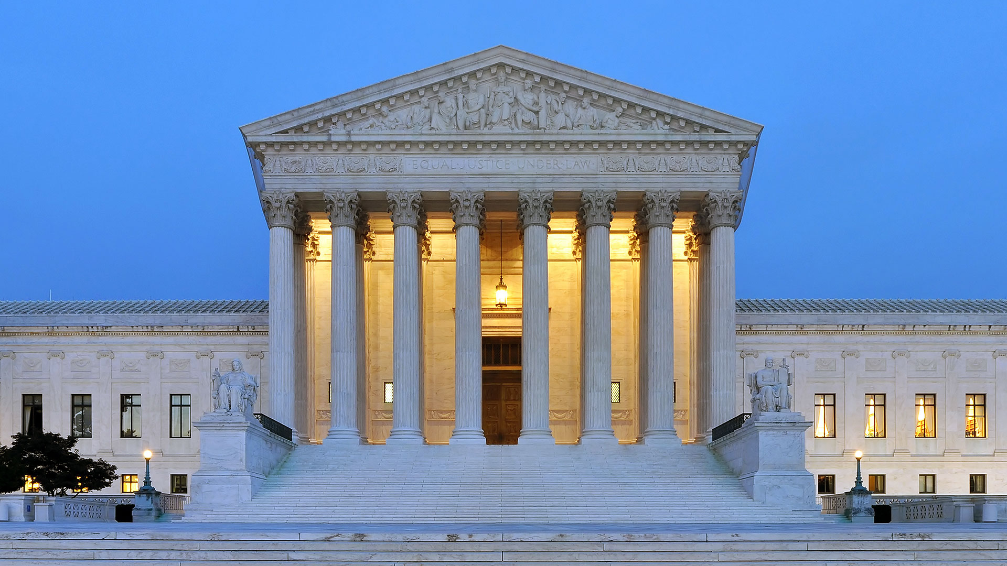

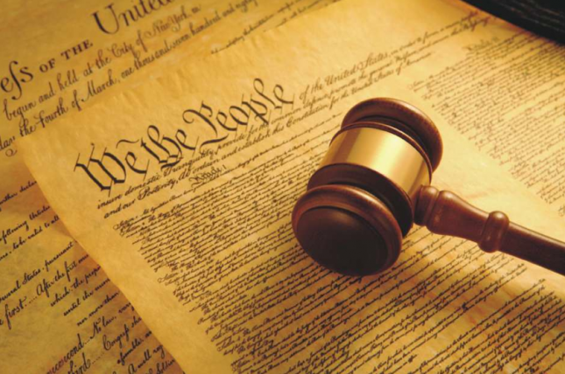
Judicial Scrutiny and Disability
How The Supreme Court Applies The 14th Amendment to Disability Cases
Nathan Altmann, Mentored By Dr. Kasper | Political Science, University of Wisconsin – Eau Claire
Introduction
Suspect Classification
The 14th Amendment’s Equal Protection Clause has been an invaluable tool for courts to strike down discriminatory laws effecting protected classes. However, constitutional protections for disability related discrimination remains the weakest of all protected classes determined by the court.
The court has defined suspect classifications in accordance with four criteria laid out in Frontiero v. Richardson.
The group must have been subjected to a history of intentional discrimination.
The group must be “the object of such deep-seated prejudice” that produces demeaning stereotypes.
The group must be a politically powerless minority
The protected identity component must exist as an immutable trait that is “determined solely by accident of birth”
Further Research
What is Judicial Scrutiny?
There remains little literature regarding the comparison between the legal decisions concerning disability rights and those concerning race, gender, and sexual orientation.
There is even less research examining a historical comparison between the disability rights movement and other civil rights movements.
Therefore, further research will examine this comparison from both a historical and legal perspective to draw parallels between the timelines of legal decisions that reduced and enhanced the civil rights of people with disabilities, the prevalent social ideologies that informed those decisions, and the correlation between the disability rights movements and other relevant civil rights movements.
Further research will also create a rationale for an appropriate disability classification with corresponding judicial scrutiny based in the civil rights model to be determined via a purely constitutional claim, not a statutory one. Further research will also examine a due process claim regarding disability issues.
Why This Matters
Traditional legal options for pursuing disability discrimination cases have largely been limited to strategies that rely on legislation like the ADA, IDEA, The Fair Housing Act, ect. However, in accordance with those statutes, there remain many state laws that continue to facially discriminate against people with disabilities, limiting rights for voting, marriage, family relations, and other vital areas of personal autonomy.
Certain classifications are considered by the judiciary to be suspect, which triggers a set of more stringent guidelines the government must follow when creating a classification to be in accordance with constitutional law.
Courts adjudicate equal protection cases considering laws that discriminate against groups of people upon three levels of scrutiny: a rational basis review, intermediate scrutiny, or strict scrutiny.
Most laws are reviewed by a rational basis test, which provides considerable latitude for legislatures because the test only requires that the law in question serve a legitimate government interest.
The strict scrutiny test originated from United States v. Carolene Products Co, where the court ruled that prejudice against certain minority groups may prevent the minority group from seeking normal legislative redress, so stricter constitutional protections should be applied by the courts. Strict scrutiny is typically applied to racial discrimination.
While the rational basis test only requires a legitimate government interest for a law in question, strict scrutiny requires that a law be narrowly tailored to serve a compelling (or critical) government interest.
The Cleburne Case
The Cleburne decision concerned a municipal statute that required a more rigorous process for obtaining zoning permits regarding homes for people with disabilities than those without disabilities.
The court did not find that the Frontiero standards were applicable to disability.
The court struck down the law in question, but not on the basis of strict scrutiny. Instead, it found that the challenged law was in violation of the rational basis test.
This application of the rational basis test in this way is much more intense than the rational basis test as regularly applied to test other, non-racial classifications.
It appears that the court is applying a more stringent standard, but refusing to clearly define it. The similarities between an “unusually rigorous rational basis test” concerning disability classifications and pre-heightened scrutiny cases concerning early race and gender classification cases is striking.
Research Methods
To better understand the issue, this research dissected the Supreme Court’s reasoning in the most important precedent establishing the level of judicial scrutiny for disability related cases, City of Cleburne v. Cleburne Living Center. Next, this research analyzed the reasoning of the case predominantly cited as precedent in Cleburne, Frontiero v. Richardson.

