Slide 1


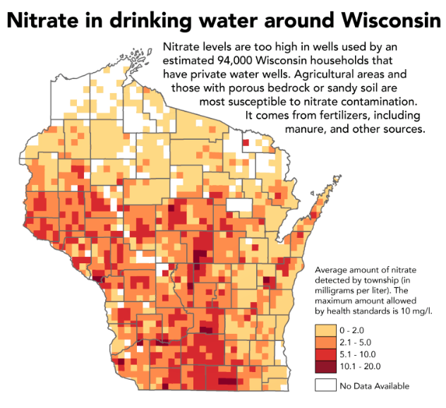
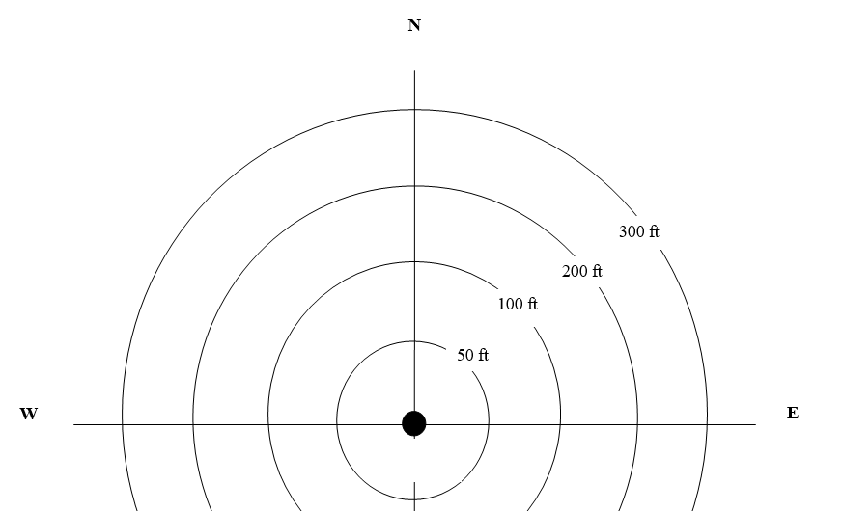
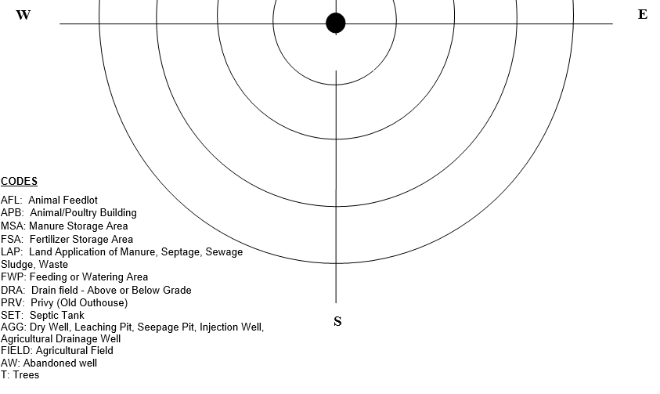
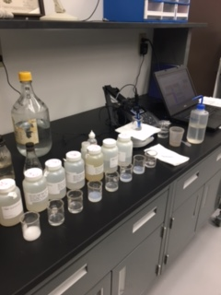
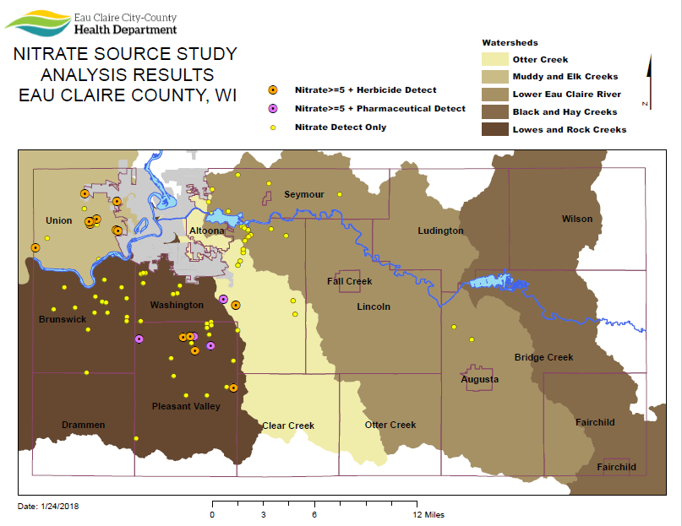
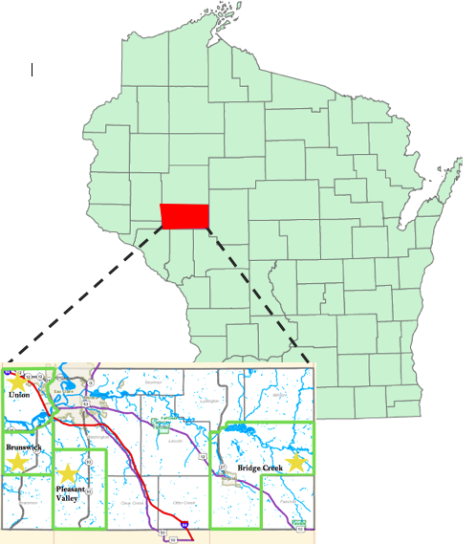
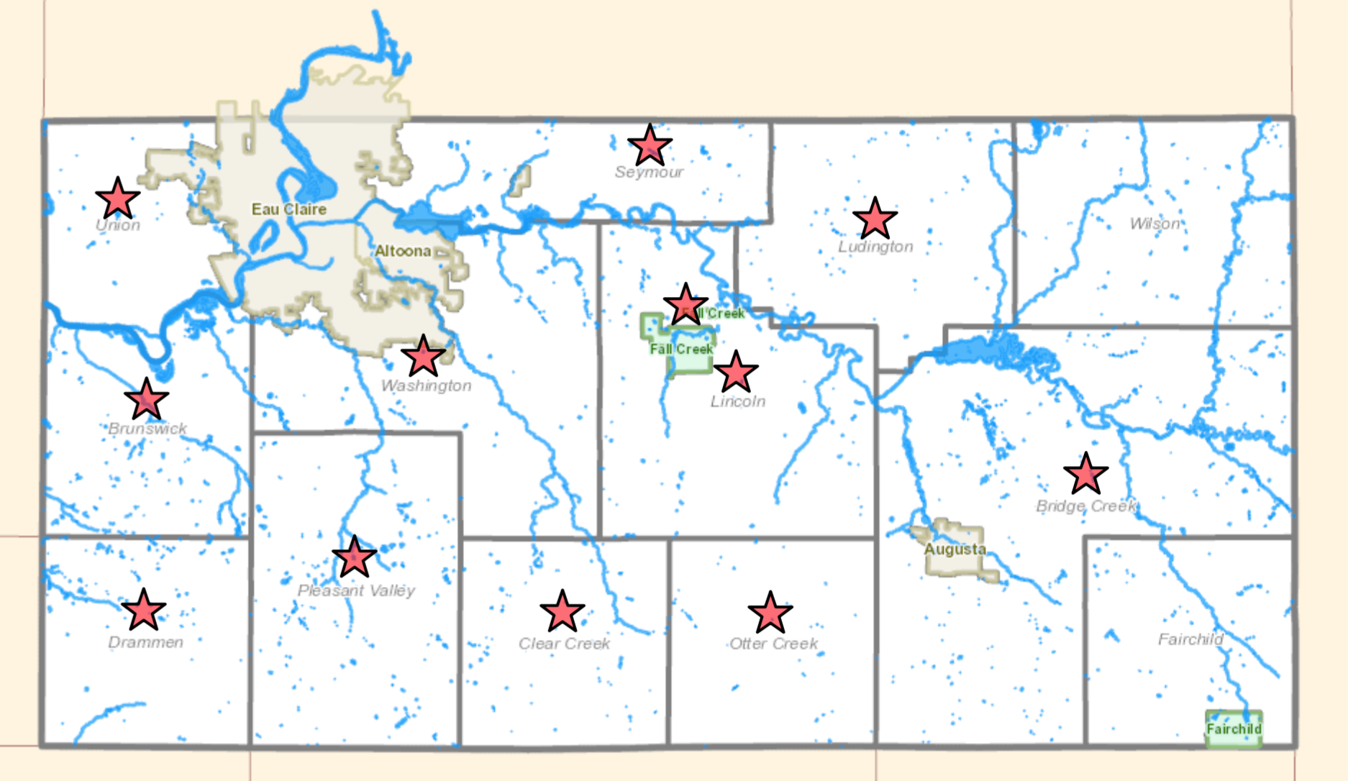
Source Investigation of Nitrate Contamination in Private Wells in Eau Claire County, WI
Dexter Zebro¹, Megan Ballweg¹, Danielle Bredehoeft¹, Jake Kentnich¹, Tori Vouk¹, Laura Suppes¹, Ted Johnson², Shane Sanderson², Audrey Boerner², Sarah Vitale³
¹Watershed Institute for Collaborative Environmental Studies – Environmental Public Health, ²Eau Claire City-County Health Department, ³University of Wisconsin Eau Claire – Geology
Introduction
Methods Cont.
Preliminary Results Cont.
Nitrate is a naturally occurring compound found in groundwater, but also has anthropogenic sources
Nitrogen-containing fertilizers, manure and septic tank effluent are potential sources of nitrate in private groundwater wells
Private wells are not regulated
WI bedrock aquifers are a mix of sand and gravel, allowing surficial contaminants (nitrate) to move through subsurface⁽¹⁾
Nitrate levels in drinking water are hazardous when exceeding 10 mg/L ⁽²⁾
Infants and pregnant women are most at risk as high nitrate causes Blue Baby Syndrome and shortness of breath ⁽³⁾
This research focuses on patterns in data to determine sources of high nitrate in private wells in Eau Claire County, WI
Indicator chemicals associated with agriculture and septic systems utilized to determine the potential source associated with high nitrate
Water Sampling Process
108 sites sampled and 97 samples analyzed as of April 20, 2018 (Table 2)
All sites have an on-site septic system
24% (23/97) of samples nitrate level results were above the EPA’s MCL of 10.0 mg/L
93% (90/97) are above the DNR’s preventive action limit (PAL) of 2.0 mg/L
18% (17/97) of samples indicate < 1 μg/L of agricultural contaminants
6% (6/97) of samples indicate < 1 μg/L of human waste water indicators
3% (3/97) of samples contain indicators of both agricultural and waste water contamination
Most common indicators found: (Fig. 7)
  Desethyl Atrazine: (14/97)
  Atrazine: (12/97)
  Caffeine: (4/97)
Share research and indicator chemical purpose with home owners by issuing IRB approved consent form
Samples collected in 1 L amber bottles from sample site before water treatment systems – typically outside or pressure tank taps
Let water run for 2 minutes to flush pipes of potential debris and standing water
Collect water sample
Return samples to ECCCHD in cooler with cold packs
Figure 3: Inspecting a homeowner's well for potential disrepair that could lead to water contamination.
Questionnaire
Administered at home sample visits (Fig. 5)
Used to gather information on well makeup, septic system, fertilizer usage, soil type, surface water sources, landfills, crops – proximity, application of fertilizers / pesticides, crop type and to map well proximity to other geographical features and potential source(s) of contamination (Fig. 4)
Figure 1: Map of nitrate in drinking water in WI from Private Drinking Water Quality in Rural Wisconsin, Journal of Health, 2013.
Objectives
Figure 4: Map on questionnaire used to determine possible sources of contamination with source codes and distances
Collect private well water samples that previously tested high for nitrate (5 mg/L or higher), focusing on indicator chemicals of agricultural and human wastewater (septic system) sources (Table 1)
Share with home owners on site the research being conducted and the purpose of the indicator chemicals
Gather and analyze data to determine trends of potential contamination sources in Eau Claire County
Evaluate the practicality of using nitrate source investigation as a tool for preventing contamination and sharing information with the public
Create necessary materials and methods to make this study reproducible by other health departments to continue research on high nitrate in private wells and possible future policy implementation
Sample Analysis
Samples analyzed at ECCCHD Public Health Lab
Nitrate
Samples treated with interference suppressor
Calibrate Ion Selective Electrode (ISE) with three known standards
Concentration vs response plotted for calibration curve
Sample response inserted into calibration curve gives sample concentration
Herbicides, Caffeine & Pharmaceutical Products
Analytes extracted from samples, blanks and control spikes with two solid phase extraction disks (SPE's)
1L sample drawn through SPE's, removed from disks with 4 mL ethyl acetate then 8 mL methylene chloride
Extract concentrated to 5 mL final volume on hot plate
Gas chromatograph with nitrogen-phosphorous detector calibrated with 3 known samples containing analytes of interest
Concentration versus area counts are plotted to create calibration curve
Blanks, samples and control spikes are injected
Concentration obtained by inserting samples into calibration curve
Figure 7: Frequency of indicator chemicals at sample sites
Results/Next Steps
Results:
There is a moderate correlation between static water level and nitrate concentration (R=0.33, P-value=0.04)
Agriculture is a source of nitrate contamination in private wells in Eau Claire County (P-value=0.0025)
  Average nitrate concentration in wells with agricultural indicators present is 10.7 mg/L
  Average nitrate concentration in wells without agricultural indicators present is 6.7 mg/L
There is no correlation between:
  Distance from well to septic system and nitrate concentration (P-value=0.12)
  Well depth and nitrate concentration (P-value=0.11)
Next steps:
Evaluate practicality of using nitrate source investigation as a tool for preventing contamination and sharing information with the public
Create materials and methods to make this study reproducible by other health departments to continue research on high nitrate in private wells
indicator chemicals
Figure 5: Filling out a questionnaire with a homeowner during a sampling visit.
Table 1: Indicator chemicals, chemical purpose and limit of detection in this research
Agricultural Indicators
Chemical Name | Chemical Purpose | Limit Of Detection (µg/L)
Atrazine | Herbicide | 0.1
Desethylatrazine | Metabolite of Atrazine | 0.2
Desisopropylatrazine | Metabolite of Atrazine | 0.2
Alachlor | Herbicide | 0.2
Metolachlor | Herbicide | 0.2
Cyanazine | Pesticide (Restricted Use) | 0.1
Acetochlor | Herbicide | 0.2
Septic System Indicators
Carbamazepine | Anti-convulsant | 0.3
Caffeine | Stimulant | 0.2
Carisoprodol | Muscle relaxant | 0.3
Statistical Analysis
Figure 6: Nitrate testing at ECCCHD via ion selective electrode (ISE)
Methods
STATA software used for statistical testing
Pearson’s correlation coefficient
0.1<R<0.3 = small correlation
0.3<R<0.5 = moderate correlation
R>0.5 = strong correlation
Site selection and recruitment
T-Test
P-value ≤0.05 = statistically significant
95% confidence interval
Figure 8: Map of herbicide, pharmaceutical and nitrate detects in Eau Claire County, WI watersheds
Collaborative research between UW – Eau Claire and Eau Claire City-County Health Department (ECCCHD)
Institutional Review Board (IRB) approval sought and attained August, 2016
Homes in Eau Claire County selected by previous nitrate tests over 5 mg/L (approximately 1,140 total sites) – Environmental Protection Agency drinking water standard is 10 mg/L
Sites with nitrate over 5 mg/L divided by township and recruited via preliminary phone call and letter sent to well owner (Fig. 2)
Interested homeowners contacted ECCCHD to schedule samples
Preliminary Results
References
Table 2: Participant response rates of townships sampled to date
Wisconsin Department of Natural Resources Bureau of Drinking Water and Ground Water. Nitrate and Drinking Water. Retrieved April 24, 2017 from http://dnr.wi.gov/files/PDF/pubs/DG/DG0001.pdf
United States Environmental Protection Agency (2017). National Primary Drinking Water Regulations. Retrieved from https://www.epa.gov/ground-water-and-drinking-water/national-primary-drinking-water-regulations
United States Environmental Health Protection Agency. (2017, March 10). The Effects: Human Health. Retrieved April 22, 2017, from https://www.epa.gov/nutrientpollution/effects-human-health
Township | Response Rate | Township | Response Rate
Bridge Creek | 12% | Otter Creek | 0%
Brunswick | 43% | Pleasant Valley | 39%
Clear Creek | 14% | Seymour | 21%
Drammen | 60% | Union | 19%
Fall Creek | 0% | Washington | 39%
Lincoln | 17%
Ludington | 17% | Total | 27%
Figure 2: Eau Claire County, WI and selected sampling townships
Acknowledgements
This research was funded by the Wisconsin Department of Natural Resources
A special thank you to all past UWEC Research Assistants and our study participants in Eau Claire County

