Slide 1
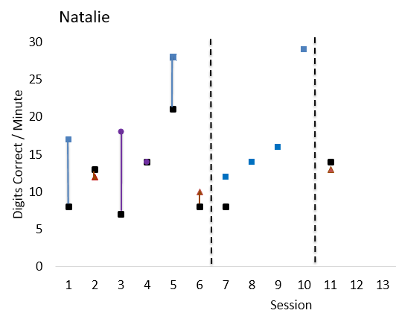
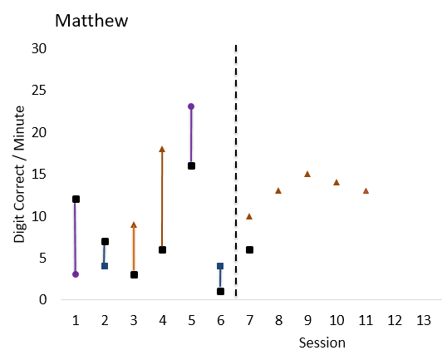
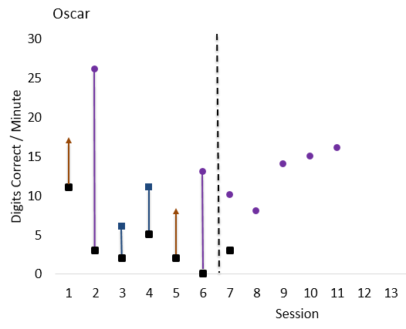
BEAs with Early Math Skills
Individualizing addition fact fluency interventions
Josephine Fudally, Zoe Gaspar, Addie Taylor, and Rachel Galloway | Psychology Department
Mary Beth Tusing, Faculty Mentor
Introduction
= BASELINE
Results / Discussion
Brief experimental analysis (BEA) is a method of assessment that allows for an individualization of intervention components to best fit the needs of specific learners. In BEA, a student’s response to different interventions is briefly tested to identify an intervention that shows evidence of having the greatest likelihood of success (Reisener, Dufrene, Clark, Olmi & Tingstrom, 2016). BEAs have been successful in quickly identifying effective interventions for increasing fluency in oral reading (Daly, Martens, Dool, & Hintze, 1998; Dufrene & Warzak, 2007; Jones & Wickstrom, 2002). Less research on the use of BEAs in math exists, however. This project extends research on the use of BEAs of math fact fluency interventions to select effective, individualized interventions for individual students.
Our study extends the BEA literature to examine the effectiveness of BEA procedures in individualizing single digit math fact fluency interventions for first grade students.
It is unclear whether BEA can effectively determine math fact fluency interventions for first grade students.
After a single trial BEA, the most effective intervention was not clearly identified for each participant
A second BEA trial was completed to verify the results.
Researchers imparted judgment when determining the most effective intervention for each participant
Data is still being collected for the extended analysis
Implications
BEA holds promise for individualizing math fact fluency interventions; however, more research is needed.
Multiple BEA trials may be needed to isolate effective interventions
Longer extended analysis periods may be needed to verify BEA results
Further exploration on how to establish effective dependent measures for BEA analysis
Decision rules for selecting effective interventions through BEA need further exploration
Participants & Setting
3 first-grade students from a local elementary school
1 female, 2 males
Participants were selected by school staff after demonstrating low performance on math assessments
Participants also participated in early numeracy tutoring
Interventions were completed in the school cafeteria
Materials
Limitations
Addition fact flashcards for 3’s to 9’s were completed to determine known, unknown and fluent facts
Individualized math worksheets were created for each participant for use during BEA and Extended Analyses
Worksheets had 6 rows of 4 randomly ordered facts (known, unknown)
Students had one minute to answer as many problems as possible; scores were digits correct per minute (DCPM)
Findings on the effectiveness of BEAs for math fact fluency may not generalize to students who are at a different state of learning basic addition facts
Participant stamina and motivation may have confounded BEA results; future research may explore different experimental designs for the extended analysis
Baseline performance suggests that the dependent measures may not have been equal in difficulty, which may impact interpretations of the extended analysis results
Procedures
Brief Experimental Analysis: A single-case, multi-element design examined changes in DCPM from pre- to post-intervention
Three interventions were tested:
Math Racetrack: targeted fact fluency and accuracy
Cover Copy Compare: models and targets fact accuracy
Flashcards: targeted fact fluency and accuracy
Each intervention was completed twice over two days
Extended Analysis: A single-case, repeated acquisition design evaluated time to mastery (mastery = 25 DCPM)
The BEA-determined most and least effective interventions were evaluated during an extended analysis
Selected References
Daly, E. J., Bonfiglio, C. M., Mattson, T., Persampieri, M., & Foreman-Ya, K. (2006). Refining the experimental analysis of academic skills deficits: Part II. Use of brief experimental analysis to evaluate reading fluency treatments. Journal of Applied Behavior Analysis, 39, 323-331.
Dufrene, B. A., & Warzak, W. J. (2007). Brief experimental analysis of Spanish reading fluency: An exploratory evaluation. Journal of Behavior Education, 8, 203-218.
Jones, K. M., & Wickstrom, K. F. (2002). Done in sixty seconds: Further analysis of the brief assessment model for academic problems. School Psychology Review, 31, 554-568.
Reisener, C. D., Dufrene, B. A., Clark, C. R., Olmi, D. J., & Tingstrom, D. H. (2016). Selecting effective interventions to increase math computation fluency via brief experimental analyses. Psychology in the Schools, 53(1), 39-57.

