Slide 1

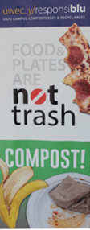
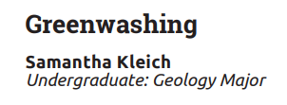
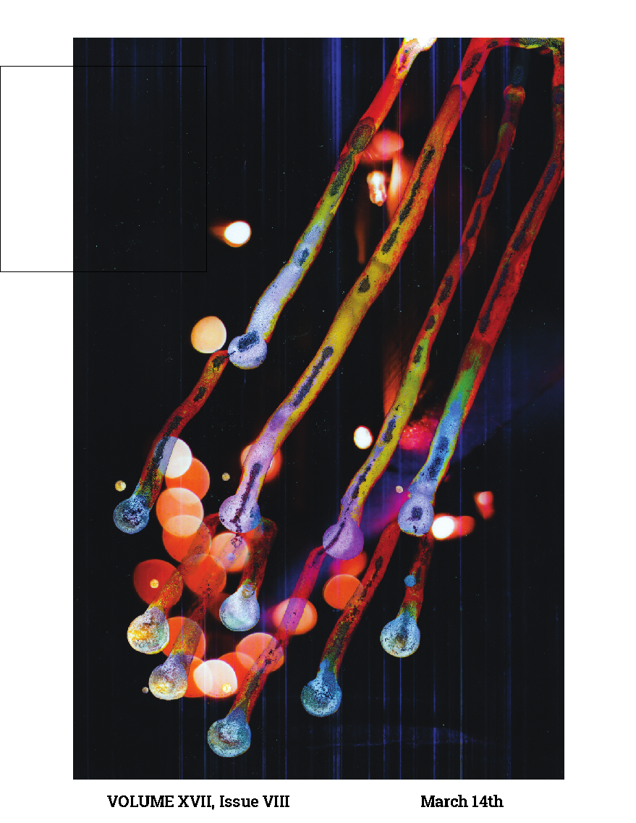
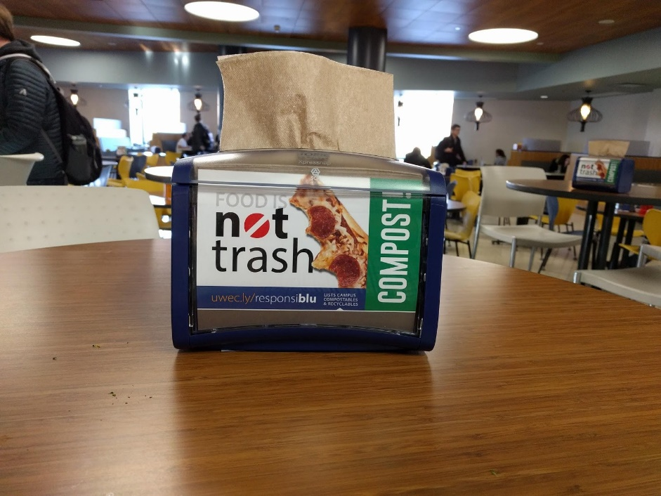
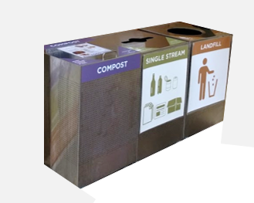
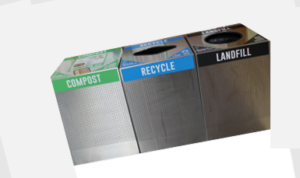
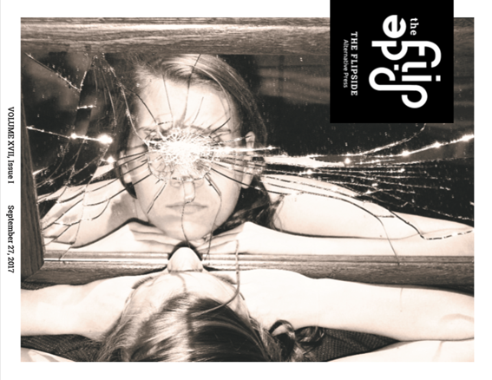
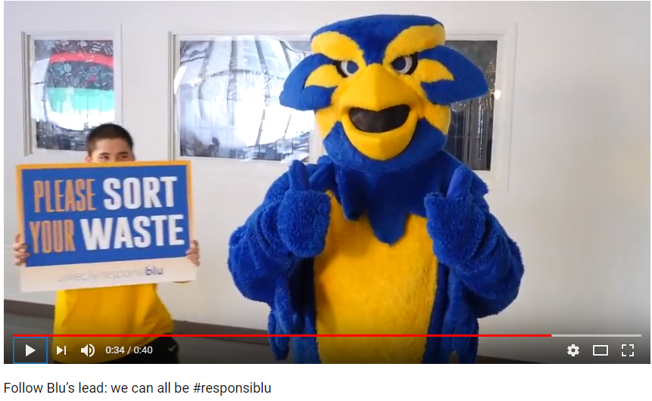
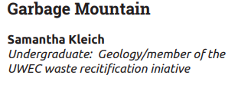
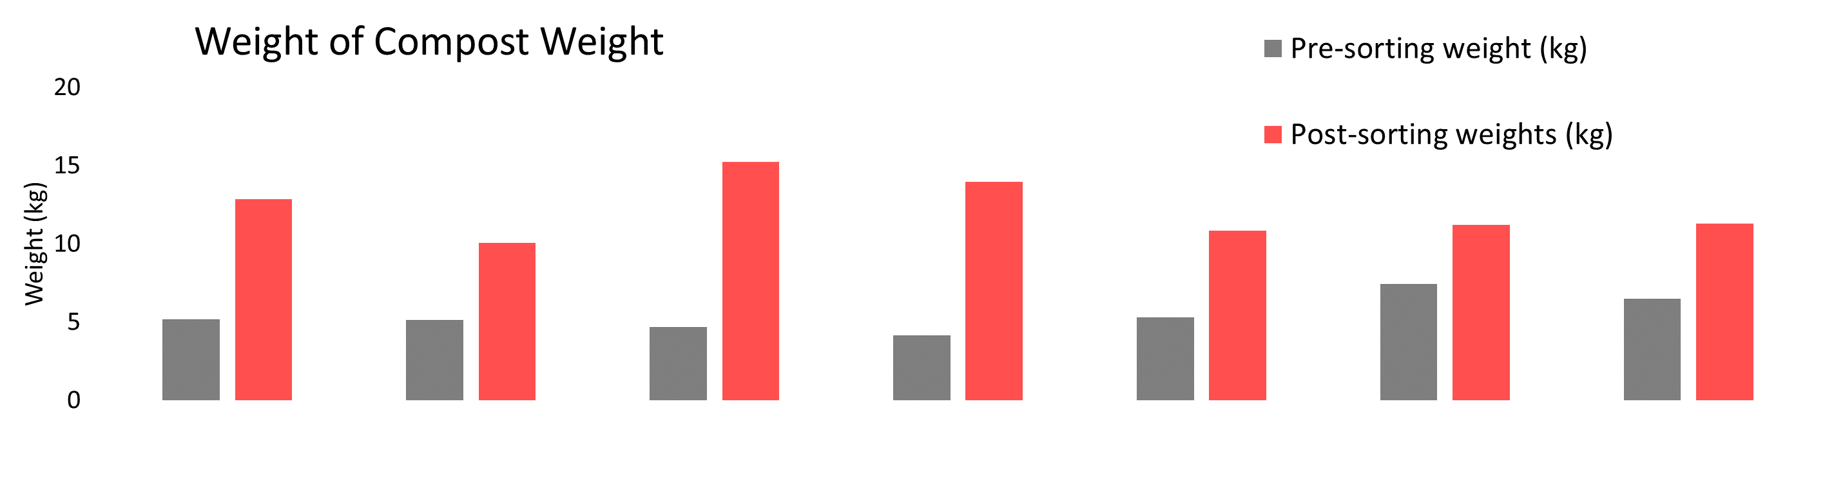
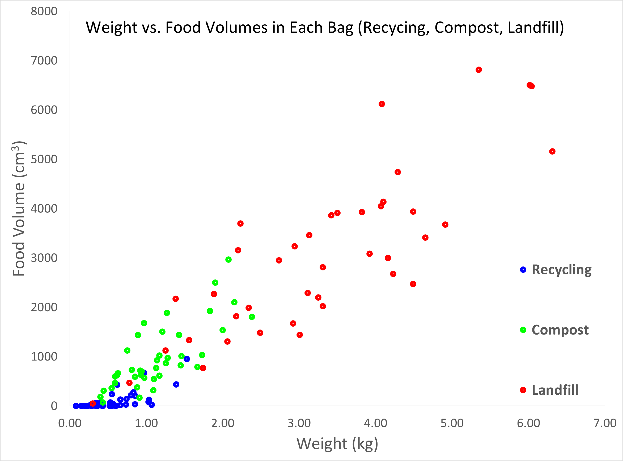
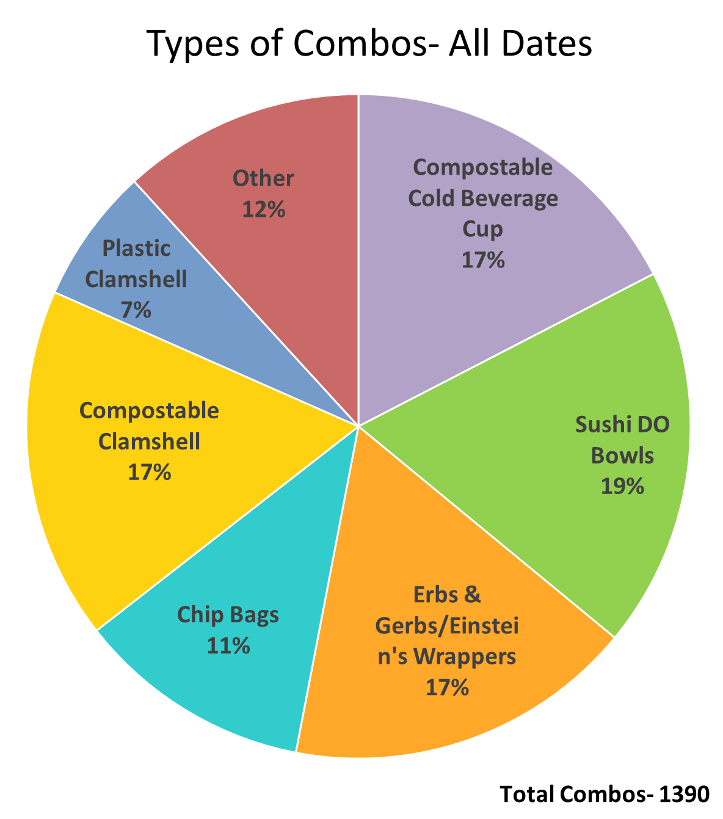
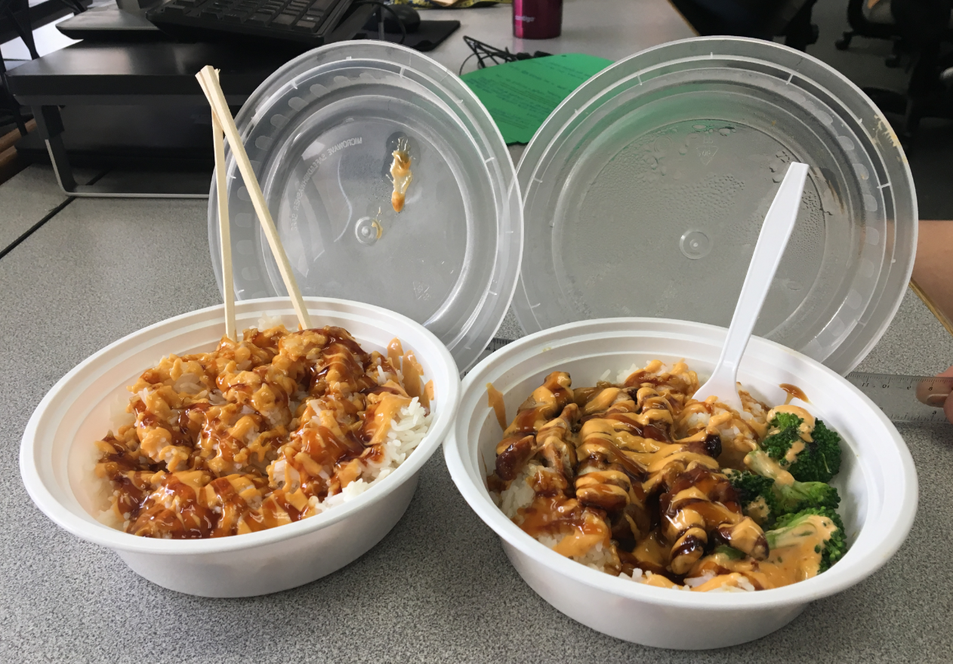
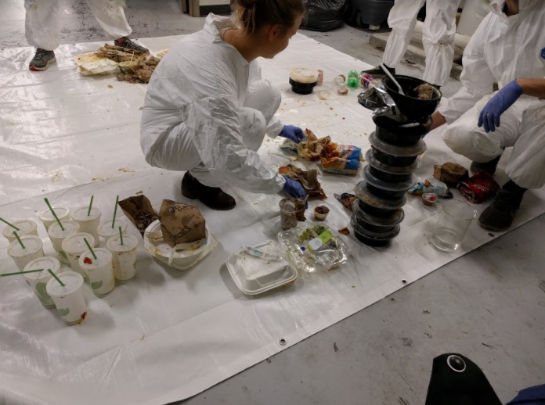
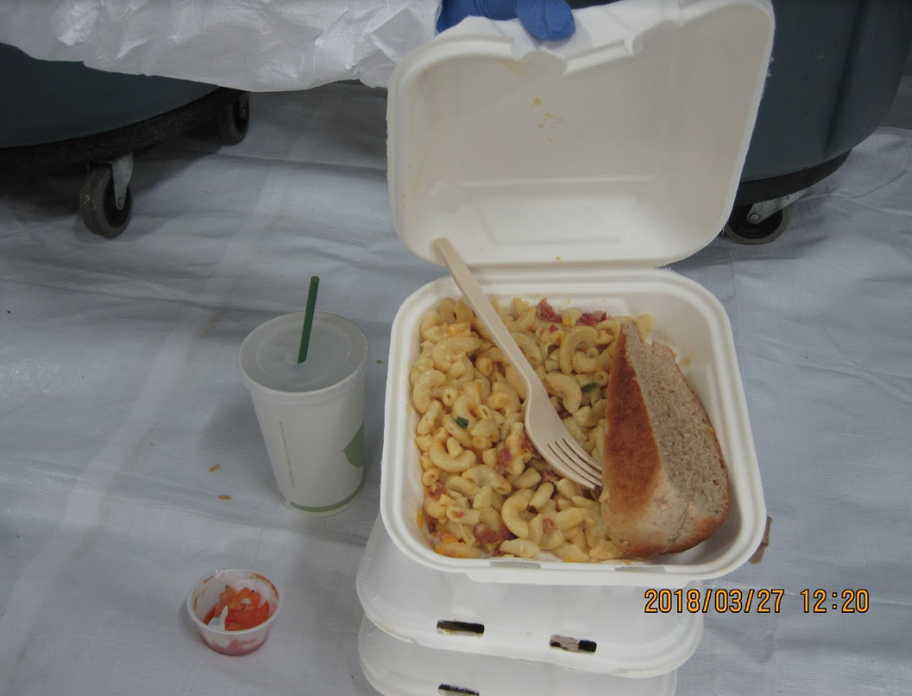
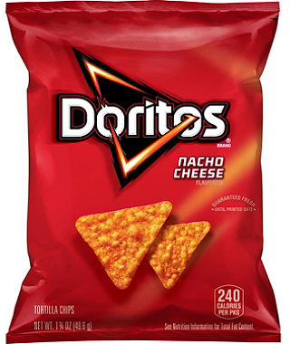
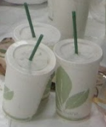
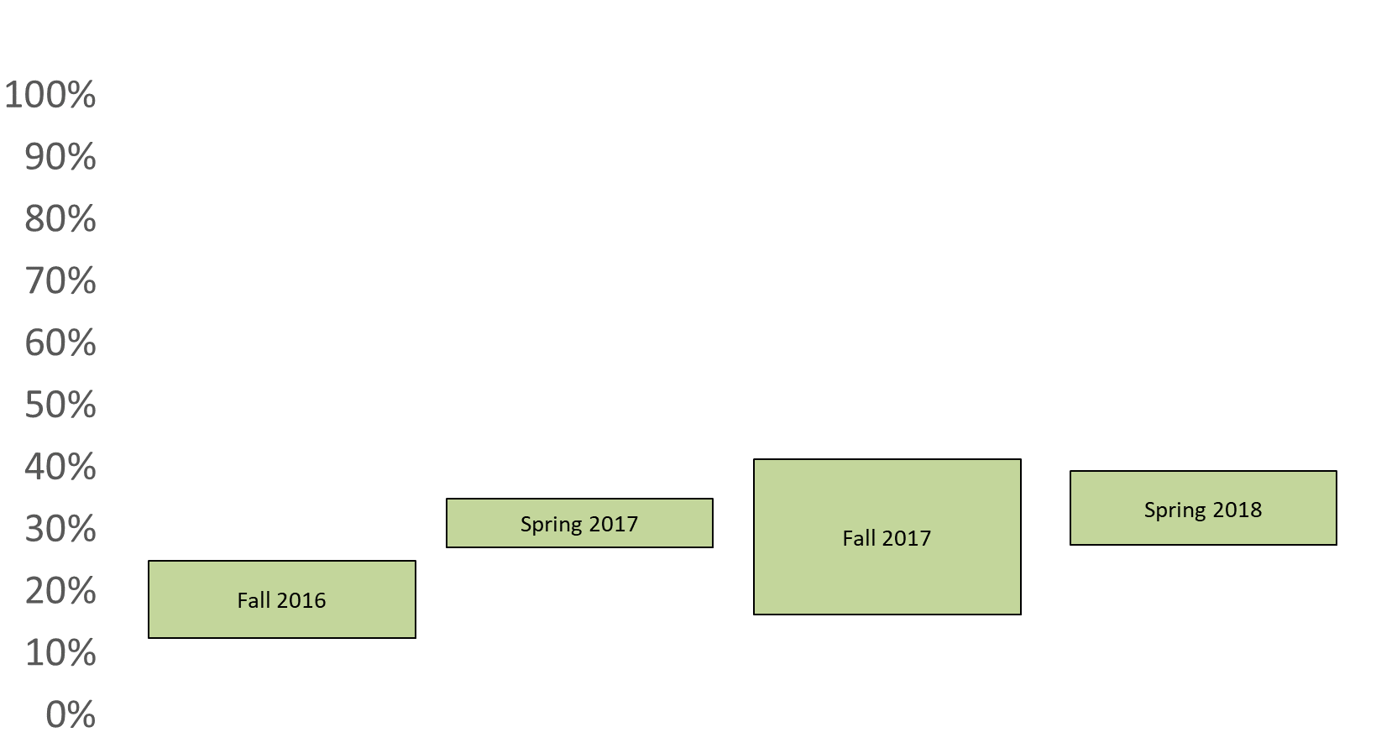
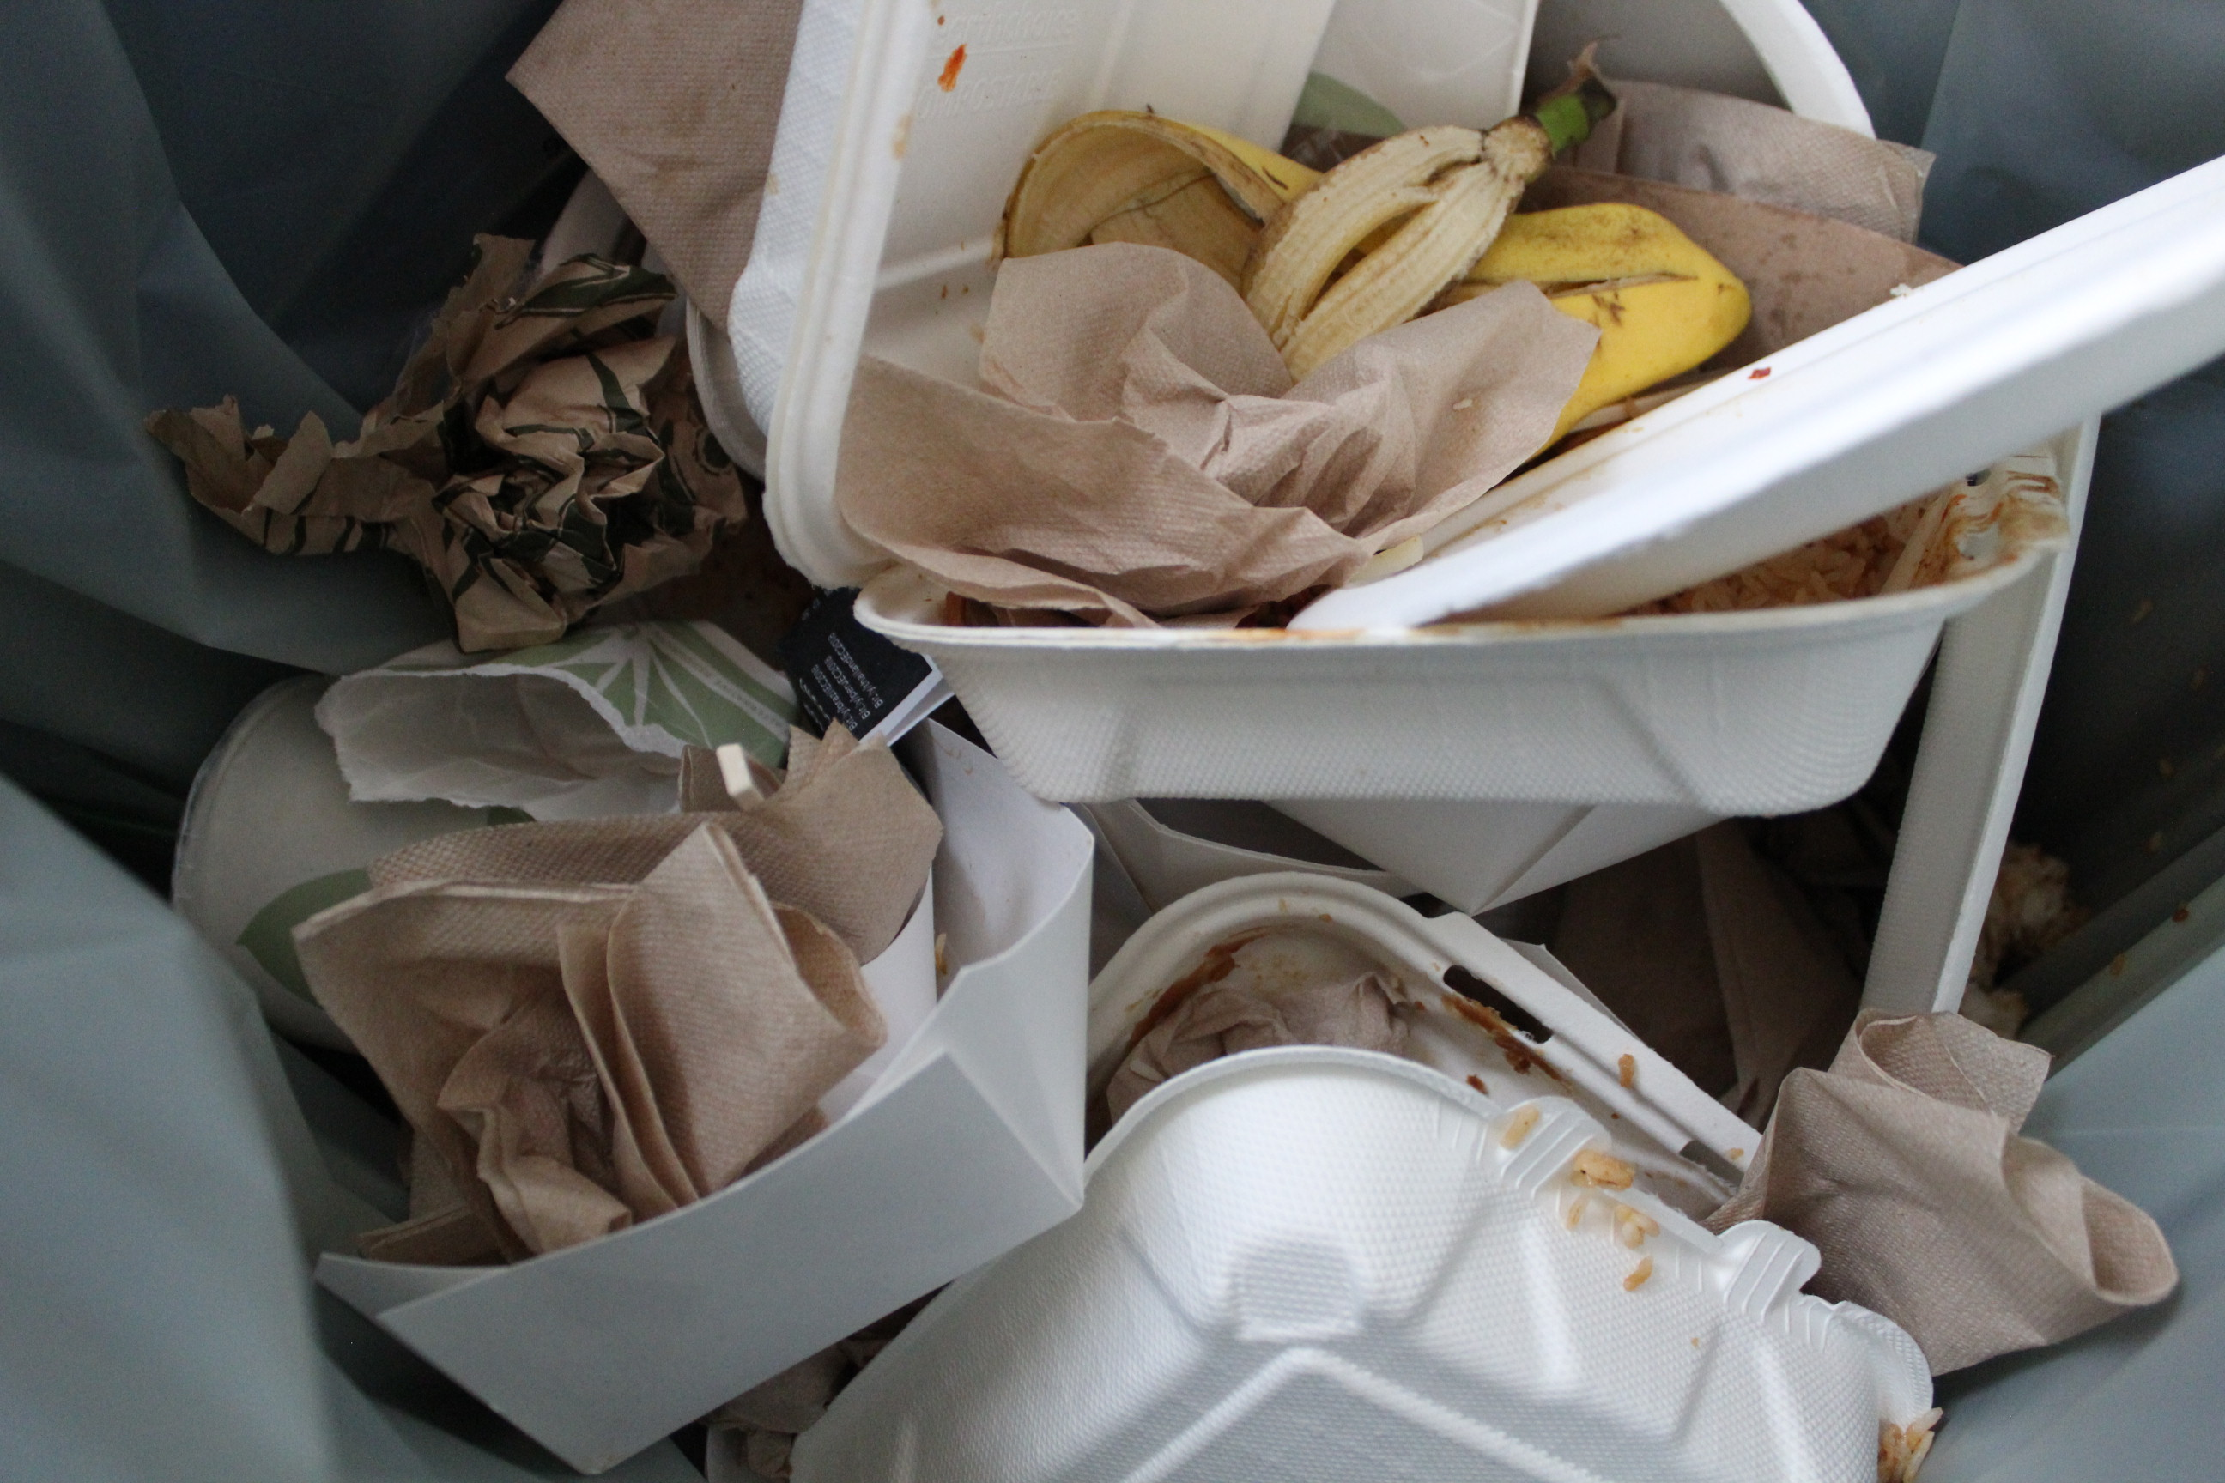
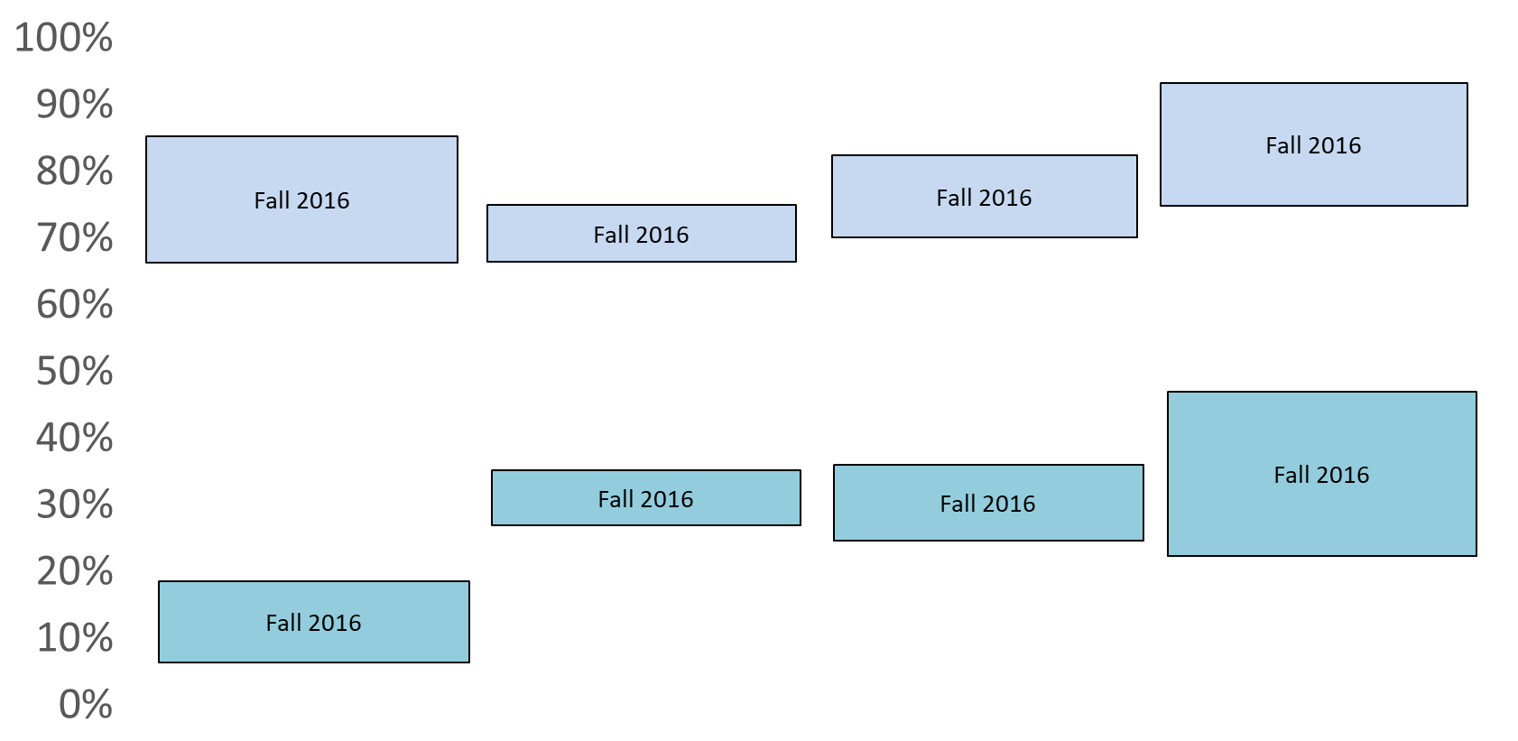
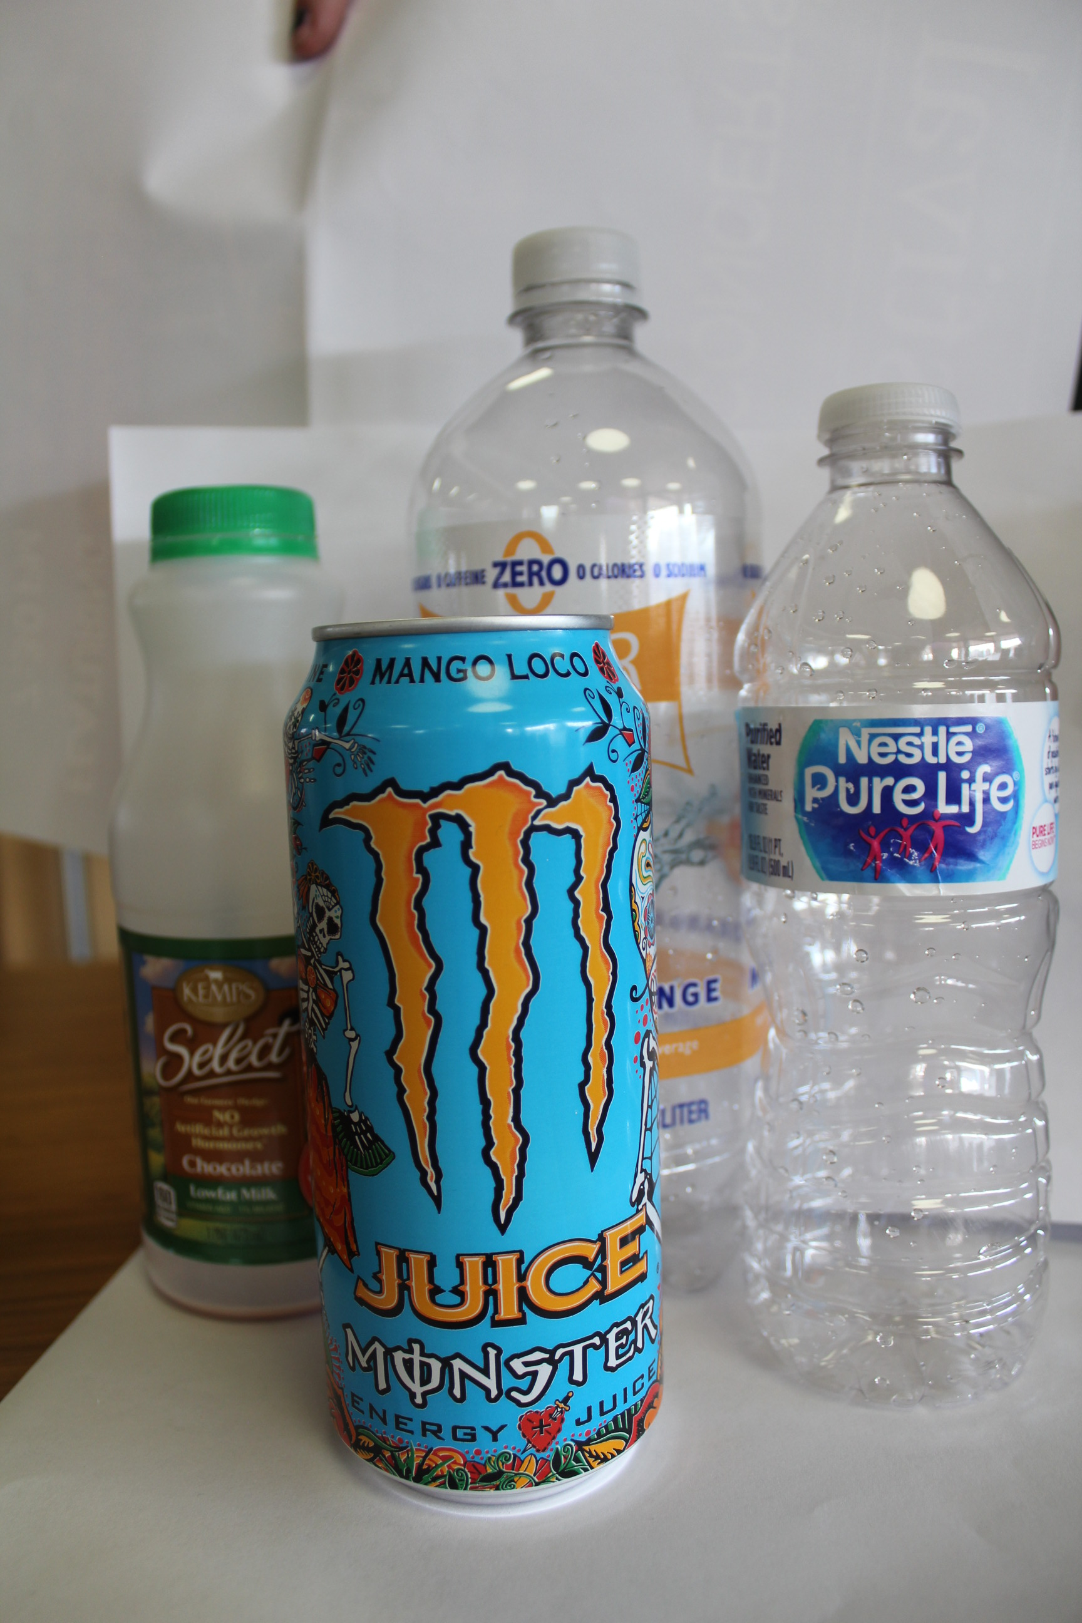
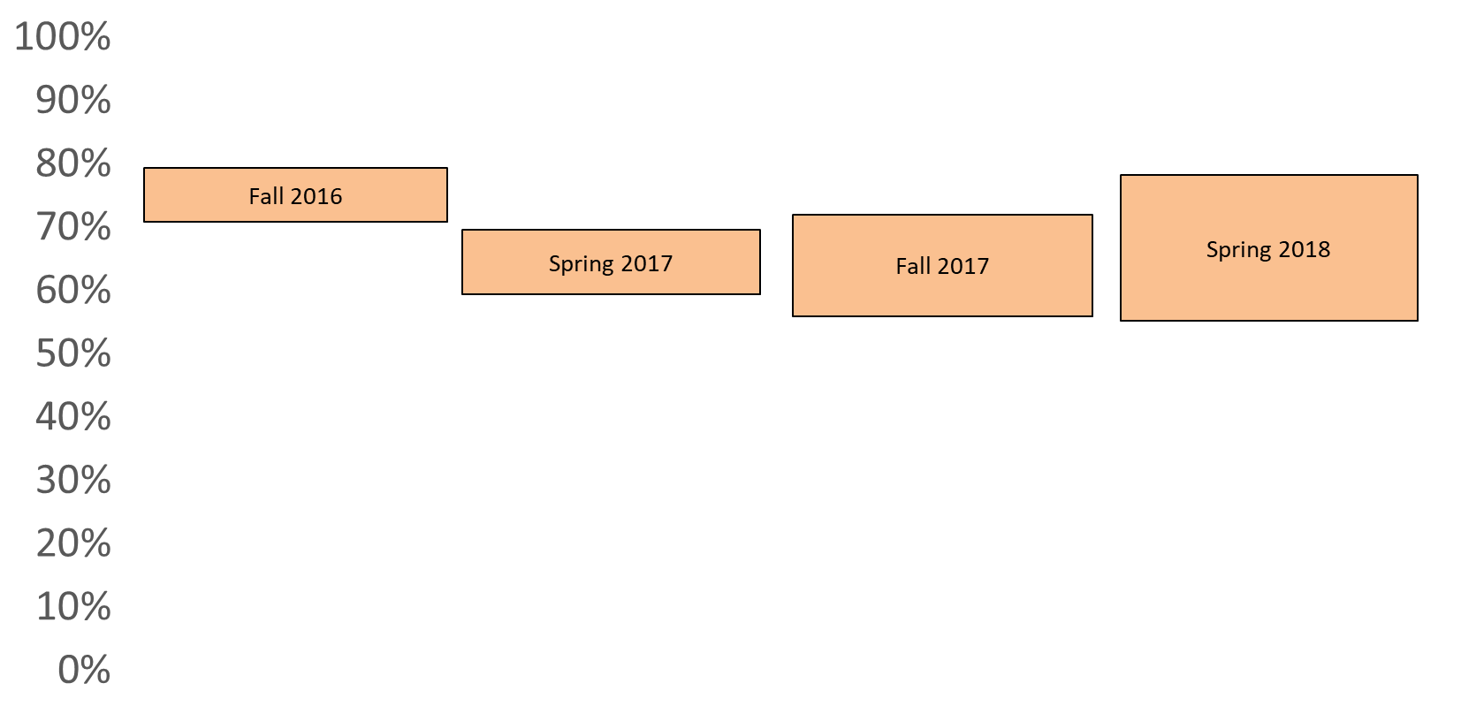
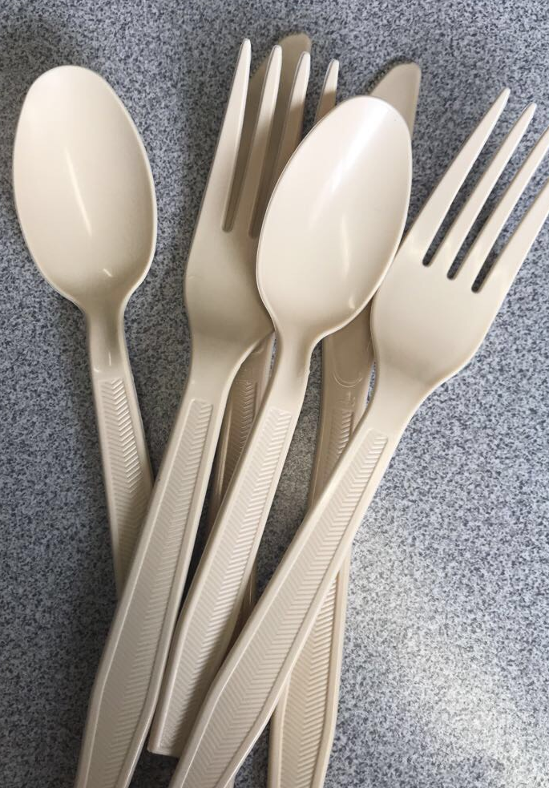
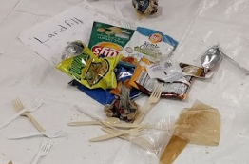
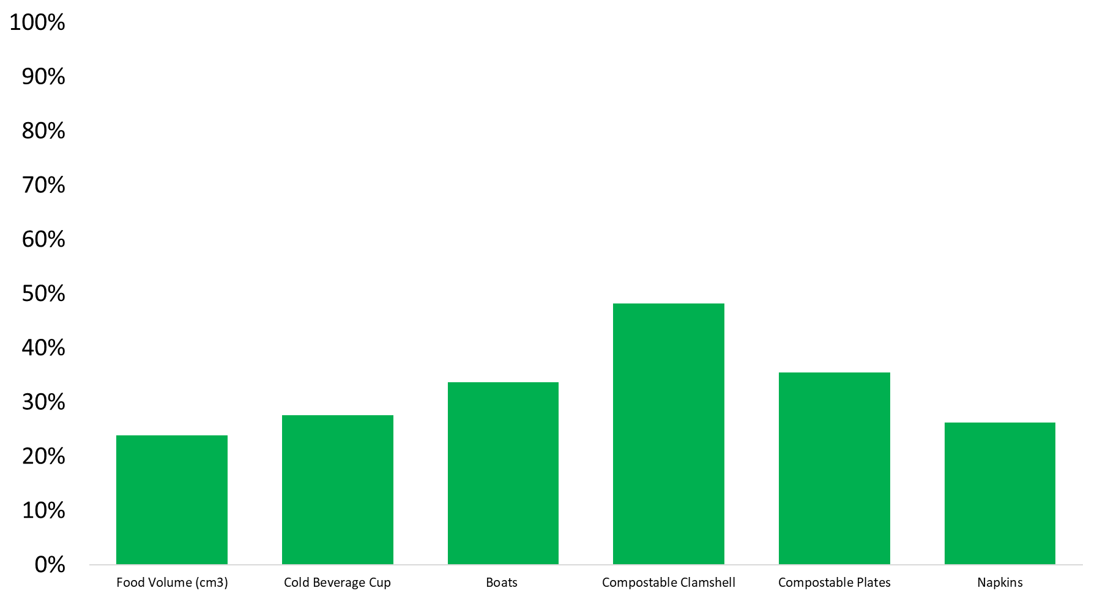
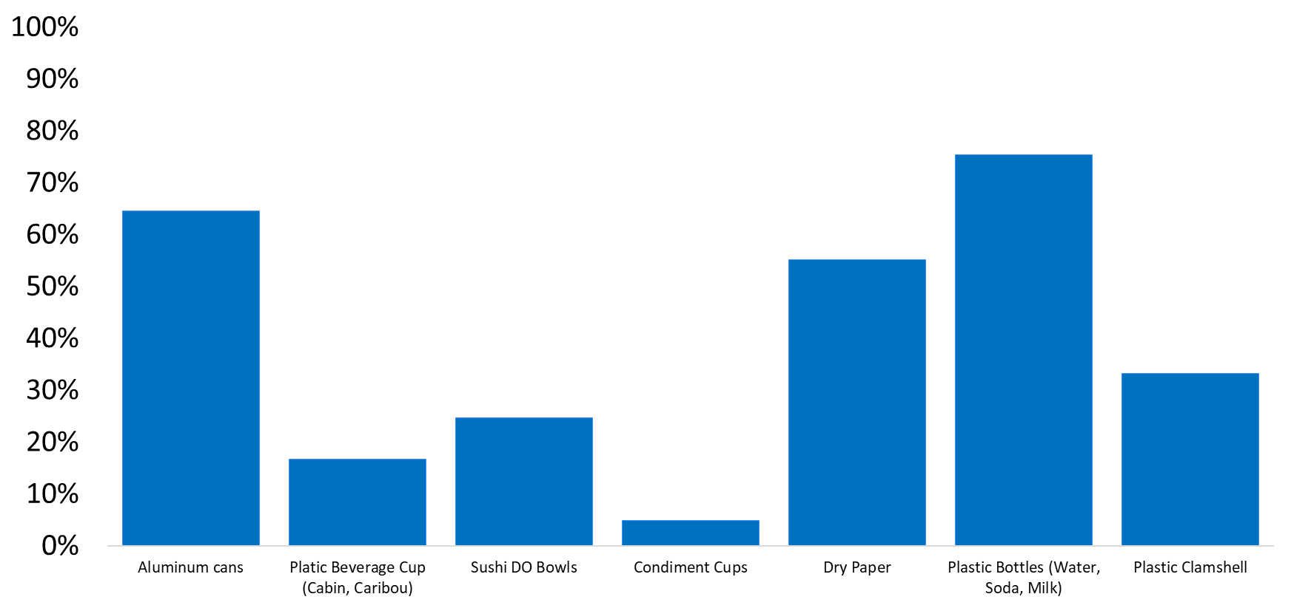
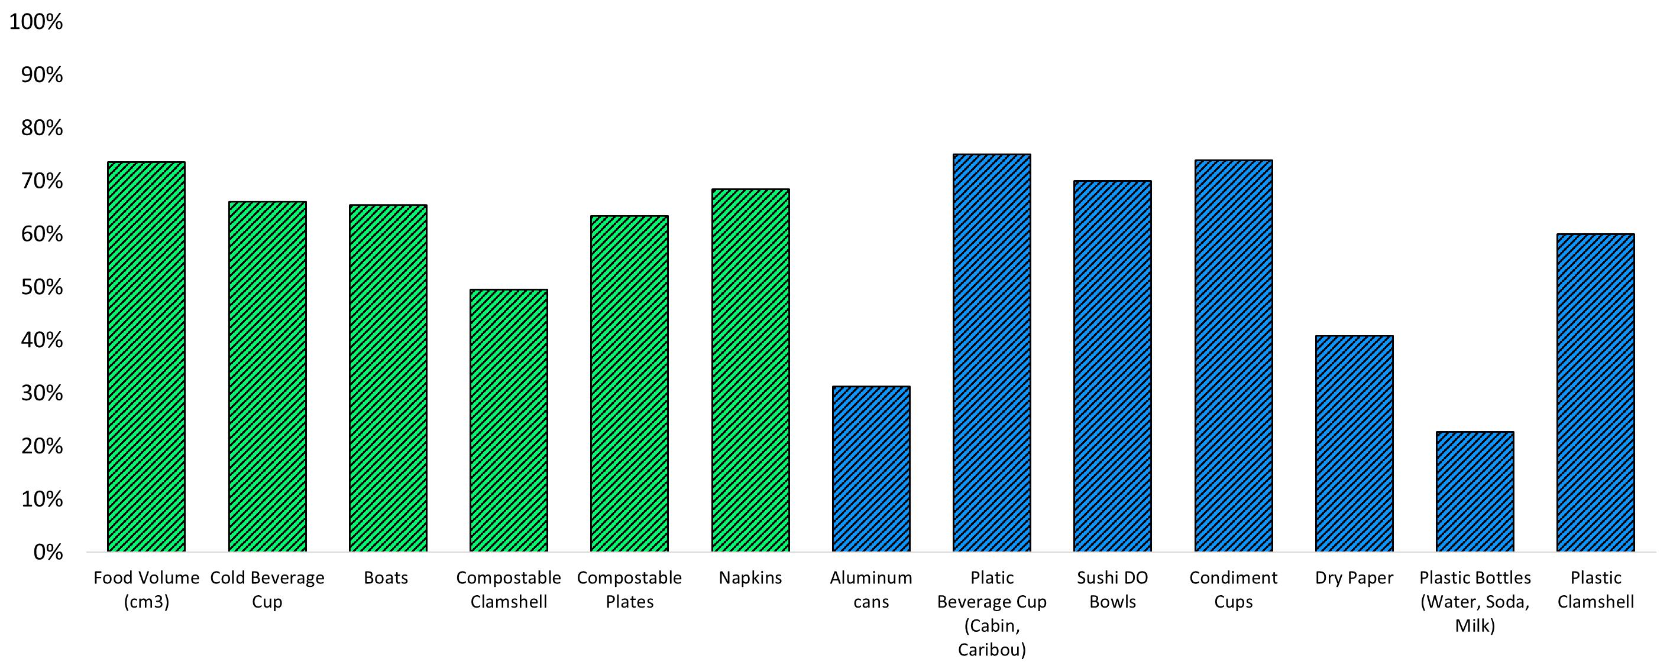
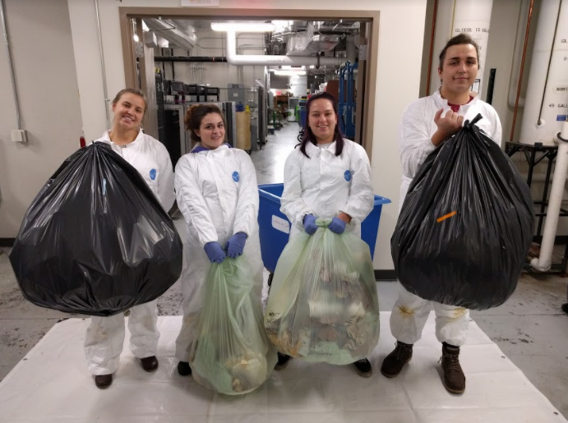
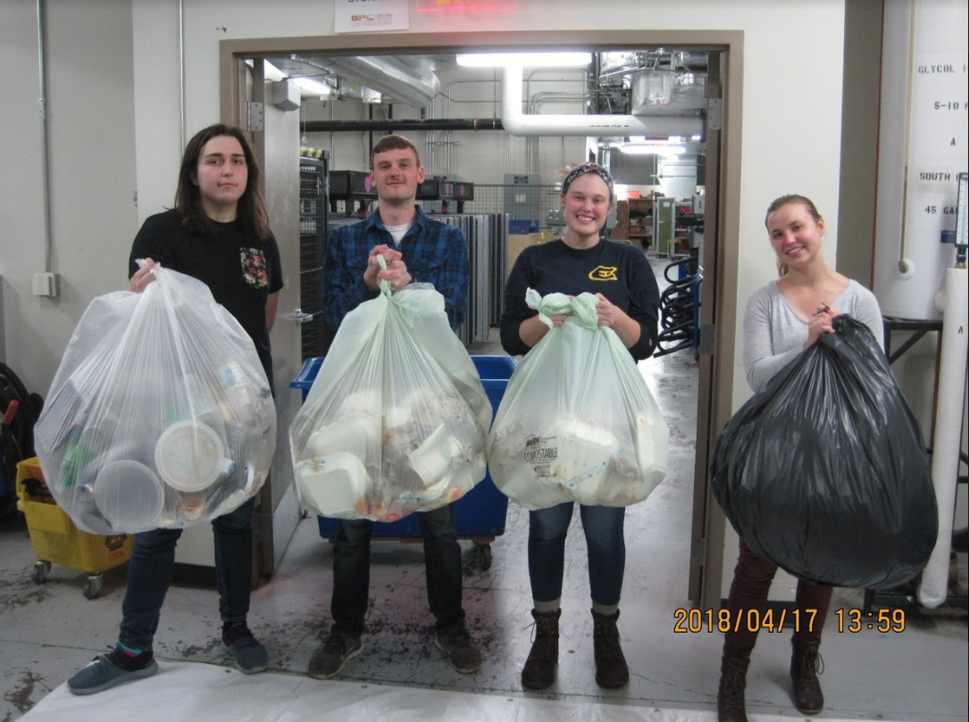
Waste Disposal Behaviors of University Students: Measuring the Impact of Intervention Efforts
Student Researchers: Betty J. Walter, Ashley E. Thompson, Samantha J. Kleich, Richard J. Mataitis, Nathaniel McFarland, Katrina G. Kawak, Alexandra E. Cook - Mentor: Scott K. Clark
University of Wisconsin-Eau Claire: Departments of Geology & Biology
Introduction:
Keeping recyclables and compostables out of the landfill is a major step toward nurturing a sustainably-minded community. This research focused on collecting data for student and faculty waste-disposal habits. Using our data we collaborated with other sustainability-minded stakeholders to take steps towards increasing environmental awareness.
Intervention Efforts:
Banners
Bin labels changed to standard colors
New Marketing Kickstart
Signage in Napkin Holders
Flipside Articles
Informational Video featuring Blu, the UWEC mascot &
Website (uwec.ly/responsiblu.edu)
Methodology for Waste Data Collection:
For the past two years, we have collected waste data for the waste disposed of in the Davies Center: compost, recycling, & landfill. We collected data on seven Tuesdays over four semesters during the lunch period (11:30 – 1:30). Individual bin waste was separated into four categories: compost, recycling, landfill, and mixed-waste combos. Every single item in each waste stream is accounted for including food and liquids.
Fall 2017
uwec.ly/responsiblu.edu
Spring 2018
Spring 2016
Fall 2017
Fall 2016
Fall 2017
Food Waste
Pre-sorting weight (kg)
Post-sorting weight (kg)
Percentages are of total waste
A mixed-waste combo contains two or more waste streams combined into one item
Combos are created because of convenience
15% end up in the recycling
10% end up in the compost
75% of combos end up in the landfill
Mixed-Waste Combos
22%
70%
28%
65%
17%
68%
17%
73%
26%
64%
41%
68%
35%
67%
5/9/17 11/2/17 11/14/17 11/26/17 3/27/18 4/10/18 4/17/18
Food waste is the easiest Item to compost and helps with the biodegradation of other compostable items
Food waste accounts for most of the weight in each bag
48% of overall food waste is found in combos that enter the landfill
Compost
Recycling
Landfill
Items that belong in the Compost bin:
Food, Napkins, Cold Beverage Cup, Chopsticks, Straw Wrappers, Wet Paper, Compostable Clam Shells and Plates, Green Mountain Beverage Cups, Boats, Compostable Bread Stick Sleeves
Items that belong in the Recycling Bin:
Aluminum Cans, Plastic Cups, Sushi DO Bowls & Lids, Plastic Condiment Cups and Lids, Glass Bottles, Dry Paper, Plastic Bottles (water, soda, milk), Yogurt and Fruit Cups, Plastic Clam Shells
Items that belong in the Landfill Bin:
Straws (blue and clear), Utensils, Chip Bags,
Coffee Cups (Caribou from the Cabin & Einstein's), Condiment Packets, Erbert & Gerbert’s / Einstein Bros. Wrappers, Milk Cartons, Soup Container Lids, Misc. Wrappers (candy, cookie, fruit rolls)
% of Plastic Bottles going into to the Recycling
% of Utensils going into to the Landfill
% of Food Waste going into to the Compost
% of Sushi DO Bowls going into to the Recycling
% of Items Correctly Placed in the Compost
% of Items Correctly Placed in the Recycling
% of Items Incorrectly Placed in the Landfill
Potential Future Initiatives
Early Interventions
Ambassadors
1st Year Experiences
Orientation
Conclusions:
Our findings suggest that multiple efforts at intervening in students’ waste disposal habits over the past two years have struggled to succeed. Changing behaviors is challenging. To normalize sustainable behaviors, we recommend prioritizing interventions that connect with incoming freshman (e.g., ambassadors and orientation activities) and the use of numerous information sources (e.g., posters, social media, instructors, and Resident Assistants).
We have Blugold Fridays, how about Trashy Tuesdays?
Trays and Hard Dishware
Laminated Placemats
Clean Consistent Messaging
Reduce Greenwashing
Acknowledgments: We thank staff at the Davies Center and at Integrated Marketing and Communications for their support. Financial support for this research was provided by Student Blugold Commitment Differential Tuition funds through the Faculty/Student Research Collaboration Grants program at the University of Wisconsin–Eau Claire.

