Slide 1


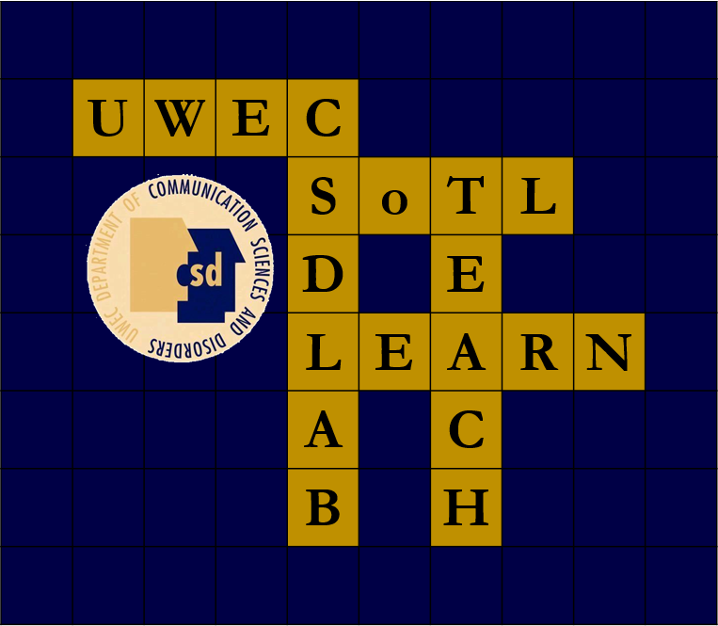



The Impact of Instructional Interns from a
Faculty Perspective: A Qualitative Study
Sophie Grelson, Erin Zigler, & Natalie Taufen
Faculty Mentors: Abby Hemmerich, Ph.D., CCC-SLP, & Jerry Hoepner, Ph.D., CCC-SLP
University of Wisconsin-Eau Claire | Communication Sciences and Disorders
Introduction
Faculty Results
Purpose
The Big Picture
Bridging Gap (14)
  To discover the impact of teaching assistants on faculty, specifically within the discipline of Communication Sciences and Disorders at UW-Eau Claire.
Neutral- 11%
Student
Benefits
Background
Disadvantages- 15%
Periodic Feedback
(3)
Faculty in various disciplines commonly employ teaching assistants to assist in course delivery
The impact of those teaching assistants on faculty has not been studied often and has never been examined in Communication Sciences and Disorders (CSD).
Benefits- 74%
Long Term Goal (9)
Research Questions
How do instructional interns impact faculty teaching undergraduate courses?
How do instructional interns impact faculty perceptions of student performance and in undergraduate courses?
Unique To Faculty Benefits
Grading
(3)
Additional Resources
(7)
Method
Student Insight
(20)
Teaching Strategy
(17)
Mentoring
(15)
Presentation of Information
(8)
Assistance/ Decreased Workload
(16)
Accountability
(5)
Disposition
(9)
Qualitative focus group
Faculty focus group (n=5)
  Facilitated by student researchers & campus teaching & learning coordinator
  Semi-structured interview based on findings from survey
Dissemination of Skills
(11)
Qualitative Data Analysis
Instructor
Student
Instructional Intern
Descriptive
Codes
Benefit vs. Disadvantage
Topic
Knowledge
(7)
Pedagogy
(27)
Transcription of faculty focus group
  Identification of codeable units
  Assignment of descriptive codes
  Thematic analysis
Strengthens II
(5)
Strengthens Resume
(4)
Conclusions/
Implications
“In our field we teach students how to implement techniques for therapy, we talk about disorders, we talk about how we assess, but we don’t spend a lot of time on how we actually teach the skills to support learning.”
‘They help me think about the student perspective as I will often change my activities based on feedback they give me.”
II
Benefits
Instructional Internships positively impact students enrolled in courses where they serve
  Faculty perceive the largest impact of IIs in gaining insight of student needs and a decreased workload due to assistance from the II
Instructional interns gain crucial skills in pedagogy that they may disseminate into a clinical or teaching setting
Instructional interns bridge the gap between students in the course and faculty teaching the course
Implementation of Instructional Intern programs within other departments and universities may improve student learning and support, as well as benefitting faculty
Understanding Complexity of Grading
(4)
“In terms of workload though, sometimes that is a little bit extra because then you have to read not only the assignment, but what the instructional intern graded..”
“Another cost is the upfront cost, so we have a training session at the beginning of every semester an we usually run it twice and at least two of us are there for at least an hour training the instructional interns on what to do.”
“So there’s a learning curve for us and how to best mentor instructional interns because I do think we get more efficient at it eventually.”
Unique To Faculty Disadvantages
Limitations/ Future directions
Grading
(2)
Results reflect views of current faculty
  Testing generalization to other departments/programs is needed
Future studies should evaluate long-term outcomes of instructional internship program related to clinical and student interest in pursuing doctoral degrees
Increased
Workload
(16)
Mentorship
(8)
Student
Disadvantages
References
Stability of II
(4)
1 ASHA. (2002). Crisis in the discipline: a plan for reshaping our future. American Speech-Language-Hearing Association and Council of Academic Programs in Communication Sciences and Disorders: Report of the joint ad hoc committee on the shortage of PhD students and faculty in communication sciences and disorders.
2 Green, J.L. (2010). Teaching highs and lows: Exploring university teaching assistants’ experiences. Statistics Education Research Journal, 9 (2), 108-122.
3 Harland, T. (2001). Pre-service teacher education for university lectures: the academic apprentice. Journal of Education for Teaching, 27 (3), 269-276. doi:10.1080/02607470120091597
4 Hemerich, A.L., Hoepner, J.K., & Samelson, V.M. (2015). Instructional Internships: Improving the teaching and learning experience for students, interns, and faculty. Journal of the Scholarship of Teaching and Learning, 15(3): 104-132. doi: 10.14434/josotl.v15i3.13090
5 Adler, P.A. (1993). Personalizing mass education: The assistant teaching assistant (ATA) program. Teaching Sociology 21, 172-176. doi:10.2307/1318639
6 Anderson-Darling, C. & Earhart, E.M. (1990). A model for preparing graduate students as educators. Family Relations, 39, 341-348. doi:10.2307/584882
7 Fingerson, L., & Culley, A.B. (2001). Collaborators in teaching and learning: Undergraduate teaching assistants in the classroom. Teaching Sociology 29, 299-315. doi:10.2307/1319189
8 Froelich, A.G., Duckworth, W.M., & Stephenson, W.R. (2005). Training statistics teachers at Iowa State University. The American Statistician, 59 (1), 8-10. doi:10.1198/000313005X24138
9 Gaia, C.A., Corts, D.P., Tatum, H.E., & Allen, J. (2003). The GTA Mentoring Program: An interdisciplinary approach to developing future faculty as teacher-scholars. College Teaching, 51(2), 61-65. doi:10.1080/87567550309596413
10 Socha, T.J. (1998). Developing an undergraduate teaching assistant program in communication: Values, curriculum, and preliminary assessment. Journal of the Association for Communication Administration, 27, 77-83.
11 Chapin, H.C., Wiggins, B.L., & Martin-Morris, L.E. (2014). Undergraduate science learners show comparable outcomes whether taught by undergraduate or graduate teaching assistants. Journal of College Science Teaching, 44(2): 90-99.
12 Kassab, S., Abu-Hijleh, M.F., Al-Shboul, Q., & Hamdy, H. (2005). Student-led tutorials in problem-based learning: educational outcomes and students’ perceptions. Medical Teacher, 27(6): 521-526. DOI: 10.1080/01421590500156186
13 Glynn, L.G., MacFarlane, A., Kelly, M., Cantillon, P., & Murphy, A.W. (2006). Helping each other to learn – a process evaluation of peer-assisted learning. BMC Medical Education, 6(18). doi:10.1186/1472-6920-6-18
14 Lockspeiser, T.M., O’Sullivan, P., Teherani, A., & Muller, J. (2008). Understanding the experience of being taught by peers: the value of social and cognitive congruence. Advances in Health Science Education, 13: 361-372. DOI 10.1007/s10459-006-9049-8
IIs Not
Used Well
(4)
II
Disadvantages
Training
Time
(5)
Online Disconnect
(4)

