Slide 1


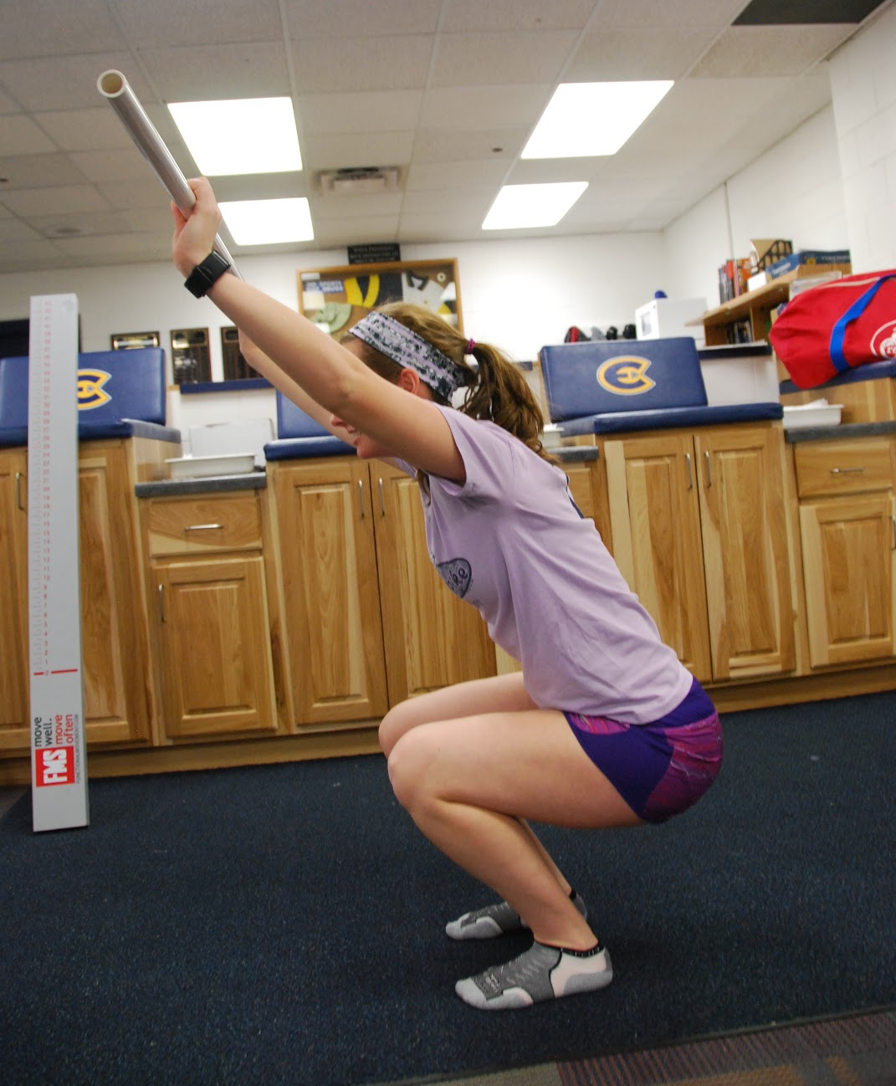
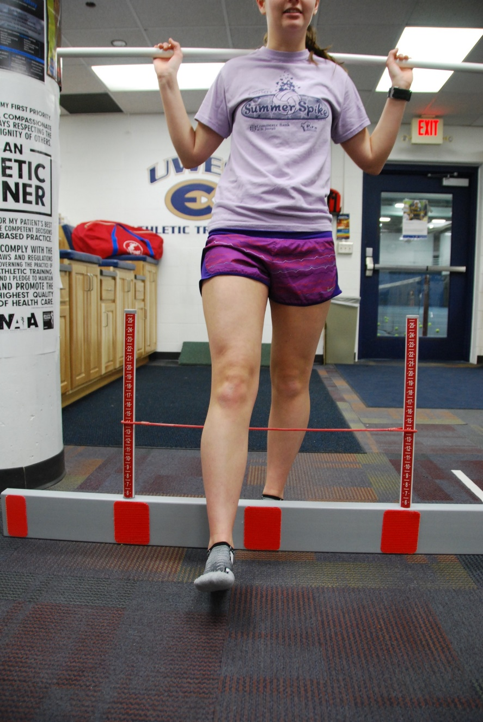
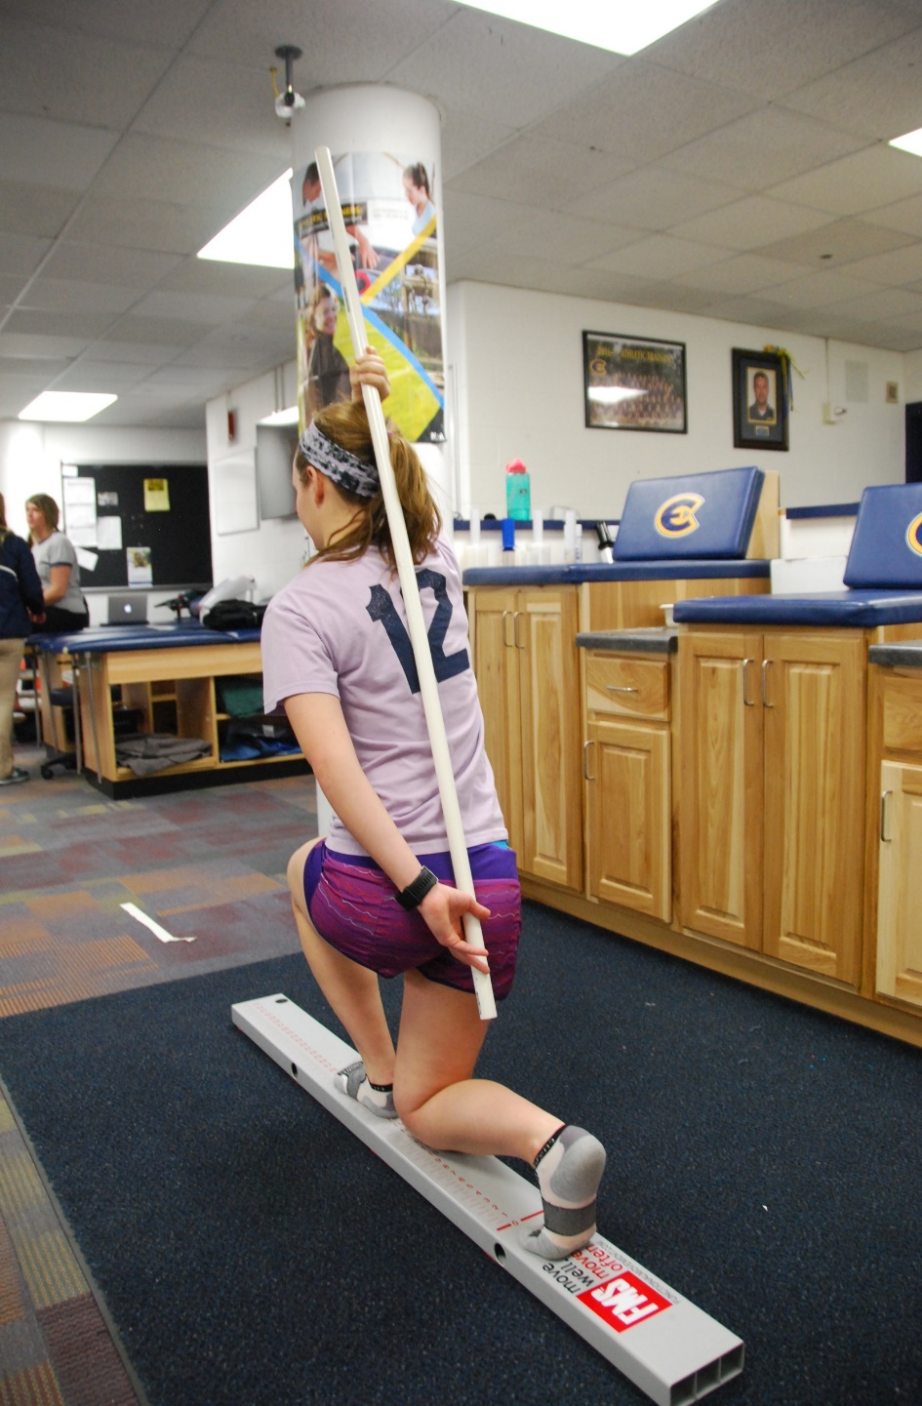
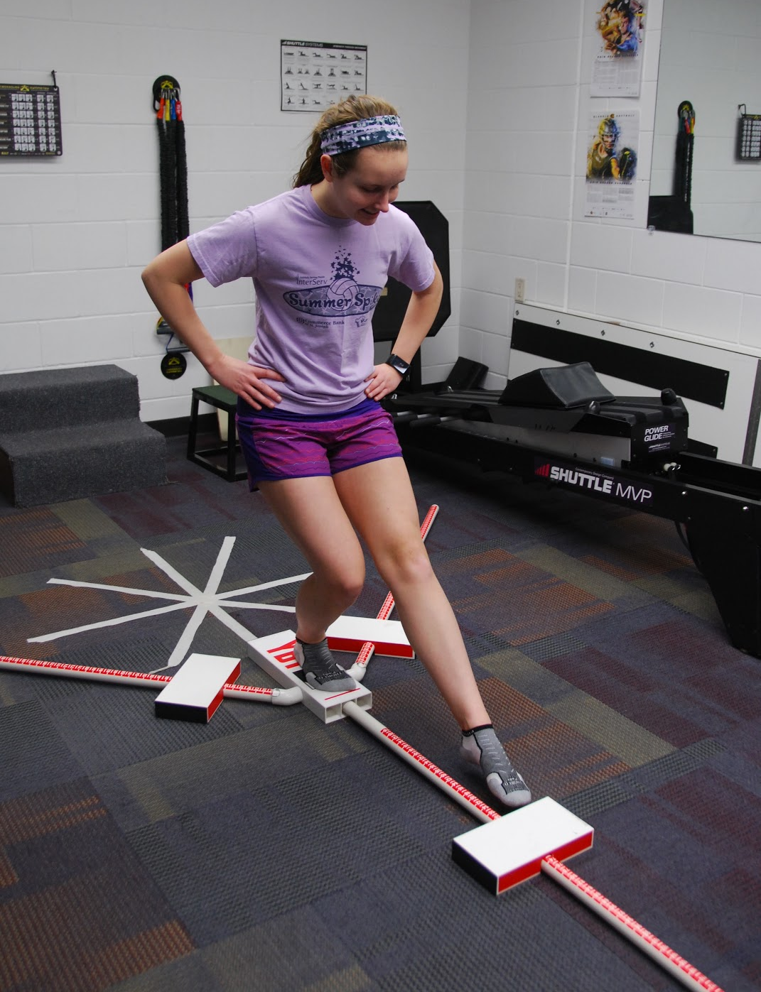
Injury Predictors in a Distance Runner Population
Camarie Slagle, Marissa Becker, Dr. Robert C. Stow, PhD, ATC
University of Wisconsin-Eau Claire | Department of Kinesiology
Abstract
Results
The purpose of this study is to validate an injury prediction test, to examine other tests as injury predictors, and to note physical characteristics of individuals participating in marathon training and how they correlate with injury rates. There is minimal evidence in the literature in regards to repeatable and validated written injury prediction tests for the athletic/physically active populations. Participation in physical activity has increased over the past decade as well as injury rates. Studies have shown in the high school student-athlete alone, 23% experience injuries, with 65% of this population having injuries to the lower body. Through examination methods of demographic/health history, range of motion, balance, and functionality in a physical assessment and survey, we seek to determine risk factors associated with lower-body injuries in a population of runners training for a marathon or half-marathon. We chose runners as our population due to the high amount of impact on their lower-body. Our hypothesis is that runners with lower scores on functional assessment and limits in range of motion will be predisposed to lower-body injuries when training as well as we will validate a written test as a prediction tool for predicting which individuals are prone to injury.
Screening and Testing Procedures
The data was analyzed using SPSS; using descriptive statistics and Pearson Correlation with significance set at p < 0.05 level.
A significant correlation was found between the Pre KJOC assessment and the Mid KJOC assessment (r = 0.840 , p < 0.001) as well as the Pre Y-Balance Test and the Mid Y-Balance Test (r = 0.855, p < 0.001).
Though no levels of significance was found, there was a dramatic change in hip Range of Motion (ROM) as seen in the table below.
Requests to participate were sent via email to those enrolled in IDIS 131 through the University and a brief presentation was given during class.
Participants signed up for a pre-assessment time slot.
A questionnaire was provided to all subjects to answer a series of questions regarding basic demographic information, history of running participation, and any past of current history of hip injuries. Each participant completed the Kerlan-Jobe Orthopaedic Clinic (KJOC) questionnaire for hip specific physical functionality.
Trained researchers collected a series of measurements for leg-length and range of motion (active and passive straight leg raise, knee flexion, and hip internal and external rotation). Three sections of the Functional Movement Screening (deep squat, hurdle step, and inline lunge) and Y-balance test were assessed. Measurements and scorings were recorded and any pain or discomfort was noted.
Participants were instructed to sign up for a mid and final assessment without the demographic portion.
 | Pre Assessment Avg. Difference | Mid Assessment Avg. Difference | Difference (From Pre to Mid)
Passive Straight Leg Raise | 5.27 | 6.67 | +1.4
Active Straight Leg Raise | 5.89 | 4.89 | -1.0
Bent Leg | 3.70 | 7.44 | +3.74
Internal Rotation | 7.49 | 5.19 | -2.30
External Rotation | 7.97 | 6.70 | -1.27
Background
Between 37% to 56% of recreational runners who train steadily and participate in a long-distance run periodically will sustain a running-related injury each year.
Movement screening tools can be used for non-contact injury risk prediction and to guide injury prevention programs.
The Functional Movement Screen is an assessment used to screen performance of fundamental movements incorporate both stability and mobility. Three of the movement patterns (deep squat, hurdle step, and inline lunge) are considered the “big three” with more complex movement patterns.
The Y-Balance Test shows to have a very good intra-rater reliability and a number of factors assessed, contribute to lower extremity dynamic performance of this test that could be linked to assessing injury risk.
The Kerlan-Jobe Orthopaedic Clinic has developed a written evaluation tool to accurately screen performance and function of the athletic hip. Future research is needed to validate its use as a predictive measure.
Leg length discrepancies and range of motion have also been considered as potential links to injury development.
Deep squat: upper torso parallel w/ tibia or toward vertical; femur below horizontal; knees aligned over feet; dowel aligned over feet
Summary and Conclusions
During the first week of training, 10% of participants reported having hip/groin pain while they were training, but did not prevent them from running. At the mid-assessment point, 9% of the participants reported of having hip/groin trouble. The data showed that the participants hip/groin ROM was increasing as well as when compared bilaterally (left to right sides), they were more balance.
This change in ROM could assist in explaining the decrease in reported pain levels while training.
There was an abnormal increase in difference for the passive straight leg raise and bent leg raise. An increase in muscle mass could be a possible implication for this but muscle mass was not assessed in this study.
Both the Y-Balance Test and KJOC assessment showed a significant decrease in scores. As scores decrease, the injury risk to the population assessed increases. The data shows that at the mid-point of this study, on average the participants risk of injury was increasing and a concern exists that the participants will show a higher level of injury at the conclusion of their training.
The mid-assessment was completed approximately 4 weeks after the participants initiated their marathon training program, thus they were in the early stages of their training and the data obtained thus far may be misleading.
While the Y-Balance test has been validated as an injury predictor, at this point the KJOC cannot be validated in the same manner as a significant correlation between the two was not found. Though both assessments did show a significant decrease in scores at a similar rate, the final assessment data will be needed to determine if the KJOC is a valid injury predictor.
Hurdle step: hips, knees, and ankles remain aligned in sagittal plane; minimal to no movement noted in lumbar spine; dowel and hurdle remain parallel
Inline lunge: dowel contacts maintained; dowel remains vertical; no torso movement noted; dowel and feet remain in sagittal plane; knee touches board behind heel of front foot
Methods
Subjects
Total of 37 long-distance runners participated in this study, ten males and 27 females.
Ages ranging between 17 and 57 years old (average of 24.1 years).
33 participants were students and 4 were community members.
All participants provided written informed consent as approved by the IRB for the University of Wisconsin-Eau Claire.
Pre-Assessment Status
Running without any hip/groin trouble | 90.0% (27)
Running without any hip/groin trouble | 6.67% (2)
Not running due to hip/groin trouble | 3.33% (1)
Y-Balance Test: a dynamic balance test performed in three directions while standing on one leg: anterior (pictured), posteromedial, and posterolateral. Performed three times per leg (only best of three is used in scoring).
Scoring: Composite Reach Distance (%) = Sum of the 3 reach directions / 3 times the limb length * 100
*7 participants did not specify their status.
 | Sedentary | Lightly Active | Active | Very Active
Description of Normal Daily Activities | 2 | 14 | 17 | 2
Acknowledgements
 | 1 Year | 5 or Less Years | More than 5 Years | Unknown
Years Running | 11 | 6 | 11 | 9
We would like to thank all of the participating runners. We want to thank and acknowledge the contribution and support of this project from Dr. Matt Evans and the Blugold Fellowship through the UW-Eau Claire; as well as LTS for printing this poster.

