Slide 1

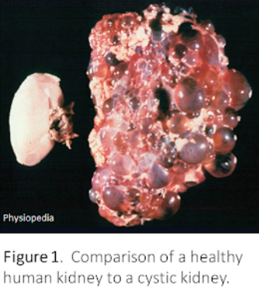
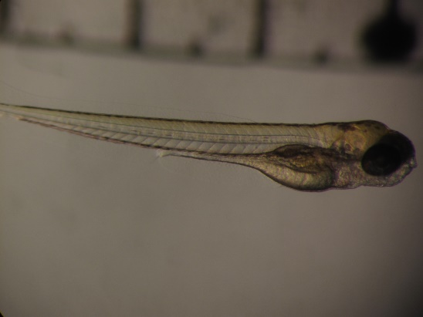
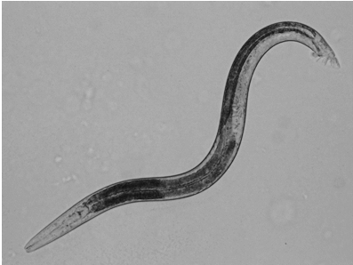
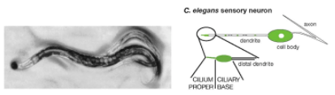
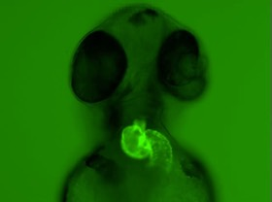
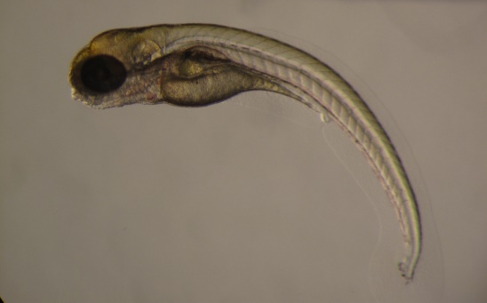
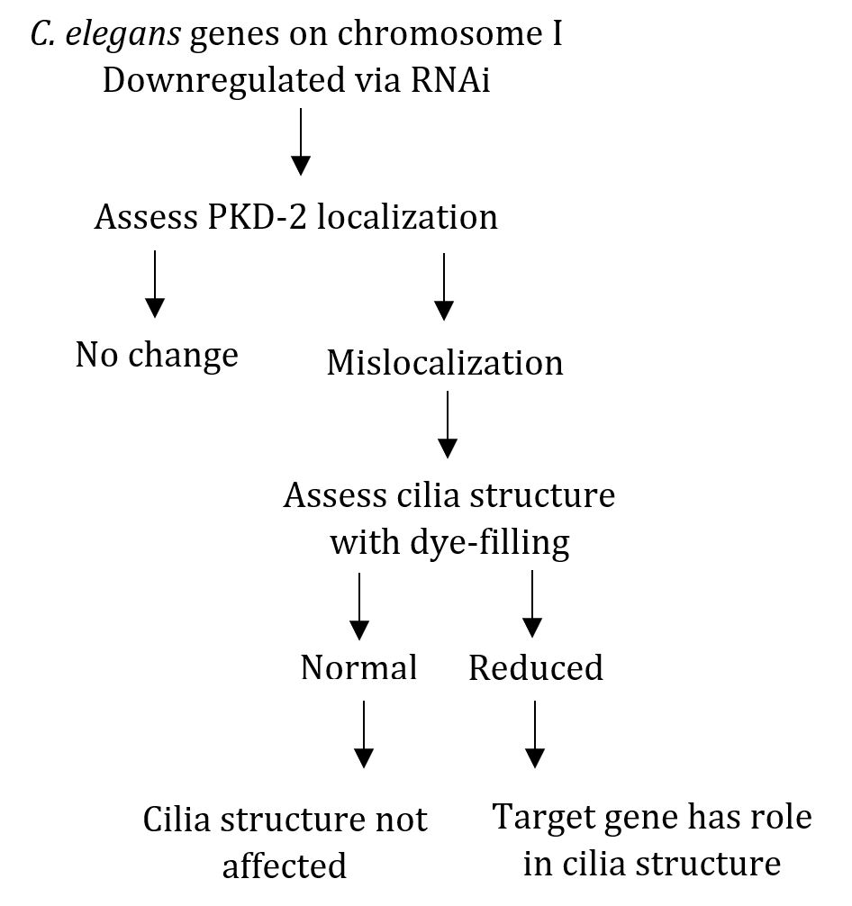
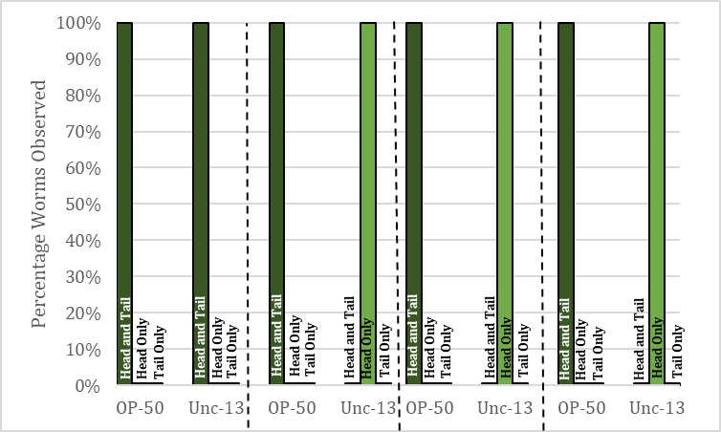
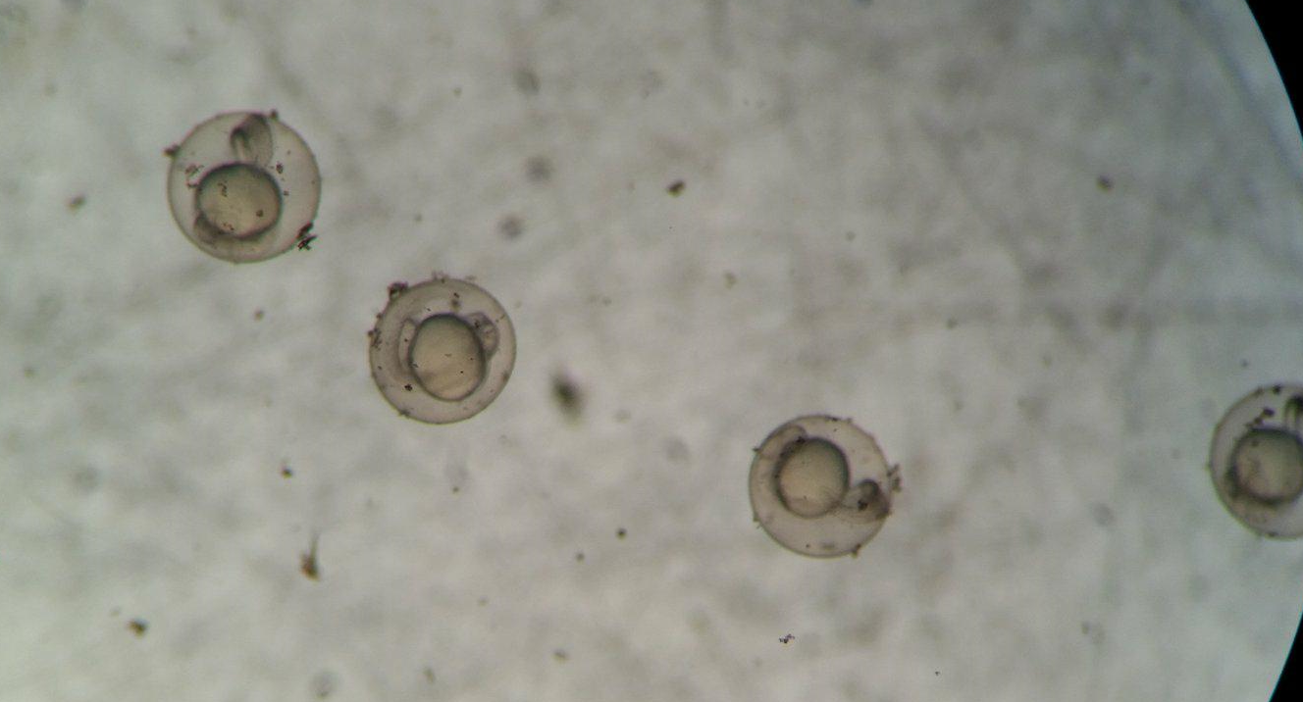
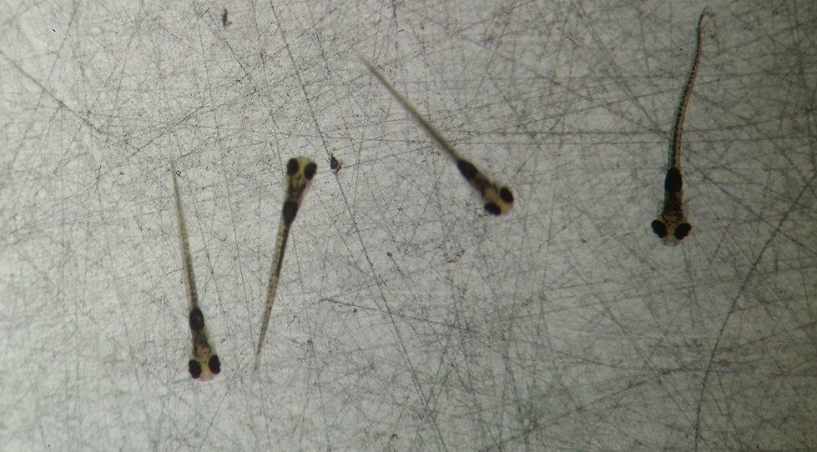
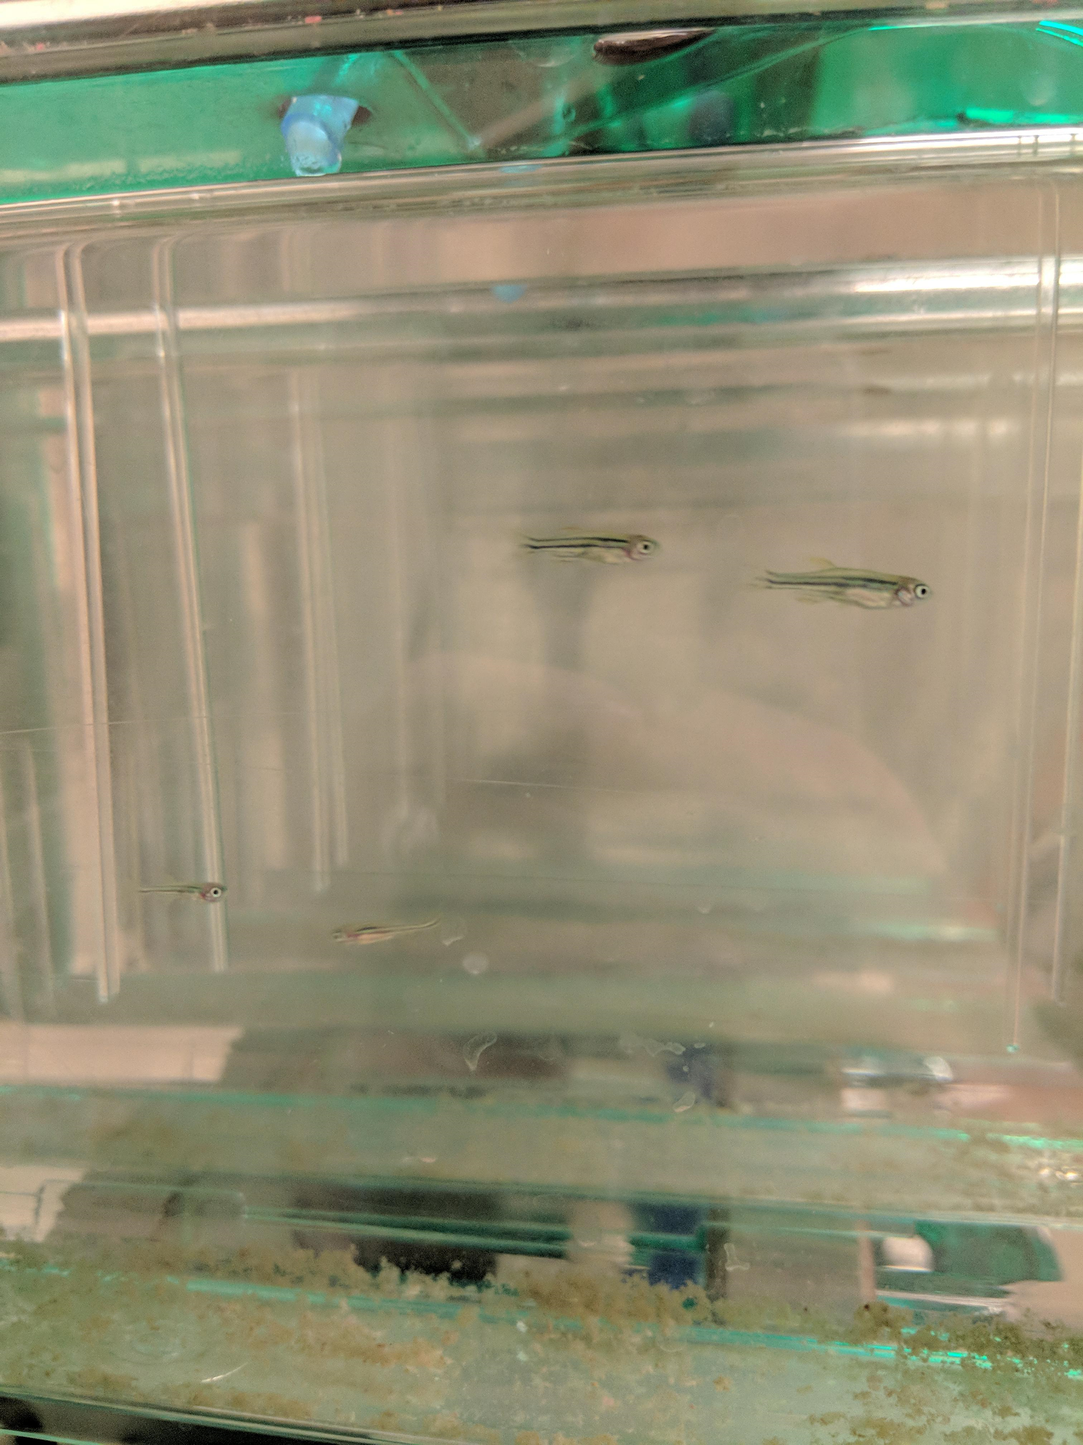
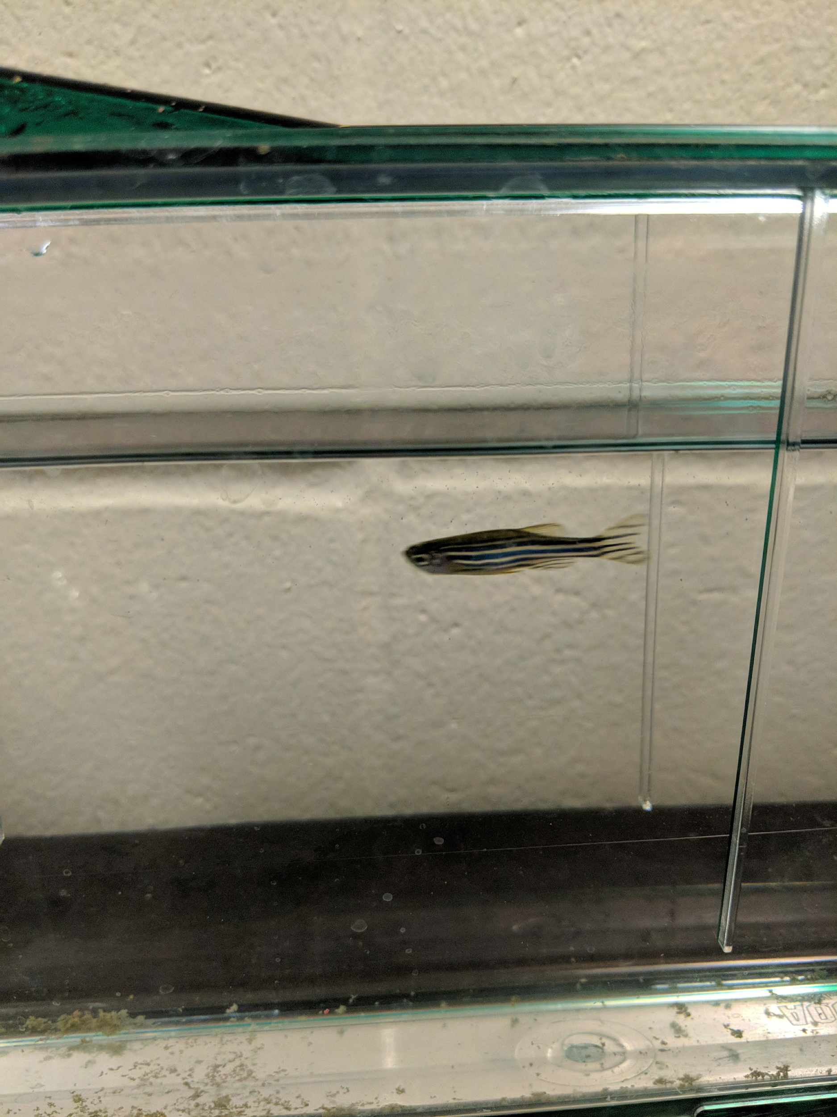
0
Laying the groundwork for investigating the link
between genes and polycystic kidney disease
Anneka Johnson, Katie Paulich, and Molly Svoboda
Faculty Mentor: Dr. Jamie Lyman Gingerich
Biology Department ◈ University of Wisconsin-Eau Claire
0
Introduction
Looking forward
Introduction
Defining cilia gene roles
Our lab studies human polycystic kidney disease using zebrafish and
C. elegans as models.
Analysis of genes related to cilia structure and function may lead to insight into the underlying pathology of ADPKD.
ADPKD is a ciliopathy, a disease
with symptoms caused by
dysfunctional cilia.
The gene pkd-2 encodes the protein
PKD-2 which is found in the primary cilia of both C. elegans and humans. The PKD-2 protein must be targeted to the ciliary membrane for proper cilia function in both humans and nematodes ^{[5]}.
Prior work in our lab has established an efficient pipeline for screening candidate PKD-2 localization factors in C. elegans. The lab screened 2,571 genes by RNAinterference (RNAi) and identified 113 putative PKD-2 localization factors.
We aim to:
Further characterize these PKD-2 localization factors.
Assess the effects of interfering with translation of localization factors in strains with enhanced sensitivity to RNAi.
All four strains (both the RNAi hypersensitive strains YY168 and NL2099 as well as the control strains him-5 IsD and N2) dye-fill in both the head and the tail indicating that ciliated neurons are structurally intact.
When expression of unc-13, a PKD-2 localization factor, is reduced via RNAi, the hypersensitive strains exhibit altered dye-filling compared to the N2 strain. Thus, indicating unc-13 may have a role in cilia structure in tail neurons.
The N2 and him-5 IsD strains are not equally sensitive to RNAi.
Future work on this project will involve testing additional putative PKD-2 localization factors as well as further analysis of the sensitivity of different strains of worms.
Now that we have established both zebrafish and C. elegans models, future work in our lab will focus on developing a more nuanced understanding of the connections between mutations, cilia and disease symptoms.
Kidney
a
b
c
Characterization of the zebrafish spinner mutant:
Analyze cilia structure in the brain.
Analyze heart asymmetry.
Assess liver development and look for presence of cysts.
Identify, clone, and characterize the causative gene.
Factors affecting PKD-2 localization:
Analyze cilia integrity and function to determine whether putative PKD-2 localization factors affect PKD-2 localization directly or as a secondary consequence.
Identify zebrafish orthologs of C. elegans localization factors to investigate gene function in a vertebrate.
Zebrafish Stripes and Pigmentation:
During the introduction of several populations to our zebrafish facility, we observed darkening of the stripes and overall pigmentation.
Investigate if the pigment darkening is due to water pH, light cycles, or food type (and thus may be useful as a measure of fish acclimation).
wild-type
Cyst
spinner
Figure 3: Male and hermaphrodite C. elegans (a). Structure of C. elegans primary cilia found on certain neurons.(b).
Figure 1. The etiology of human polycystic kidney disease (a, left – normal kidney, right – diseased kidney) can be studied using zebrafish (b) and C. elegans (c), not to scale.
Figure 6: Example of wild-type asymmetric heart looping (Amack 2018) .⁶
Patients with autosomal dominant polycystic kidney disease (ADPKD) suffer from disrupted kidney function due to large, fluid-filled cysts that form in the collecting ducts and kidney tubules (a) ^{[1]}. Current treatments for the disease manage cyst growth but do not prevent cyst formation.
Although the specific mutations that underlie polycystic kidney disease have been identified, the intervening steps between the altered gene and the disease symptoms remain unclear. We are particularly interested in the link between primary cilia and kidney cysts.
This year, we worked to amplify target zebrafish genes, maintain healthy zebrafish and nematode populations, and study the effects in C. elegans of downregulating cilia-related genes through RNAinterference (RNAi) ^{[2]}.
a
b
Investigating zebrafish with cystic kidneys
The zebrafish mutant, spinner, forms kidney cysts and has cilia defects thus making it a good model to study how cysts arise.
In collaboration with the Mayo Clinic (Rochester), we aim to:
Characterize the gene expression changes that take place during kidney cyst formation using deep RNAsequencing.
Characterize additional symptoms found in spinner mutant zebrafish^{[3, 4]}.
Identify the specific change in the DNA that underlies the mutant phenotypes.
The precise gene affected in the spinner mutant zebrafish remains unknown. Through deep RNA sequencing, we have identified 30 genes that are expressed in the wild-type, but not in the spinner mutant zebrafish – these are ideal candidates for the cause of the spinner phenotype. In addition, whole genome sequence data revealed a deletion of part of chromosome 17.
In order to localize the mutation within the genome, we are using known markers to “map” the mutation.
Skills developed during our time in the lab
him 5 IsD
N2
YY168
NL2099
After completing an academic year of research in the Lyman Gingerich lab, we have developed several scientific research skills:
Through analysis and discussion of primary literature on several topics (including RNAinterference, polycystic kidney disease, and zebrafish husbandry), we can design experimental procedures and determine directions for research.
Through time spent at the microscope and in the fish room, we developed the ability to sex both C. elegans and zebrafish and set up successful crosses.
By developing a plan to compare different types of growth media (necessary for maintaining C. elegans), we learned about experimental design and the proper use of equipment, such the autoclave.
By running a number of different protocols (PCR, gel electrophoresis, dye-filling assays), we learned how to use micropipettes, centrifuges, and balances. We also developed skills to interpret results and ask the next research questions.
Figure 4. Reduction of unc-13 gene expression affects ciliary structure as assessed by dye-filling. Putative PKD-2 localization using RNAi (a) represents the step by step determination of target genes’ impact on cilia structure. When bathed in a lipophilic fluorescent dye (b), ciliated neurons in the head and tail will take up the dye. Strains YY168 and NL2099 have been previously shown to have enhanced sensitivity to RNAi, particularly in the neurons^{[5]}.
Mapping Strategy
b
c
a
spinner chromosome 17
Isolate DNA from mutant and wild-type fish
?
z7266
2.3cM
z13336
z1990
z24042
Amplify known markers by PCR and process by restriction digest
Deletion
?
z4268
3.8cM
z652
z9179
5.0cM
Establishing a stable zebrafish colony
0
When using live organisms for research, like zebrafish and C. elegans, it is important to maintain healthy sustainable populations.
C. elegans are relatively easy to maintain while the zebrafish require more intensive care.
To maximize fish well-being we have
established a feeding and light schedule
and their room is kept at a constant 25°C.
Breeding the fish is essential for
continued research: during early
development, the fish are transparent
making it easy to observe the internal
organs. We have had success obtaining
several clutches of embryos.
References
Compare marker patterns to determine location of mutation
Whole Genome Sequence Data
Genetic Map
1. Afzelius BA. (2004) Cilia-related diseases. J Pathol. 204(4):470-477.
2. Wang Z, Gerstein M, Snyder M. (2009) RNA-Seq: a revolutionary tool for transcriptomics. Nat Rev Genet. 10(1):57-63.
3. Hsu LS, Chiou BH, Hsu TW, Wang CC, Chen SC. (2016) The regulation of transcriptome responses in zebrafish embryo exposure to triadimefon. Environ Toxicol.
4. Yin J, Morrissey ME, Shine L, Kennedy C, Higgins DG, Kennedy BN. (2014) Genes and signaling networks regulated during zebrafish optic vesicle morphogenesis. BMC Genomics. 15:825.
5. Yang H, Zhou Y, Gu J, Xie S, Xu Y, Zhu G, Wang L, Huang J, Ma H, Yao J. (2013) Deep mRNA sequencing analysis to capture the transcriptome landscape of zebrafish embryos and larvae. PLoS One. 8(5):e64058.
6. Amack lab; University of New York, Upstate Medical University
7. Wormatlas; Introduction to male C. elegan anatomy
z7266
z9179
z11456
z4268
Figure 2. Strategy for locating the mutation in spinner mutant zebrafish. Amplification and cleavage of wild-type DNA (b) verity that protocols (a) work in our lab. Identification of the boundaries of the deletion (c) will be useful for identifying candidate genes.
a b
The deletion of chromosome 17 is located somewhere between 2.3cM and 5.3cM.
The spinner mutation is tightly linked to this deletion.
The whole genome sequence data in this region is incorrectly assembled, thus candidate gene identification will require additional steps.
c d
Figure 5: Stages of zebrafish development. Thirty hours old (a) Ten days old (b) Two months old (c) adult zebrafish (d)
0
We plan to more precisely identify the boundaries of the deleted region and test for the presence of candidate gene sequences within the spinner mutant DNA.
Acknowledgements
This research is supported by the Office of Research and Sponsored Programs and the Department of Biology at UW-Eau Claire. We are grateful to our colleagues at the Mayo Clinic, Rochester, MN and our labmates for sharing ideas, expertise and reagents. We thank LTS for printing this poster.
Notes:
4/21 – Try distributing text/figures/panels so that the white space isn’t uneven.
Where is reference 2? (Introduction goes from 1 to 3)
Graph of dye-filling – rename him-5 IsD (note italics and capitalization); also, put worm strain on 1 line and plate type underneath or use bracket to indicate strain for both plate types. See comment for reference
I would really like the graph to have wider bars and span the width of the column, but I haven’t gotten the spacing to work yet.
Also, the conclusions that I wrote for the section seem rather wordy.
You should have space now to make the references text bigger (as well as the acknowledgements text). I have not touched this as the references need to be edited.
Work on spacing in introduction (I am not sure how to get the text to wrap nicely around the figure. I did group the legend and figure.) I think we can get the text to wrap the figure better when we convert it back to PowerPoint +
Add specific research goals to introduction. +
Titles (headings for each section) should be more descriptive. +
Figure 2: This figure needs a better (more descriptive) figure legend. Also, a better description. For figure two, crop figure and show just results from 1 or 2 primers (representative results) +
Dye-filling: Can you put in a graph of your results - e.g. a stacked graph (head only, tail only, head+tail) and then a representative picture of dye-filling (look on slide 2)
4/18 – Make sure that you are using the same font throughout.
What do you think about stacking the figures in the introduction into 1 figure? Rewrite figure legend for figure 1. Add A, B, and C to figure 1. Could also make figure 1 vertical across the section. +
Add in the figure from Mayo that shows the cilia defects.
Text in red – there should really be a figure here of the work you did reconstructing the whole genome sequence.
Double check your figure numbers and references to figures within text.
C. elegans is always italicized, plural, and capitalized (the C. not the e).
Tell us more about unc-13, prbm and phi-24.
Also, why did we use different strains of worms? (Anneka – find reference from BIOL324 that talks about these different strains and how they may make different tissues hypersensitive to RNAi.)
Gaph: Change to percent of worms (Y axis). 3 parts to each stack: head only, tail only, head and tail
What was your control? Make sure that is clear in your figure legend to your graph. Put graph title in figure legend, not above. Title: Reduction of unc-13 gene expression affects ciliary structure as assessed by dye-filling.
Bullet point results:
Talk about results for different RNAi constructs
Talk about results when comparing different strains of worms.
Combine photos of fish into 1 figure. Label panels A, B, C, D. Describe in figure legend. +
Check lengths of green lines under titles. +
These is a lot of text on this poster. Try changing your future directions to bullet points. (You can give the audience more details if they are interested.) +
Only include references that you specifically cite (don’t forget to cite them within the poster!)

