Slide 1

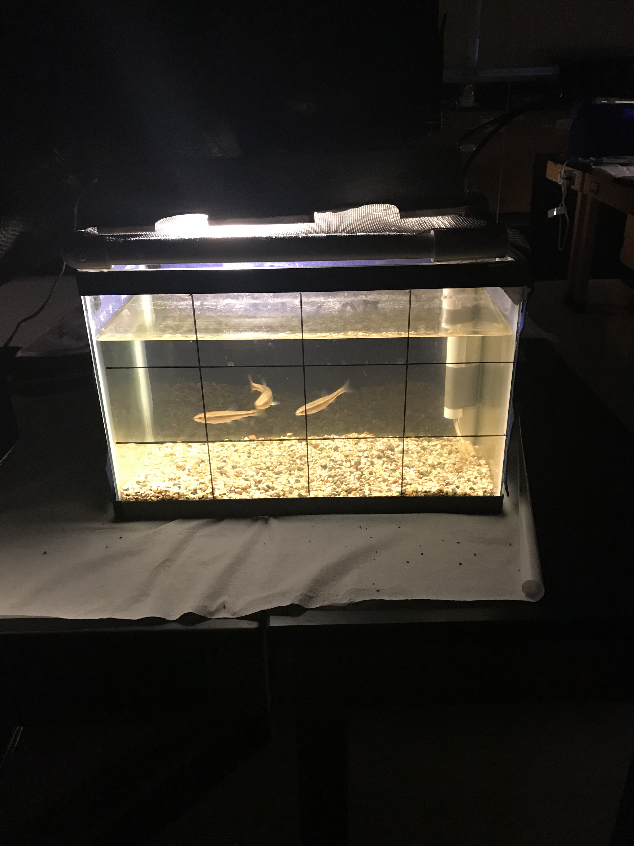
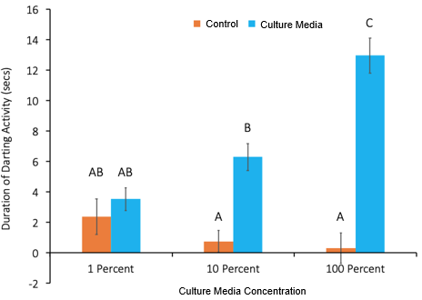

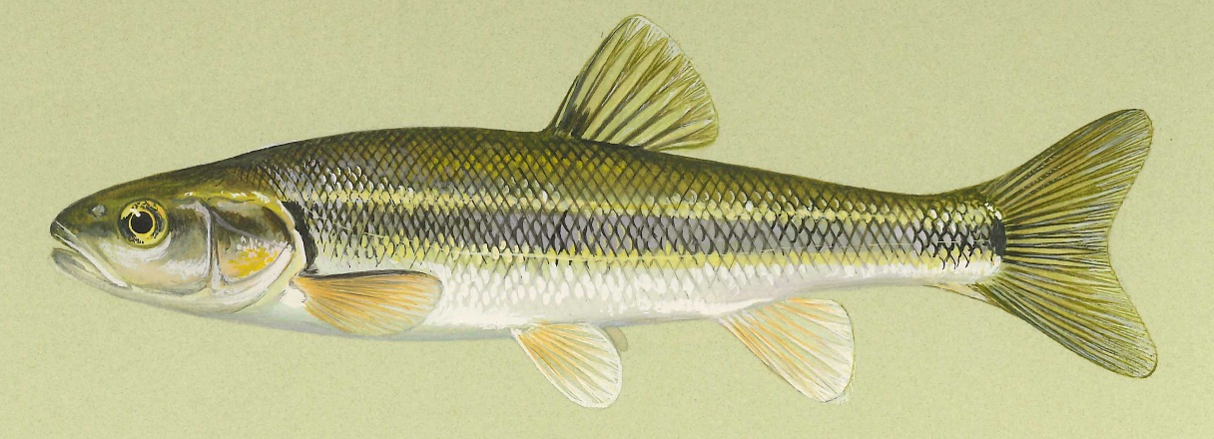
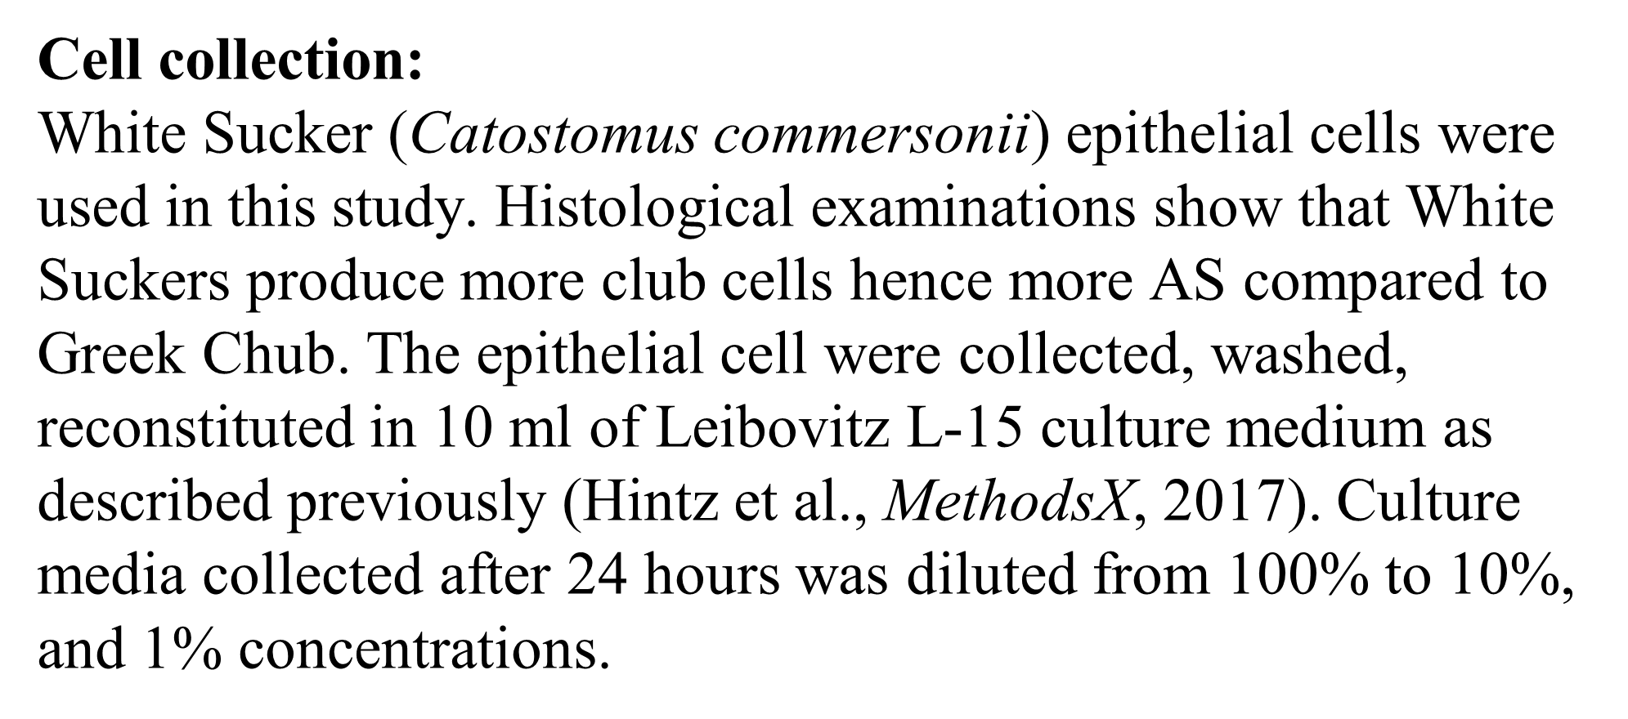
Dose-Response Study of Culture Media Using Creek Chub
Rachel Bayer, Eleni Seyoum, and Winnifred Bryant
Department of Biology
University of Wisconsin - Eau Claire
Abstract
Methods, continued
Results and Conclusions
In previous research, we demonstrated that alarm substance (AS) derived from a primary culture of Creek Chub (Semotilus atromaculatus) epithelial cells induced anti-predator behavior in Creek Chub. In this study, we harvested AS from a primary cell culture and performed dose-response studies.
Culture media was serially diluted and used to determine the minimal and maximal doses that induce anti-predator behavior in Creek Chub.
When challenged with AS, Creek Chub darting behavior increased in a dose-dependent fashion.
Introduction
Figure 2. Glass aquaria with three Creek Chub. Food pellets were provided daily while monitoring normal behaviors and obvious signs of infection for each fish. Tank was cleaned every three weeks to provide a healthy, clean environment for the fish. Filters and aeration were also inspected daily to ensure that it is working properly to maintain water quality.
In various species of fishes, the importance of visual cues in the determination of environmental threat and subsequent predator avoidance is clear. Chemical cues also play an essential role facilitating predator avoidance. Among fish in the superorder Ostariophysi, club cells in the epidermis produce an alarm substance. Damage to the skin during a predation event releases an AS, which diffuses through the water column and binds to olfactory receptors of conspecifics. Fish then engage in a number of anti-predator behaviors that may include darting, schooling, or hiding.
Figure 4. Creek Chub were observed in the absence of treatment, and in the presence of distilled water (control) and culture media differing in concentrations. Observation time was 180 seconds. Seconds of darting behavior was averaged for 16 trials. The error bars are +/- 1 SE. Data was analyzed by a one-way ANOVA followed by Bonferroni Post-Hoc (p-value < 0.05). Means sharing the same letter are not significantly different.
Cell collection:
White Sucker (Catostomus commersonii) epithelial cells were used in this study. Histological examinations show that White Suckers produce more club cells hence more AS compared to Greek Chub. The epithelial cell were collected, washed, reconstituted in 10 ml of Leibovitz L-15 culture medium as described previously (Hintz et al., MethodsX, 2017). Culture media collected after 24 hours was diluted from 100% to 10%, and 1% concentrations.
Culture media increases darting behavior (as compared to treatment with distilled water) at 10% and 100% concentrations.
No difference in behavior observed across the control groups.
There is no difference between the 10% and 1% concentrations, but a highly significant difference between the 100% and 10% concentrations of culture media.
The results suggest that the effect of culture media was weak but noticeable at 10% and much stronger at 100%. Thus, the findings do not indicate a threshold response.
Methods
Housing:
Juvenile Creek Chub were used in this study because they show a more robust behavioral response when exposed to AS as compared to adults. The animals were wild caught and kept in glass aquaria at 20C with a 12:12 light cycle. Food pellets were provided daily. Filters and aeration maintained water quality and fish were visually inspected daily for normal behavior and obvious signs of infection.
Significance
Figure 2. Cell collection. To collect epithelial cells, sterile scalpels were used to gently abrade the skin of White Suckers (Catostomus commersonii). Cells were cleaned and reconstituted in culture media, and incubated at 20C. After 24 hours, culture media was harvested, diluted and stored at -20C. Aliquots of culture media were thawed to room temperature immediate prior to use in behavioral assays.
The remarkable thing about this study is that cultured cells elicit an antipredator response in Creek Chub. Written literature regarding antipredator responses are predicted upon cellular damage. Our findings indicate that an alarm response can be elicited from cells in culture that have not been lysed or damaged.
There is a possibility that the documented behaviors might have been induced by the chemicals included in the media formulation. Further studies should be done to control for the media and test the repeatability of the study.
Experiments:
The four aquaria contained three Creek Chub each; the average response was used in all analyses. Each aquaria was recorded on a video camera for a duration of ten minutes. Fish were recorded for three minutes each during a: 1) pre-trial 2) control and 3) introduction of culture media.
Analysis:
For each video and upon introduction of the control and alarm substance, darting behavior was measured for each fish between all four aquaria. Time measurements were obtained over the same period of time. Measurements were taken as soon as the fish started moving in response, which was usually after two seconds.
.
Acknowledgments
Figure 1. Creek Chub (Semotilus atromaculatus) is the experimental model used to study behavioral responses after administration of culture media. Photo credit: http://www.iowadnr.gov/idnr/Fishing/Iowa-Fish-Species/Fish-Details/SpeciesCode/CRC.
We would like to thank the Office of Research and Sponsored Programs for funding this project and Dr. David Lonzarich for technical assistance and assistance in behavioral assays.

