Slide 1
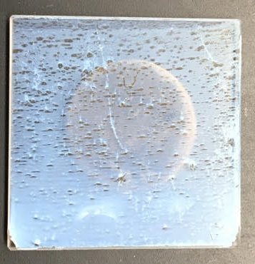
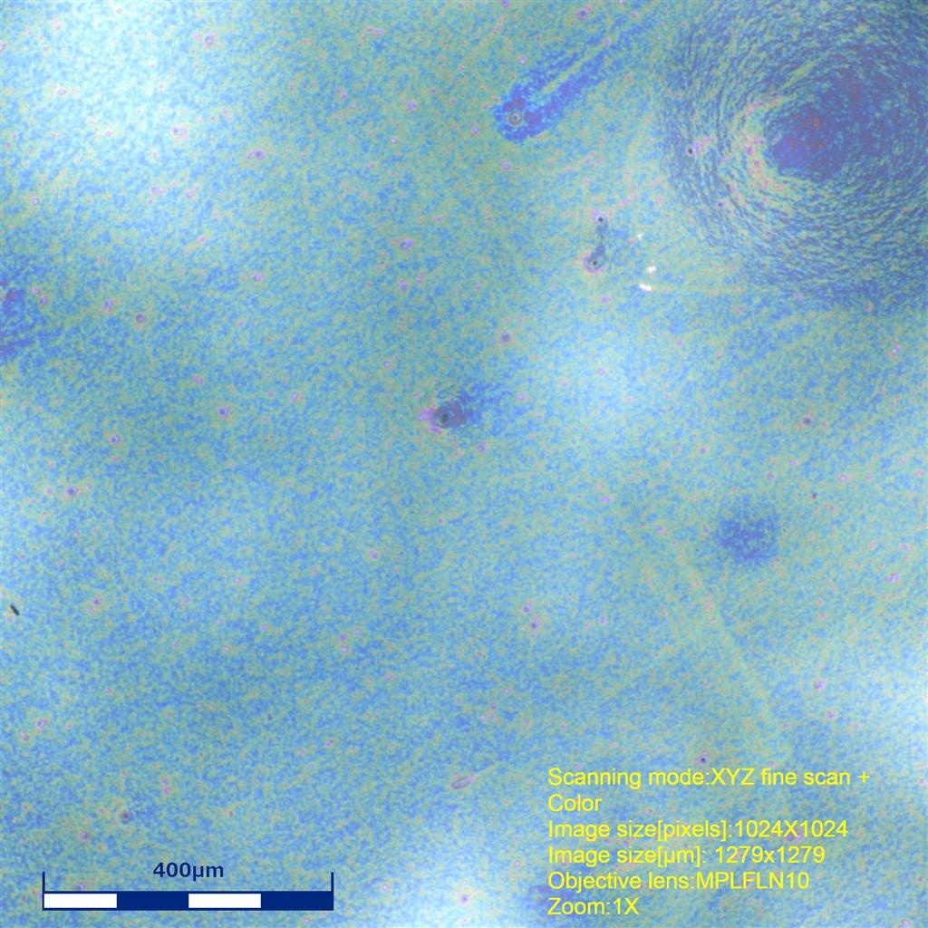
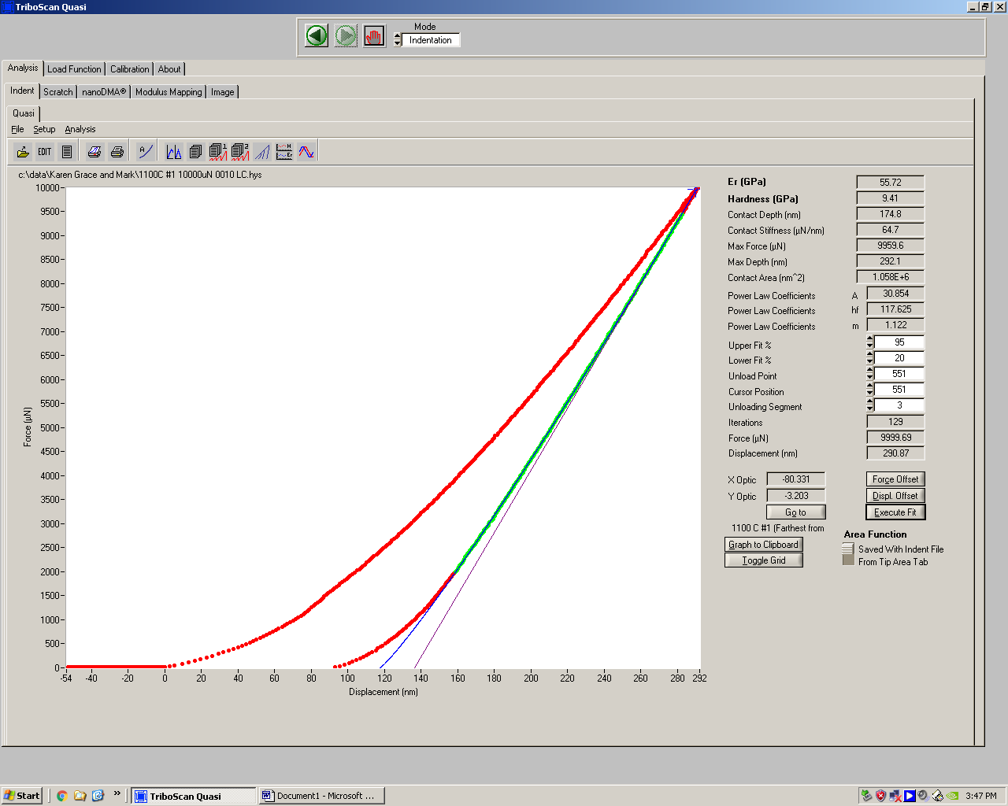
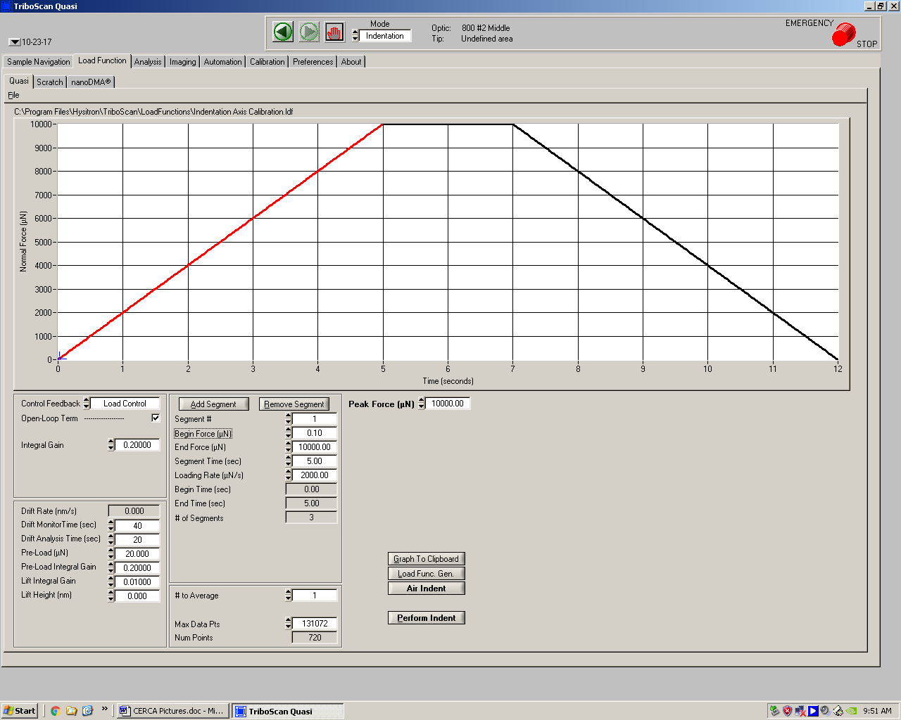
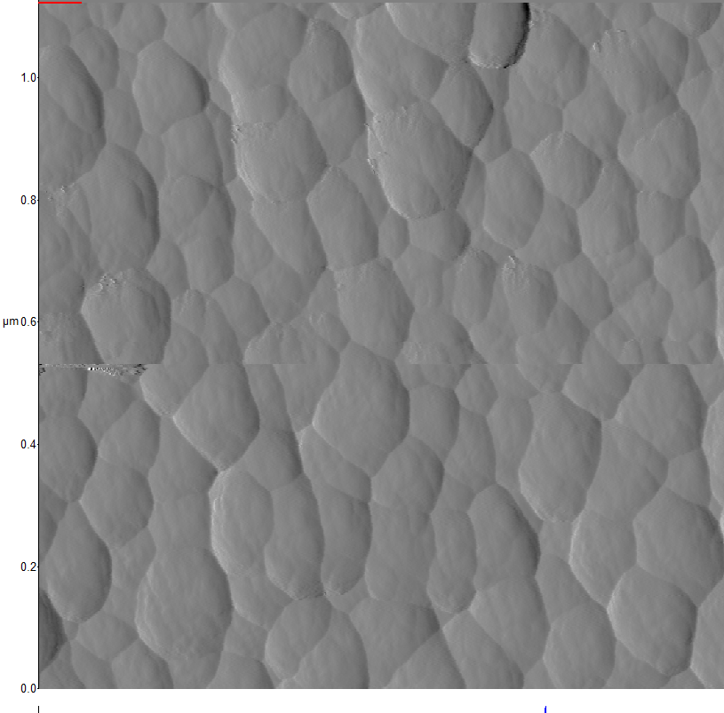
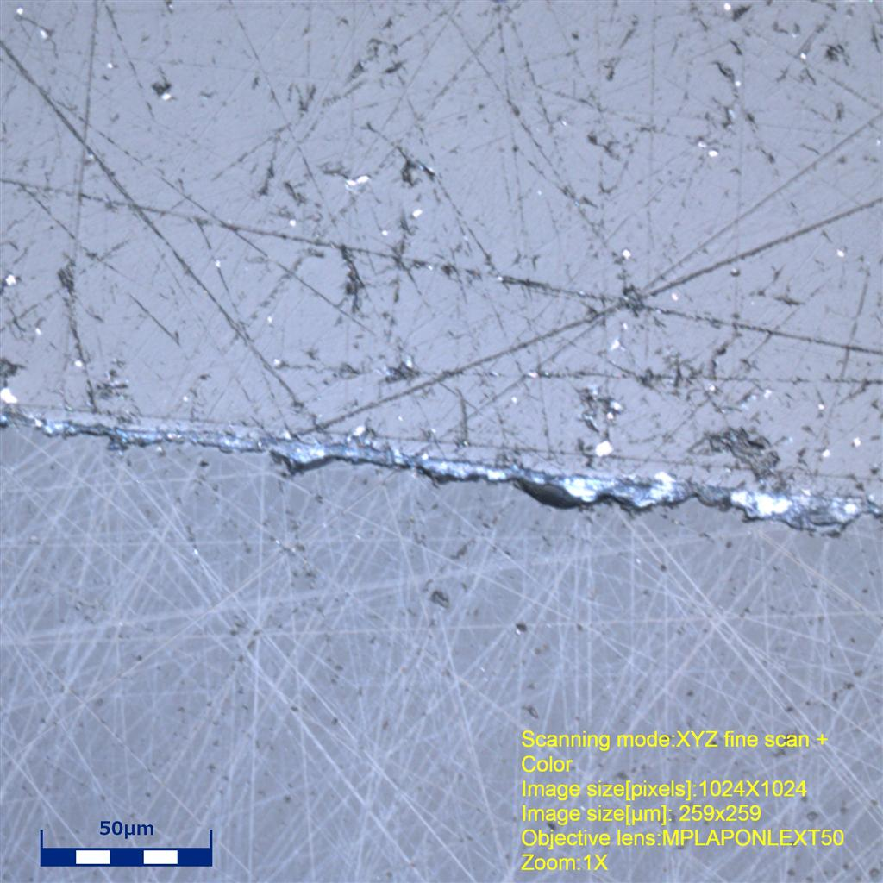
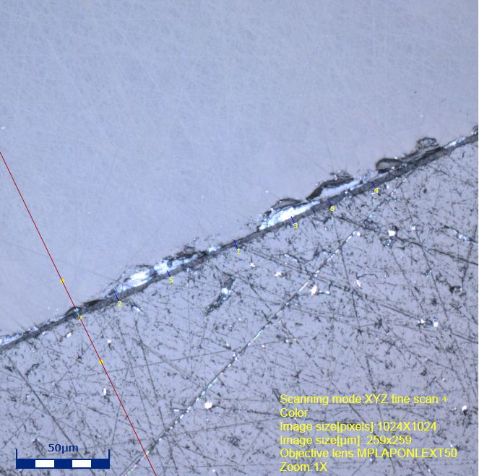
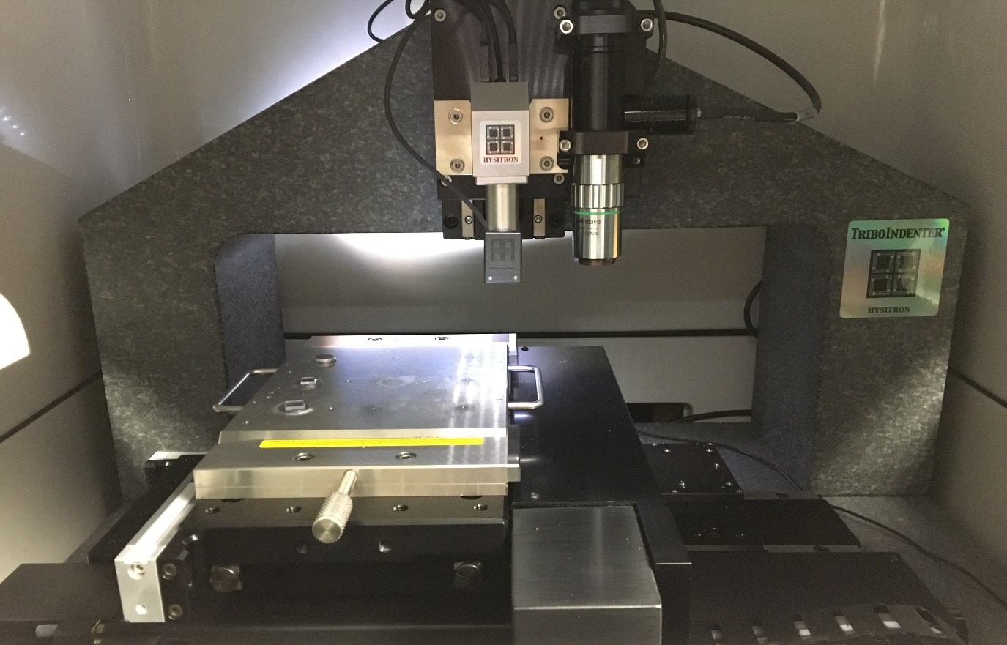
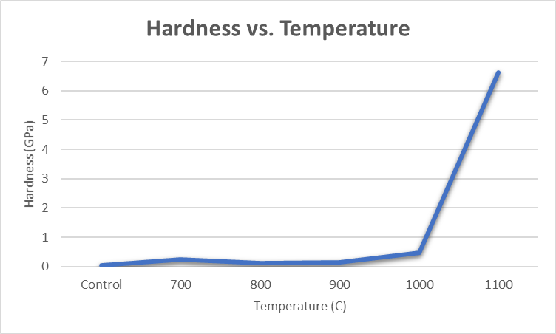
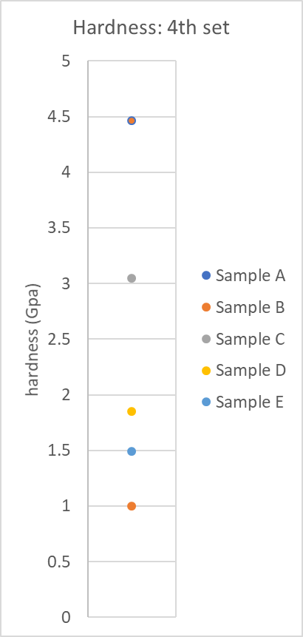
Nanoindentation of Silica Colloid Thin Films
Karen Knoke, Grace Baker, and Dr. Douglas Dunham, Materials Science UW-Eau Claire, Eau Claire, WI
Yana Astter, and Dr. John Kirk, Chemistry Department, Carthage College, Kenosha, WI
Introduction
Sample | Force
1100 C | 10,000 uN
1000 C | 10,000 uN
900 C | 10,000 uN
800 C | 10,000 uN
700 C | 2,500 uN
Control | 1,000 uN
Spin Coated | 1,000 uN
Results
On the Surface:
Silica colloid films are technologically important as they can serve as the matrix to hold nanoparticles for the fabrication of thin film sensors. Thin film sensors need to be durable to function in a variety of environments. A Hysitron nanoindentor was used to test the hardness of three sets of silica colloid thin films. The first set was slip casted and sintered at temperatures varying by 100 C (700C-1100C). The second set was spin coated using various layer thicknesses (1-20 coats). The third set consisted of various layer thickness and gold nanoparticles with a silica matrix of various layers. Of the sintered samples our findings indicated samples sintered at higher temperatures had a higher hardness. Of the spin coated samples it was found that the third layer, from the second set, had the highest hardness, but that could be due to an uneven spread of silica. The thickness of the first two sets were also found to observe the difference between the slip casted and spin coated samples. The spin coated samples had a thinner film. As for the samples with the gold nanoparticles we found that adding gold nanoparticles do not compromise the silica matrix.
1st set
2nd set
3rd set
Surface images were taken from samples of each set.
1100 C
Average
20 Layer
Average
20 Layer
Average
Hardness: 6.619 GPa Modulus: 53.894 GPa
Hardness: 0.261667 GPa
Modulus: 6.691429 GPa
Hardness: 0.16950 GPa
Modulus: 2.40639 GPa
1000 C
Average
15 Layer
Average
10 Layer
Average
Hardness: 0.467 GPa Modulus: 21.325 GPa
Hardness: 0.294952 GPa
Modulus: 9.517619 GPa
Hardness: 0.21797 GPa
Modulus: 3.99119 GPa
Sintered Sample that was slip casted at 800 C
Confocal Microscope:
1 coat spin coated
900 C
Average
10 Layer
Average
5 Layer
Average
Silica Particle Packing:
1100 C
Hardness: 0.147 GPa Modulus: 19.039 GPa
Hardness: 0.346857 GPa
Modulus: 12.91429 GPa
Hardness: 0.18492 GPa
Modulus: 4.73408 GPa
The silica particles measure 150 nm in diameter. These images will be used to compare to difference in packing arrangement when gold nanoparticles are added.
800 C
Average
5 Layer
Average
1 Layer
Average
Layer Comparison
Hardness: 0.124 GPa Modulus: 13.535 GPa
Hardness: 0.330714 GPa
Modulus: 17.19143 GPa
Hardness: 0.25659 GPa
Modulus: 18.7679 GPa
700 C
Average
3 Layer
Average
1:20 Ratio
Average
Hardness: 0.245 GPa Modulus: 7.579 GPa
Hardness: 1.545 GPa
Modulus: 36.66429 GPa
Hardness: 0.16287 GPa
Modulus: 3.5017 GPa
Control
Average
1 Layer
Average
1:1 Ratio
Average
AFM at 1.13um
Silica Particle Packing
SEM: Silica particles at 667 um
1 Layer
5 Layer
10 Layer
20 Layer
Hardness: 0.035 GPa Modulus: 4.168 GPa
Hardness: 0.555 GPa
Modulus: 31.32714 GPa
Hardness: 0. 22984 GPa
Modulus: 8.79178 GPa
Thickness of thin film:
Methods
With the first three sets it is seen that there is no significant trend between the layers of silica, they are all similar to one another. For sintering there is a large significance in the 1100 C hardness, however spin coating is a faster and more effective method for an even coat.
Alternating Layer
Average
The thickness of the thin films were taken via cross section analysis. Measurements were taken in two areas on each sample with 7-8 points measured at each area.
Using the Hystiron Nanoindentor, a load function of five second approach, two second hold, and five second unload was used for each of the samples.
Hardness: 0.20112 GPa
Modulus: 4.8123 GPa
4th set
Sample D
Average
Hardness: 1.6523
Modulus: 46.54
Sample A
Average
Hardness: 4.5343
Modulus: 56.2838
900 C
Average thickness:
6.77 um
20 coat
Average thickness:
3.93 um
Sample B
Average
Hardness: 2.6914
Modulus: 50.6276
Sample E
Average
Hardness: 1.4087
Modulus: 38.5162
Next Steps
On each sample, we tested 15 points in a concentrated area. We then tested five to eight points on various spots around the sample, making sure to stay over the area of the magnet to ensure a stable surface for the diamond tip to approach.
Sample C
Average
Hardness: 2.6419
Modulus: 49.7267
The next step is to correlate the elastic modulus and hardness data, along with SEM images with the sample preparation procedures for a journal article.
Sample preparation for the fourth set involved a more thorough cleaning process of the substrate before deposition of the thin film.
Acknowledgments
UW-Eau Claire Materials Science Program
Dr. Anthony Wagner

