Slide 1


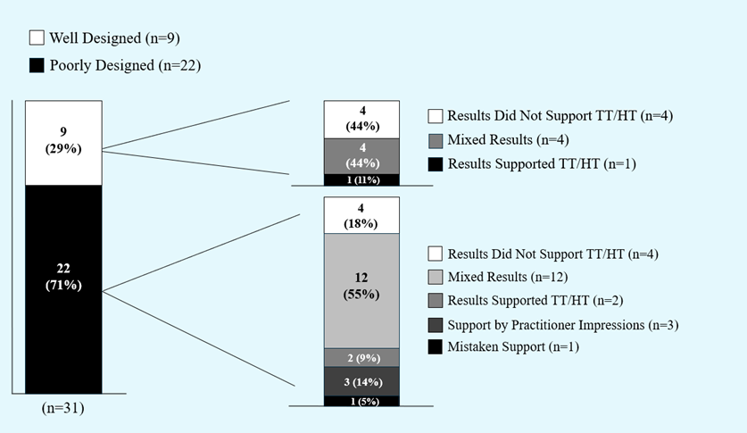
0
Are Energy Therapies Supported by Randomized,
Placebo-Controlled Trials? A Systematic Review
Katie Paulich and Keith Jorgensen
Faculty Mentor: April Bleske-Rechek
Department of Psychology  University of Wisconsin-Eau Claire
Introduction
Quality Assessment Process
Implications
Therapeutic Touch and Healing Touch are complementary, energy-based treatments. They are based on the premises that (1) illness is a result of “a disruption of the flow of energy surrounding a person’s being” and (2) re-patterning the energy field facilitates health (Mentgen, 2001, p. 145).
During an energy intervention, practitioners hover their hands just above the patient’s body, purportedly adjusting and balancing the energy field via the flow of healing energy through their hands.
Healing Touch and Therapeutic Touch are promoted in the nursing curriculum at UWEC and at hundreds of universities nationwide.
Proponents of these interventions claim myriad benefits, such as pain relief, accelerated wound healing, reduced anxiety, and improved immune system functioning (Fazzino et al., 2010).
However, peer-reviewed, controlled studies have shown that human energy fields are not systematically measureable or detectable, even by trained energy therapy practitioners (Rosa et al., 1998).
Further, multiple previous reviews of the studies that have examined these practices have concluded that the research claiming to support the validity of these interventions is fraught with methodological errors, such as small sample size, lack of appropriate placebo control, and subjective rather than objective outcome measures (Anderson & Taylor, 2011; Peters, 1999; Robinson et al., 2007).
We conducted a review of recently published papers (2010-2016) to determine if the quality of the research has improved, and if high-quality studies support the efficacy of Therapeutic Touch and Healing Touch.
During the 2016-2017 academic year, the 31 empirical articles were coded independently by three raters on three critical elements of methodological integrity (shown below); discrepancies were resolved by discussion. Pairwise agreements (κ) ranged from .62 to .82.
During the fall of 2017, two of the original raters and a fourth rater independently reexamined each article; subsequently, the three researchers discussed as a group each article’s standing on the two critical elements.
First, to be a true test of a practitioner’s healing energy (as opposed to physical touch), the intervention should not involve touch.
Second, as with any medical research, a test of a therapy’s effectiveness must show improvement above and beyond placebo effects. In terms of energy therapies, improvement could come from faith in the treatment or hope inspired by a well-intentioned practitioner, as opposed to the energy therapy itself. To address potential placebo effects, high quality studies make certain that participants are either (a) blind to condition (or asleep) or (b) naïve (e.g., babies); or, they include a placebo or “mimic” intervention condition (e.g., trained practitioners do math problems while hovering; untrained individuals mimic the practice).
Previous reviews of the empirical literature on Healing Touch and Therapeutic Touch (e.g., Anderson & Taylor, 2011) have called for more rigorous tests of these energy therapies before the medical establishment can conclude that they are evidence-based practices. Our review of the literature published since then (between 2010 and 2016) suggests that the quality of the research has not improved. Of the 57 papers we found, just nine involved a rigorous, well-designed test of the claim that practitioners can facilitate healing through intentional repatterning (or “smoothing”) of a yet-undetectable energy field (Rosa et al., 1998). We categorized these studies as well-designed because they (1) did not involve touch, and (2) addressed the possibility of placebo effects by blinding participants to their treatment condition (e.g., by using infants or conducting the treatment while patients slept) or by including a placebo or “mimic” group. Only one of the nine well-designed studies offered support for the energy therapies; the other studies offered mixed results or, in four cases, offered no support.
Over half of the empirical studies we found allowed practitioners to touch their patients during their healing sessions, thus removing the feasibility of testing these practices as “energy therapies.”
Notably, nearly every paper we read, regardless of its study design or results, began with a review of claims (from other poorly designed studies) about the positive effects of the therapies, and concluded with positive sentiments about the healing potential of these therapies; in fact, one paper claimed statistical support when the data they laid out in their tables and results sections clearly showed no support at all (Coakley & Duffy, 2010). Thus, those who are not well-versed in research design or statistics might easily walk away from the literature with a mistaken conclusion that Healing Touch and Therapeutic Touch are statistically supported by systematic research.
On the basis of our review of recent studies and of previous reviews of the literature on Healing Touch and Therapeutic Touch, we conclude the following:
Ethically, medical practitioners are obligated to provide the best available empirically supported treatments. Therapeutic Touch and Healing Touch have not established themselves as supported by randomized, placebo-control studies.
At UWEC and many universities nationwide, class time and resources are devoted to energy therapies such as Therapeutic Touch and Healing Touch. We are not suggesting that complementary therapies in general are ineffective; however, we are opposed to researchers’ claims that their evidence supports energy therapy in particular if their effects may actually be a product of physical touch, relaxation, or hope inspired by a caring and well-intentioned practitioner. Valuable time and resources in and out of the classroom should be devoted to treatments and medical practices that have been systematically tested and consistently supported by randomized placebo-control designs.
Quality Assessment
Empirical (n=31)
Does Not Involve Touch (n=13)
Includes Blind/Placebo (n=9)
Non-Empirical (n=26)
Involves Touch (n=18)
Does Not Include Blind/ Placebo (n=4)
13 (42%)
9 (69%)
31 (54%)
4 (31%)
18 (58%)
(n=13)
Study Selection
(n=31)
Articles identified through database searches and references section searches
(searched MEDLINE, Cochrane Library, CINAHL Complete, Alt-HealthWatch, and Health Source: Nursing) (n=57)
26 (46%)
Of the 31 empirical articles, 13 did not involve touch. Of those, nine addressed the possibility of placebo effects either by blinding patients to condition or by using a mimic/sham intervention; thus, those nine studies were characterized as well-designed.
Articles omitted for not being empirical tests of TT/HT or for being a non-scholarly piece (n=23)
(n=57)
Empirical studies screened for eligibility (n=34)
Results
Study omitted for being redundant* (n=1) Study omitted for Healing Harp confound in all HT conditions; not a true test of HT (n=1) Study omitted because it assesses nurses’ attitudes toward HT, rather than efficacy of HT (n=1)
Empirical studies included in systematic review (n=31)
References
Anderson, J., & Taylor, A. (2011). Effects of healing touch in clinical practice: A systematic review of randomized clinical trials. Journal of Holistic Nursing, 29, 221-228.
Coakley, A. B., & Duffy, M. E. (2010). The effect of therapeutic touch on postoperative patients. Journal of Holistic Nursing, 28, 193-200.
Fazzino, D., Quinn Griffin, M., McNulty, R., & Fitzpatrick, J. (2010). Energy healing and pain: A review of the literature. Holistic Nursing Practice, 24, 79-88.
Mentgen, J. (2001). Healing Touch. Holistic Nursing Care, 36, 143-157.
Peters, R. M. (1999). The effectiveness of therapeutic touch: A meta-analytic review. Nursing Science Quarterly, 12, 52-61.
Robinson, J., Biley, F. C., & Dolk, H. (2007). Therapeutic touch for anxiety disorders (review). Cochrane Database of Systematic Reviews, 3, 1-11. doi:10.1002/14651858CD006240.pub2.
Rosa, L., Rosa, E., Sarner, L., & Barrett, S. (1998). A close look at therapeutic touch. Journal of the American Medical Association (JAMA), 279, 1005-1010.
*In conducting our literature search, we came across several articles published by an Iranian research team. All of these articles pertained to Therapeutic Touch and nausea. Two papers are completely redundant, yet both published:
Matourypour, P., Zare, Z., Mehrzad, V., Musarezaie, A., Dehghan, M., & Vanaki, Z. (2015). An investigation of the effects of therapeutic touch plan on acute chemotherapy-induced nausea in women with breast cancer in Isfahan, Iran, 2012-2013. Journal of Education and Health Promotion, 4, 61 (online).
Vanaki, Z., Matourypour, P., Gholam, R., Zare, Z., Mehrzad, V., & Dehghan, M. (2016). Therapeutic touch for nausea in breast cancer patients receiving chemotherapy: Composing a treatment. Complementary Therapies in Clinical Practice, 22, 64-68.
The two papers merely have a different author order. Also, both papers claim an effect of Therapeutic Touch on a specific form of nausea but do not provide data within the paper to support the claim.
Upon further investigation, we discovered four additional (for a total of six) papers published by this research team. There were several issues with these papers; all used the same sample of women from the same hospital. Occasionally, Matourypour was referred to as Matory, though s/he appears to be the same individual. Additionally, we were unable to locate one paper in full, as the volume of the journal it was published in does not seem to exist. In papers that do provide data, their tests were insufficient to support Therapeutic Touch.
Acknowledgements
This research is supported by the Office of Research and Sponsored Programs at UWEC. We thank our colleagues in psychology and in the IDEP lab for helpful discussions of this topic, and we thank LTS for printing this poster.
Notes:
AGE??!?!!?!?

