Slide 1
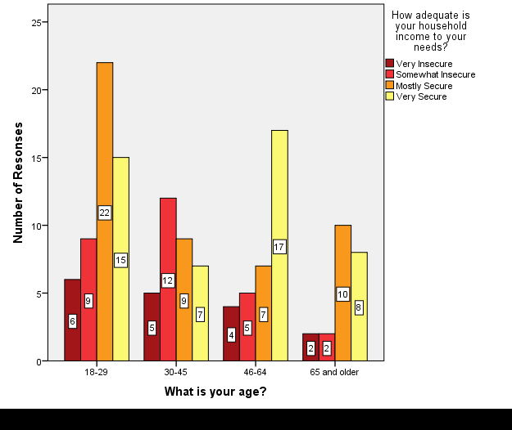
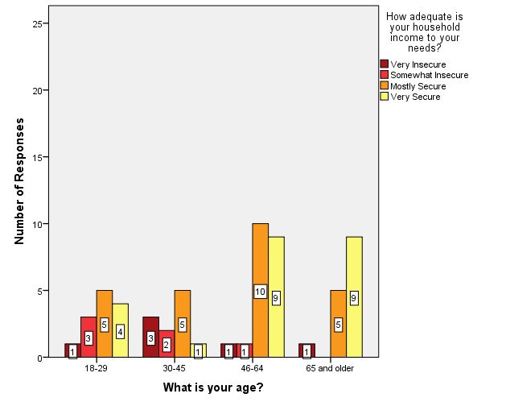
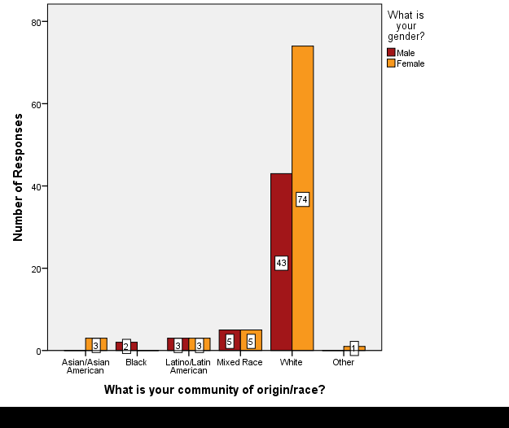
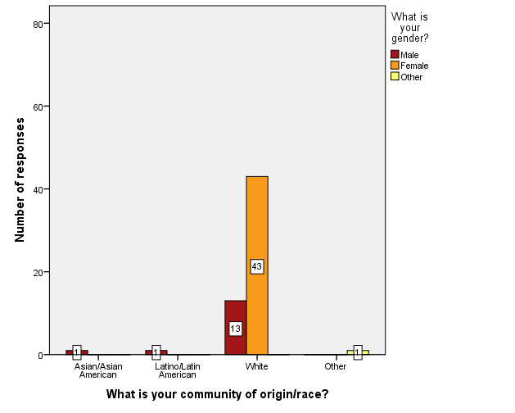
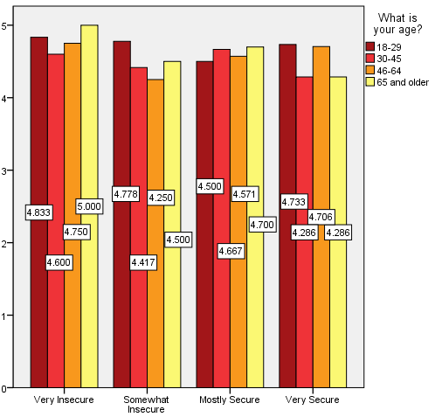
We the Citizens: Citizen Participation to Address Poverty
eau claire clear vision poverty summit
Emmanuel Castellanos, Psychology
Sophia Thoen, Social Work
Faculty Mentor: Dr. Ruth Cronje, English
Qualitative findings
background
Quantitative findings
Three coders were used and sufficient interrater reliability occurred between the three independent coders (average percentage agreement of 97.24, ĸ = 0.67). Summit participants answered three similar qualitative prompts in October and April.
Democracy means the rule and voice of the people. The Clear Vision Eau Claire (CVEC) Poverty Summit was meant to offer community members a mechanism of inclusion in the democratic process. From October 2016 to April 2017, community members gathered and deliberated on how to best solve the issue of poverty in the area; 13.1% of Eau Claire residents live below the poverty line (U.S. Census Bureau, 2016). This Poverty Summit was meant to include all types of community members in identifying and creating solutions related to reducing poverty
To protect individual anonymity, the October survey data is not linked to April survey data. Using SPSS 24.0, researchers conducted independent samples T-tests and frequency analyses.
what brought you here tonight?
WHAT IS YOUR AGE? WHAT IS YOUR INCOME SECURITY?
OCTOBER (LEFT) APRIL (RIGHT)
study objective
Our participation in the Summit was meant to investigate participants’ perception of the Clear Vision Eau Claire democratic process and demographics of participants over time. Was the CVEC Poverty Summit successful at including diverse voices throughout the entire process?
methods
Participants took voluntary, written surveys at the October (n=140) and April meeting (n=60). The October survey measured expectations and April measured reflections. These surveys collected demographic information and both quantitative and qualitative data.
Quantitative data was analyzed with SPSS 24.0 using independent samples T-tests and frequency analyses.
Grounded theory model, inductive thematic analysis, constant comparative method, and NVivo11® helped analyze qualitative responses.
Figure 1a. In October, participants stated a commitment to change and action, as well as curiosity about local poverty bringing them to the summit; in April, those were still the top reasons.
Figure 2a. Less than half of the total population at the October Poverty Summit were at the April Poverty Summit, including fewer very income insecure and somewhat insecure participants.
How can we ensure/were diverse voices (are) encouraged to participate in the Poverty Summit?
WHAT IS YOUR COMMUNITY OF ORIGIN/RACE?
OCTOBER (LEFT) APRIL (RIGHT)
discussion
We know that everyone has different lived experiences, therefore the same process cannot work equally for all participants. Retainment of diverse populations (and quantity of participants) was less at the final meeting than the first meeting. In a summit that focuses on the deliberative, democratic process surrounding poverty and diversity, it is important to have affected members be active stakeholders. Participants responded feeling that they treated each other respectfully across all household incomes, however those in poverty did not remain active in the summit, neither did other diverse populations.
Future research questions include:
How can we encourage the retainment of participants of a diverse background?
How do/can we value the input of diverse populations and continue to involve those experiencing poverty in the conversation surrounding poverty and actions that are taken?
Figure 1b. In October, diversity of experiences and then inclusivity were the top reported strategies to ensure voices were heard; by April, inclusivity was the most cited strategy.
How can we ensure/did diverse voices (will) guide the actions we will take to address poverty ? how?
Figure 2b. At the October Poverty Summit’s 84% of participants identified as white. By the April Poverty Summit, 95% of participants identified as white. Eau Claire, WI is 90.4% white (U.S. Census Bureau, 2016).
additional post-summit testimony*
DID PARTICIPANTS TREAT EACH OTHER RESPECTFULLY? (APRIL ONLY)
Why did you go to the CVEC Poverty Summit?
“The people who invited me were people who I respected…Being broke is a form of trauma…It determines what spaces you are welcome in, and whether people listen to you. I felt like the poverty summit was an opportunity to level that playing field, to have my voice be heard.”
Figure 2c. Participants were asked whether they perceived participants treating each other respectfully on a scale of 1 (strongly disagree) to 5 (strongly agree) participants. The average mean was between agree (4) and strongly agree (5) across all income securities.
What was the first meeting like?
“I was sitting there with $20 in my pocket and 10 days until I get paid. I was devastated during that meeting. If you know they knew this [ALICE poverty levels], why hasn’t something already been done? Why are they expecting my feedback without giving me any benefit from it? I know nothing is going to change soon…”
MEAN: Participants Treated Each Other Respectfully During The Summit
Figure 1c. Lastly, in October, inclusivity, diversity of experience, and the CVEC process were cited to ensure diverse voices to guide actions; by April, having diverse experiences present in order to guide action of the team was the most frequent strategy.
Why do you think others dropped out?
“People can't look upstream when they are the ones floating down the stream. ”
Household Income Security
Email for references: thoensk6816@uwec.edu; castelle7650@uwec.edu
*This testimony was provided by S. Ferber on March 15th, 2018. It is not included in the qualitative analysis. This CVEC Poverty Summit Participant is still on an action team and identifies as earning a low income.
We would like to thank our funding sources: our ORSP SREU grant and CVEC Poverty Summit.

