Slide 1

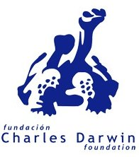
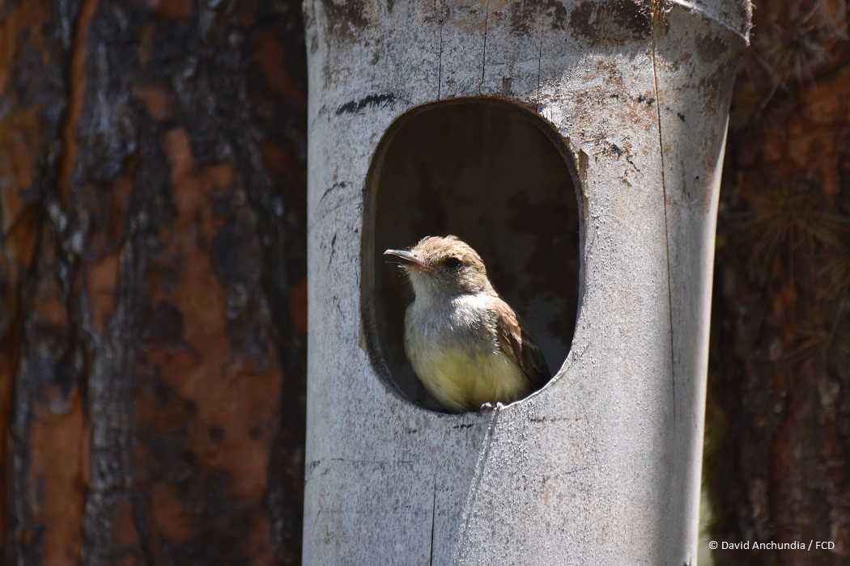
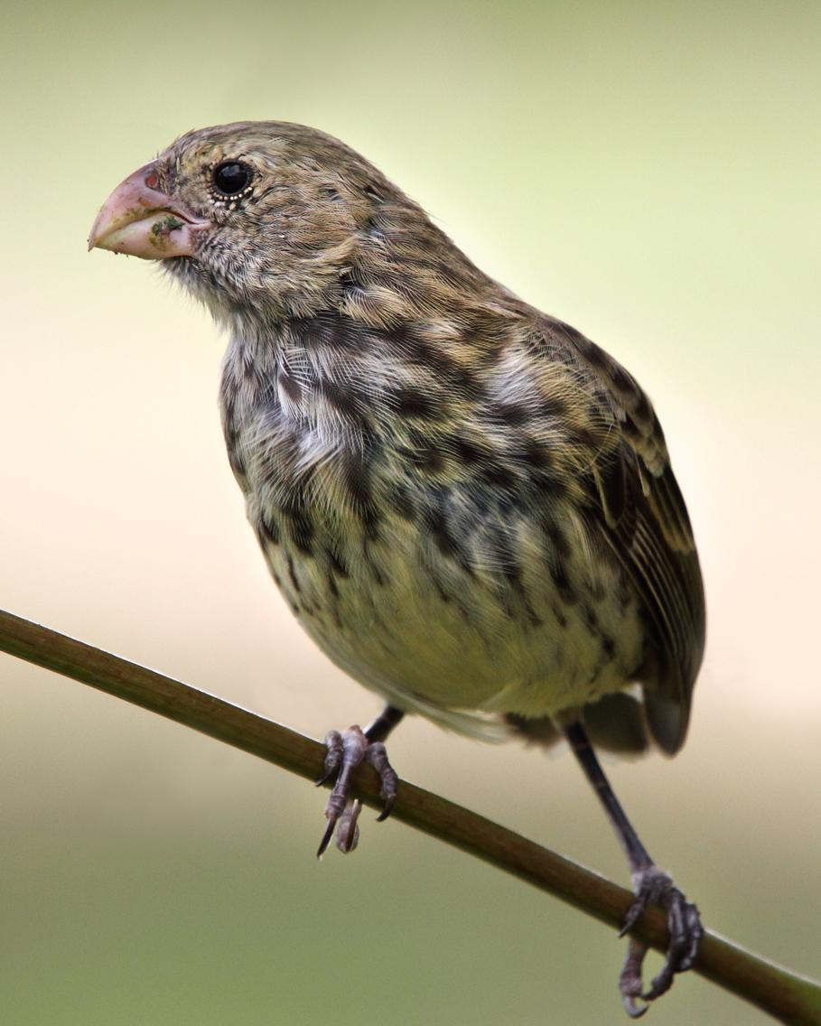
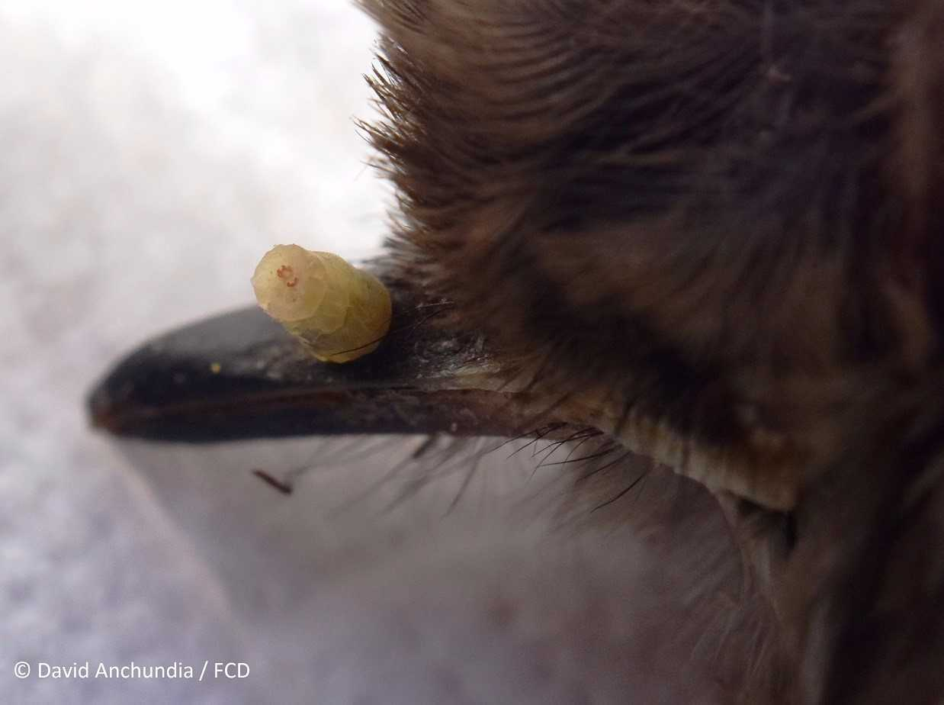
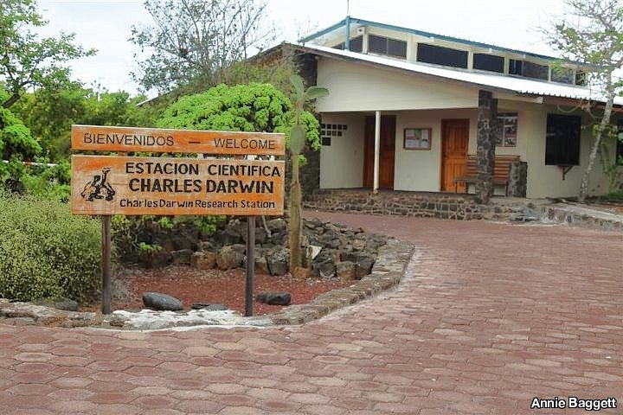
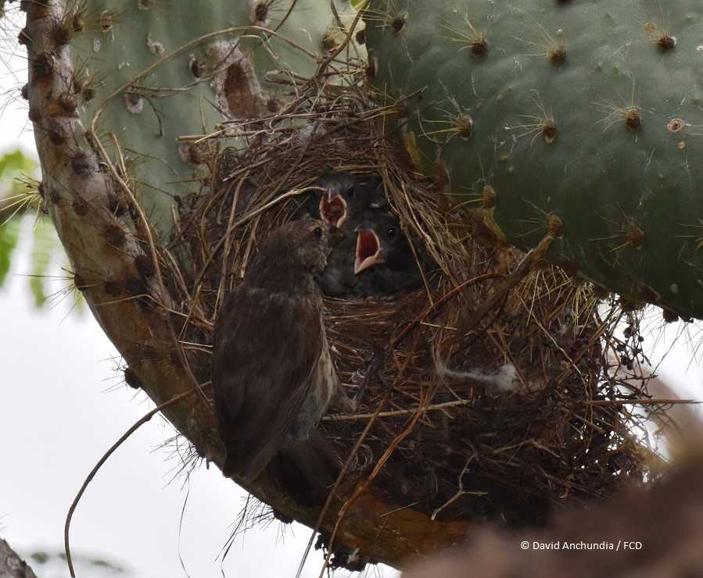
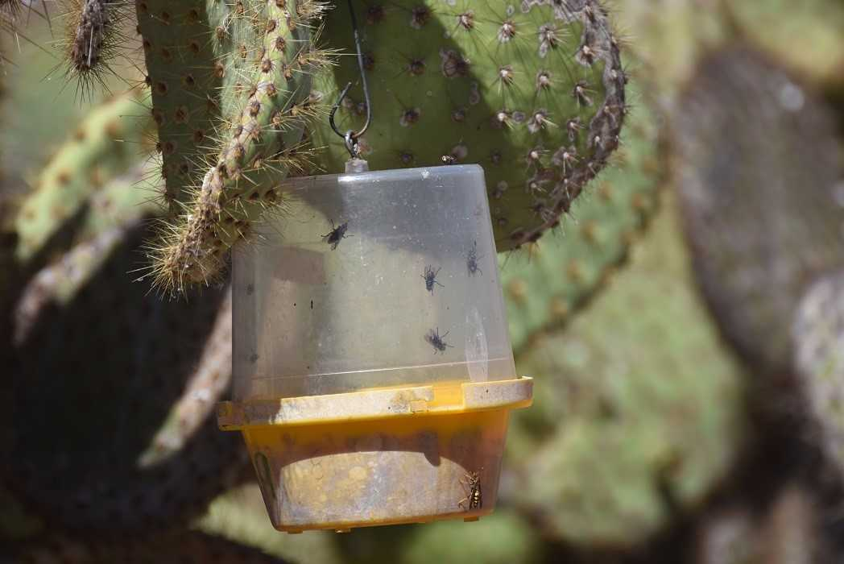
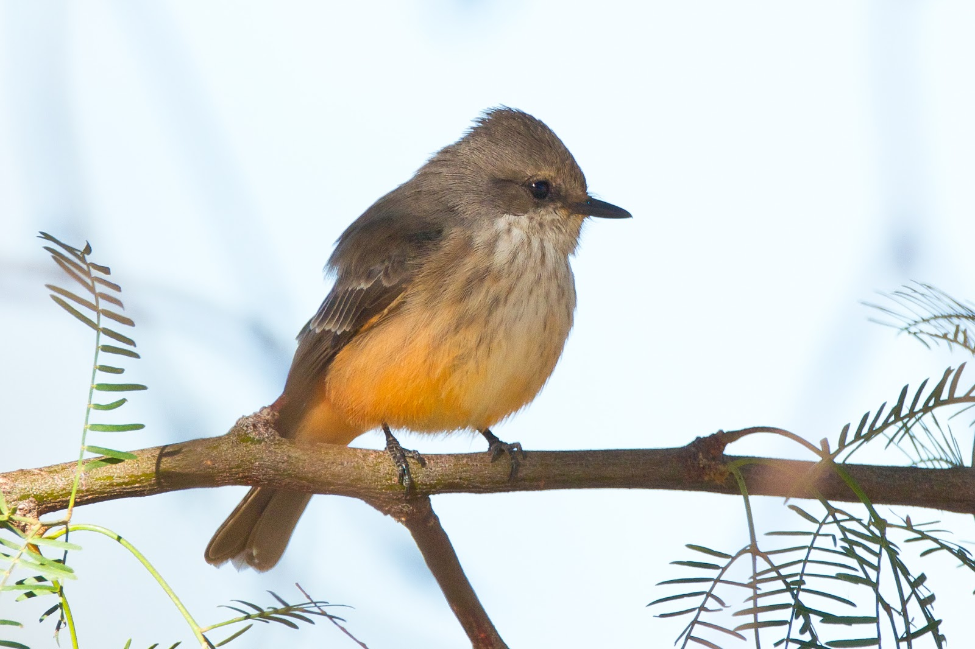
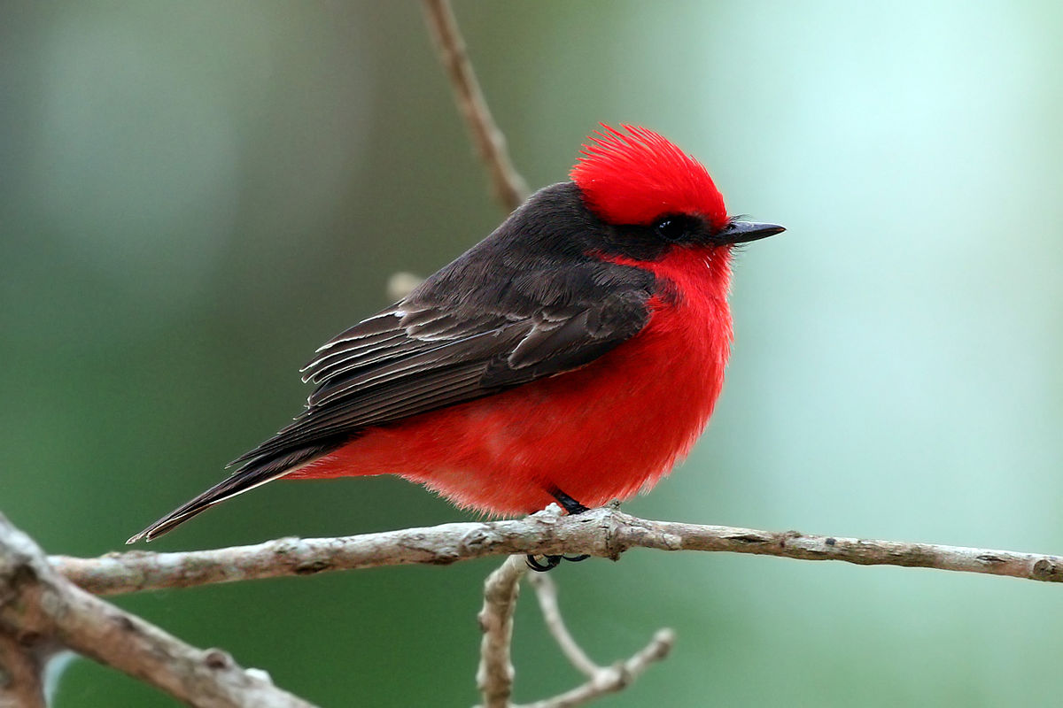
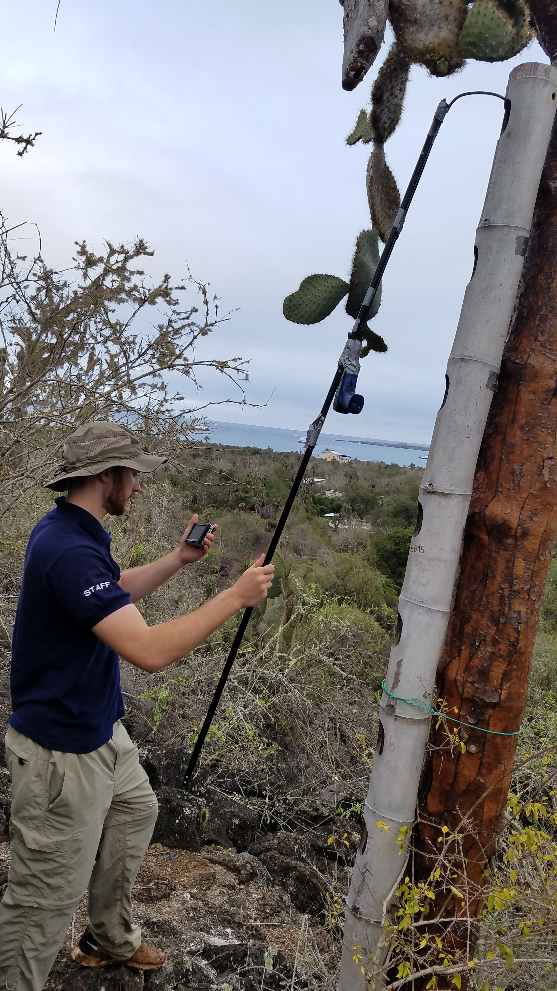
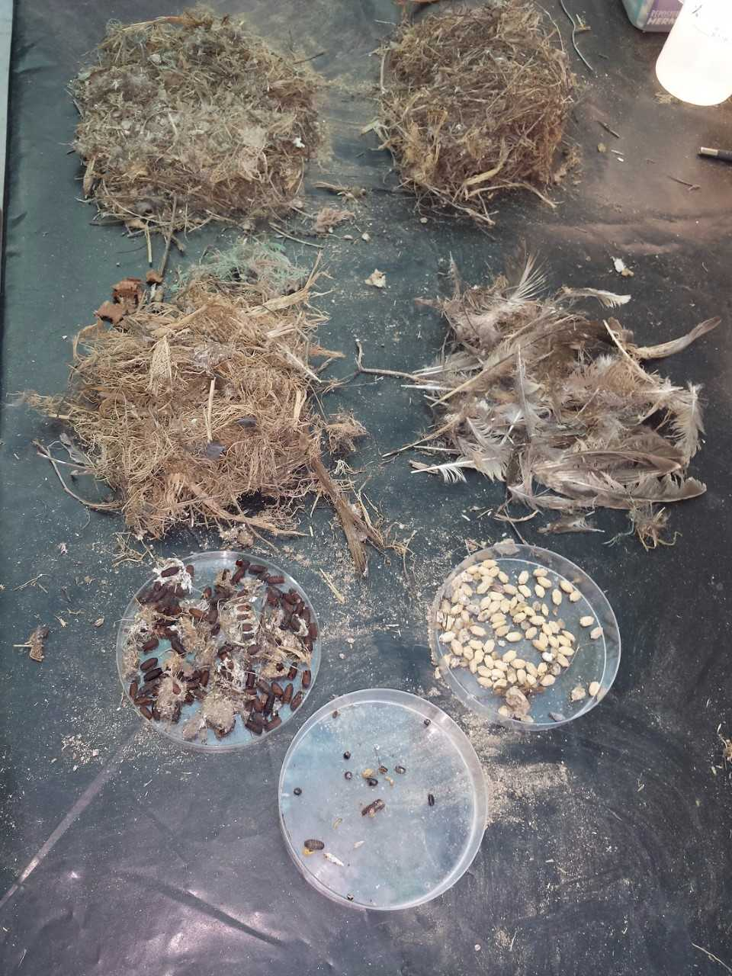
The Galapagos Islands Land Bird Conservation
and Philornis downsi Projects
Quinn Steiner, Dr. Wilson Taylor
Collaborators: Charles Darwin Research Station
Department of Biology, University of Wisconsin-Eau Claire, Eau Claire, WI
Introduction
The second aspect of the Land Bird Conservation Project worked to gather further information about species of which little is known including the Galapagos Flycatcher and the Vegetarian finch.
Philornis downsi Project
As part of the international research program through the biology department I had the opportunity to be involved with research at the Charles Darwin Research Station. Through the Charles Darwin Research Station I was involved with two large projects, the first being The Land Bird Conservation Project and the second being, the Philornis downsi project. The Land Bird Conservation Project focused on gathering ecological and breeding information on bird species that have been in serious decline. Another goal of the project was to gain more knowledge of the bird species that have had little information collected on them so far. This was done through monitoring feeding and nesting behavior as well as tracking the breeding of these bird species. This project also collaborated with the Philornis downsi project. This project attempts to gather information on ways to control the invasive parasitic fly Philornis downsi. By gathering information about mating, and breeding behavior of this fly species, the continued decline of many of the bird species within the Galapagos Islands can be prevented. Throughout the summer I collected data to be used to continue rebuilding the bird populations in the Galapagos Islands.
Philornis downsi is a parasitic fly that lays its eggs in the nests of these land birds. The larvae then hatch and crawl into the nostrils of the chick to feed on their blood which leads to the death of the chick. This project aims to gain more information about this fly and work to prevent the decline of multiple bird species.
Figure 3. Galapagos Flycatcher (Left) Vegetarian Finch (Right)
Nests of both species were observed for extended periods of time to monitor feeding behavior of the chicks and parents.
Nests infected with Philornis downsi were observed to determine the flies impact on the bird’s behavior.
Materials brought to the nests were also documented.
Figure 6. Larvae feeding on developing chick
Traps were placed at various locations around the research station to collect live flies.
In some experiments traps were placed at varying heights to determine flies’ preferred altitude.
Homozygous
Mutant Control
Figure 1. Charles Darwin Research Station
Figure 4. Female feeding her chicks
The Land Bird Conservation Project
Bamboo towers were used to monitor nesting behavior of the Galapagos Flycatcher.
These allowed us to monitor the chicks using video cameras, record the types of material used when making nests, and determine the preferred nesting heights.
Figure 7. Fly trap with multiple Philornis downsi captured
The first aspect of this project involved gathering information on bird species that are in serious decline including the vermillion flycatcher.
Abandoned and empty nests were collected and examined for the presence of Philornis downsi larvae.
Nest materials were quantified to determine correlations between nest content and presence of Philornis downsi
Figure 2. Feale Vermillion Flycatcher (Left) Male (Right)
GPS coordinates of Vermillion Flycatcher nests were gathered.
Video cameras were used to gather information regarding the age and health of chicks.
The nests were observed for an extended period of time to monitor how often the nests were visited by the parents.
Interactions between male and female Vermillion Flycatchers were also observed to better understand mating behaviors.
Figure 8. Sorted nest material
Acknowledgements
Thank you to IFP and the Charles Darwin Research Foundation for funding and support.
Figure 5. Using video camera to record chick behavior

