Slide 1

WIRELESS POWER TRANSFER USING CLASS-DE CONVERTER VIA STRONGLY COUPLED TWO PLANAR COILS
by
Ayetullah Bahadir Biten
The University of Wisconsin – Milwaukee, August 2016
Under the supervision of Professor Adel Nasiri

Slide 2


Who am I?
Electrical and Electronics Engineering Bachelors Degree at Dokuz Eylul University Turkey (2008 - 2012)
T.C. Ministry of National Education Scholarship Award (2012)
English as Second Language Program at The University of Pennsylvania (2013 - 2014)
Electrical Engineering Master of Science Degree at The University of Wisconsin - Milwaukee (2014 - 2016)
￼
￼
Contact Info:
abbiten@uwm.edu
414-5262003

Slide 3



Who do I work with?
Ethan Zimany / Master of Science in Electrical Engineering
Birger Pahl / Lead Engineer at Eaton Corp.
Vijay Bhavaraju / Principal Engineer at Eaton Corp.
￼

Slide 4
OUTLINE
Introduction Class-D Power Amplifier Class-E Power Amplifier
Wireless Power Transfer System Class-DE Converter Design Inductive Coupling of Two Planar Coils
Matlab/Simulink Simulation Simulation Settings Simulation Results Efficiency Calculations a. Method 1: Via Resistive Losses b. Method 2: Input vs. Output Power
Varying Load Condition Analysis for Real Life Cases Case1: Circuit Designed for Full Load Case2: Circuit Designed for Half Load Comparison of the Two Designs a. Full Load Circuit Run Under Half Load b. Half Load Circuit Run Under Full Load Output Voltage Control
Conclusion
References
￼
￼

Slide 5
Introduction
A Wireless Power System:
Transfer of Electric Power Wirelessly – Coreless (coupling < 1)
Transmitter & Receiver
Microwatts to Megawatts
Short - Medium - Long Distances
Coupling Constant (k) is Defined
Efficiency
￼
￼

Slide 6
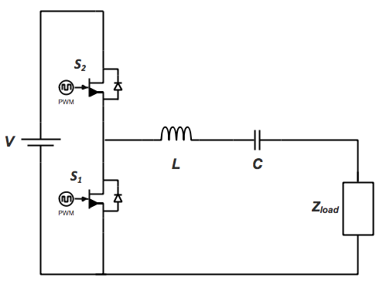
Introduction
Class-D Power Amplifier: [1]
Transistor timing is key (zero current or voltage hit)
50% Duty cycle
Transistor voltage stress = Supply voltage
C_{oss} may result in high loss at higher freq. (wireless)
ZCS (zero current switching) → ZVS (zero voltage switching) by adjusting load to appear inductive
High efficiency (up to %100) under high f
Below Optimal Impedance = Inductive Above Optimal Impedance = Capacitive (Decrease in conversion efficiency)
￼
￼
Figure 1: Class-D Power Amplifier Circuit
Notes:
However, tuning the load to appear inductive @operating f shifts the resonancy below the tuned f, so the efficiency goes down.

Slide 7
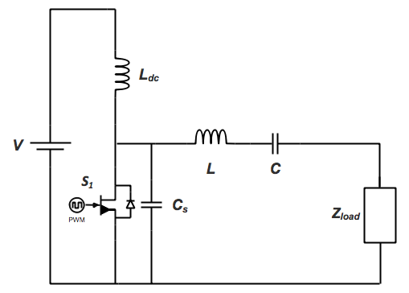
Introduction
Class-E Power Amplifier: [2]
Single switch (easier, cheaper)
50% duty cycle
ZVS (zero voltage switching) & ZVDS (zero derivative voltage switching)
Higher power delivered
Transistor stress is 3.56 times of input
Below Optimal Impedance = Inductive Above Optimal Impedance = Capacitive (Decrease in conversion efficiency)
￼
￼
Figure 2: Class-E Power Amplifier Circuit
Notes:
Complexity of out-of-phase of PWM is eliminated

Slide 8
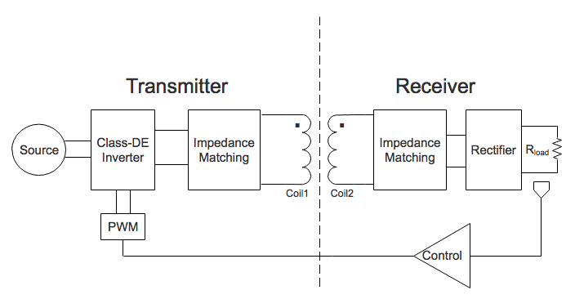
Wireless Power Transfer System
￼
￼
Figure 3: Proposed System
Notes:
+Transmitter sends only when the receiver penetrates the magnetic field
+Power transferred when needed
+Q is important
+Alignment is important, coil ratios is important

Slide 9
Wireless Power Transfer System
Project Requirements:
Resonant inductive coupling
High efficiency converter design ( >85% )
Input voltage limitation ≈ 700V
10 V_{dc} output voltage
500W power at the output (for full load condition)
25kHz - 35kHz switching frequency range
2mm gap between inductive coils (high coupling)
￼
￼
Notes:
2 magnetically coupled coils that are part of resonant circuits tuned to resonate at a freq. (band pass filters in radios and switching power supplies)
The current rings between coil and cap and creates oscillating magnetic field

Slide 10
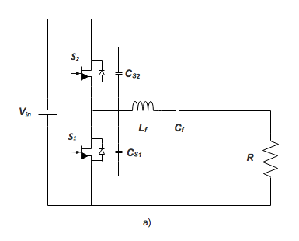
Wireless Power Transfer System
Class-DE Converter Design:
25% duty cycle
ZVS (zero voltage switching) & ZVDS (zero derivative voltage switching)
Shunt capacitors for improved efficiency
Advantages of both class-E and class-D
￼
￼
Figure 4: Class-DE Power Amplifier Circuit

Slide 11


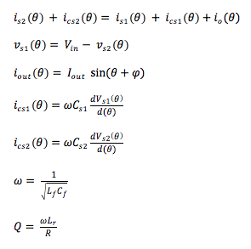
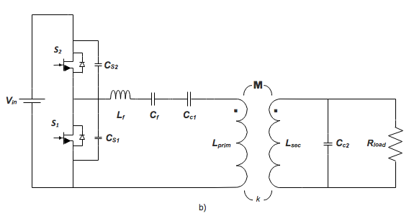
Wireless Power Transfer System
Starting with [3]
￼
￼
Figure 5: Class-DE Power Amplifier with Inductive Coils and Load

Slide 12



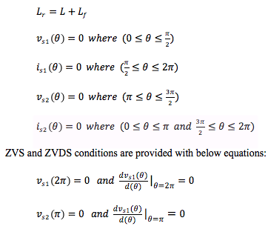

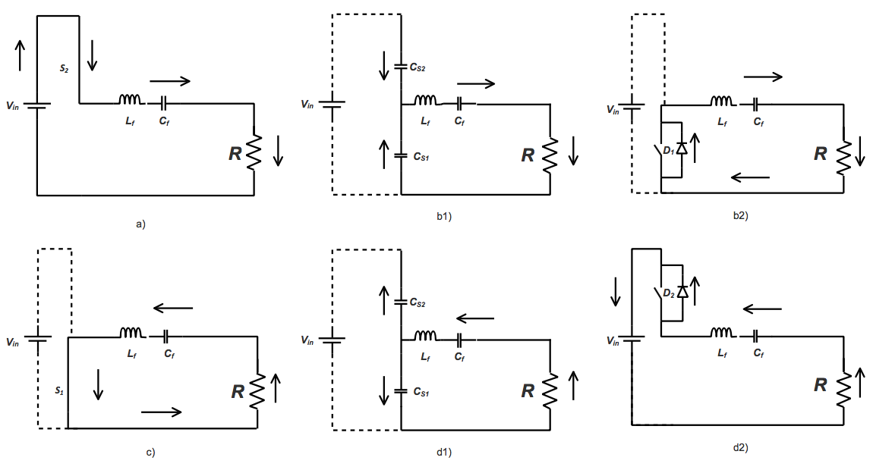
Wireless Power Transfer System
Continuing
￼
￼

Slide 13
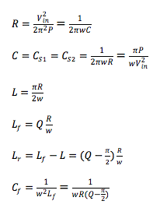
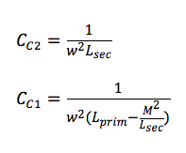
Wireless Power Transfer System
Finally
￼
￼
Figure 5: Class-DE Power Amplifier with Inductive Coils and Load

Slide 14
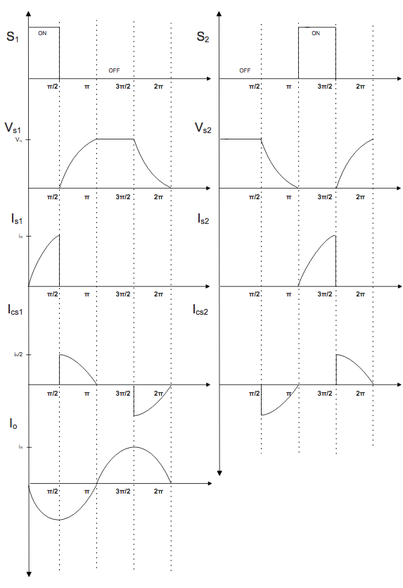
Wireless Power Transfer System
￼
￼
Figure 6: Waveforms of a Class-DE Power Amplifier

Slide 15

Wireless Power Transfer System
￼
ZVS and ZVDS apply as
￼
Figure 6: Waveforms of a Class-DE Power Amplifier

Slide 16
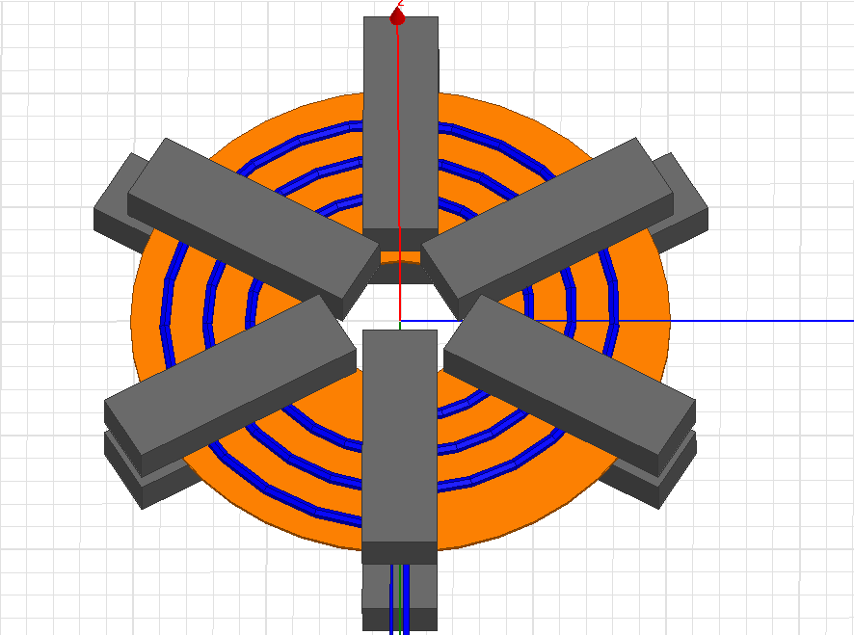
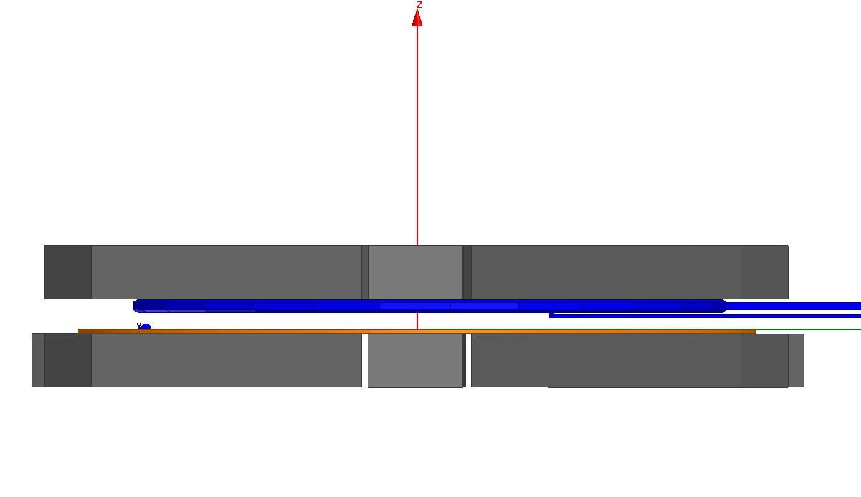
Wireless Power Transfer System
Inductive Coupling of Two Planar Coils:
Ethan Zimany’s research [4] is on design of highly inductive-coupled two planar coils
To Maximize k
Reduce the gap (2mm)
Increasing the ferrite area → Increase in flux coupling →Increase in inductance of the coils →Decrease in flux density (less heat loss)
￼
￼
Notes:
To optimize the ferrite core cofiguration

Slide 17
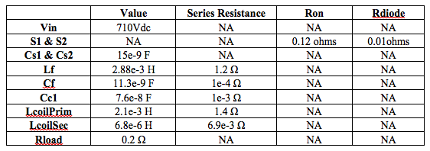
Matlab/Simulink Simulation
Simulation Settings:
Coupled N=16
k=0.9
￼
￼
Table 1: Circuit Component Values for Full Load Design
Notes:
Started with the Vin and Pout

Slide 18
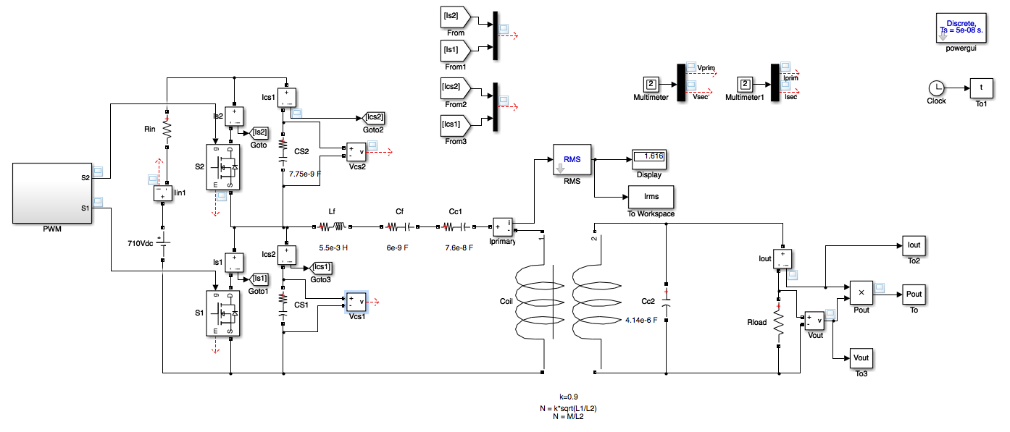
Matlab/Simulink Simulation
￼
￼
Figure 7: Circuit of the Proposed System Created Using Simulink

Slide 19
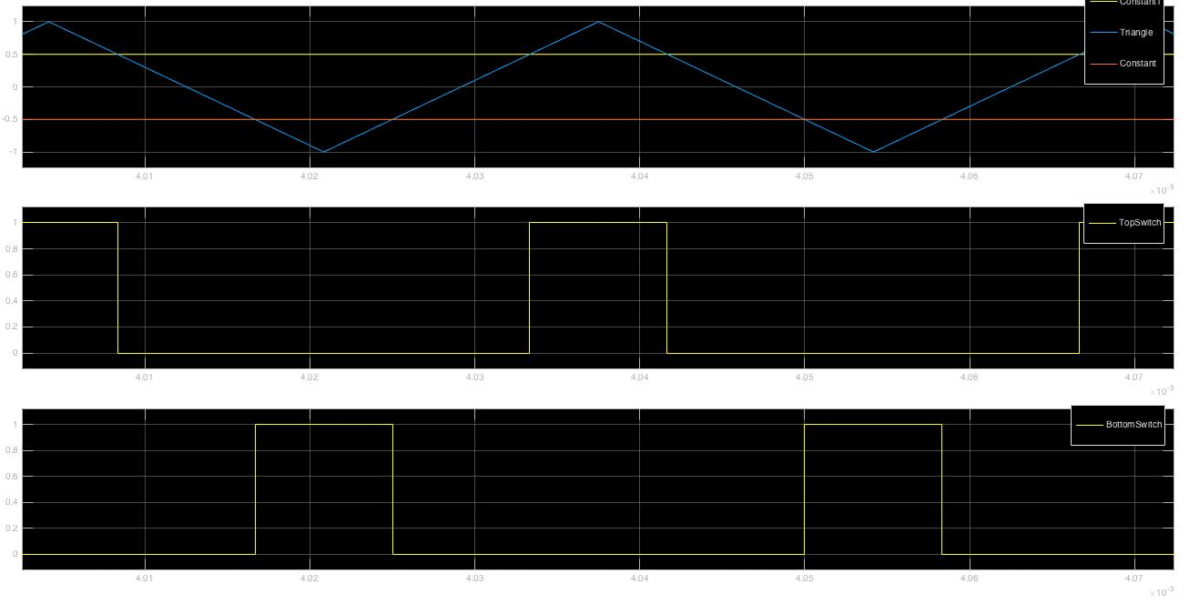
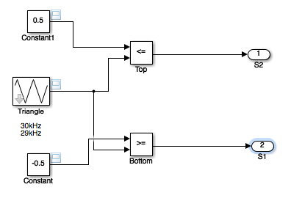
Matlab/Simulink Simulation
￼
￼
Figure 8: Inside of the PWM Block
Figure 9: PWM Plot

Slide 20
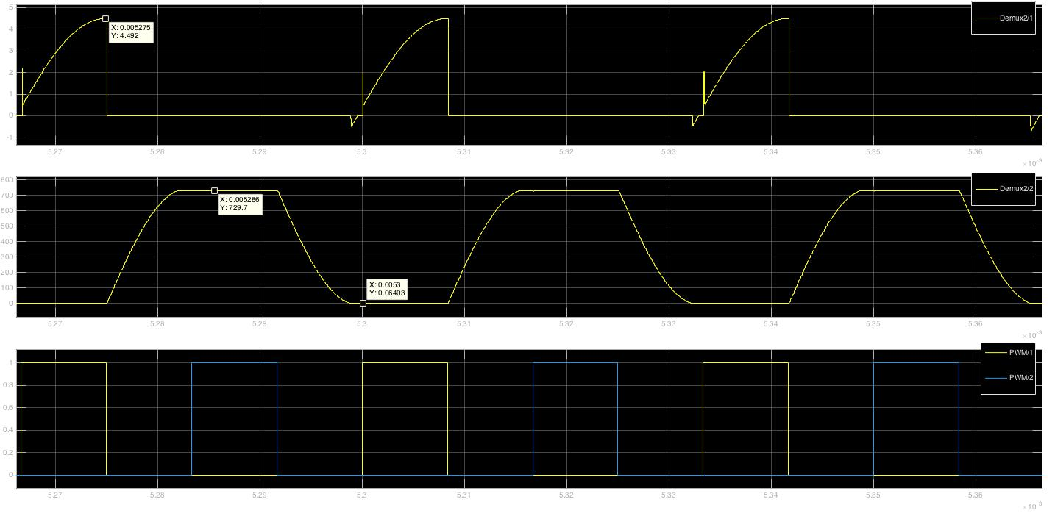
Matlab/Simulink Simulation
I_{S2}
￼
￼
V_{S2}
PWM
Figure 10: Current, Voltage, PWM vs. Time (top to bottom) Waveforms of the Top Switch S₂ for Full Load Design

Slide 21
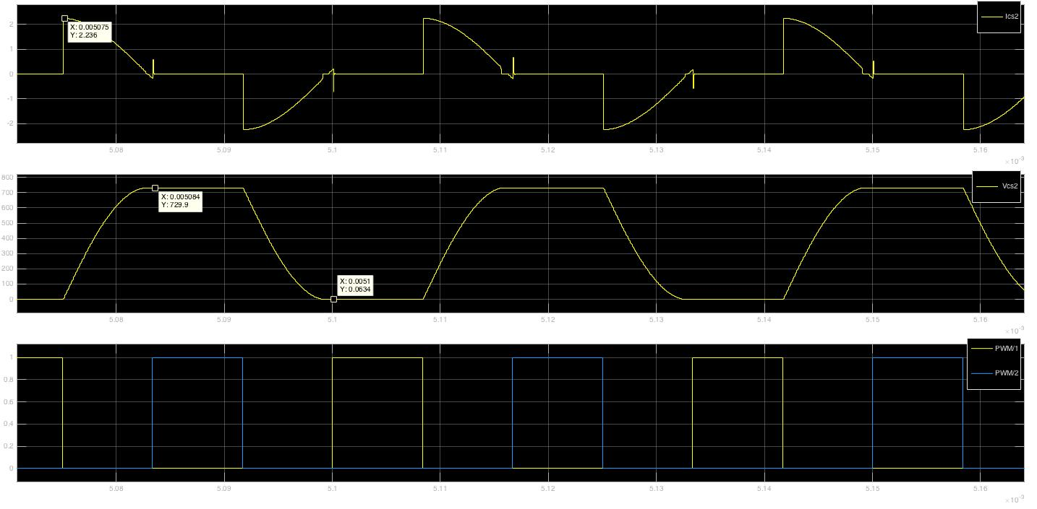
Matlab/Simulink Simulation
I_{CS2}
￼
￼
V_{CS2}
PWM
Figure 11: Current, Voltage, PWM vs. Time (top to bottom) Waveforms of the Top Top Shunt Capacitor C_{S2} Full Load Design

Slide 22
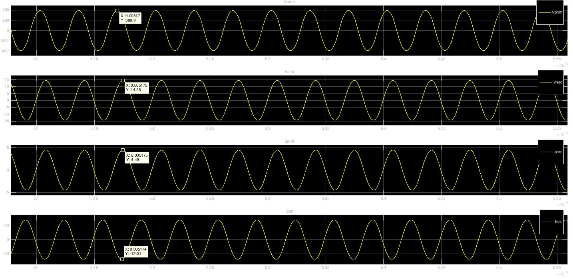
Matlab/Simulink Simulation
V_{prim}
V_{sec}
￼
￼
I_{prim}
I_{sec}
Figure 12: Primary Coil Voltage, Secondary Coil Voltage, Primary Coil Current, Secondary Coil Current (top to bottom) vs.
Time Wave Forms for Full Load Design
Notes:
Nice sinusoidal waveforms (easier to deal with EMI)

Slide 23
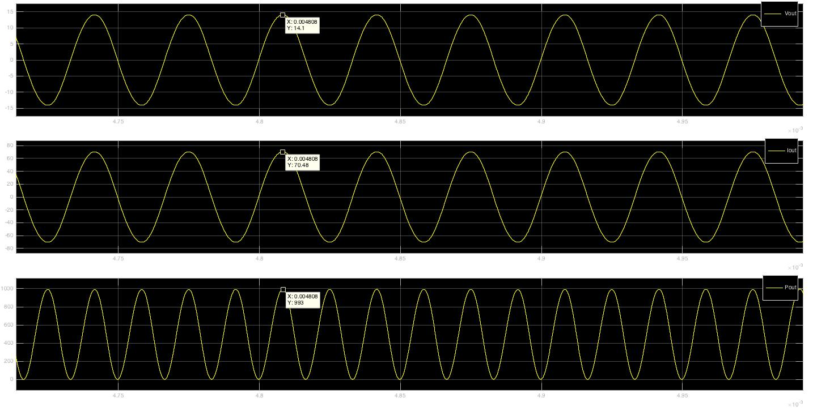
Matlab/Simulink Simulation
V_{out}
￼
￼
I_{out}
P_{out}
Figure 13: Voltage, Current, and Power (top to bottom) vs. Time Waveforms of the Load for Full Load Design

Slide 24
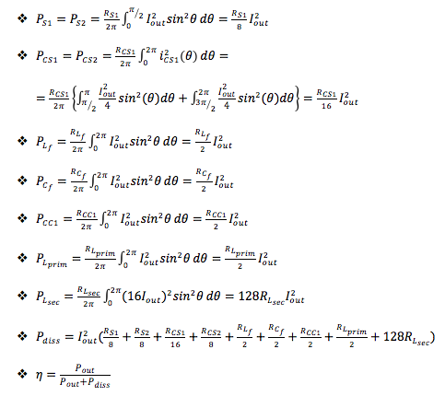
Matlab/Simulink Simulation
Efficiency Calculations:
Method 1: Via Resistive Losses [3]
Series resistance of each component
Integration during conduction on the switches
Used in this paper
￼
￼

Slide 25
Matlab/Simulink Simulation
Efficiency Calculations:
Method 1: Via Resistive Losses
%open up the .mdl file first
%change the load manually in the .mdl file itself
%resistance values can be changed below based on real series resistance values
Rs1=0.12;Rcs=1e-5;Rlf=1.2;Rcf=1e-4;Rcc=1e-3;Rprim=1.4;Rsec=6.9e-3;
%calculate the system efficiency by
%setting up the freq below in "set_param" command
%changing freq will regulate the output voltage
set_param('FCwoRec30/PWM/Triangle','Freq','30e3')
sim('FCwoRec30')
Pdiss = ([max(Irms)*sqrt(2)]^2)*[(Rs1/4)+(Rcs/8)+(Rlf/2)+(Rcf/2)+(Rcc/2)+(Rprim/2)+
(Rsec*128)];
Pout=max(Vout)*max(Iout);
n=100*Pout/(Pout+Pdiss)
￼
￼
Table 2: Matlab Script of Method 1 Efficiency Calculation

Slide 26
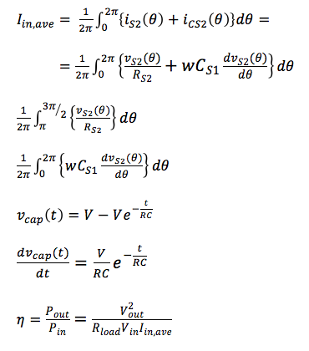
Matlab/Simulink Simulation
Efficiency Calculations:
Method 2: Input Vs. Output Power [5]
Average input current
Average input power vs. output power
￼
￼
Notes:
1st integral for Switch branch
2nd integral for Capacitor branch

Slide 27
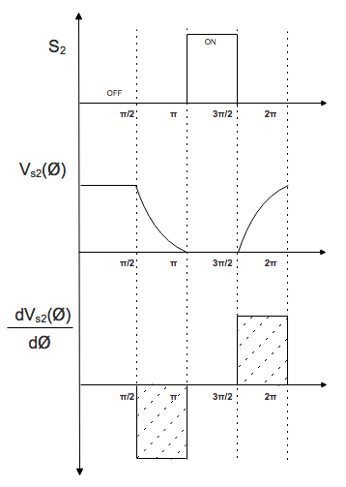
Matlab/Simulink Simulation
Efficiency Calculations:
Method 2: Input Vs. Output Power
￼
￼
Switch is conducting,
R_{S2} is active
Capacitor is conducting
Figure 14: Class-DE Power Amplifier Branch Currents
Figure 15: PWM, Voltage, Derivative of Voltage vs. Time of Top Switch

Slide 28
Varying Load Condition Analysis for Real Life Cases
In Real Life Applications:
Adaptive system
Load variation
Worst case scenario - optimal point
Half Load (250W) - Full Load (500W)
Non-resonance
Circuit component selection
Method
￼
￼
Full Power Design
Half Power Design
Run Under Full Power
Run Under Half Power
Notes:
Vital to have an adaptive system

Slide 29
Varying Load Condition Analysis for Real Life Cases
Case 1: Circuit Designed for Full Load
Previous Slides have showed the simulation results for full load condition
500W
10V_{dc}
Resistive Load of 0.2Ω
Calculated efficiency of ≈ 95.75%
￼
￼

Slide 30
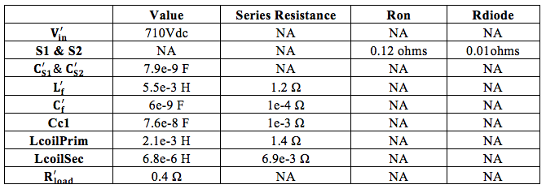
Varying Load Condition Analysis for Real Life Cases
Case 2: Circuit Designed for Half Load
250W
10V_{dc}
Resistive Load of 0.4Ω
Calculated efficiency of ≈ 97.8%
￼
￼
Table 3: Circuit Component Values for Half Load Design

Slide 31
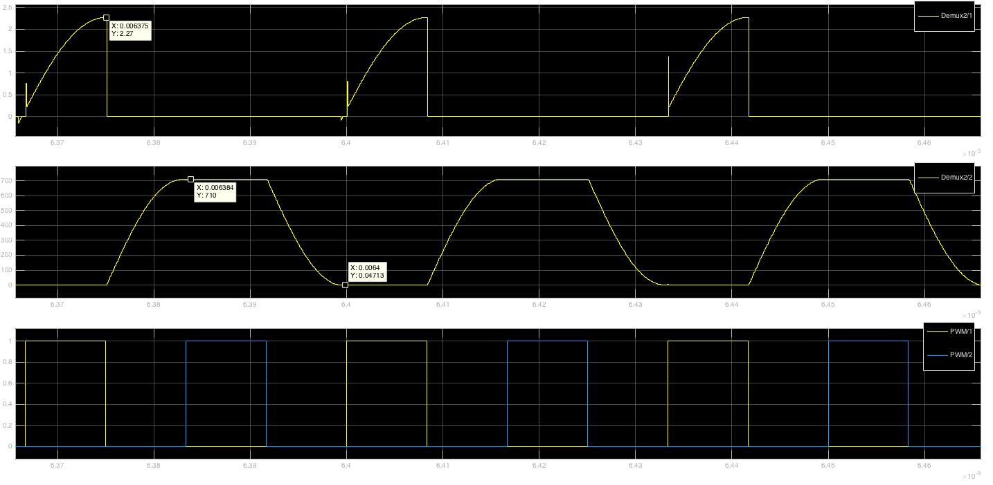
Varying Load Condition Analysis for Real Life Cases
Case 2: Circuit Designed for Half Load
I_{S2}
￼
￼
V_{S2}
PWM
Figure 16: Current, Voltage, and PWM vs. Time (top to bottom) Waveforms of the Top Switch S₂ for Half Load Design

Slide 32
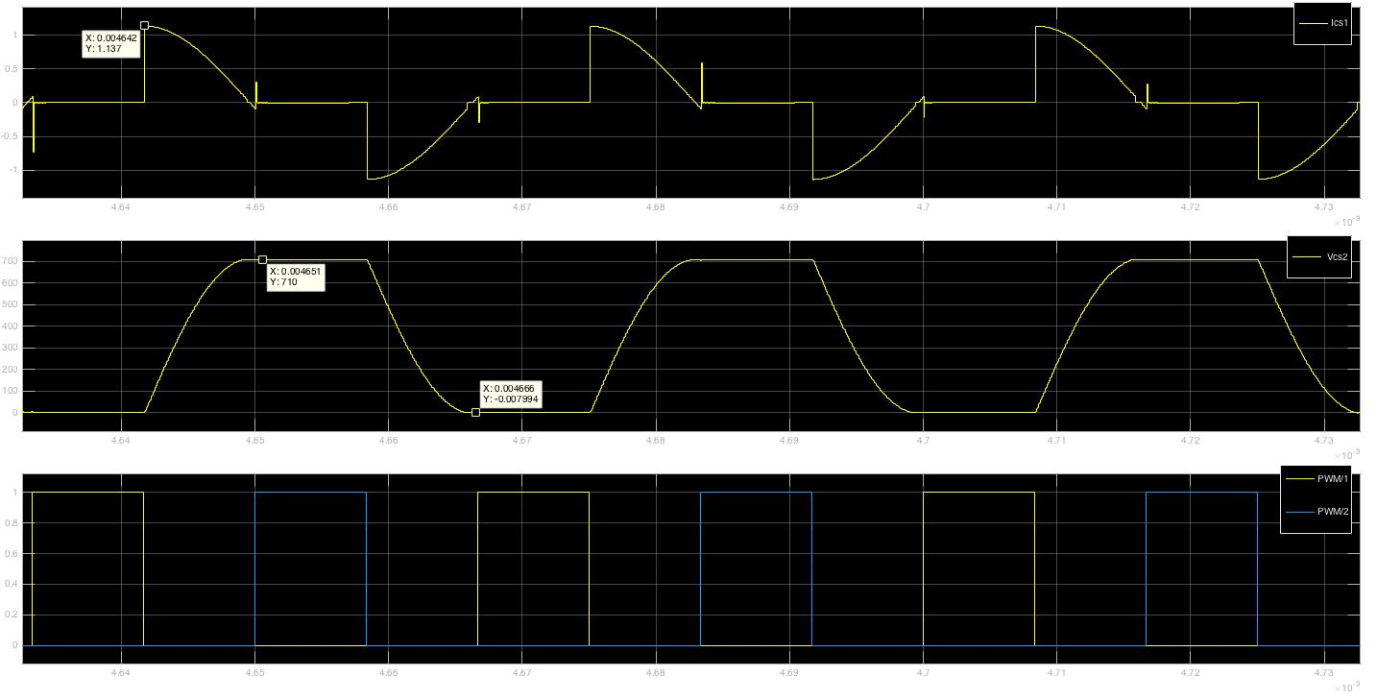
Varying Load Condition Analysis for Real Life Cases
Case 2: Circuit Designed for Half Load
I_{CS2}
￼
￼
V_{CS2}
PWM
Figure 17: Current, Voltage, and PWM vs. Time (top to bottom) Waveforms of the Top Shunt Capacitor C_{S2}
for Half Load Design

Slide 33
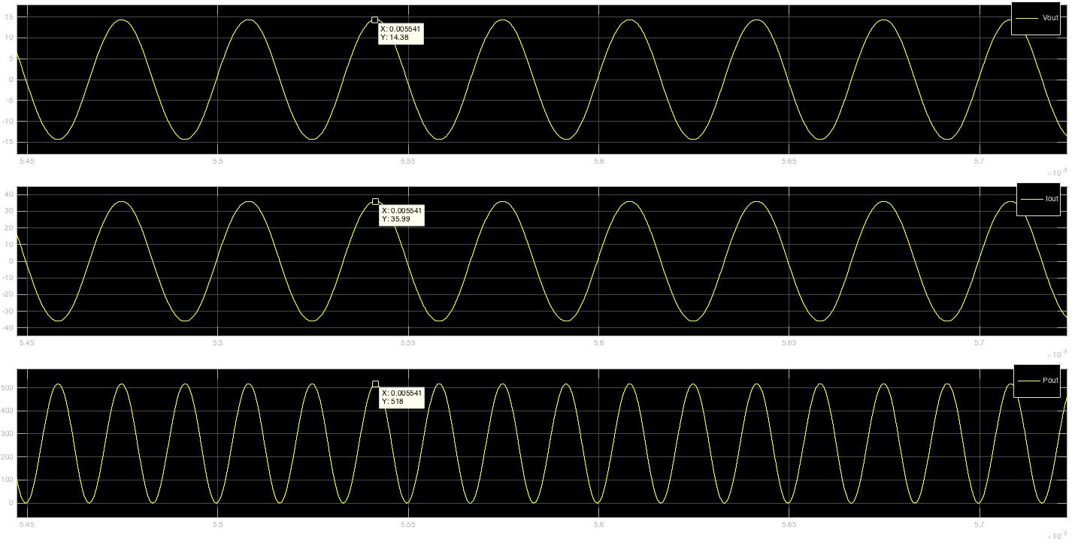
Varying Load Condition Analysis for Real Life Cases
Case 2: Circuit Designed for Half Load
V_{out}
￼
￼
I_{out}
P_{out}
Figure 18: Voltage, Current, and Power (top to bottom) vs. Time Waveforms of the Load for Half Load Design

Slide 34
Varying Load Condition Analysis for Real Life Cases
Comparison of Two Designs
Full Load Design Run Under Half Load
Change of R_{load} from 0.2Ω to 0.4Ω
Change the f_{s} = 31.8kHz to adjust the output voltage (will be mentioned)
Less current is drawn from the supply
Shunt capacitors can’t be fully charged
Or fully charged capacitor can’t fully discharge
Resulting in peak in current waveform
Harmful stress on devices
Efficiency is not calculated
￼
￼
Notes:
The purpose of this section is to validate if any of these scenario-based designs would be a perfect fit for all conditions between full power and half power
It can still be in safe operating area (but we want to avoid)

Slide 35
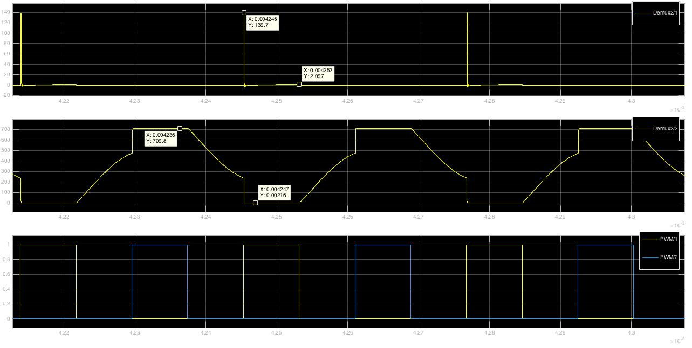
Varying Load Condition Analysis for Real Life Cases
Comparison of Two Designs
Full Load Design Run Under Half Load ( @ 31.8kHz )
I_{S2}
V_{S2}
PWM
Figure 19: Current, Voltage, and PWM vs. Time (top to bottom) Waveforms of the Top Switch S₂ for Full Load Design
Run Under Half Load Condition at 31.8kHz

Slide 36
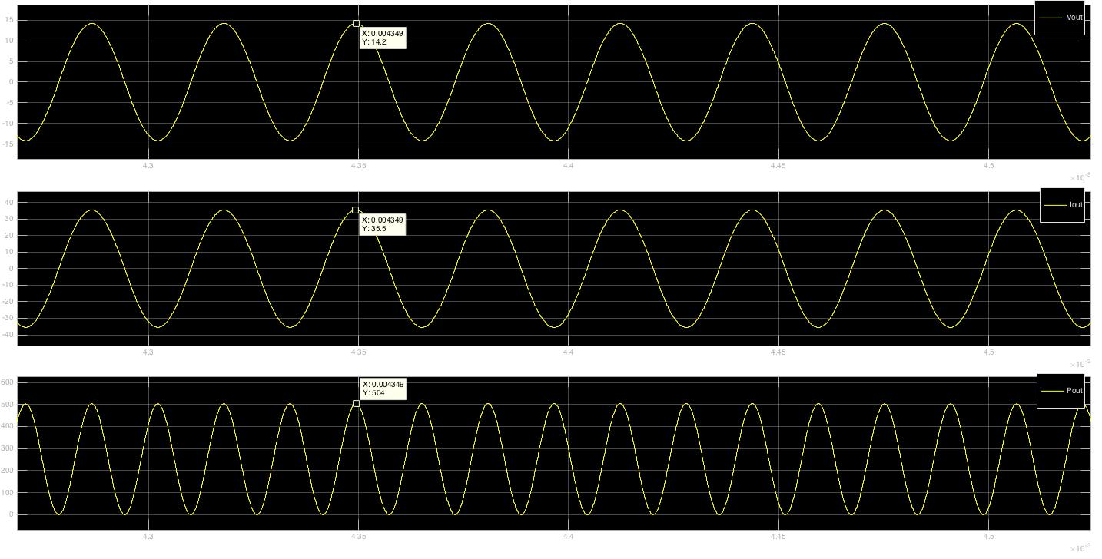
Varying Load Condition Analysis for Real Life Cases
Comparison of Two Designs
Full Load Design Run Under Half Load ( @ 31.8kHz )
V_{out}
I_{out}
P_{out}
Figure 20: Voltage, Current, and Power (top to bottom) vs. Time Waveforms of the Output for Full Load Design
Run Under Half Load Condition at 31.8kHz

Slide 37
Varying Load Condition Analysis for Real Life Cases
Comparison of Two Designs
Half Load Design Run Under Full Load
Change of R_{load} from 0.4Ω to 0.2Ω
Keep the the f_{s} = 30 kHz
More current is drawn from the supply
Shunt capacitors are charged quickly
Or discharged quickly
Resulting in dead times waveforms
No extra stress on device, but extra resistance losses
￼
￼

Slide 38
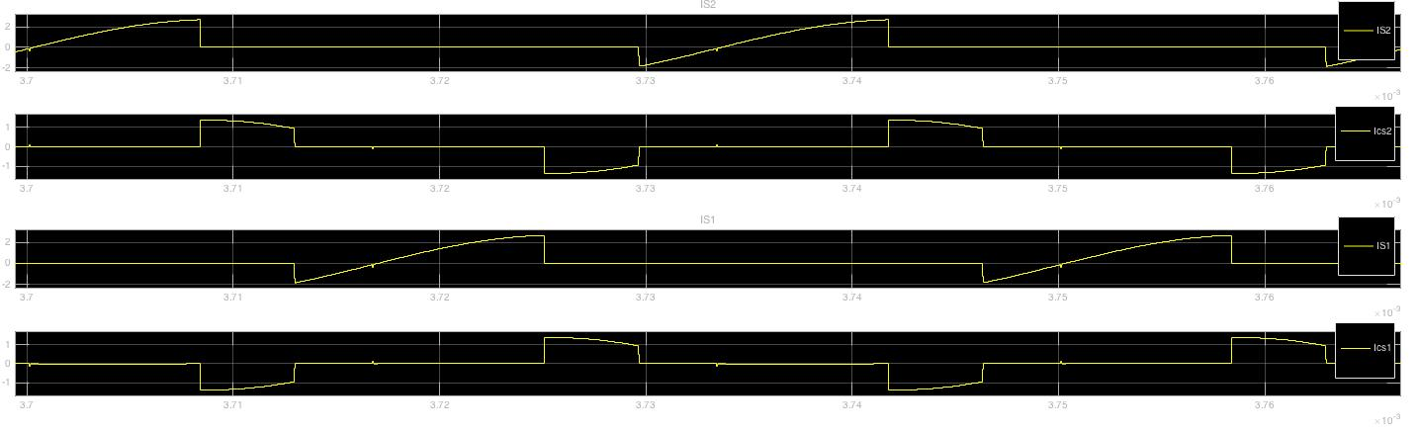
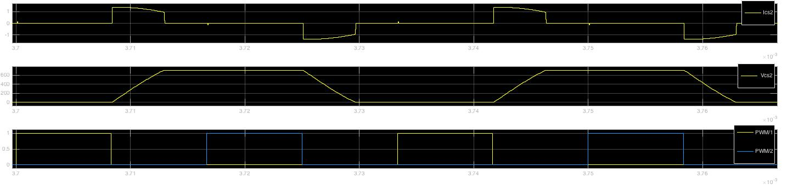
Varying Load Condition Analysis for Real Life Cases
Comparison of Two Designs
Half Load Design Run Under Full Load ( @ 30kHz )
I_{S2}
￼
￼
I_{CS2}
I_{S1}
I_{CS1}
PWM
Figure 21: Top Switch, Top Shunt Capacitor, Bottom Switch, Bottom Shunt Capacitor Currents (top to bottom) vs. Time
Waveforms for Half Load Design Run Under Full Load Condition at 30kHz

Slide 39
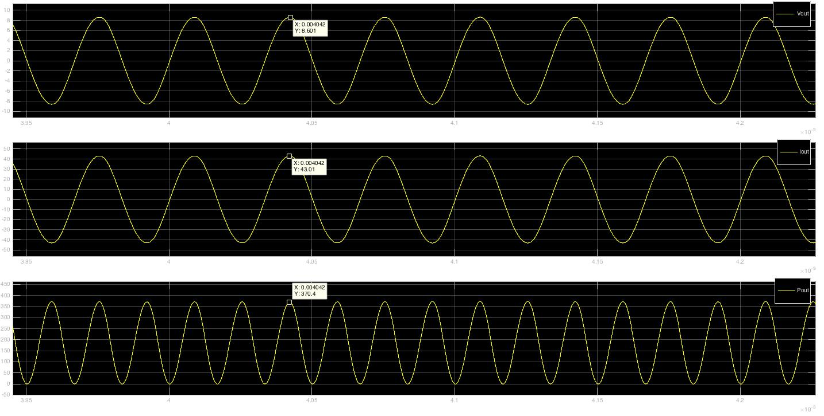
Varying Load Condition Analysis for Real Life Cases
Comparison of Two Designs
Half Load Design Run Under Full Load ( @ 30kHz )
V_{out}
￼
￼
I_{out}
P_{out}
Figure 22: Voltage, Current, and Power (top to bottom) vs. Time Waveforms of the Output for
Half Load Design Run Under Full Load Condition at 30kHz

Slide 40
Varying Load Condition Analysis for Real Life Cases
Comparison of Two Designs
Half Load Design Run Under Full Load ( @ 30kHz )
￼
￼
Figure 23: Current Flow Paths for Each Operation Cycle of Class-DE Power Amplifier

Slide 41
Varying Load Condition Analysis for Real Life Cases
Output Voltage Control [6]
Voltage regulated by change of frequency
Out of resonant
Capacitive losses (above optimal point)
Distortions can be eliminated with duty cycle
Closed feedback is required
A Matlab script is written
￼
￼
Table 3: Matlab Script of Frequency Sweeping

Slide 42
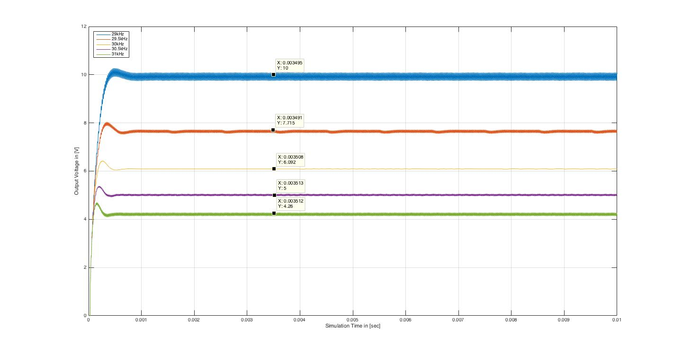
Varying Load Condition Analysis for Real Life Cases
Output Voltage Control
29 kHz
￼
29.5 kHz
￼
30 kHz
30.5 kHz
31 kHz
Figure 24: Output Voltage vs. Time with Variable Switching Frequency of Half Load Design Run Under Full Load Condition
Notes:
When f change is introduced, distortions occur

Slide 43
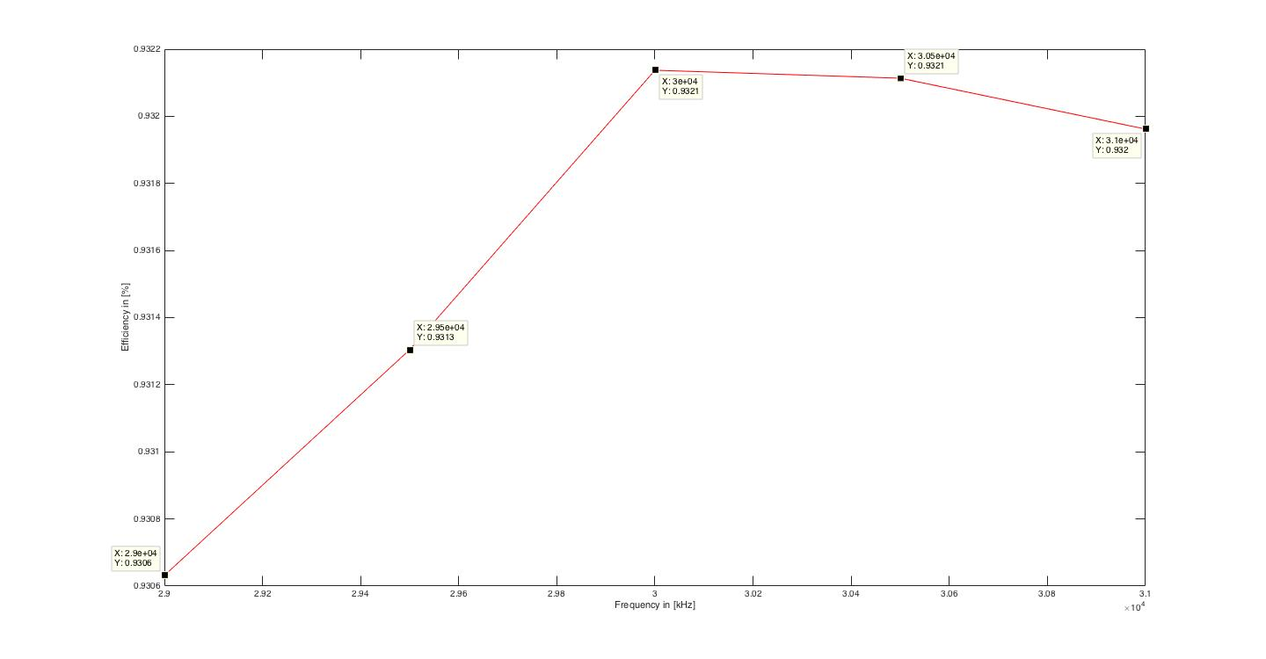
Varying Load Condition Analysis for Real Life Cases
Output Voltage Control
￼
￼
Figure 25: Efficiency vs. Frequency of Half Load Design Run Under Full Load Condition with 25% Duty Cycle

Slide 44
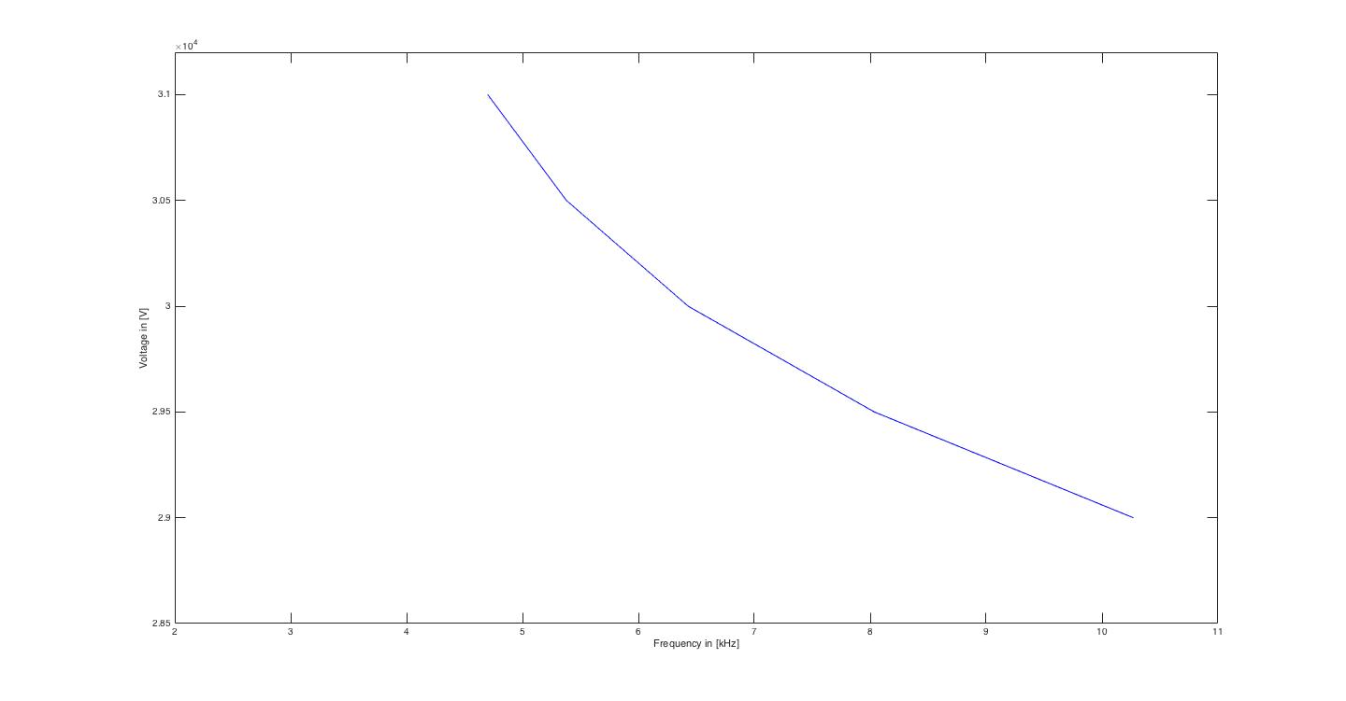
Varying Load Condition Analysis for Real Life Cases
Output Voltage Control
￼
￼
Figure 26: Voltage vs. Frequency of Half Load Design Run Under Full Load Condition

Slide 45
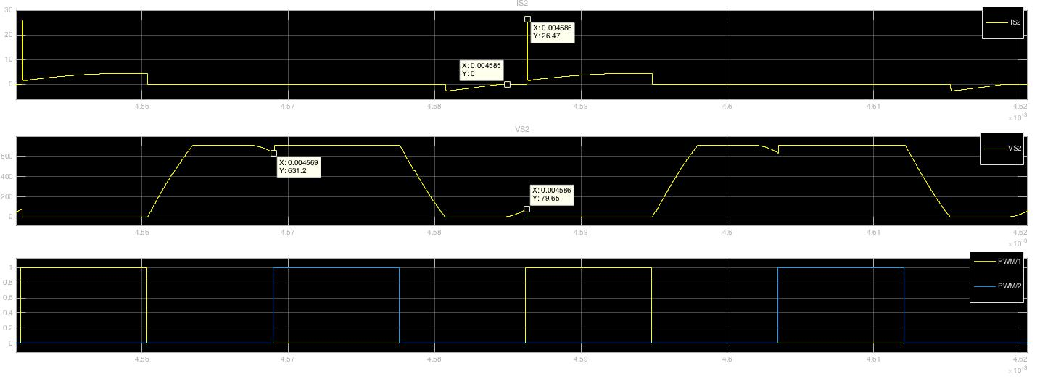
Varying Load Condition Analysis for Real Life Cases
Output Voltage Control
I_{S2}
￼
￼
V_{S2}
PWM
Figure 27: Distorted Current, Distorted Voltage, and PWM (top to bottom) vs. Time Waveforms of Top Switch S2
for Half Load Design Run Under Full Load Condition at 29kHz and 25% Duty Cycle

Slide 46
Varying Load Condition Analysis for Real Life Cases
Output Voltage Control
Distorted waveforms
Brainstormed the duration of ON cycle
Duty cycle
Class-DE DC = 25% → DC = 35%
Resultant system reaches an overall efficiency of ≈ 95.7 % (35% DC) ≈ 93 % (25% DC)
￼
￼
Notes:
Efficiency has dropped 2% when operating under Full Load

Slide 47
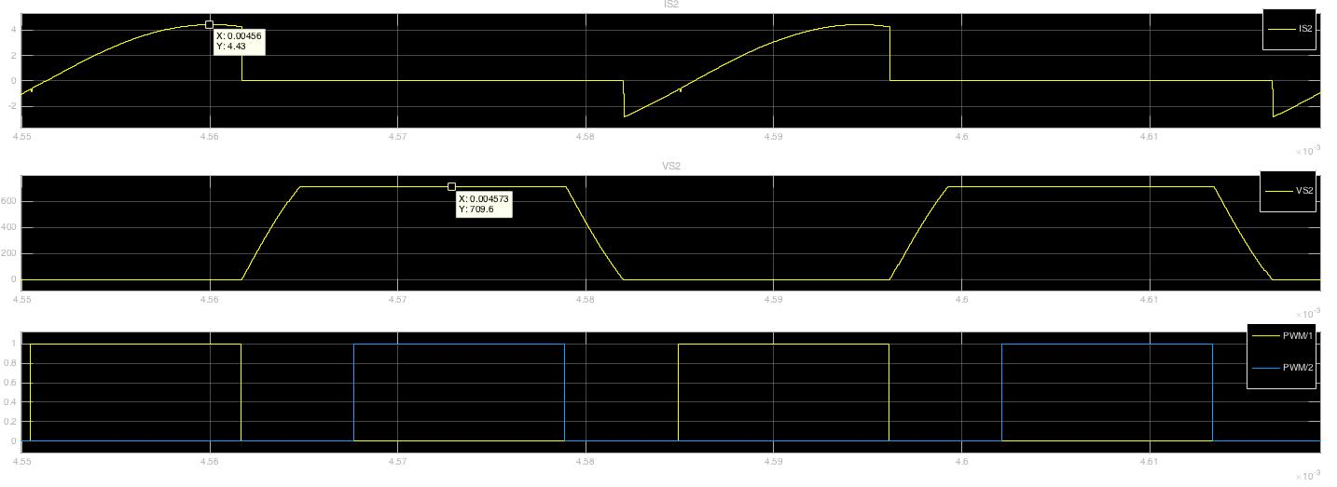
Varying Load Condition Analysis for Real Life Cases
Output Voltage Control
I_{S2}
￼
￼
V_{S2}
PWM
Figure 28: Restore Current, Restored Voltage, and PWM (top to bottom) vs. Time Waveforms of Top Switch S2
for Half Load Design Run Under Full Load Condition at 29kHz and 35% Duty Cycle

Slide 48
Conclusion
Accomplished:
Half load design
High system efficiency
Challenge of stepping down from 710V_{dc} - 10V_{dc}
Large load variation range
Approval of engineers
Future Work:
Rectification
Closed feedback control (algoritihm)
Hardware
￼
￼

Slide 49
References
[1] N. O. Sokal and A. D. Sokal, "Class E-A new class of high-efficiency tuned single-ended switching power amplifiers," in IEEE Journal of Solid-State Circuits, vol. 10, no. 3, pp. 168-176, Jun 1975
[2] Michael A. de Rooij, Wireless Power Handbook - 2nd Edition
[3]H. Koizumi, T. Suetsugu, M. Fujii, K. Shinoda, S. Mori and K. Iked, "Class DE high-efficiency tuned power amplifier," in IEEE Transactions on Circuits and Systems I: Fundamental Theory and Applications, vol. 43, no. 1, pp. 51-60, Jan 1996
[4]Ethan Zimany
[5] K. Inoue, T. Nagashima, X. Wei and H. Sekiya, "Design of high-efficiency inductive-coupled wireless power transfer system with class-DE transmitter and class-E rectifier," Industrial Electronics Society, IECON 2013 - 39th Annual Conference of the IEEE, Vienna, 2013, pp. 613-618
[6] Tiefu Zhao, B. Pahl, Jun Xu, B. Wu, P. Nirantare and M. Kothekar, "Optimal operation point tracking control for inductive power transfer system," Wireless Power Transfer Conference (WPTC), 2015 IEEE, Boulder, CO, 2015, pp. 1-4
[7] K.Siddabattula, “Wireless Power System Design Component and Magnetics Selection”, .pdf Texas Instruments
[8] D. Murthy-Bellur, A. Bauer, W. Kerin and M. K. Kazimierczuk, "Inverter using loosely coupled inductors for wireless power transfer," 2012 IEEE 55th International Midwest Symposium on Circuits and Systems (MWSCAS), Boise, ID, 2012, pp. 1164-1167
￼
￼

Slide 50
Thank You
Any Questions?
￼
￼

