Slide 1


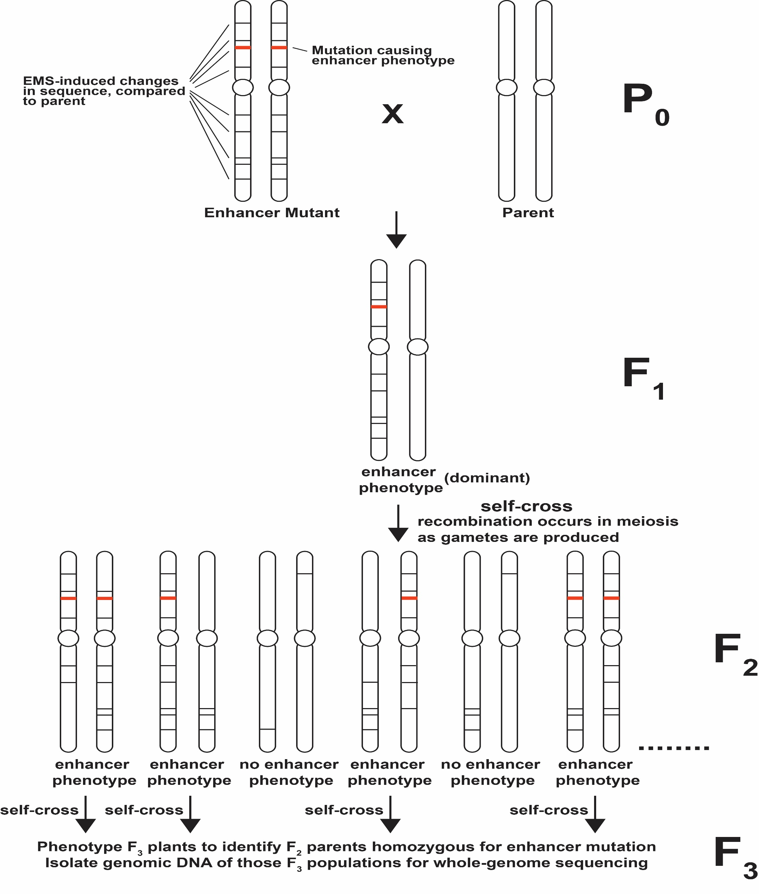
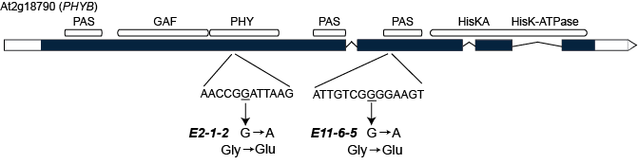
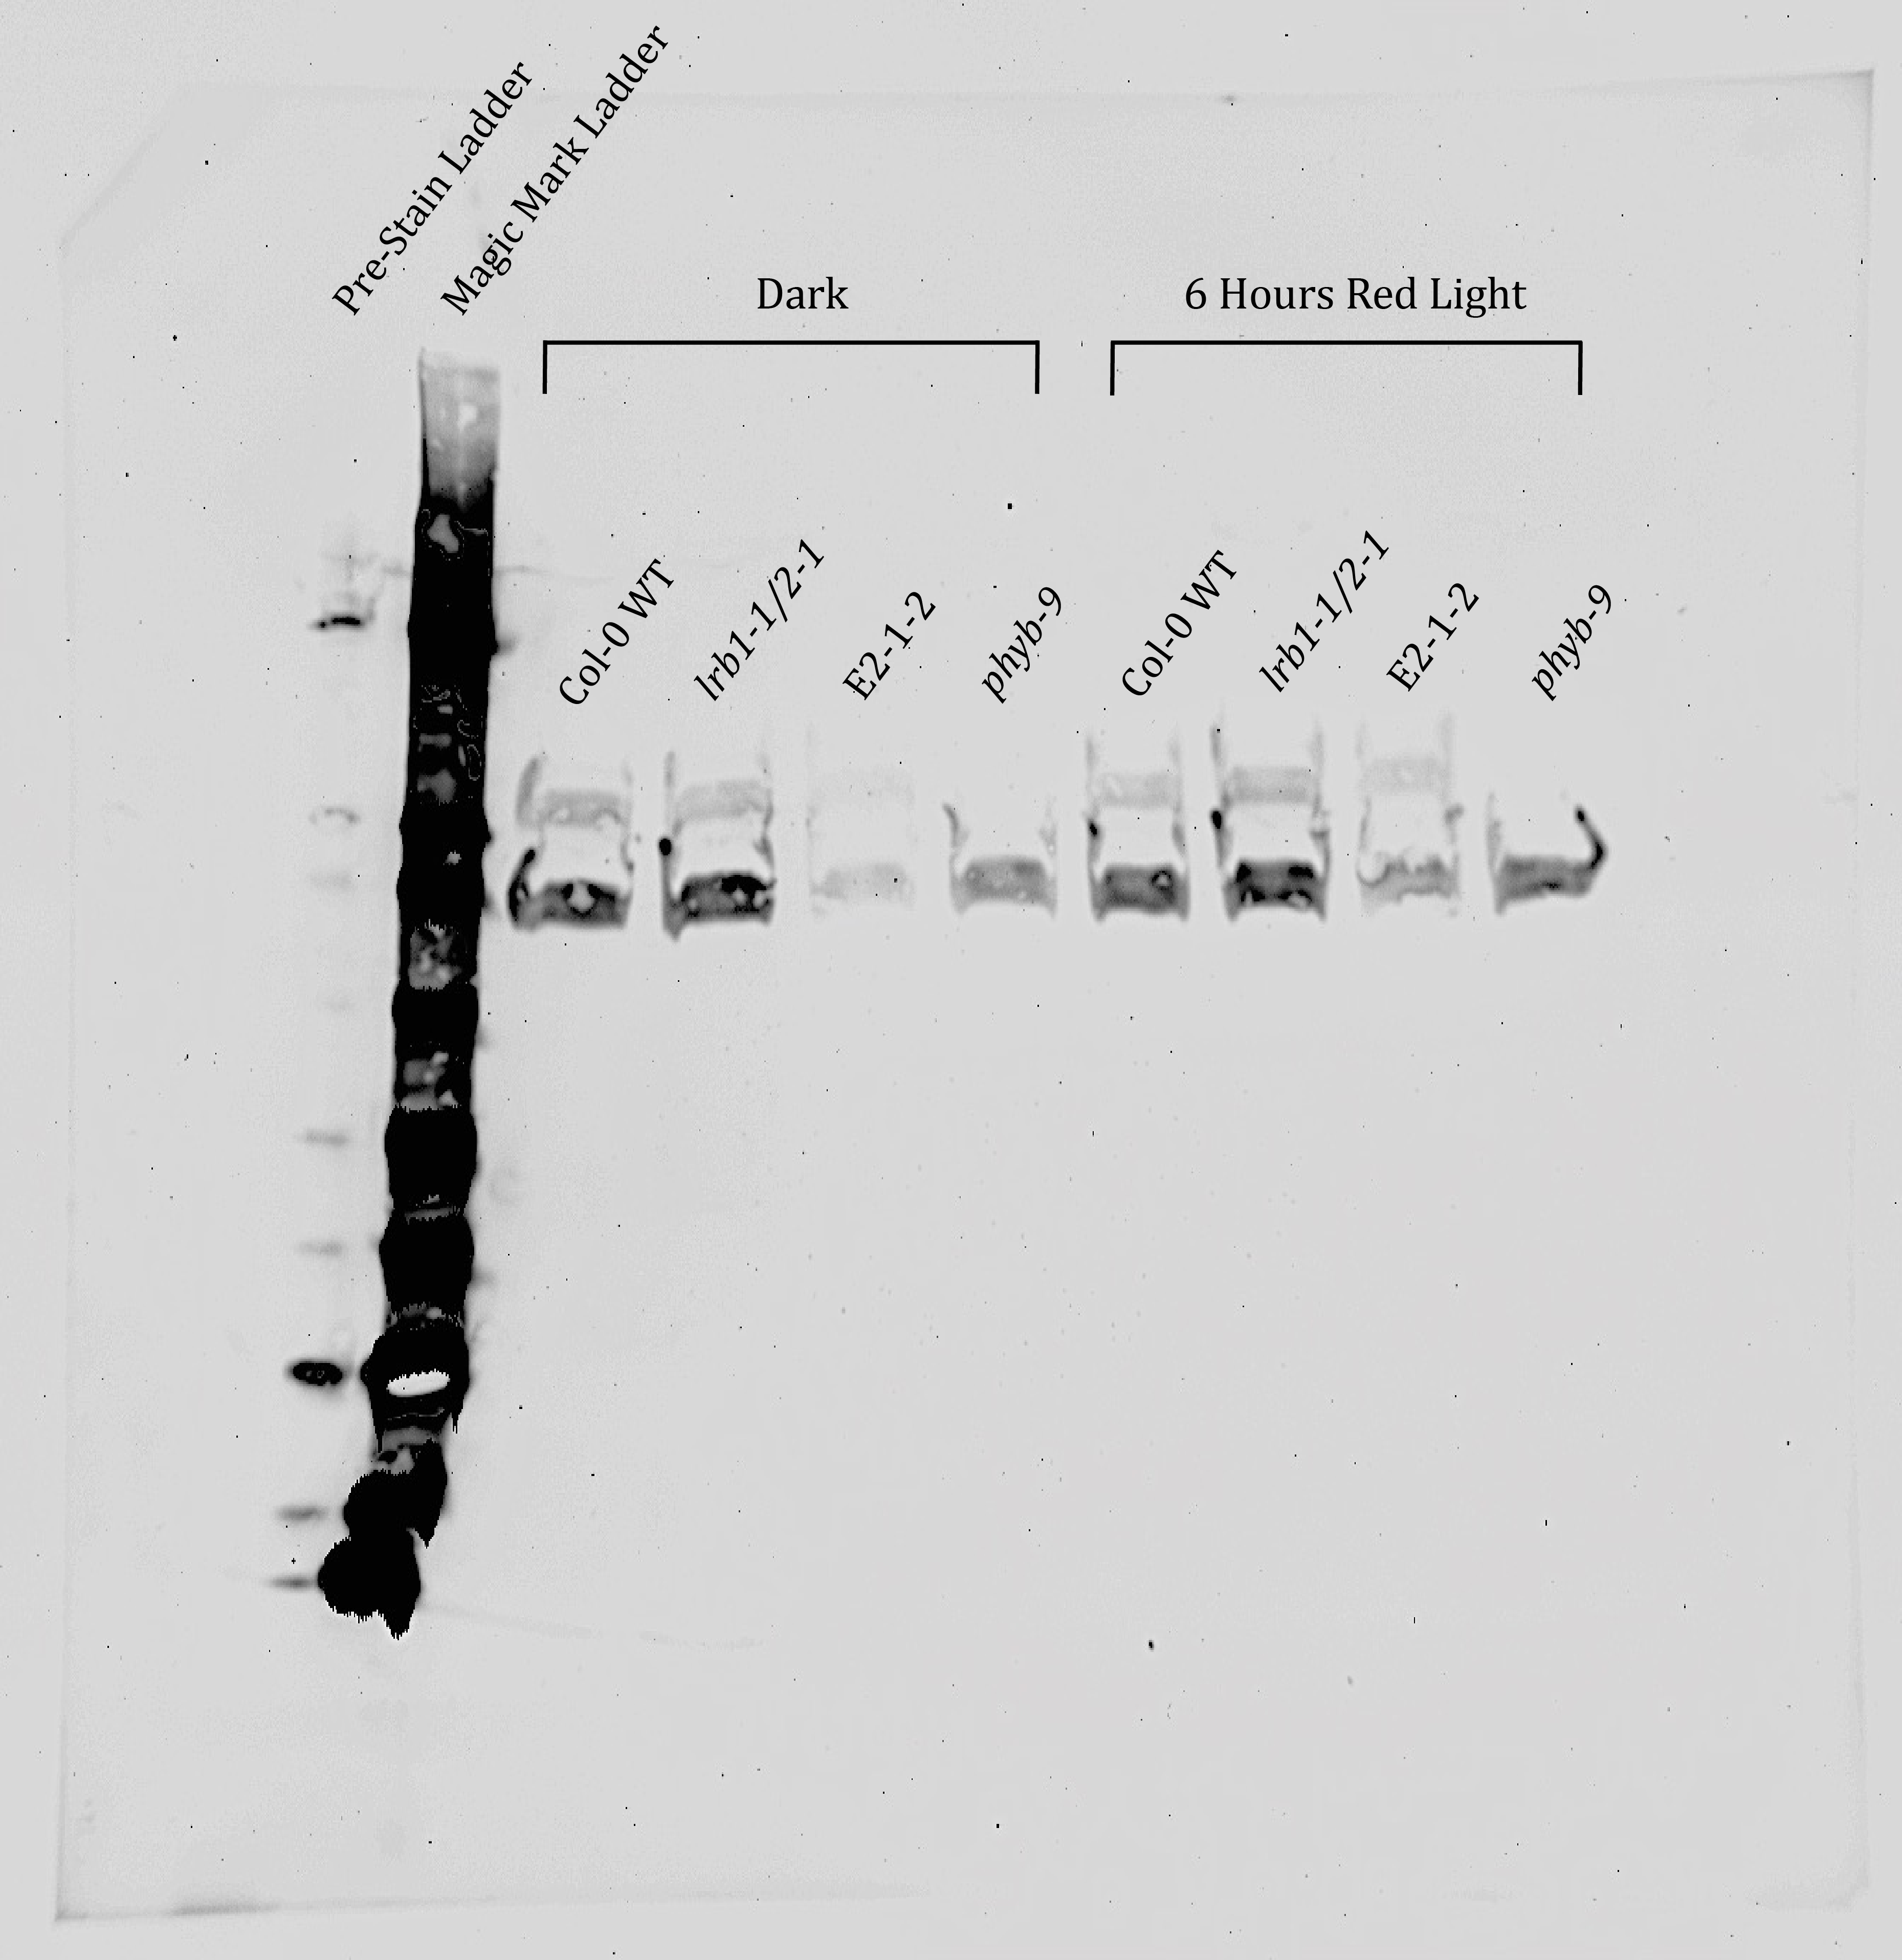
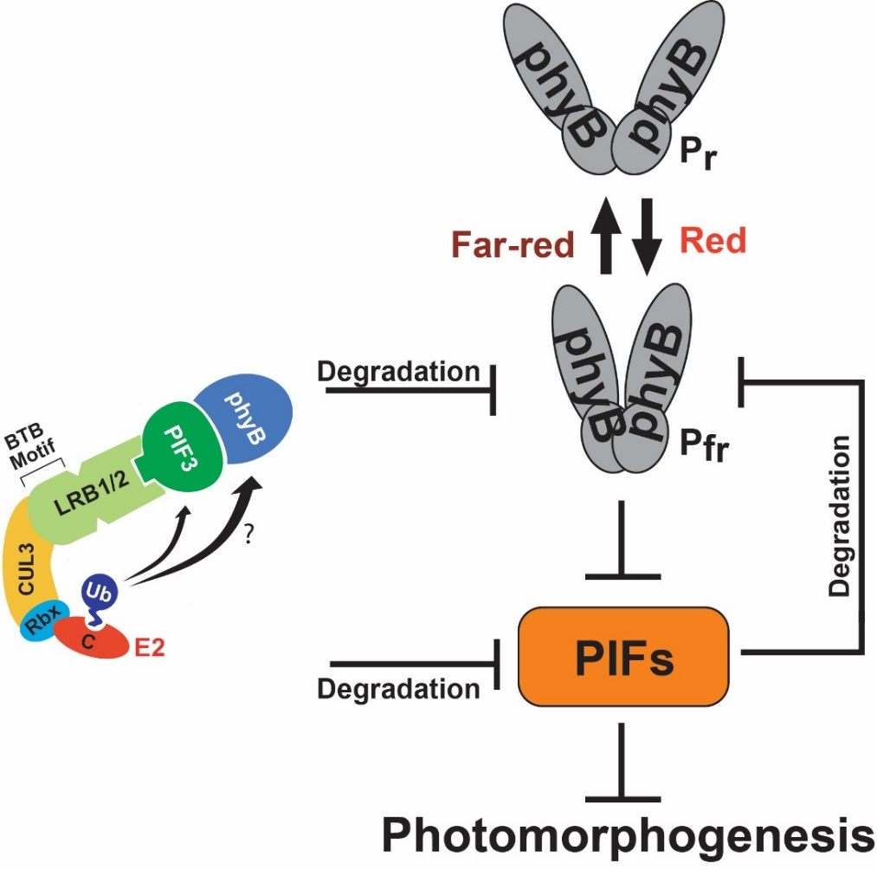
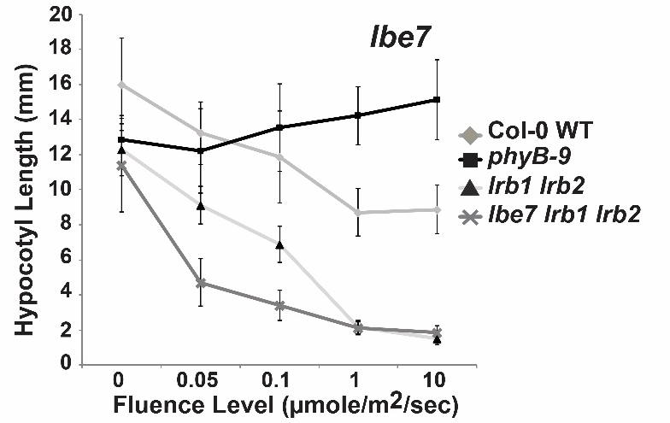
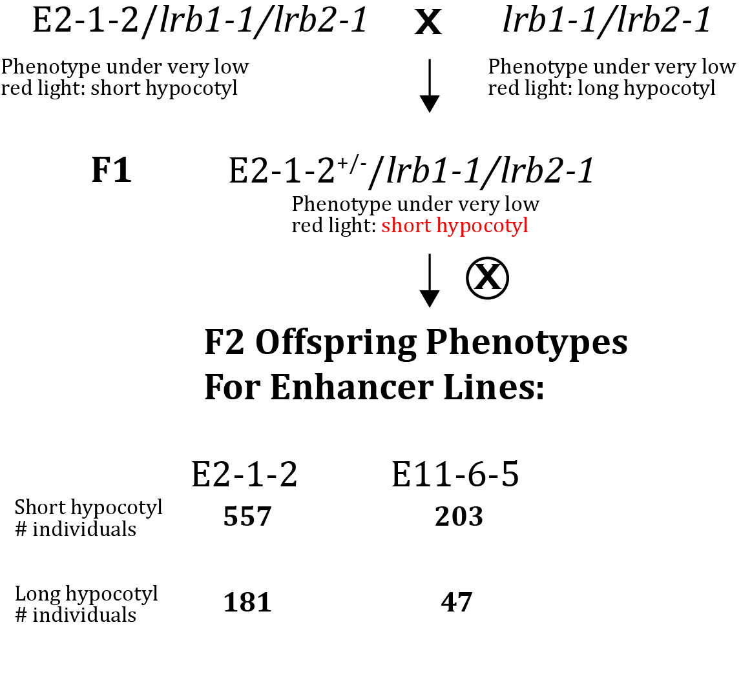
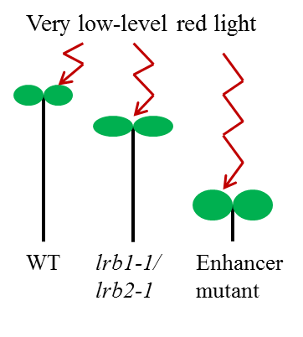
Analysis of Arabidopsis thaliana Red-Light Response Mutants
Identified in a Genetic Enhancer Screen
Allison Welter Faculty Mentor: Derek Gingerich
Department of Biology, University of Wisconsin-Eau Claire, Eau Claire, WI
For more information contact:
Derek Gingerich
Email: gingerdj@uwec.edu
Introduction
Strategy to Map Enhancer Mutants by Whole-Genome Sequencing
Putative Casual Mutations Identified in the PHYB Gene
Plants require light for survival and have developed sophisticated pathways to respond and adapt to the light in their environment¹. Photoreceptors allow plants to sense specific wavelengths of light, one family being the red /far-red-absorbing phytochromes (phys). Phys have two conformations: inactive (P_{r}) and active (P_{fr}) forms. Absorption of red light promotes a shift to active P_{fr}, while far-red light absorption promotes assumption of inactive P_{r}². P_{fr} can also shift back to P_{r} independent of light (known as dark reversion)³. Upon activation by red light and transition to the P_{fr} form, the phytochromes are translocated into the nucleus from the cytosol to regulate gene expression⁴ (Figure 1).
Work by our lab and others has shown two genes called Light-Response BTB 1 and 2 (LRB1 and LRB2) regulate the phy light-response pathway in the model plant Arabidopsis thaliana^{5,6}. LRB1 and LRB2 encode BTB (Bric-a-Brac, Tramtrack and Broad Complex) proteins that are target adaptors in E3 ubiquitin-ligase complexes that lead to the degradation of the phys through ubiquitylation under light treatment (Figure 1)^{5,6}. Plants containing mutations within LRB genes (lrb1 lrb2 mutants) display hypersensitivity to red light due to elevated levels of the phys^{5,6}.
To discover additional genes involved in light responses, previous members of the Gingerich lab conducted genetic enhancer screens utilizing the red light- hypersensitive lrb1 lrb2 mutants. They mutagenized lrb1 lrb2 seed with ethyl methanesulfonate (EMS) and identified individuals that exhibited further enhanced red light hypersensitivity. I have been working to map the mutations responsible for the highly increased red-light hypersensitivity in a subset of the lines (Figure 2). Our initial hope was that these mutations may occur in genes not previously known to be involved in light responses.
Figure 6. Locations of putative enhancer mutations in the PHYB gene in lines E2-1-2 and E11-6-5. Boxes indicated exons, lines indicate introns. Domains of the phyB protein are indicated. Both mutations in enhancer lines lead to a single amino acid change of glycine to glutamic acid.
Western Blot Analysis of phyB Protein Levels in Line E2-1-2
E11-6-5
Figure 3. Generation of plants for whole-genome sequencing. In the P₀ generation the lrb1-1 lrb2-1 double mutant parent is crossed with original enhancer mutant, which also contains the lrb1-1/lrb2-1 insertion mutations (not shown).
Figure 5. Preliminary Western Blot analysis of phyB protein levels in enhancer line E2-1-2. Controls included Col-0 wild-type, lrb1-1/2-1, and phyB-9 plants. Seedling germination was induced by 8 hours of white light. Seedlings were then grown for 5 days in the dark. One group of plants were kept in the dark, while a second was treated with 6 hours of red light (20 μmole/m²/sec. red light). The bands indicated by the arrow are the phyB protein. The band below is likely another protein reacting to the antibody. While lanes were likely not loaded with equal amounts of total protein, these results suggest that the E2-1-2 line does not have significantly increased levels of phyB protein compared to wild-type or the lrb1 lrb2 parent line.
E11-6-5 lrb1 lrb2
The E2-1-2 and E11-6-5 Enhancer Mutations are Dominant
Future Work
Figure 1. Structure and function of the LRB/CUL3 E3 ubiquitin ligase complex in the red light response pathway in Arabidopsis thaliana. Red light activates phytochrome B, which blocks the activity of PIF proteins, which are negative regulators of red light responses. The complex mediates ubiquitylation and degradation of both PIF3 and phyB. Figure is based partly on model of LRB action presented by Ni et. al.⁶
Figure 2. Hypocotyl elongation response to red light of the E11-6-5 line, one of the enhancer mutants identified in the Gingerich lab genetic screen. Hypocotyl lengths of wild-type (Col-0 WT), lrb1 lrb2, phyB-9, and E11-6-5 mutants grown in darkness or in various levels of red light are shown. The E11-6-5 line contains the lrb1-1 lrb2-1 insertion mutations of the lrb1 lrb2 parent line. Seeds were germinated under white light and then grown in the dark or under continuous red light for 4 days. Error bars indicate ± SD.
Figure 4. The E2-1-2 and E11-6-5 enhancer mutations act in a dominant fashion. Seedlings were grown for four days under low level (0.075 μmole/m²/sec) red light.
F1 individuals showed the phenotype of the enhancer mutation and F2 populations displayed an approximately 3:1 enhancer phenotype: wild-type phenotype ratio.
Repeat Western Blot analyses for both E2-1-2 and E11-6-5 to determine the amount of phyB protein present under different light conditions.
Prove the mutations in the PHYB genes in lines E2-1-2 and E11-6-5 are responsible for the enhancer phenotype by expressing these mutant forms in plants containing a null mutation in the endogenous gene (phyB-9) and analyzing the red light phenotype of the plants.
Conduct red/far-red light pulse experiments to test the ability of the mutant phyB proteins in E2-1-2 and E11-6-5 to photoconvert between the P_{r} and P_{fr} forms.
Sequence/map additional enhancer mutants lines (genomic DNA for a third line is already awaiting sequencing at the Washington University GATC).
WGS/Mapping Results
Screen to Identify Enhancer Mutants
E2-1-2
E11-6-5
References
Chromosome | Position | Reference | Change | Gene_ID | Gene_name | old_AA/new_AA
chr1 | 6598789 | G | A | AT1G19100 | AT1G19100 | R/H
chr1 | 10847738 | G | A | AT1G30610 | EMB2279 | E/K
chr2 | 890071 | G | A | AT2G03030 | AT2G03030 | V/M
chr2 | 7402342 | G | A | AT2G17033 | AT2G17033 | G/E
chr2 | 7411044 | G | A | AT2G17050 | AT2G17050 | Q/*
chr2 | 8111222 | G | A | AT2G18700 | ATTPS11 | S/N
chr2 | 8141622 | G | A | AT2G18790 | PHYB | G/E
chr2 | 8378739 | G | A | AT2G19360 | AT2G19360 | E/K
chr2 | 8848502 | G | A | AT2G20560 | AT2G20560 | P/S
chr2 | 9915638 | G | A | AT2G23300 | LRR-RLK | G/E
chr2 | 10121722 | G | A | AT2G23770 | LYK4 | T/I
chr2 | 10171848 | G | A | AT2G23890 | AT2G23890 | R/H
chr2 | 12552986 | G | A | AT2G29200 | APUM1 | A/V
chr2 | 12564147 | G | A | AT2G29220 | LECRK31 | P/L
chr2 | 12644793 | G | A | AT2G29550 | TUB7 | P/L
chr2 | 13168951 | G | A | AT2G30940 | AT2G30940 | R/H
chr2 | 13660433 | G | A | AT2G32150 | AT2G32150 | A/T
chr2 | 16283136 | G | A | AT2G38995 | AT2G38995 | R/K
chr2 | 17979359 | G | A | AT2G43250 | AT2G43250 | A/T
chr2 | 18042367 | G | A | AT2G43445 | AT2G43445 | G/E
chr2 | 18792991 | G | A | AT2G45620 | AT2G45620 | A/T
chr5 | 12223176 | C | T | AT5G32590 | AT5G32590 | S/N
Chromosome | Position | Reference | Change | Gene_ID | Gene_name | old_AA/new_AA
chr2 | 2581713 | G | A | AT2G06500 | AT2G06500 | T/I
chr2 | 7556311 | G | A | AT2G17390 | AKR2B | G/E
chr2 | 8142670 | G | A | AT2G18790 | PHYB | G/E
chr2 | 11190164 | G | A | AT2G26280 | CID7 | A/V
chr2 | 17234822 | G | A | AT2G41360 | AT2G41360 | R/Q
chr5 | 6574139 | C | T | AT5G19485 | AT5G19485 | G/E
1. Mathews S (2006) Phytochrome-mediated development in land plants: red light sensing evolves to meet the challenges of changing light environments. Molecular Ecology 15: 3483-3503.
2. Kretsch T, Poppe C, Scäfer E (2000) A new type of mutation in the plant photoreceptor phytochrome B causes a loss of photoreversibility and an extremely enhanced light sensitivity. Plant J 22(3): 177-186.
3. Ádám É, Hussong A, Bindics J, Wüst F, Viczián A, et al. (2011) Altered dark- and photoconversion of phytochrome B mediate extreme light sensitivity and loss of photoreversibility of the phyB-401 mutant. PLoS ONE 6(11): e27250.
4. Jiao Y, Lau O, Deng X (2007) Light-regulated transcriptional networks in higher plants. Nature Reviews Genetics: 217-230.
5. Christians M, Gingerich D, Hua Z, Lauer T, Vierstra, R (2012) The light-response BTB1 and BTB2 proteins assemble nuclear ubiquitin-ligases that modify Phytochrome B and D signaling in Arabidopsis. Plant Physiology 160: 118-34.
6. Ni W, Xu S, Tepperman J, Stanley D, Maltby D, Gross J, Burlingame A, Wang Z, Quail P (2014) A mutually assured destruction mechanism attenuates light signaling in Arabidopsis. Science 344(6188): 1160-1164.
Mutagenize population of lrb1-1 lrb2-1
seed with ethyl methanesulfonate (EMS)
Germinate seeds and grow plants, 2000 individuals total
Collect seed from these individuals
Figure 5. Whole-genome sequencing and analysis of our samples were performed by the Washington University in St. Louis Genome Technology Access Center. Samples were submitted and processed as part of a laboratory consortium led by Dr. Lucia Strader of Washington University. Shown are lists of mutations present in the enhancer lines that may be responsible for the enhancer phenotype. Notice that in both lines a similar region in chromosome 2 is linked to the phenotype and in both lines, there is a mutation in the PHYB gene. Since both lines show very similar phenotypes and PHYB is known to be involved in red light response, we believe these mutations are likely causing the phenotype.
Funding
Germinate and grow this next generation (M2) under red filtered light; identify individuals that have increased red light sensitivity compared to the lrb1-1 lrb2-1 double mutant parents.
This work was funded by a National Science Foundation-Research in Undergraduate Institutions (RUI) grant (#1354438), and was supported by the UW-Eau Claire Blugold Fellowship Program which is jointed funded by Differential Tuition and The Foundation.
Whole-genome sequencing and downstream analysis of three samples cost less than $700!

