Slide 1

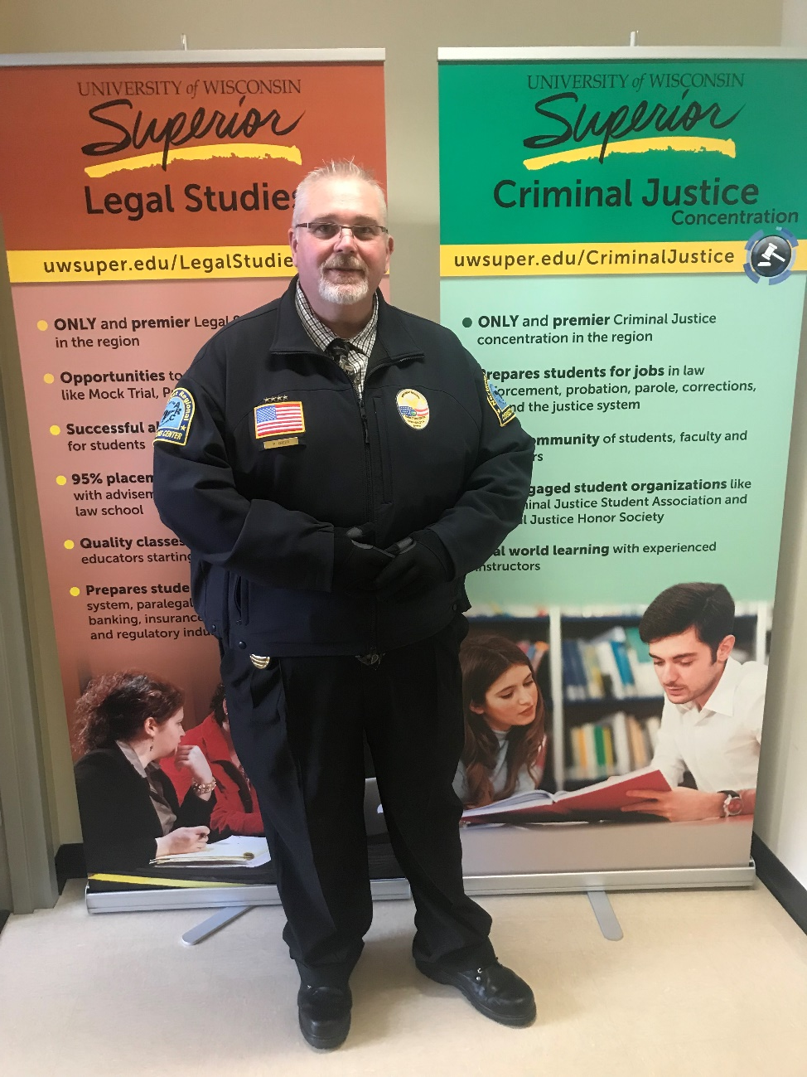
Immersive Corrections Pedagogy: Pre-Professional Development in a Liberal Arts Curriculum Alli Willingham, Legal Studies and Criminal Justice
ABSTRACT
Undergraduate corrections courses offer unique opportunities to approach teaching and learning through immersive experiences shared between the students, the professors, and the professional communities they encounter. Immersive experiences could include tours of correctional facilities, mock interviews, brown-bag Q&As with professionals in the field, mock restorative circles, mock pre-sentencing investigations, guest speakers, and other unique approaches to teaching. A typical course evaluation would not adequately measure the outcomes of immersive experiences, such as: job and internship opportunities, changed views about the justice system, or course-impacted career decisions. Thus, a refined instrument needs to be developed to evaluate the effectiveness of immersive corrections on these important pre-professional student concerns. Upon the administration of such a questionnaire, a report that include best practice recommendations for corrections instructors could be developed, emphasizing the benefits of a course that places the student directly into the correctional system as a potential employee, as well as offering recommendations for creative, immersive corrections education. Job-seeking criminal justice undergraduates could benefit from a refined pedagogy of immersion.
Restructuring CJUS 316 Crime, Corrections, and Punishment
Research Methodology
Career Competent Classroom Practices
E-mail etiquette guidelines
Accountability: late work, in-class participation, attendance, peer reviews
Guest speakers & field trips
In-advance questions
Dress codes
Integration of resumes into academics
Final Assessments
Poster session to share and disseminate knowledge about a topic of interest related to the career field and to the course content
Midterm exam – research outline
Final exam – poster session
Research question: How may a course that uses an immersive teaching approach impact criminal justice students’ perceptions of their own professionalism and career goals?
Research preparation: Careful implementation in course structure/syllabus of the eight career competencies outlined by National Association of Colleges and Employers; inclusion of immersive teaching practices such as field trips, Q&A sessions, and mock restorative justice circles
Mixed methods experimental design involving a pre-test and post-test questionnaire that included both open-ended and closed-ended questions
Student Feedback
This course greatly improved my…
Ability to work productively with others – 58%
Time workload management – 58%
Ability to act with the interest of the larger group in mind – 54%
Ability to learn from my mistakes – 50%
Punctuality – 42%
Nonverbal communication and personal work image – 39%
This was the first course I ever took that…
Offered tours of professional settings - 58%
Sometimes required a dress code – 50%
Asked me to prepare in advance for guest speakers – 50%
Required me to make a presentation and poster – 50%
Did not accept late work – 46%
Required email etiquette – 46%
After taking this course, I would describe myself as a professional who is…
Thoughtful - 69%
Prepared – 69%
Humble – 69%
Able to ask questions of mentors/leaders – 65%
Positive – 65%
Organized – 65%
Considerate – 65%
Utilizing good judgment – 62%
Prone to use kindness first – 62%
Timely and responsive – 62%
Emotionally intelligent – 58%
Utilizing appropriate language – 58%
Mannerly – 58%
Able to seek out resources – 54%
Not someone to miss deadlines – 42%

