Slide 1
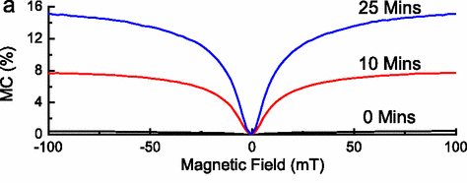

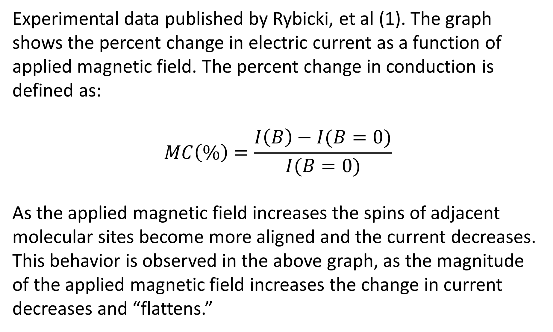
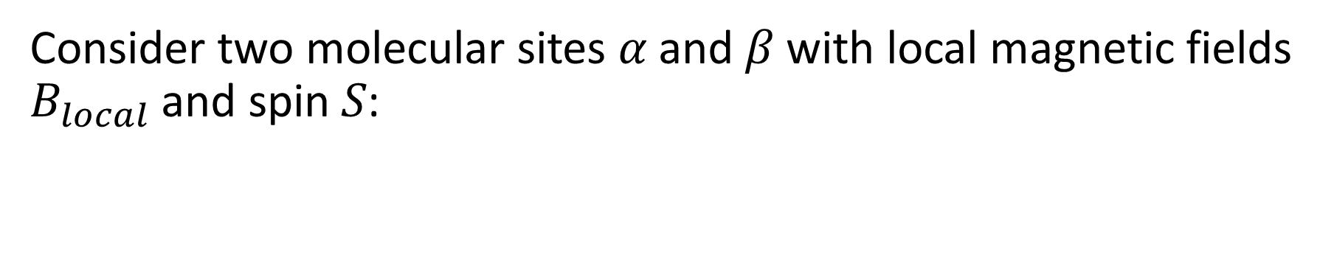

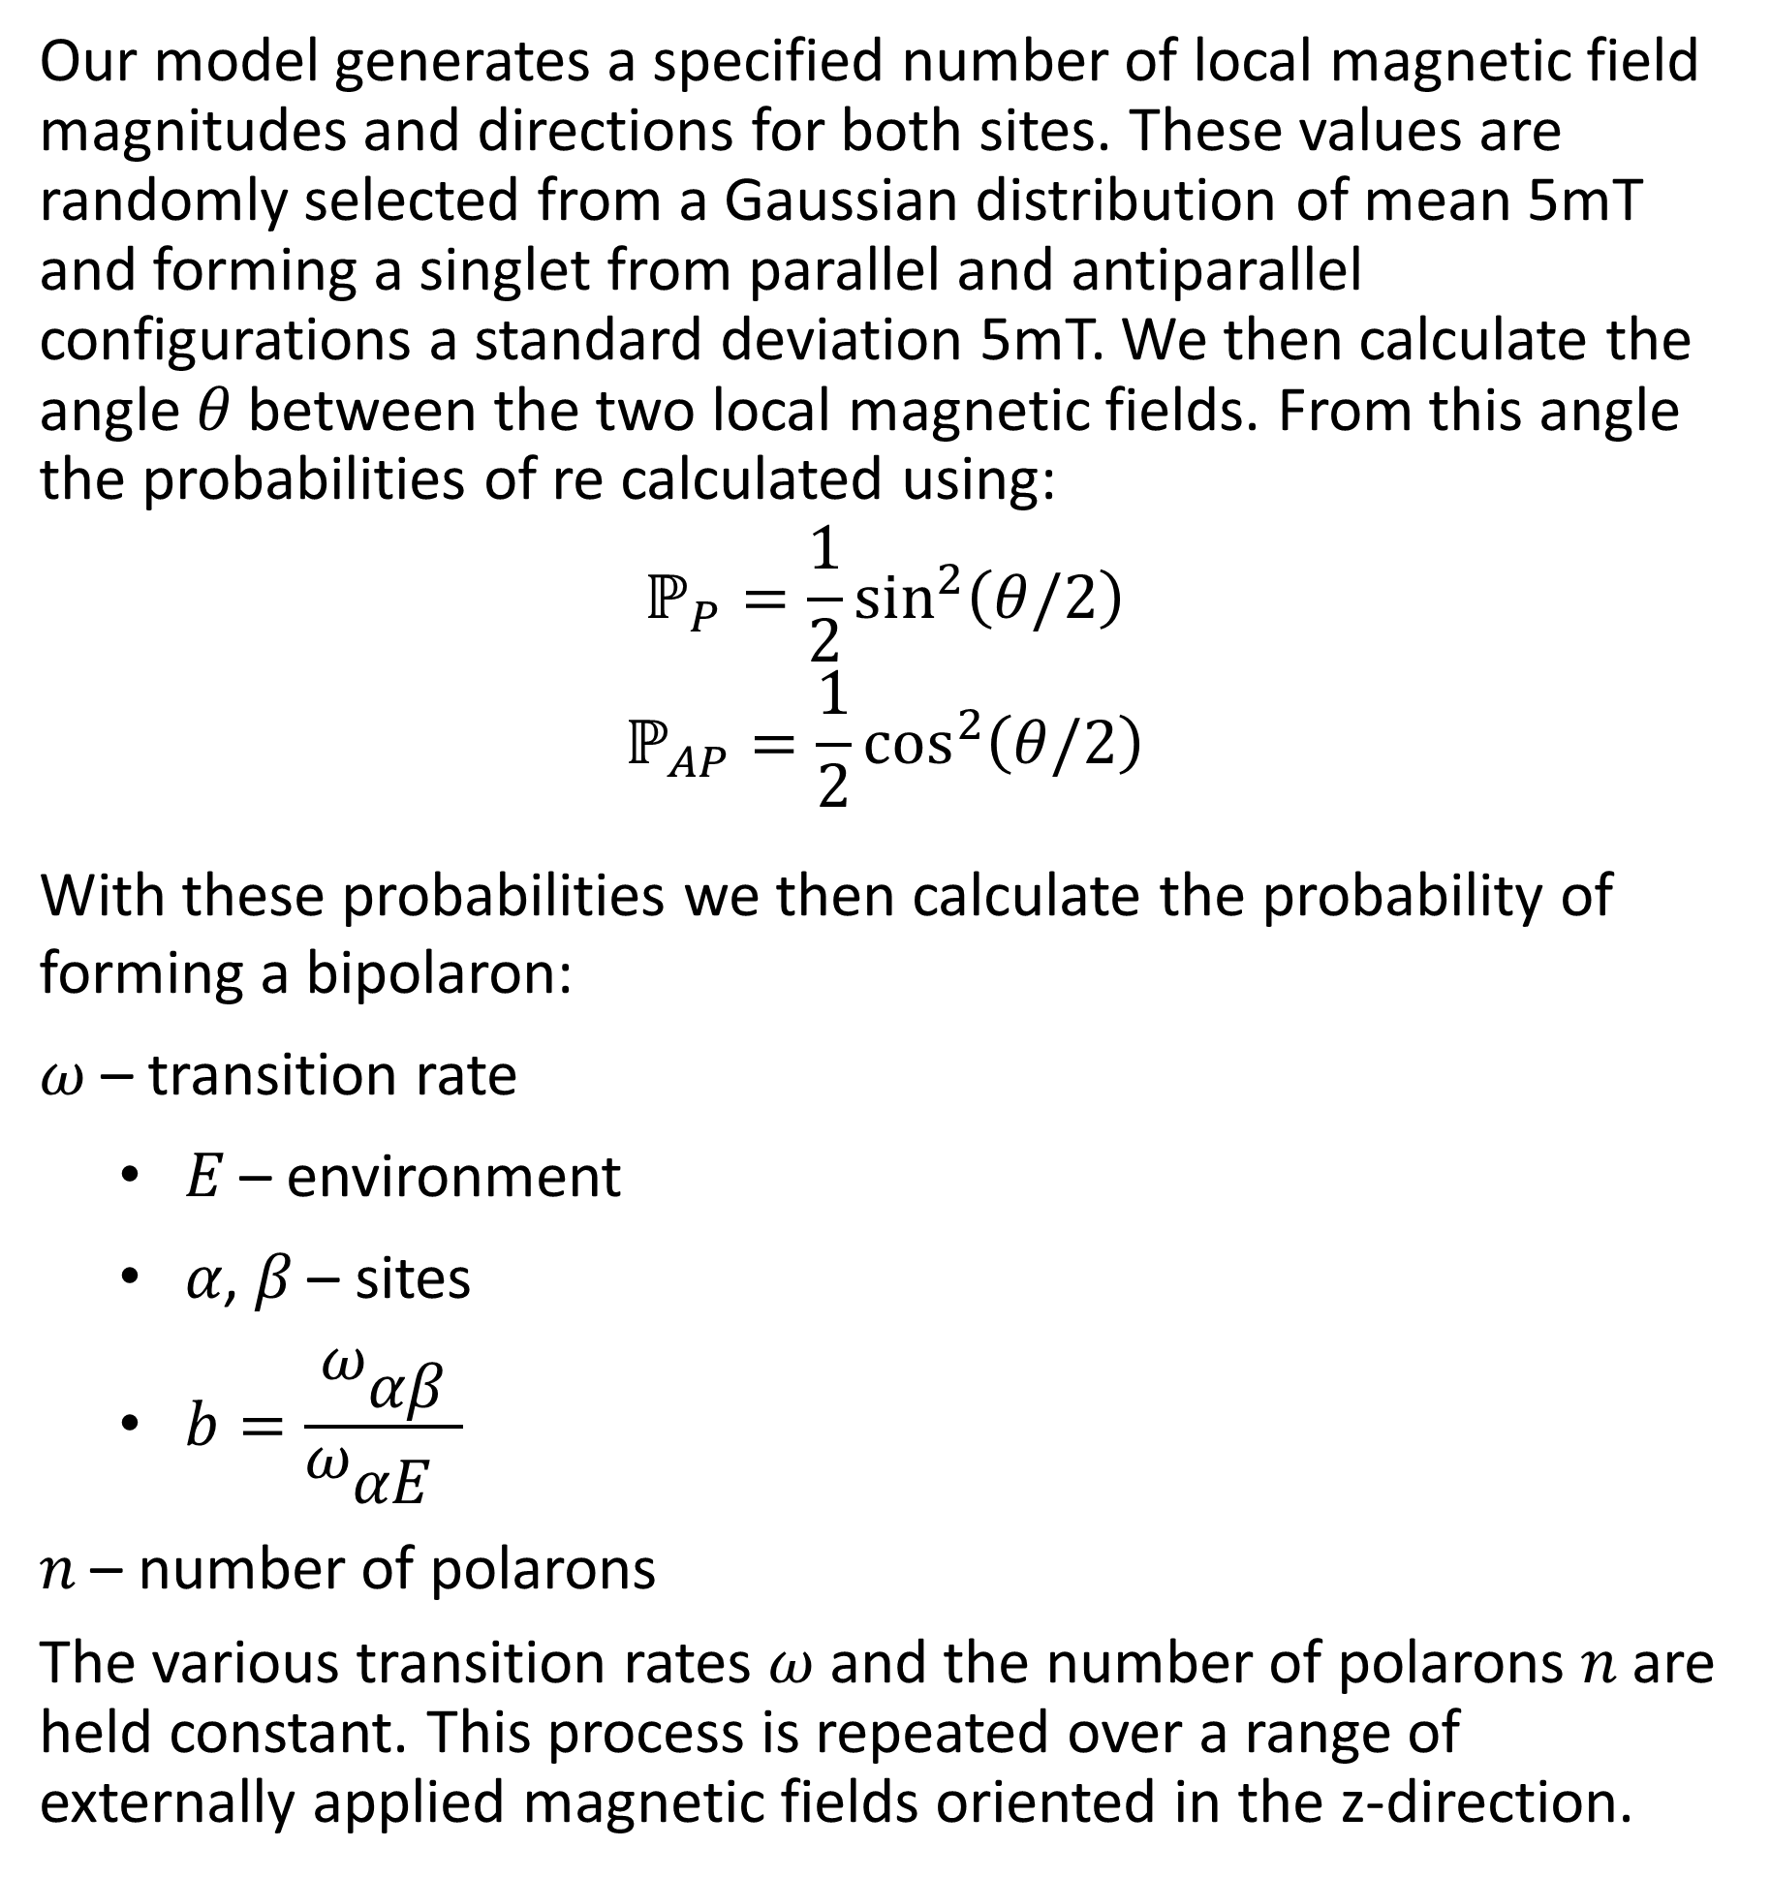

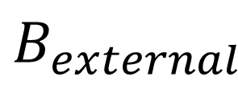
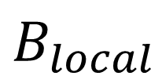


Numerical Modeling of Bipolarons in Organic Magnetoconductance
Michael McDonnell ▪ Paul Thomas | Department of Physics
Introduction
Two-site Model
Results
Carbon-based, or organic semiconductors have several advantages over their conventional silicon-based counterparts. Notably, organic semiconductors can be used in the construction of flexible LED displays and thin-film transistors which, in some characteristics, outperform silicon-based transistors. Under certain experimental parameters, such as an external magnetic field, the behavior of organic semiconductors remains difficult to predict. As such, the goal of our research project is to numerically model various charge carriers in organic semiconductors under the presence of an external magnetic field.
Under the presence of an external magnetic field the electrical conductivity of an organic semiconductor changes, this behavior is known as magnetoconductance. Fundamentally magnetoconductance is a result of the Pauli Exclusion Principle which states that two charge carriers cannot occupy the same molecular site with identical spin states (i.e. spin up and spin down). This prevents charge carriers from hopping between molecular sites and hence decreases electrical conduction. In other words, charge carriers in adjacent sites must be in different spin states for one of the charge carriers to hop and share the other site with the other charge carrier. Electrical conduction occurs as charge carriers hop from site to site. These molecular sites produce local magnetic fields that the spin of the charge carrier precesses about. With some uncertainty, the direction of these local magnetic fields determines spin state of the charge carrier. By introducing an external magnetic field it is possible to align the local magnetic fields of adjacent sites. As these local magnetic fields align, it becomes more likely that the charge carriers in adjacent sites will be in identical spin states. This causes the rate at which charge carriers hop between sites to decrease and, therefore, electrical conduction to decrease.
Consider two molecular sites 𝛼 and 𝛽 with local magnetic fields $B_{local}$ and spin 𝑆:
Experimental
$$B_{local}$$
$$S$$
$$α$$
$$β$$
$$α$$
$$β$$
$$B_{external}$$
Experimental data published by Rybicki, et al (1). The graph shows the percent change in electric current as a function of applied magnetic field. The percent change in conduction is defined as:
$$MC\left(\%\right)=\frac{I\left(B\right)−I(B=0)}{I(B=0)}$$
As the applied magnetic field increases the spins of adjacent molecular sites become more aligned and the current decreases. This behavior is observed in the above graph, as the magnitude of the applied magnetic field increases the change in current decreases and “flattens.”
Our model generates a specified number of local magnetic field magnitudes and directions for both sites. These values are randomly selected from a Gaussian distribution of mean 5mT and forming a singlet from parallel and antiparallel configurations a standard deviation 5mT. We then calculate the angle 𝜃 between the two local magnetic fields. From this angle the probabilities of re calculated using:
$$ℙ_{P}=\frac{1}{2}\sin^{2}\left(θ/2\right)$$
$$ℙ_{AP}=\frac{1}{2}\cos^{2}\left(θ/2\right)$$
With these probabilities we then calculate the probability of forming a bipolaron:
𝜔 – transition rate
𝐸 – environment
𝛼, 𝛽 – sites
$b=\frac{{\text{ω}}_{\text{αβ}}}{{\text{ω}}_{\text{α}\text{E} }}$
𝑛 – number of polarons
The various transition rates 𝜔 and the number of polarons 𝑛 are held constant. This process is repeated over a range of externally applied magnetic fields oriented in the z-direction.
Model
Polaron
To model this behavior we have created a MATLAB program that describes the conduction of a charge carrier known as a polaron between two molecular sites under the presence of a varying external magnetic field. A polaron is a quasi-particle that consists of an electron and the coulombically attracted lattice of surrounding nuclei. When a two polarons occupy the same site and form a singlet configuration they are referred to as a bipolaron. Thus the conduction of polarons can be thought of as the rate of bipolaron formation.
N-site Model
B
B
B
Graph of our current results for the two-site model. The graph shows the percent change in the probability of forming a bipolaron as a function of applied magnetic current. The probability of forming a bipolaron is proportional to the electric current . As expected the plot matches the general shape of the experimentally produced curves. The N-site model is expected to more accurately reflect the experimental results.
B
B
B
B
B
B
B
Currently, we are expanding on the two-site model to include N molecular sites. In this scheme a charge carrier can hop to any of its nearest neighbors. This increases the number of possible sites a charge carrier can hop to from one to six.
References
Bipolaron
(1) J. Rybicki, R. Lin, F. Wang, M. Wohlgenannt, C. He, T. Sanders, Tuning the Performance of Organic Spintronic Devices Using X-Ray Generated Traps, PHYSICAL REVIEW LETTERS 109 (2012).
Special thanks to Professor James Rybicki of the UW-Eau Claire Physics Department and his research group for assistance in this project.

