Slide 1
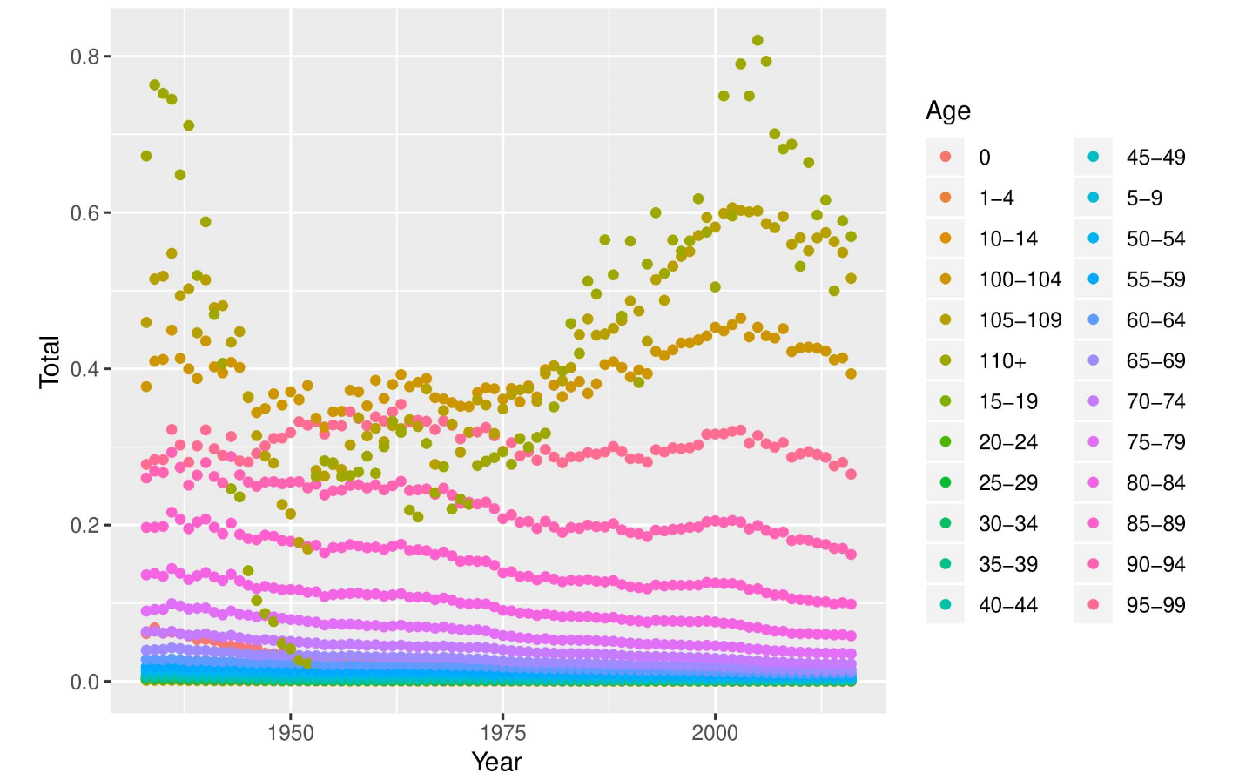
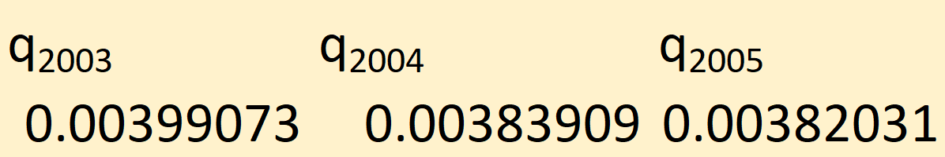
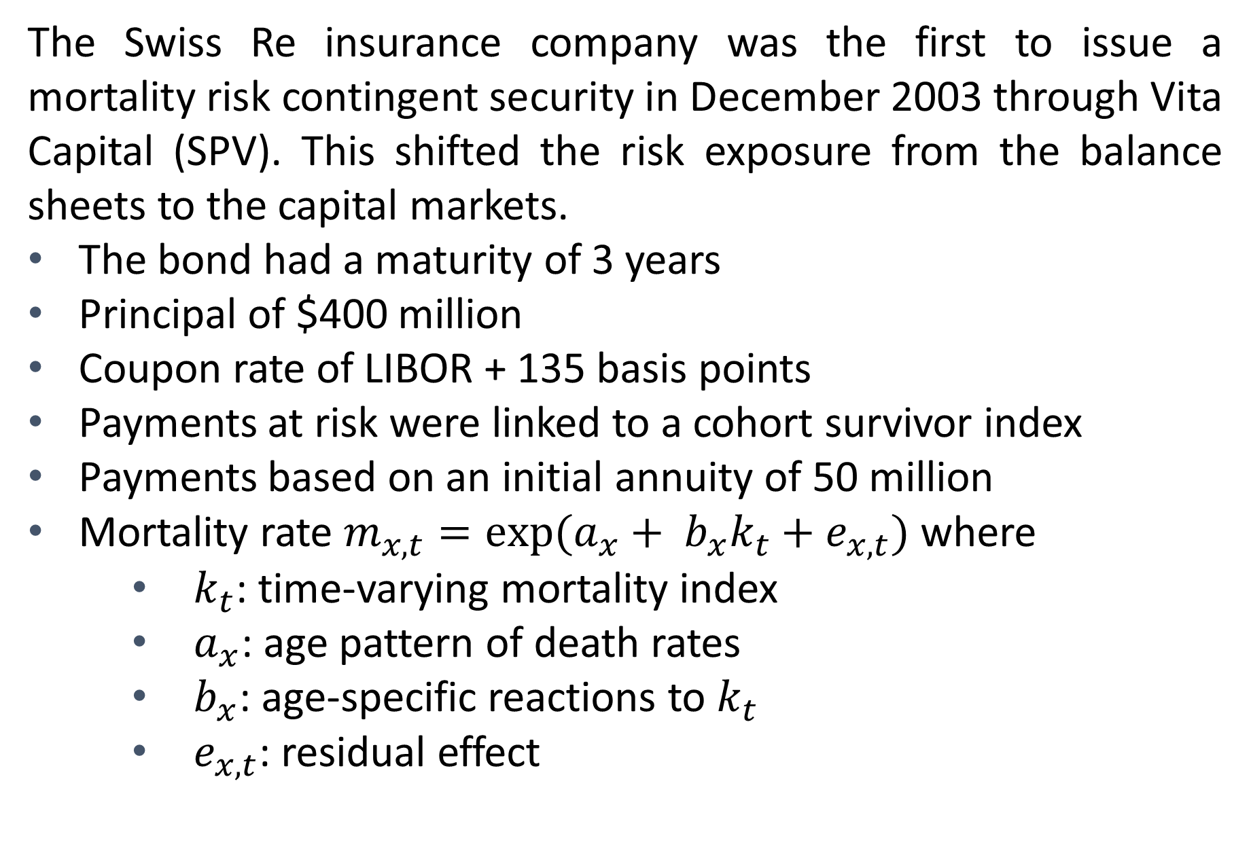
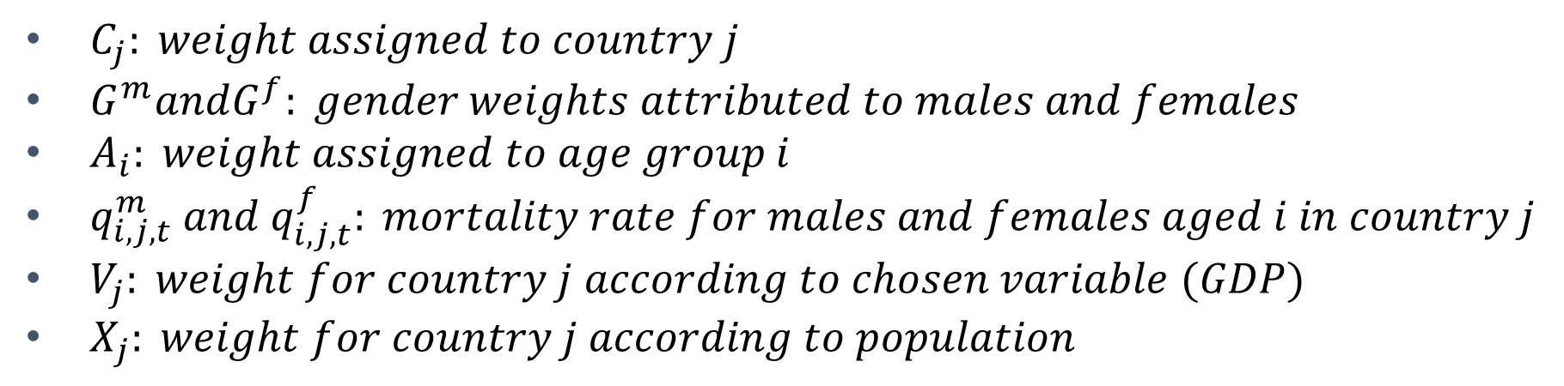
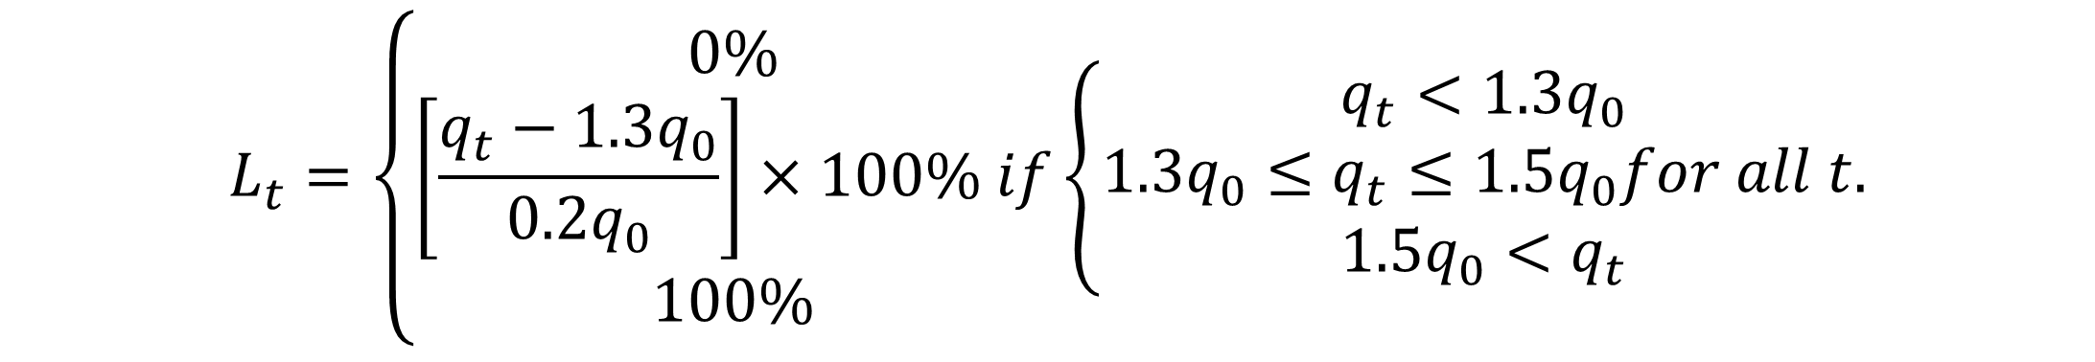
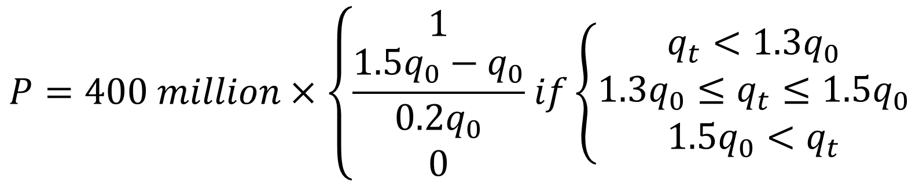
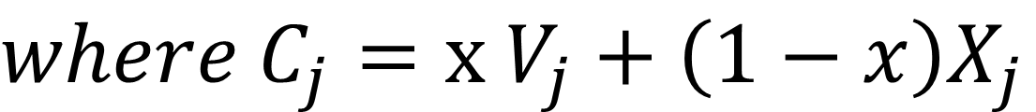
Modeling Mortality-Linked Securities
A Study with the Swiss Re Bond
Kola Loh and Marie-Claire Koissi (Faculty Advisor) | Actuarial Science Program, Department of Mathematics
Abstract
The Swiss Re Bond
The Payment at Risk
The Swiss Re bond is the first mortality risk contingent security. In this research, we introduce two modifications, to address some criticisms about the bond's original index. Firstly, we add an economic variable into our mortality index, because mortality experience is affected by economical parameters. Secondly, we modified the location parameter in the index to capture the mortality experienced in different geographic regions.
Finally, we study how the new index could affect the bond's price. Projections and calculations were made using R.
The Swiss Re insurance company was the first to issue a mortality risk contingent security in December 2003 through Vita Capital (SPV). This shifted the risk exposure from the balance sheets to the capital markets.
The bond had a maturity of 3 years
Principal of $400 million
Coupon rate of LIBOR + 135 basis points
Payments at risk were linked to a cohort survivor index
Payments based on an initial annuity of 50 million
Mortality rate $m_{x,t}=exp⁡(a_{x}+ b_{x}k_{t}+e_{x,t})$ where
$k_{t}$: time-varying mortality index
$a_{x}$: age pattern of death rates
$b_{x}$: age-specific reactions to $k_{t}$
$e_{x,t}$: residual effect
$$P=400 million×\left\{\begin{aligned}1 \\ \frac{1.5q_{0}−q_{0}}{0.2q_{0}} \\ 0\end{aligned} if\left\{\begin{aligned}q_{t}<1.3q_{0} \\ 1.3q_{0}≤q_{t}≤1.5q_{0} \\ 1.5q_{0}<q_{t}\end{aligned}\right.\right.$$
Results and Discussion
The Data
Source: Human Mortality Database, www.mortality.org
Introduction
The last several decades has seen life expectancy for populations in developed nations steadily increase, and it is of an interest to insurance companies, annuity providers, pension funds and investment banks. However, it is acknowledged that changes in mortality rates over time are only partially predicted, and improvements have been systematically underestimated. This phenomena, in turn, has challenged longevity risk management. Longevity risk describes the risk that an individual or group will live longer than expected. On the other side of the problem, mortality risk describes the risk that an individual or group will live a shorter life than expected.
The Mortality Index
$$q_{t}=∑_{j}C_{j}∑_{i}(G^{m}A_{i}q_{i,j,t}^{m}{+G}^{m}A_{i}q_{i,j,t}^{m})$$
$where{ C}_{j}=x$ $V_{j}+\left(1−x\right)X_{j}$
The Lee-Carter mortality model was used and the parameters estimated with the method of Maximum Likelihood (MLE).
Mortality-linked Securities
Modification of the Mortality Index
Mortality-linked securities are securities that are contingent upon the death or survival of a specified population.
Blake and Burrows (2001) were the first to propose linking the mortality risk to a financial product.
Examples of mortality-linked products (with issuers):
Catastrophe Mortality Bond
Banks: JP Morgan, Goldman Sachs
Insurance Companies: Swiss Re, Munich Re
Longevity Bond
Q-Forwards
Reverse Mortgage
The mortality experience of populations in 4 countries were incorporated (USA, UK, France, Germany)
Countries were weighted by population and GDP
Modified index ended up being much lower compared to the original index
This result will benefit bond holders rather than the bond issuers
Change in Mortality over time by age groups
Results
Computational results:
Difficulties in Pricing
Special Purpose Vehicle (SPV)
Interest Rate Swap Counterparty
Debt Investor
Mortality Index
Reinsurer
The Loss Function
Mortality experience differs across countries and regions
$$L_{t}=\left\{\begin{aligned}0\% \\ \left[\frac{q_{t}−1.3q_{0}}{0.2q_{0}}\right]×100\% if \\ 100\%\end{aligned}\left\{\begin{aligned}q_{t}<1.3q_{0} \\ 1.3q_{0}≤q_{t}≤1.5q_{0}for all t. \\ 1.5q_{0}<q_{t}\end{aligned}\right.\right.$$
Main References
Deng, Y., Brockett, P.L., and MacMinn, R.D., (2012), Longevity Mortality Risk Modeling and Securities Pricing, The Journal of Risk and Insurance 79 (3), 697-721
Cairns, A.J.G., Blake, D., Dawson, P. Dowd, K., (2005), Pricing the Risk on Longevity Bonds
The percentage loss of principal in year t
$C_{j}: weight assigned to country j$
$G^{m}andG^{f}: gender weights attributed to males and females$
$A_{i}: weight assigned to age group i$
$q_{i,j,t}^{m} and{ q}_{i,j,t}^{f}: mortality rate for males and females aged i in country j$
$V_{j}: weight for country j according to chosen variable (GDP)$
$X_{j}: weight for country j according to population$
Acknowledgements
Our sincerest thanks to the University of Wisconsin Eau Claire – Office of Research and Sponsored Programs for supporting this research, and Learning and Technology Services (LTS) for printing this poster.
Contract Design of a Mortality-linked Security

