Slide 1
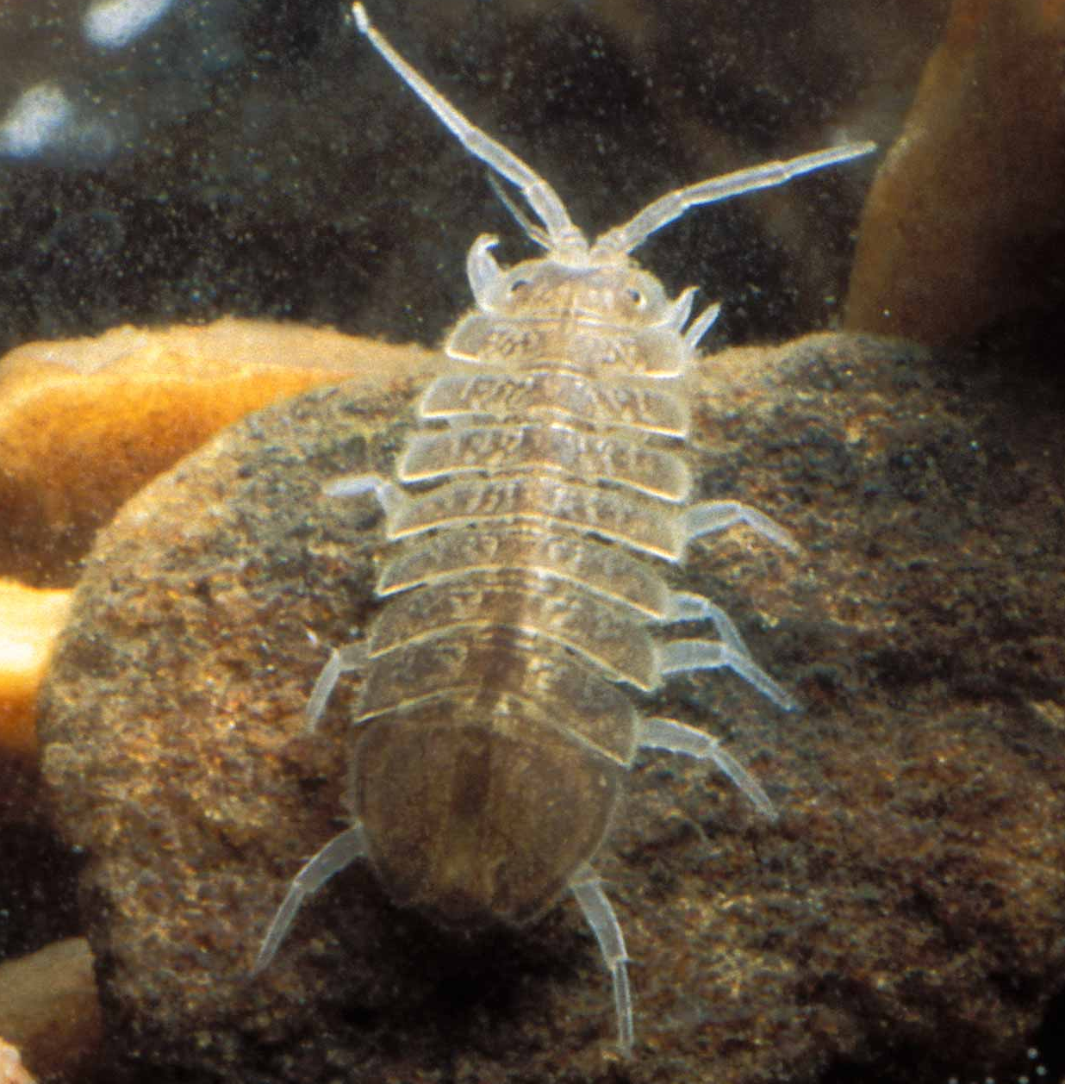
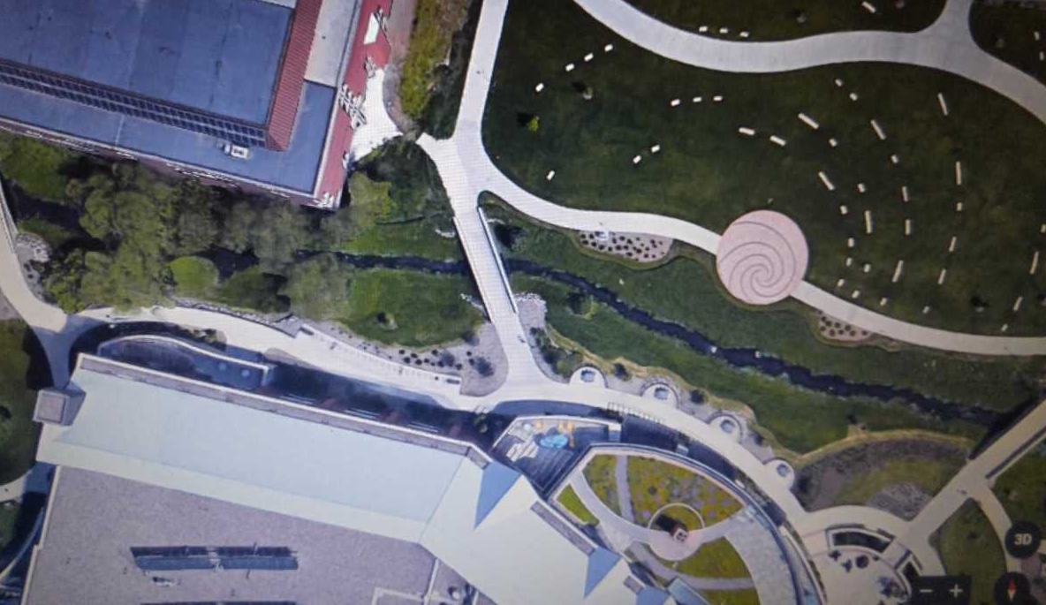
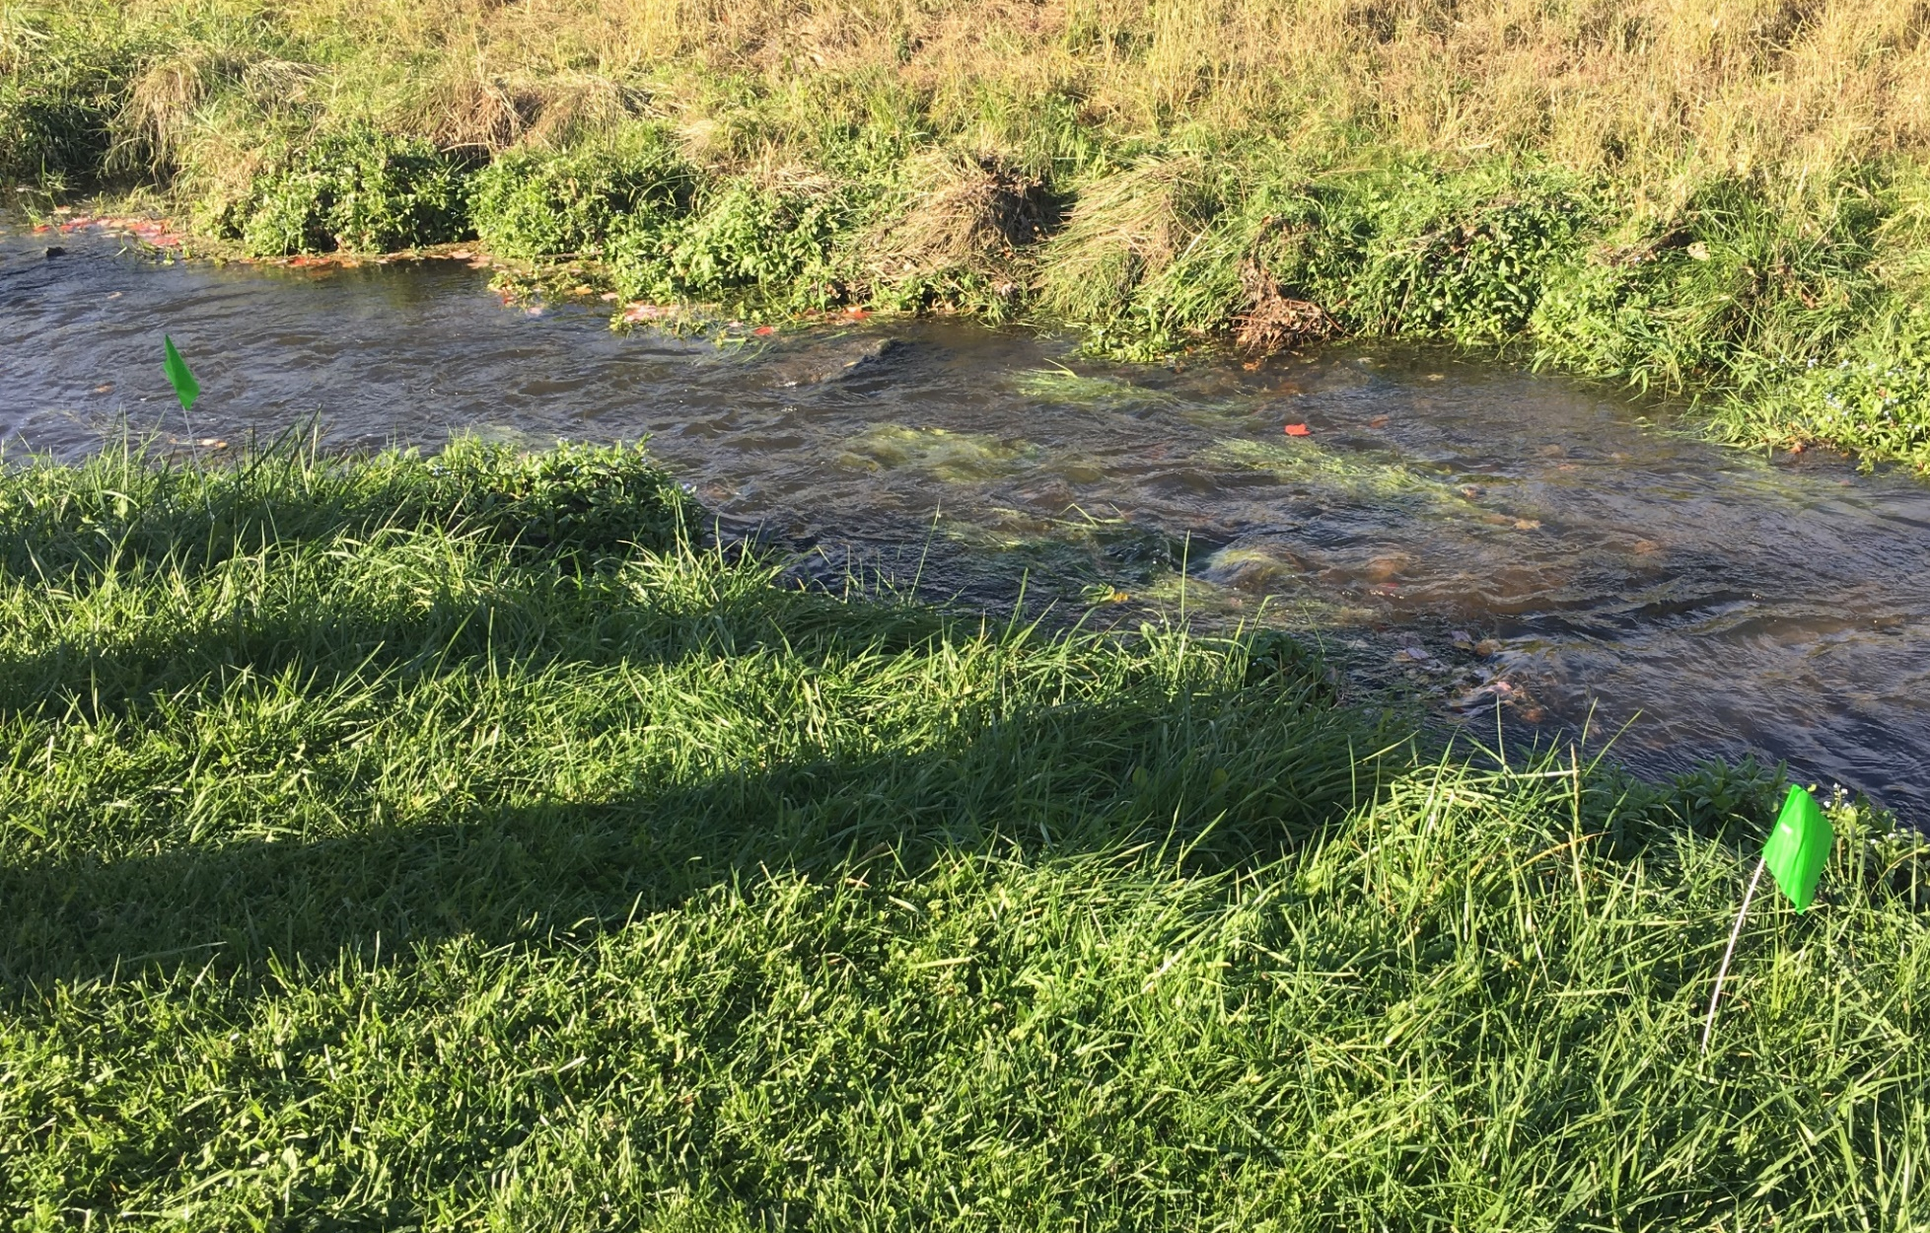
Crayfish Abundance in Little Niagara Creek
Maria Brandel, Keith Jorgensen, Jennifer Alderman and Jessica Houliston | Dr. Todd Wellnitz, mentor | Biology
Introduction
Results
Crayfish are an important component of the stream community in Little Niagara Creek, an important teaching and learning tool for the UWEC campus community. These large crustaceans are “ecosystem engineers” that can shape stream habitats and contribute significantly to stream food web structure (Houghton et al. 1998). They also are an indicator species for water quality (Reynolds et al. 2013). Understanding the factors that influence crayfish
We used a General Linear Model (GLM) to test for the effects of light intensity, current velocity and depth on crayfish and isopod abundance. Our results show that each factor was significant in the context of the full factorial model, but light intensity was the single most important factor. (Error bars for light intensity are ± 1 SE).
A
B
r² = 0.28
p = 0.004
C
Crayfish abundance
r² = 0.13
p = 0.03
Crayfish abundance
r² = 0.58
p = 0.009
abundance in Little Niagara Creek is an important first step in assessing their importance to the structure and function of this valuable resource.
Our study investigated crayfish abundance patterns in Little Niagara Creek. We initially hypothesized that crayfish numbers would differ between riffles and pools as suggested by Clark et al. (2013). Pools can be characterized as having slower current, deeper water and less light. We hypothesized that a pools would have more crayfish because there would be less drag and displacement from current and less light and greater depth would provide cover from predators such as raccoons and wading birds.
Light Intensity (μmoles/m²/s)
An aquatic isopod, or sow bug, crawling on the streambed. Isopods were the most common macroinvertebrate found in Little Niagara Creek.
D
E
F
r² = 0.40
p < 0.001
Isopod abundance
Methods
r² = 0.15, p = 0.001
Four riffles and four pools were designated along Little Niagara Creek where it runs through the UWEC campus. At each site, crayfish and macroinvertebrates were sampled and depth, current and streambed light intensity were measured.
https://nature.mdc.mo.gov/discover-nature/field-guide/aquatic-pillbugs-and-sowbugs-aquatic-isopods
Light Intensity (μmoles/m²/s)
Current velocity (cm/s)
Discussion and Conclusion
Rather than finding a difference between riffles and pools as initially hypothesized, we found that light, depth and current together were better predictors of crayfish abundance. Light intensity was the sole factor influencing crayfish numbers independently (A). This may be be because brighter light helps crayfish better see their prey (Perkin et al. 1994). A GLM model incorporating depth (B) and current velocity (C) showed both factors and their interaction also influenced crayfish abundance. Summarizing these effects, Little Niagara Creek crayfish appear to prefer areas of the stream that are well lit, deep and have slower current.
Isopods (D) made up the majority (53%) of the macroinvertebrate in our samples, and are likely an important prey species for Little Niagara Creek crayfish (Lodge and Hill 1994). This would explain the abundance patterns isopods showed in response to light intensity (E) and current velocity (F), each of which was the opposite of that seen in crayfish. These data suggest either that isopods were being eaten by crayfish or they were avoiding areas that crayfish preferred.
In conclusion, both biotic (isopod prey) abiotic factors (light, current and depth) appear to shape crayfish distribution patterns in Little Niagara Creek. Futures studies might examine how these factors vary in their importance across seasons.
= Sampling sites
A.
Photo from Google Earth
C.
3 meters
B.
D.
Literature Cited
Clark JM, Kershner MW, Montemarano JJ. 2013. Habitat-specific effects of particle size, current velocity, water depth, and predation risk on size dependent crayfish distribution Hydrobiologia 716:103-114
Houghton DC, Dimick JJ, Frie RV. 1998. Portable displacement of riffle-dwelling invertebrates by the introduced rusty crayfish, Oroconectes rusticus (Decapoda: Cambridae), in a north-central Wisconsin stream. Great Lakes Entomologist 31(1):13-24
Lodge DM, Hill AM. 1994. Factors governing species composition, population size, and productivity of cool-water crayfishes. Nordic Journal of Freshwater Research 69:111-136
Perkin EK, Franz H, Richardson JS, Sadler JP, Wolter C, Tockner K. 2011. The influence of artificial light on stream and riparian ecosystems: questions, challenges and perspectives. Ecosphere 2(11):1-16
Reynolds J, Souty-Grosset C, Richardson A. 2013. Ecological roles of crayfish in freshwater and terrestrial habitats. Freshwater Crayfish 19(2):197-218
https://goo.gl/images/U5d6uj
Each site spanned 3 m (A) and crayfish and macroinvertebrates were collected with a kick net (B) for for 15 min. A Marsh-McBirney current velocity probe (C) measured stream current and a Licor quantum sensor measured light intensity (D).

