Slide 1
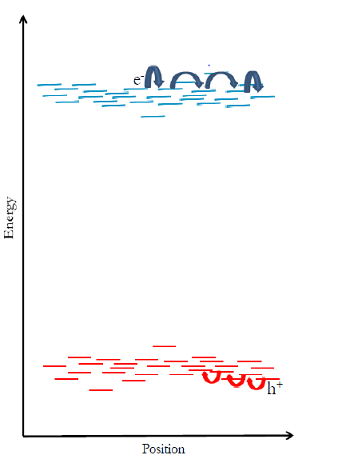
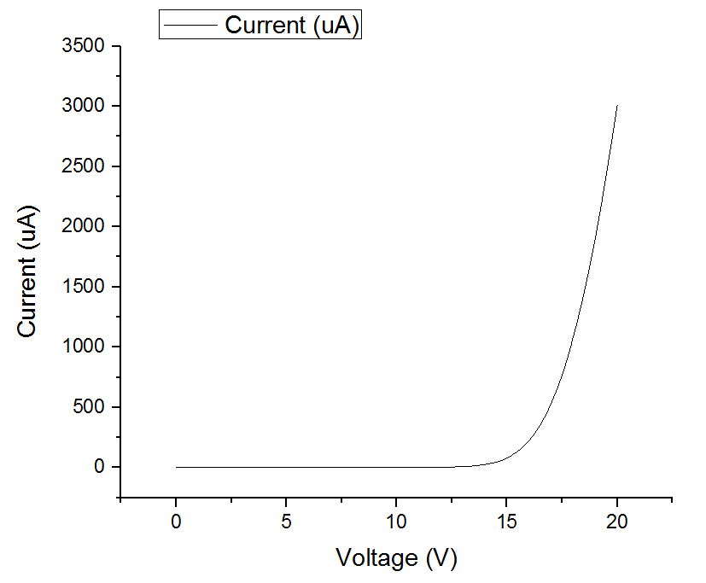
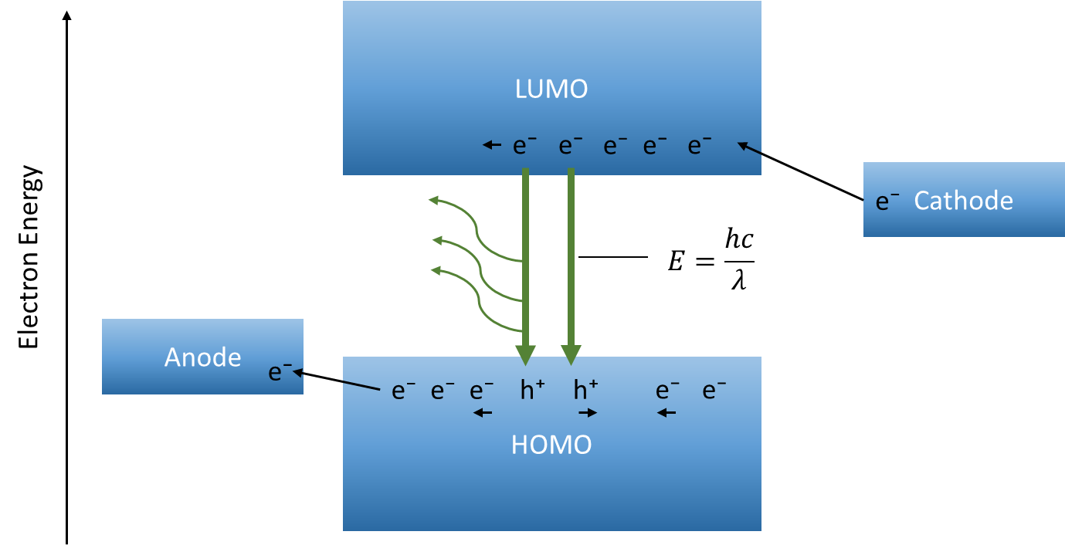

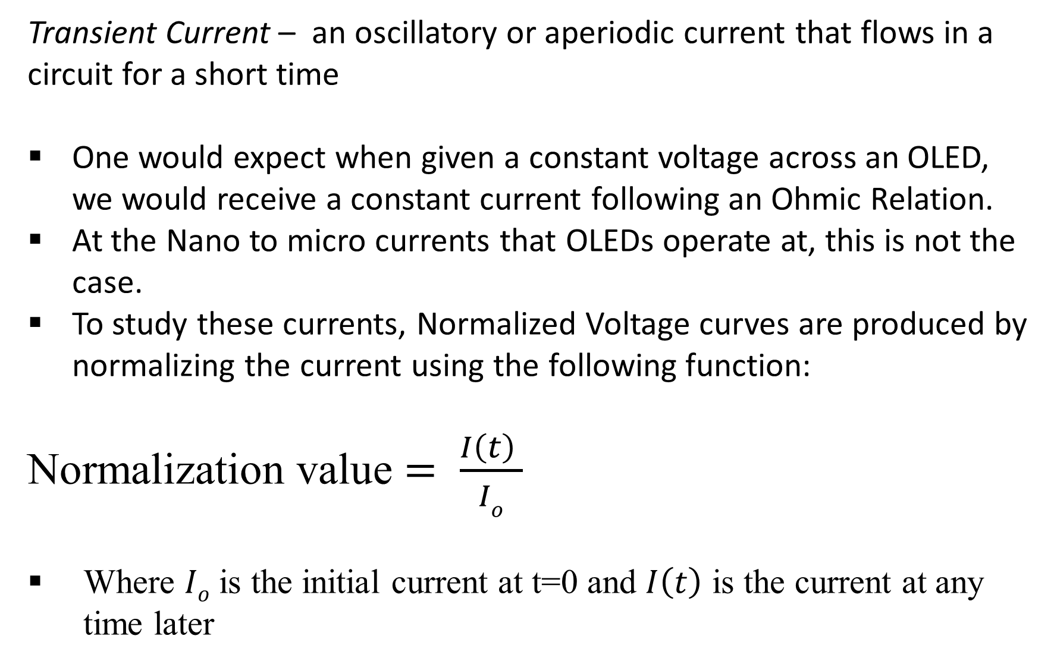
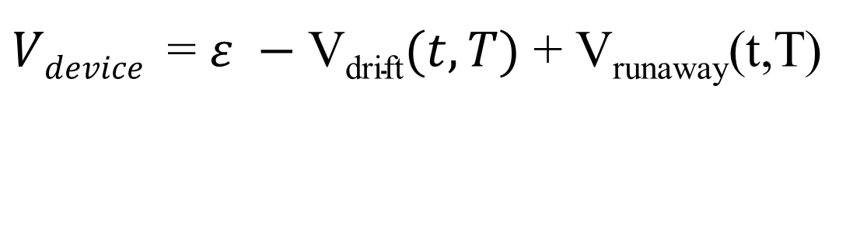

Transient Currents in Organic Light Emitting Diodes
Tris-(8-hydroxyquinoline)aluminum
Charge characteristics of Organic LEDs made with Alq3
Connor Feltman with Faculty Mentor Dr. James Rybicki | University of Wisconsin – Eau Claire Department of Physics and Astronomy.
Why Organic Electronics?
Transient Currents
Discussion and Modeling
Easily tunable to particular wavelengths
Stronger contrast ratio than normal LEDs
Cheap to manufacture, thin and flexible
Transient Current – an oscillatory or aperiodic current that flows in a circuit for a short time
One would expect when given a constant voltage across an OLED, we would receive a constant current following an Ohmic Relation.
At the Nano to micro currents that OLEDs operate at, this is not the case.
To study these currents, Normalized Voltage curves are produced by normalizing the current using the following function:
Normalization value $= \frac{I\left(t\right) }{Io}$
Where $Io$ is the initial current at t=0 and $I\left(t\right)$ is the current at any time later
Both drift and runaway effect may be linked to the valence shell mobility of electrons.
Electrons hop from atom to atom before falling down to lower conduction band, but it’s possible for electrons to get stuck in orbitals that don’t allow for recombination.
Deceasing/drift effect - The distribution of HOMO levels not being perfectly uniform causes electrons to build up in device, thereby making it more difficult for new electrons to pass through.
Increasing/runaway effect – Given sufficient external energy i.e. voltage, these trapped electrons may be freed from trap states and surge into the device cascading as a large current increase.
Purpose and Experiment
To fabricate and observe steady state currents found in Organic Light Emitting Diodes (OLEDs) and to produce a theoretical framework of their explanation.
Produce devices of varying light emission layer thicknesses and temperature to probe for current drifting effects.
Produce normalized constant voltage curves that track the current in the devices in times units determined by LabVIEW programming software.
Induced Voltage by trapped electrons
Structural overview
Results
$$ε$$
V_{drift}
(e⁻)
(-)
Electrons
Aluminum
Three main devices were fabricated at the previously specified thicknesses (37nm, 62nm and 100nm).
Each device was tested under temperatures of 275K, 200K, 100K and 20K.
A variety of voltages was applied to each device in order to produce a “runaway” current as well as a “drift” current.
These figures were produced using Origin graphing software.
Thermal release of electrons
Trap State where
Electron gets stuck
(+)
Calcium (Cathode)
Recombination
Alq₃ (Organic)
$$ε$$
P = I²R
PEDOT (Stabilizer)
ITO
(h⁺)
Current vs Voltage
Device 5, 275K (62nm Alq₃ )
Speculative Model:
Holes
$Vdevice$ = $ε −\text{V}\text{drift}(t,T)$ + V_{runaway}(t,T)
Alq₃ – Tris(8-hydroxyquinolinato)aluminium
PEDOT - poly(3,4-ethylenedioxythiophene) polystyrene sulfonate
ITO – Indium Tin Oxide
As the temperature decreases in our device, conductivity increases and therefore our current increases. This is contrary to Ohmic expectations but is idiosyncratic to organic devices
Both of these voltage effects compete against one another under the particular temperature and voltage conditions necessary for the runaway effect to start emerging.
This suggests that the dominant effect is the drifting trend downward until the “dam” of electrons is released back into the device as a current spike.
General Theory and Function
OLEDs produce light differently than regular LEDs.
Our devices use the semi-filled valence shells of Alq₃ for electron-hole recombination.
Upon recombination, light is emitted at wavelengths characteristic to the material used. Alq₃ will produce a green wavelength photon.
Device 7, 100K (37nm Alq₃ )
Device 6, 20K (100nm Alq₃ )
Conclusions and Future Experimenting
The currents displayed in the devices varied based on both initial voltage and internal temperature variables.
These transient phenomena may be linked to the idiosyncratic structure of OLEDs and experiments that investigate trapped electrons in these devices could provide a mathematical framework for analysis.
Works Cited
Sahin-Tiras, Kevser, et al. “Identification of Both Bipolaron and Electron-Hole Pair Contributions to Organic Magnetoresistance in a Regioregular Polythiophene Device.” Organic Electronics, vol. 48, 2017, pp. 198–203., doi:10.1016/j.orgel.2017.05.051. pp. 622–627.
Rybicki, James. “FREQUENCY AND TIME DOMAIN STUDIES OF MAGNETO-TRANSPORT AND CHARGE TRAPPING IN AMORPHOUS ORGANIC SEMICONDUCTORS.” July 2012, p. 9
Acknowledgments
Temperature appears related in exhibiting an increasing transient effect as shown by device 6 and 7.
Thicker devices require a larger voltage to produce similar current behavior.
Dr. Markus Wohlgenannt - University of Iowa
University of Wisconsin - Eau Claire Department of Physics and Astronomy
LUMO – Lowest Unoccupied Molecular Orbital
HOMO - Highest Unoccupied Molecular Orbital

