Slide 1

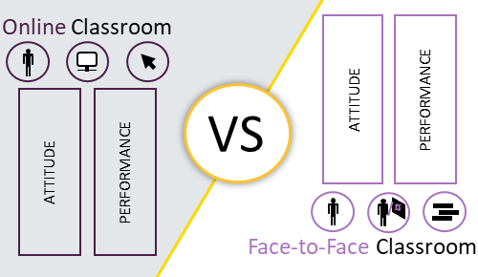
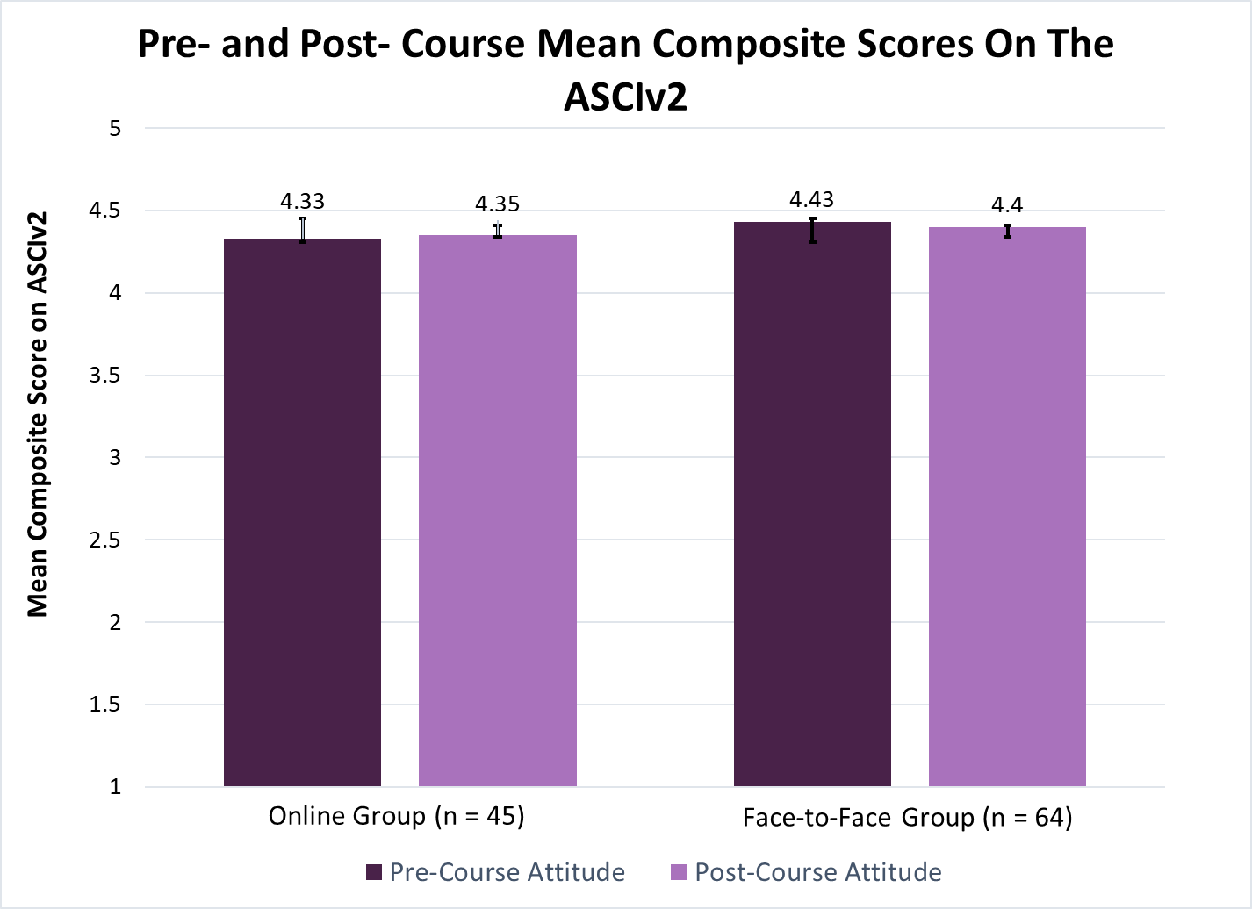
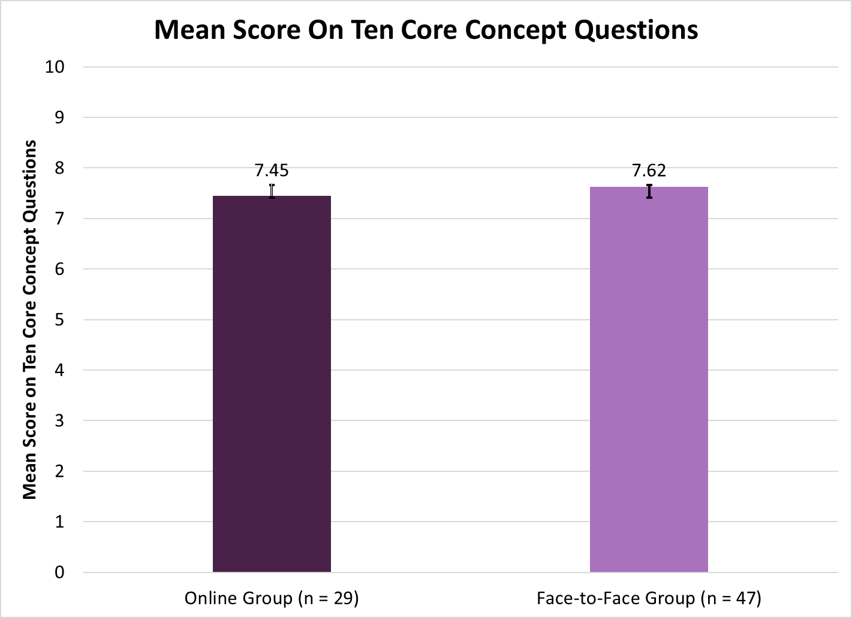
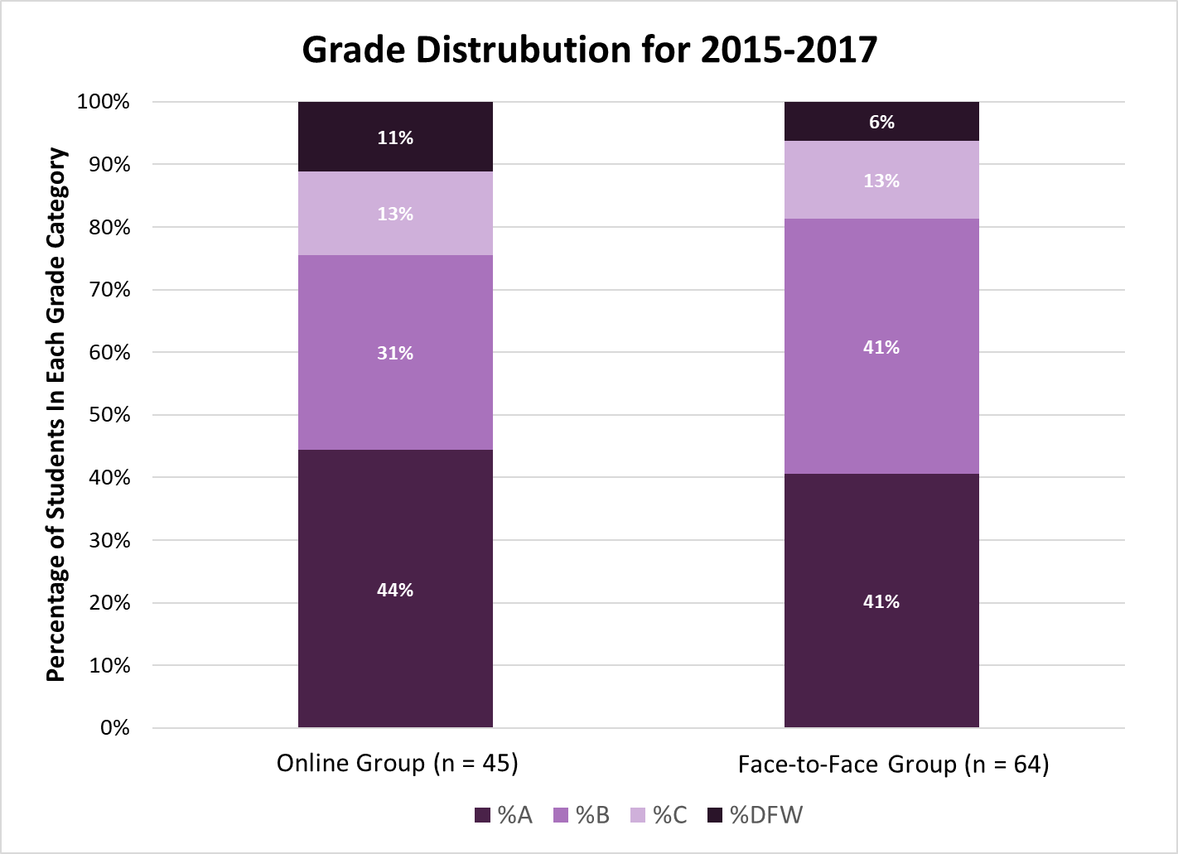
Investigation of Student Attitudes and Understanding in an Online Versus Face-to-Face Introduction to Inorganic Chemistry Course
Luke D. Salzer, Hannah T. Nennig, and Dr. Roslyn M. Theisen
Department of Chemistry, University of Wisconsin- Eau Claire
Project Overview
Background
Based on research in the last 15 years, online classrooms show same to slightly better effectiveness in teaching the material compared to a face-to-face course.
In chemistry education, only a few studies have compared online versus traditional formats in undergraduate chemistry courses.
In the still small number of quantitative studies of fully online classrooms versus traditional classrooms, none, to our knowledge, have looked at student performance and student attitude towards chemistry using a validated and reliable survey instrument in an undergraduate chemistry course.
Hypothesis
Students who are enrolled in an online or a face-to-face course will have the same measurable outcomes in their understanding of and attitudes towards chemistry.
The purpose of this project is to evaluate the content-delivery formats in inorganic chemistry to improve academic experiences for students in STEM majors. This study, online and face-to-face student attitudes and understanding will be assessed by quantitative and qualitative measures. An attitude survey about chemistry was given to participants (the ACSI v2) at the beginning and end of the course. To assess student understanding of the core concepts covered in inorganic chemistry, several measures were examined and analyzed, such as grade distribution and final exam scores. The approach will integrate several evidence based elements that have yet to be implemented in chemistry higher education. This study is
Statistical Analysis
Participants took the ASCIv2 at the beginning and end of the semester
An Independent t – Test was conducted to determine if there was a difference in mean scores
A χ2 test was conducted to compare grade distribution
A Cronbach's α test was administered to test internal validity in the ASCIv2, with scores of 0.721 for IA and 0.642 for EA
intended to strengthen instruction in chemistry, benefit student learning,
and foster positive attitudes for sciences. In determining what the students gain from the online versus a face-to-face learning environment will help to determine whether similar types of online course offerings should be integrated into other STEM disciplines.
Research Questions
Do students in an online versus a face-to-face course format have the same measurable outcomes in the understanding of core concepts of Introduction to Inorganic Chemistry?
Do students in an online versus a face-to-face course format have the same grade distribution at the end of the term?
Do these students have the same measurable outcomes in attitude toward chemistry?
Populations Studied
Item | Online Group | Face-to-Face Group
N_{Total} | 45 | 64
N_{Study} | ∼25 | ∼43
Class Standing | 4% Fr, 31% So, 33% Ju, 31% Se | 3% Fr, 34% So, 31% Ju, 32% Se
Gender | 60% F, 40% M | 44% F, 56% M
Fr= Freshman, So= Sophomore, Ju= Junior, and Se= Senior
Table 1. Summary of Demographic Information for Face-to-Face and Online Groups
Courses Studied
Table 2. Grading Scheme of Online and Face-to-Face Introduction to Inorganic Chemistry Courses Studied
Results
One instructor taught the face-to-face groups and another instructor taught the online groups.
The face-to-face and online courses were designed to achieve equivalent expectations for student effort as shown in Table 2.
Using a 1 to 7 scale, the online group scored on average the same as the face-to-face group on both the pre-course and post-course attitude survey.
Descriptive statistics and Independent Sample t Test were conducted to determine if a difference in attitude between each group existed.
There was no statistical significance (p< .05) in student attitudes toward chemistry between face-to-face and online groups.
This means that we accept the null hypotheses to be true. Face-to-face and online groups do not differ statistically in their attitudes.
Item | Online Group | Face-to-Face Group
Exams | 38% | 55%
Discussion Activities | 8% | 11%
Assigned Homework | 16% | 19%
Quizzes | 38% | 15%
Face-to-Face
Instruction incorporated weekly active learning strategies (including minute paper assignments and reflection notecards).
Class time mainly consisted of PowerPoint slides with the instructor using the document camera to write out lecture notes.
Attendance was not required; however, participation points were awarded for lecture attendance.
Online
Students in the online groups completed the entire course, including examinations at a distance and did not participate in any on-campus instructional activities.
The weekly course content was a combination of one-way video lectures and web resources.
The Attitude Toward the Subject of Chemistry Inventory (ASCIv2)
CHEMISTRY IS
1 | Easy | 1 | 2 | 3 | 4 middle | 5 | 6 | 7 | Hard
2 | Complicated | 1 | 2 | 3 | 4 | 5 | 6 | 7 | Simple
3 | Confusing | 1 | 2 | 3 | 4 | 5 | 6 | 7 | Clear
4 | Comfortable | 1 | 2 | 3 | 4 | 5 | 6 | 7 | Uncomfortable
5 | Satisfying | 1 | 2 | 3 | 4 | 5 | 6 | 7 | Frustrating
6 | Challenging | 1 | 2 | 3 | 4 | 5 | 6 | 7 | Not Challenging
7 | Pleasant | 1 | 2 | 3 | 4 | 5 | 6 | 7 | Unpleasant
8 | Chaotic | 1 | 2 | 3 | 4 | 5 | 6 | 7 | Organized
The online groups scored on average the same as the face-to-face groups on the ten common exam questions targeting core concepts discussed in Introduction to Inorganic Chemistry.
Descriptive statistics and Independent Sample t Test were conducted to determine if a difference in academic performance between each group existed.
There was no statistical significance (p< .05) on student scores from the ten core concept questions between the face-to-face and online groups.
This means that we accept the null hypothesis to be true. Face-to-face and online groups do not differ statistically in conceptual understanding of core concepts.
Two to three videos were typically assigned each week and made available only on the course management system; each was paired with an assignment.
Participation points were awarded for posting questions to the online discussion board using the course management system (one question or response per question per week).
Online |  |  | Face-to-Face
Activity |  | Time | Activity |  | Time
Lecture | Summer 2015 | 1.5 hour lecture per week- 8 weeks | Lecture | Fall 2015 | MWF 1-1:50 PM- 15 weeks
 | Winter 2016 | 4.5 hour lecture per week- 3 weeks
 |  |  |  | Spring 2017 | MWF 2-2:50 PM- 15 weeks
 | Summer 2017 | 1.5 hour lecture per week- 8 weeks
Homework | Summer 2015 | 5-7 hours per week | Homework | Fall 2015 | 2 hours per week
 | Winter 2016 | 10-11 hours per week
 |  |  |  | Spring 2017 | 2 hours per week
 | Summer 2017 | 5-7 hours per week
Exams & Quizzes | Summer 2015 | 60 minute Exams- 3 Exams 30 minute Quizzes- 6 Quizzes | Exams & Quizzes | Fall 2015 | 50 minute Exams- 4 Exams 20 minute Quizzes- 11 Quizzes
 | Winter 2016 | 60 minute Exams- 3 Exams 30 minute Quizzes- 6 Quizzes
 |  |  |  | Spring 2017 | 50 minute Exams- 4 Exams 20 minute Quizzes- 11 Quizzes
 | Summer 2017 | 60 minute Exams- 3 Exams 30 minute Quizzes- 6 Quizzes
Discussion | Summer 2015 | N/A | Discussion | Fall 2015 | 15 minutes per week
 | Winter 2016 | N/A
 |  |  |  | Spring 2017 | 15 minutes per week
 | Summer 2017 | 1-2 hours per week
The percent of A, B and C grades for students in the online course and the students in the face-to-face course during the study were similar.
DFW% is the percent of students who received a failing grade of D or F or Withdrew from the course.
The DFW% are similar between the online and face-to-face groups
Future Work
We plan on investigating gender differences when analyzing the students’ attitudes and
grades in inorganic chemistry.
We plan on gathering more data during Summer 2018, Winter 2019 and Spring 2019 in order to investigate the potential differences in students’ attitudes and grades based on their academic standing (Freshmen, Sophomore, Junior, Senior).
We plan on examining students’ retention rate of the course materials based on which format of the course was taken.
Table 3. Comparison of Activities and Time Expectations For The Online and Face-to-Face Groups.
References:
Bauer, C. F. Attitude toward Chemistry: A Semantic Differential Instrument for Assessing Curriculum Impacts. J. Chem. Educ. 2008, 85 (10), 1440–1445.⏐ Tallent-Runnels, M. K; Thomas, J. A.; Lan, W. Y.; Cooper, S.; Ahern, T. C.; Shaw, S. M.; Liu, X. Teaching Courses Online: A Review of the Research. Rev. Educ. Res. 2006, 76 (1), 93–135.⏐ Means, B.; Toyama, Y.; Murphy, R.; Bakia, M.; Jones, K. Evaluation of Evidence-Based Practices in Online Learning: A Meta-Analysis and Review of Online Learning Studies. U.S. Department of Education September 2010.⏐ Bernard, R. M.; Abrami, P. C.; Lou, Y.; Borokhovski, E.; Wade, A.; Wozney, L.; Wallet, P. A.; Fiset, M.; Huang, B. How Does Distance Education Compare With Classroom Instruction? A Meta-Analysis of the Empirical Literature. Rev. Educ. Res. 2004, 74 (3), 379–439. ⏐ Theisen, R. Was Approved to Work on This Project by the UW-EC Institutional Review Board (IRB) for the Protection of Human Subjects under the Category of Exempt (IRB Number THEISERM6702012). August 2012.⏐ Xu, X.; Lewis, J. E. Refinement of a Chemistry Attitude Measure for College Students. J. Chem. Educ. 2011, 88 (5), 561–568.
Acknowledgments:
Department of Chemistry at the University of Wisconsin - Eau Claire
Jason Halfen (UW-Eau Claire, Chemistry) for teaching the online course discussed
April Bleske-Rechek (UW-Eau Claire, Psychology) for consultation on statistical analysis
Student Travel Award though the Office of Research and Sponsored Programs at UW – Eau Claire 2018
The Student Blugold Commitment Fund through the CETL Summer SoTL Grant Program at UW – Eau Claire 2016 and 2017 (RMT)
University of Wisconsin – System Office of Professional and Instructional Development Teaching and Learning Grant 2015 (RMT)
Caitlin E. Hites for creating the graphical abstract

