Slide 1

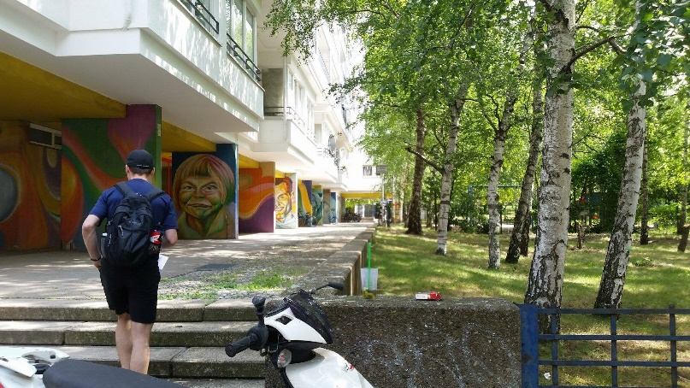
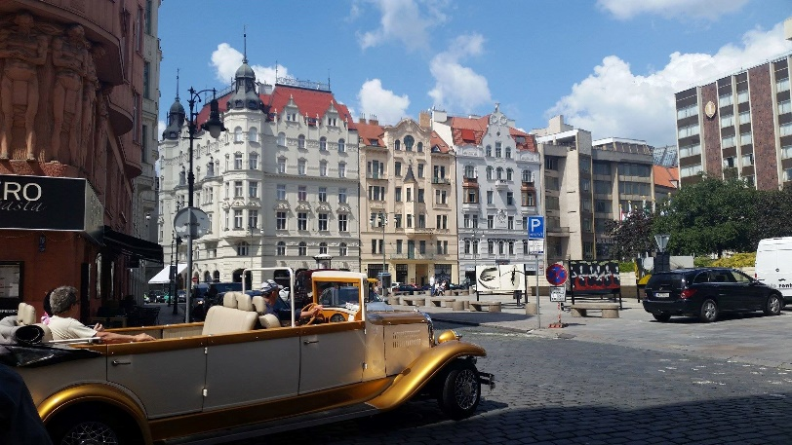
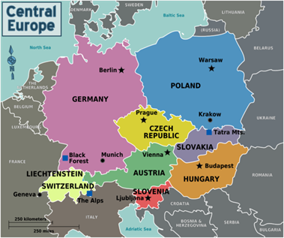
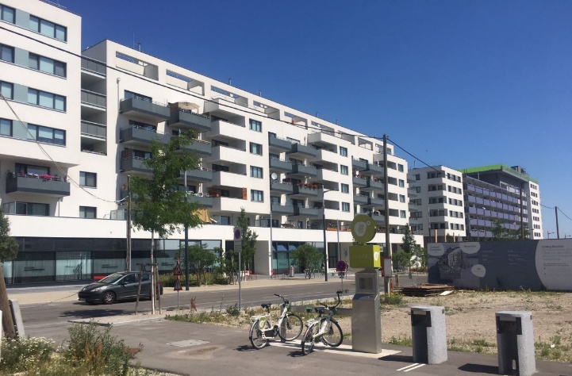
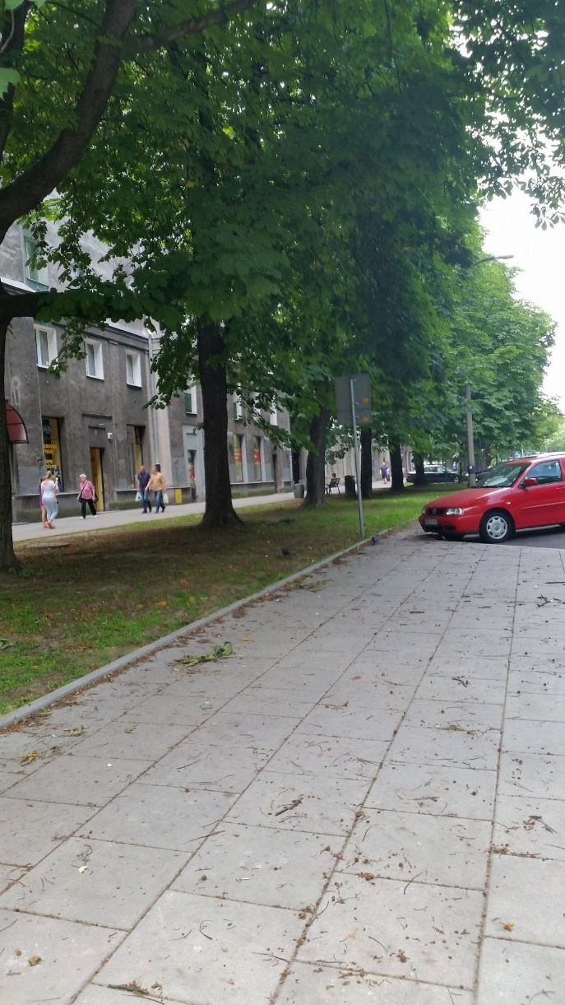
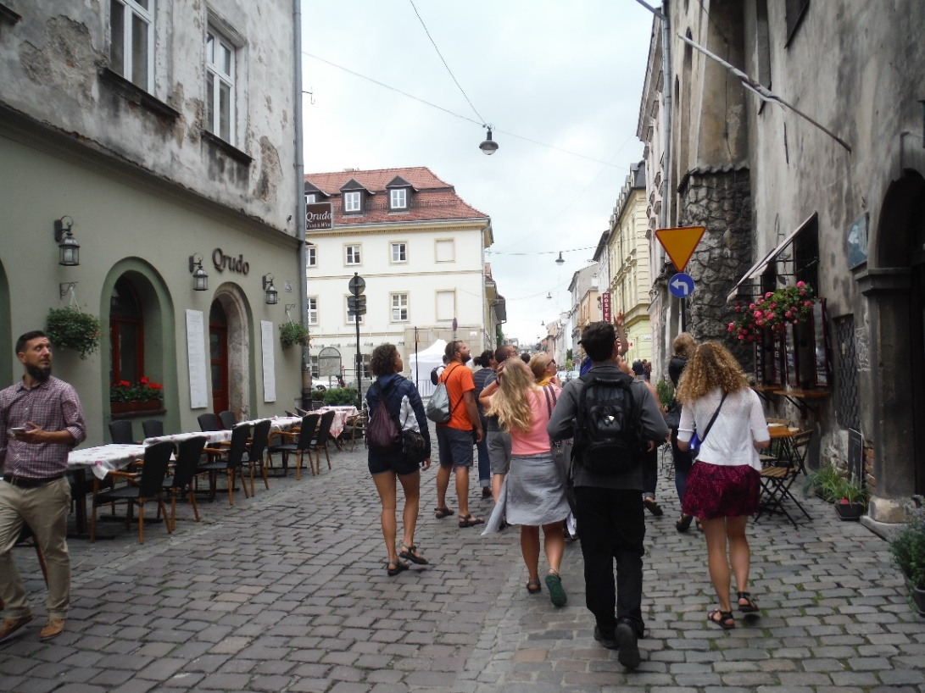
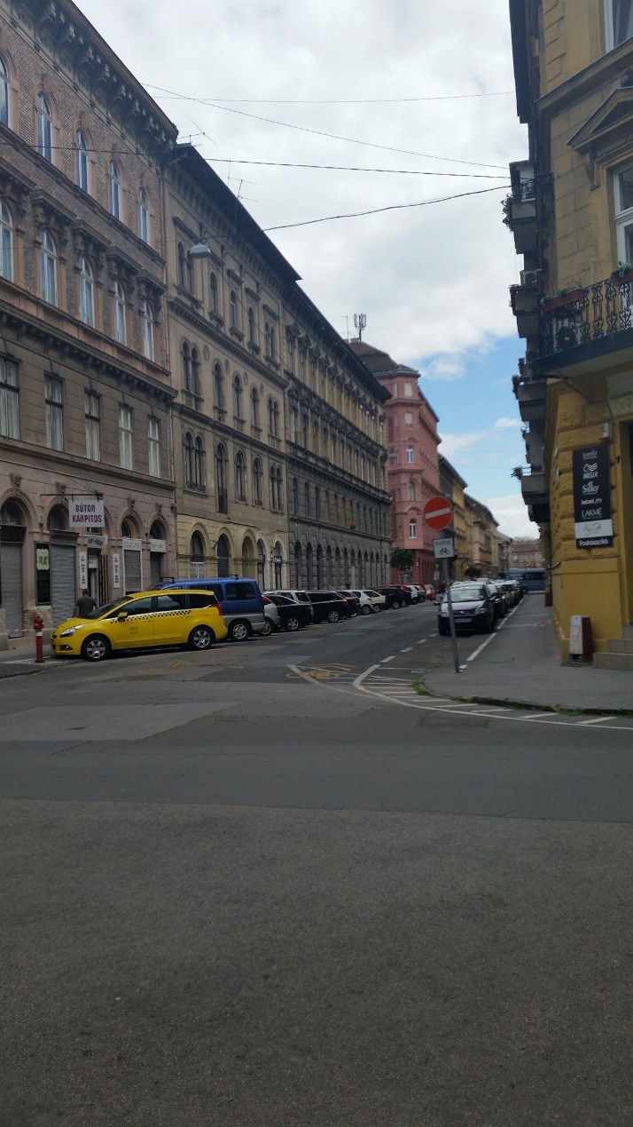
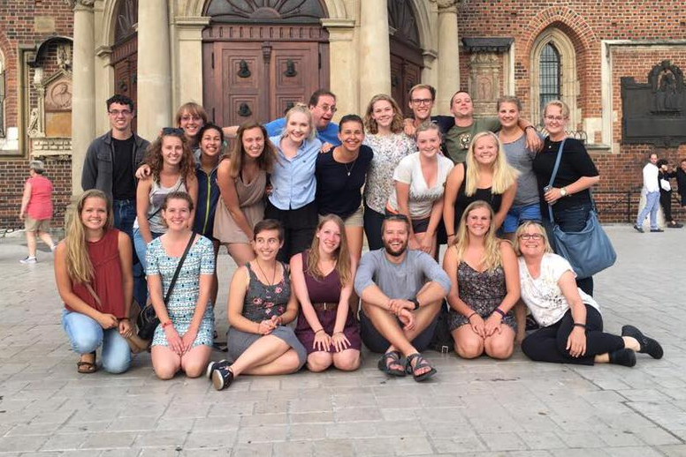
0
Student Perceptions of Neighborhood Sense of Place Among Central European Neighborhoods
Katie Paulich, Biology and Psychology; Faculty Mentors: Karen Mumford, Jeff DeGrave, and Jill Olm  University of Wisconsin-Eau Claire
Introduction
Study Sites
Methods
Neighborhood sense of place characterizes how people create meaning from their experiences within neighborhoods (Adams, 2013). Differences in sense of place experiences may be due to individual characteristics, such as age and sex, and environmental and social neighborhood characteristics, such as the presence of greenspace or people hanging out along streets. Neighborhood sense of place is an important area of study because it can influence individual well-being and the degree to which people engage with neighborhood settings (Adams et al., 2017).
During June 2017, UWEC students participated in a neighborhood sense of place assessment of five Central European neighborhoods as part of the University of Wisconsin-Eau Claire Central European Travel Seminar (CETS) program. The purpose of this study is to examine similarities or differences among student perceptions of social and environmental characteristics of each neighborhood and the degree to which students preferred particular neighborhoods. In this study, we refer to sense of place as "the unique collection of qualities and characteristics… that provide meaning to a location" (McMahon, 2012).
Students visited five neighborhoods in Central Europe: Kreuzberg in Berlin, Germany; Josefov in Prague, the Czech Republic; Aspern Seestadt in Vienna, Austria; Andrassy Avenue in Budapest, Hungary; and Nowa Huta in Krakow, Poland.
Students walked through each neighborhood and recorded observations of environmental and social features.
Following the conclusion of the trip, students then submitted a report summarizing their observations and perceptions of each neighborhood.
Utilizing Qualtrics Survey Software, we created a short questionnaire to evaluate student perceptions of several social and environmental dimensions of each neighborhood.
At the beginning of the Fall 2017 semester, students completed the Qualtrics survey and provided their individual perceptions of and feelings toward each neighborhood (e.g. their sense of belonging, feelings of safety, etc.,).
We also asked students for their overall impressions of the neighborhoods, how they would rank the neighborhoods in terms of most preferred, and which neighborhood they would live in, if given the opportunity.
Finally, we asked students about the neighborhoods in which they grew up to examine whether similarities and differences of their home neighborhoods to the European neighborhoods were related to neighborhood preferences.
Data were processed and reviewed for consistency and identification of errors.
Data were downloaded and analyzed in SPSS statistical software to examine the links between perceptions of the physical and social characteristics and neighborhood preferences.
Kreuzberg supports an ethnically diverse, entrepreneurial and artistic community. It is well known for its building graffiti and wall art. Residential areas include single family homes and energetic mixed-use buildings.
Josefov, the Jewish Quarter of Prague, dates back to the 13th century. In addition to its historic Jewish buildings ethnic history, the neighborhood supports upscale shops, condominiums, apartments, and cobbled streets.
Aspern Seestadt is a new development located on the outskirts of Vienna. The neighborhood boasts modern multi-family homes, apartments, cooperative housing, shops, and offices. The site supports a large artificial lake and park.
Nowa Huta was built in the 1950s by the Soviet Union employing socialist-realist architecture. The neighborhood supports large concrete apartments, parks, boulevards, and shops.
Andrassy Avenue is a renowned commercial district in Budapest. It hosts high-end shops, apartments, and aging, yet fascinating, neo-classical homes. A small park lies in the center of the neighborhood.
Results
Discussion
Our sample (N = 18) consisted of four male and fourteen female college students between the ages of 18 and 22. Due to the small sample size, parametric statistical analyses were not appropriate.
We therefore summed the responses from each question by neighborhood and then ranked each neighborhood based on responses relating to questions about physical features (Physical Rank), social features (Social Rank), and a combination of physical and social features (Overall rank). We also ranked how much in common the neighborhoods had with respondents’ home neighborhoods (Most in Common) and the neighborhood respondents would prefer to live in (Choose to Live).
Neighborhood ranks were not consistent across physical, social, and overall ranks (Table 1). The Kreuzberg and Andrassy neighborhoods were ranked as the highest (1) and lowest (5) across these three scores, respectively. However, the Aspern neighborhood ranked second across the physical features and fourth across the social and overall ranks. Josefov and Nowa Huta ranks were slightly higher on the social and overall ranks and lower on the physical ranks.
The Nowa Huta neighborhood was judged to have the most in common with respondents’ home neighborhoods and yet it was ranked last in terms of choosing to live in this neighborhood. Aspern had a lower physical and social rank and yet was the second most favored neighborhood in which to live.
These findings suggest that social and physical rankings are not consistent across the neighborhoods. Some neighborhoods ranked higher on social features but lower on physical features. Also, neighborhood choice was not to be related to similarities in one’s home neighborhood.
Due to the small sample size, conclusions from this study are limited. However, neighborhood preferences appear more complex than anticipated, as reflected in the variability of ranks across different types of features. Future studies involving a larger sample size may help assess the role that physical and social features play in influencing student sense of place experiences. The sense of place activity did help students more carefully assess neighborhood social and physical features and to discern why they preferred certain neighborhoods over others.
Table 1. Neighborhood Ranks
0
0
References
Acknowledgements
Adams, J. D. (2013). Theorizing a sense of place in a transnational community. Children, Youth, and Environments, 23, 43 – 65. doi:10.7721/ chilyoutenvi.23.3.0043
Adams, J., Greenwood, D., Thomashow, M., Russ, A. (2017). Sense of Place. The Nature of Cites. Web. 20 April 2018.
Ross, J. E. (2001). What is sense of place? Archives of the 12th Headwaters Conference, 2 – 4. Web. 11 July 2017.
McMahon, E. T. (2012). The distinctive city. Urban Land. Web. 11 July 2017.
We would like to acknowledge the student participants of the June 2017 Central European Travel Seminar for completing our research survey.
We also want to thank CETS 2017 faculty Cheryl Contant for her assistance in developing this project.
We would like to thank the UWEC Faculty-Led Intercultural Immersion Experience Program for support for student travel.
This research is supported by the Office of Research and Sponsored Programs at UWEC.
We thank LTS for printing this poster.
Notes:
AGE??!?!!?!?

