Slide 1
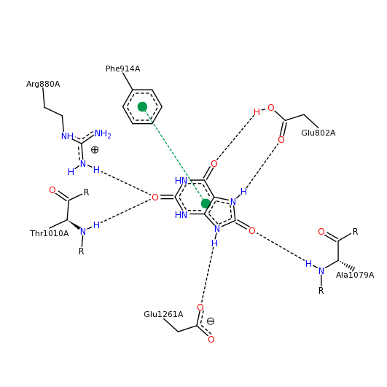
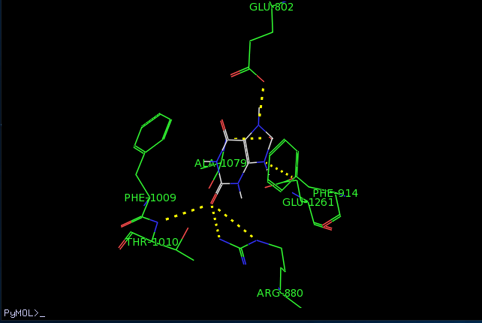
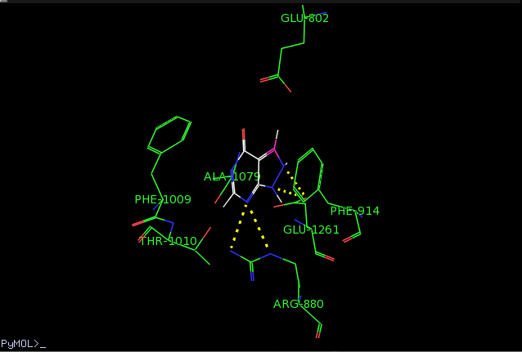
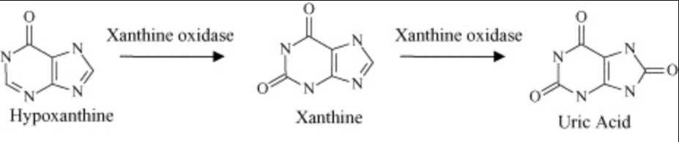
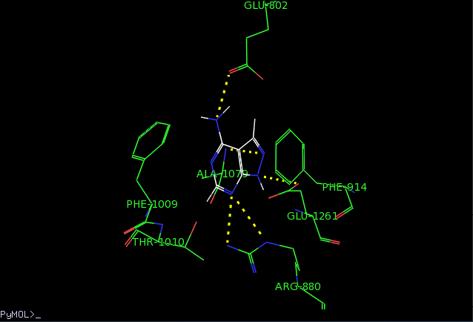
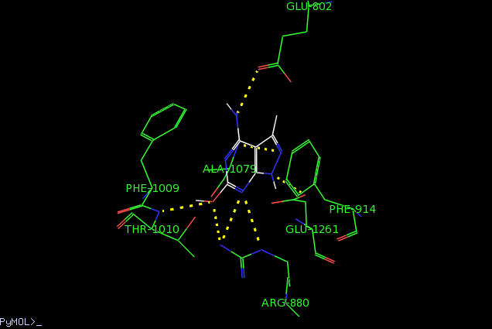
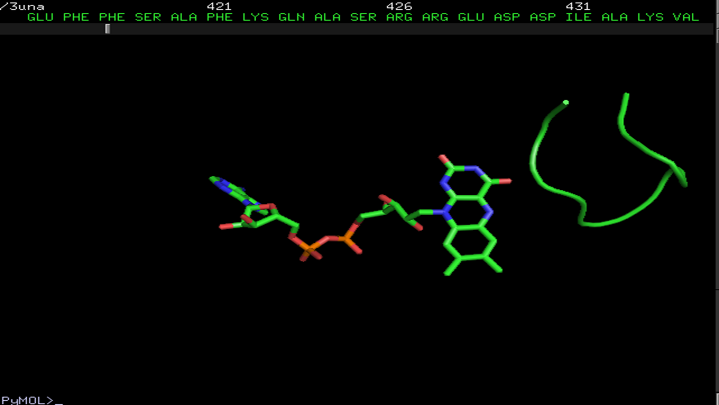
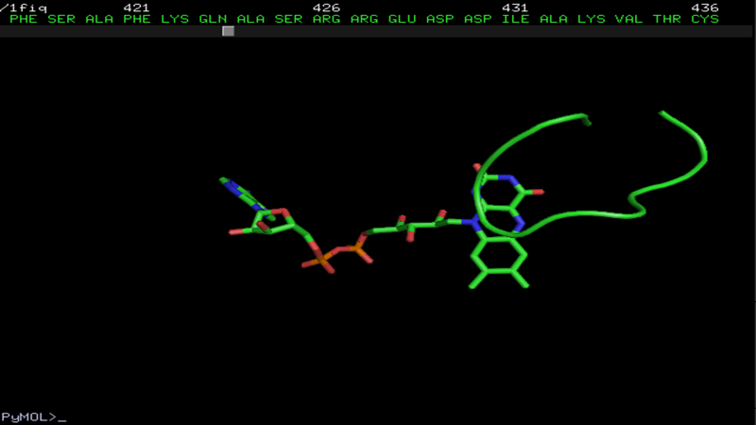
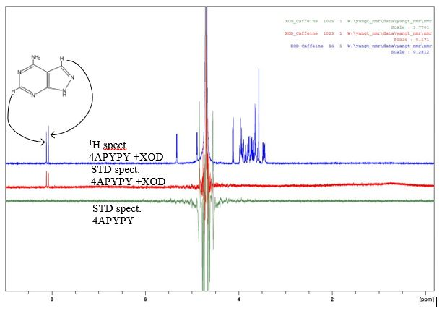
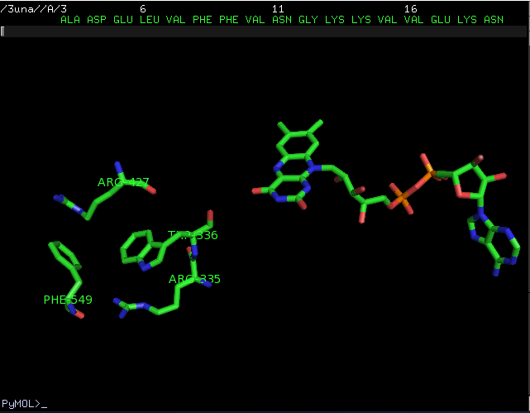
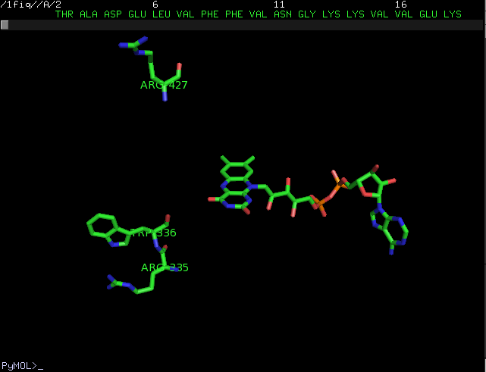
Studies of Small Molecules Binding to Xanthine Oxidase Modeled After Urate Binding
Eric E. Colwitz, Keng Chang (Presenter) and Thao Yang
Department of Chemistry, University of Wisconsin-Eau Claire, Eau Claire WI;
Celebration of Excellence in Research & Creative Activity (28th Annual CERCA), April 27-May 1, 2020.
Abstract
In this study, we investigate the binding of two small molecules, 4-aminopyrazolo[3,4-d] pyrimidine and 4-amino-1H-pyrazolo[3,4-d] pyrimidine-6-ol, to XOD by computational ligand-docking method using the Autodock Vina software (2). We first performed docking of uric acid binding to XOD and compared the results to the x-ray crustal structure of XOD-urate bound structure, then we performed the docking of a known XOD inhibitor, allopurinol, binding to XOD. The docking results of other small molecules were then compared to those of uric acid and allopurinol results.
Methods
Size | Center
x=12 | x= -70.094
y=12 | y= -25.821
z=12 | z= -39.822
We will present the binding results of 4-aminopyrazolo[3,4-d] pyrimidine and 4-amino-1H-pyrazolo[3,4-d] pyrimidine-6-ol binding to xanthine oxidase (XOD). XOD is an enzyme found in the human serum and lungs. The disease gout is caused by formation of high level of uric acid in the blood. Molecules that can bind to XOD are potential inhibitors, which could be developed as possible remedies for treating gout symptoms. The compounds consist of the pyrazolopyrimidine skeletal structure with different peripheral groups around the fused rings. The binding studies were first carried out by computer docking of the molecules onto the XOD active site, then the results of interactions between the docked molecule and side chain groups, as well as the affinity energies, were evaluated compared to the known binding of uric acid and allopurinol to XOD. The computer docking results showed that these molecules formed similar hydrogen bonding pattern and hydrophobic interactions at the active side when compared to the results obtained by docking uric acid and allopurinol. The binding of these molecules to XOD was also carried out in solution by the technique Saturation Transferred Difference NMR spectroscopy. The binding results obtained from the NMR experiments showed that both molecules have interactions with XOD.
All molecules for this study were manually created with the Spartan software, using the PDB file of XOD with uric acid downloaded from Protein Data Bank. Only one subunit containing one active site is used for docking. The other subunits and groups associated with the XOD structure were deleted. The native uric acid structure is obtained by deleting everything but the uric acid atoms. Results were obtained by using Autodock Vina software (2). Docking techniques were used to determine mode of binding, interactions, root-mean-square (RMSD) and the binding energy value.
Table 1. Grid box size used for running Autodock Vina for results.
Objective
Objectives
The purpose of this study is to use computational technique to perform “docking” of two small molecules, 4-aminopyrazolo[3,4-d] pyrimidine (APP) and 4-amino-1H-pyrazolo[3,4-d] pyrimidine-6-ol (APPO), binding to XOD to see if they can bind with similar results compared to uric acid and allopurinol. Uric acid is a native ligand to XOD, while allopurinol is a known inhibitor being as use a drug to treat gout. A small molecule that can bind XOD is a potential inhibitor or drug for treating uricemia diseases.
Results
Conclusions
Below are results for best fit ligands. The best fit ligand does not necessarily mean it is the ligand that will have the exact interactions as the native ligand, but is the best structure for where it is positioned relative to the bound uric acid.
- The compound APP has hydrogen bondings (H-bonds) to XOD similar to uric acid and allopurinol. It has one H-bond at the 4-amino group to the side chain O-atom of Glu-802 similar to uric acid, which allopurinol does not have. The affinity energy is comparable to the value for allopurinol (-6.0 kcal/mol vs. -5.7 kcal/mol).
- The compound APPO has the same numbers of H-bonds as uric acid (see Fig. 4(A and B); in addition it has a H-bond from the N-1 atom to the Arg-880 guanidinium group. Its bonding affinity value is highest compared to those of uric acid and allopurinol (-6.7 kcal/mol).
- The STD NMR results showed that the protons on the pyrazolo-pymidine ring of APP have interactions (binding) to XOD.
- The best observed binding was 4-Amino-1H-pyrazolo[3,4-d] pyrimidine-6-ol (APPO).
- Both of these molecules (APP and APPO) could potentially be inhibitors of xanthine oxidase.
- Further testing will be required, however computational results give a guide on which molecule will be a better inhibitor.
Introduction
A
B
C
Xanthine Oxidase (XOD) is an enzyme that converts hypoxanthine to xanthine then to uric acid (salt form, urate), a metabolic waste product (Fig. 1). The XOD structure contains two subunits, each containing a molybdopterin group and one flavin adenine dinucleotide group (FAD) (1). When the activity of XOD is accelerated the level of uric acid increases and high level of this can lead to a build up of urate crystals in a person’s joints, leading to the cause of gout disease.
Figure 1. Oxidation of hypoxanthine to produce uric acid (4).
XOD, also known as xanthine oxidoreductase, exists in two catalytically active forms, the oxidase form (XO) and the xanthine dehydrogenase form (XDH). When the XDH form is converted to the XO form, three major changes in its structure occurred. First, formation of a disulfide bond between Cys-535 and Cys-992 occurred; second, a major structural shift (movement) of a ten-residue loop (Gln-423 – Lys-433) at the NAD binding site occurred. In the XDH form the loop does not block the NAD binding site (Fig. 2), but when it transitions to the XO form, the loop has moved to now block the NAD binding site, no longer allowing NAD into the active site in the XO form. The third major structural change observed was the disruption of a residue cluster containing Arg-335, Trp-336, Arg-427, and Phe-549 close to the FAD binding site (5). This cluster is no longer compact when it transitions into the XO form (Fig. 3).
Figure 4.(A,B). (A) Observed bonding interactions of uric acid from docking in pymol (Middle) (3) compared to the (B) interactions from the PDB (Left) (1).
Figure 4C. Docking results of known inhibitor allopurinol binding to XOD. Energy, best fit, mode and RMSD are shown below.
Molecule | Energy | Best fit | RMSD
Allopurinol | -5.7 | Mode #8 | 2.199,2.933
References
Okamoto, K., Kawaguchi, Y., Eger, B.T., Pai, E. F, and Nishino, T. Crystal Structures of Urate Bound Form of Xanthine Oxidoreductase: Substrate Orientation and Structure of the Key Reaction Intermediate. J. Am. Chem. Soc. 132, 17080-3 (2010). DOI: 10.1021/ja1077574
O. Trott, A. J. Olson, AutoDock Vina: improving the speed and accuracy of docking with a new scoring function, efficient optimization and multithreading, Journal of Computational Chemistry 31, 455-461, (2010).
The PyMol Molecular Graphics System, Version 1.8, Schrodinger, LLC. http://pymol.org/educational
Cooper, Nancy, et al. “Quantification of Uric Acid, Xanthine and Hypoxanthine in Human Serum by HPLC for Pharmacodynamic Studies.” Journal of Chromatography B, Elsevier, 2 May 2006, www.sciencedirect.com/science/article/pii/S157002320600225X.
Nishino, Tomoko, et al. “The C-Terminal Peptide Plays a Role in the Formation of an Intermediate Form during the Transition between Xanthine Dehydrogenase and Xanthine Oxidase.” Researchgate.net, Mar. 2015, www.researchgate.net/publication/274140526_The_C-terminal_Peptide_Plays_a_Role_in_the_Formation_of_an_Intermediate_Form_during_the_Transition_between_Xanthine_Dehydrogenase_and_Xanthine_Oxidase.
5.A
5.B
Figure 5.(A,B). (A) The interactions of 4-Amino-1H-pyrazolo[3,4-d] pyrimidine with XOD (which has a similar structure to allopurinol) compared to those of the original ligand, bound uric acid (see Fig 4.A and 4.B); very similar bond types and interactions resulted. (B) The interactions of 4-Amino-1H-pyrazolo[3,4-d] pyrimidine-6-ol (APPO) with XOD compared to those of the original ligand, bound uric acid (see Fig 4.A and 4.B); very similar bond types and interactions resulted.
 | Molecules | Energy (kcal/mol) | Structure (best fit) | RMSD
5A | 4-Aminopyrazolo[3,4-d] pyrimidine | -6.0 | Mode #2 | 1.702,3.652
5B | 4-Amino-1H-pyrazolo[3,4-d] Pyrimidine-6-ol | -6.7 | Mode #1 | 0,0
Figure 2. The residue loop of Gln-423 to Lys-433 in the XDH form on the left and the XO form on the right (3).
6.A
6.B. ¹H NMR work for APPO compound is to be carried out at a later time because of COVID-19 disruption.
Acknowledgements
Figure 6 (A, B). A). STD NMR spectra:
(Blue), Normal ¹H NMR spectrum of APP plus XOD. Protons from the APP are at 8 ppm.
(Red), STD NMR spectrum of a mixture of 4-Aminopyrazolo(3,4-d)pyrimidine (APP) plus XOD. STD peaks at 8 ppm show that the protons of APP binds to XOD. All hydrogen resonances between 3 ppm – 5.5 ppm do not bind to the XOD (non-binding peaks), so no STD peaks are present for these protons.
(Green), STD NMR spectrum of APP without XOD. No XOD present, so no STD peaks at 8 ppm, thus no binding.
I would like to thank the UWEC Office of Research and Sponsored Programs (ORSP) for providing the Student/Faculty Research Collaboration grant to support this research, the UWEC Chemistry Department for use of the Autodock Vina software and NMR spectrometer, and also the Blugold Commitment for printing this poster.
Figure 3. The difference in the four-residue cluster can be seen above in the XDH form (left) and XO form (right) (3).

