Slide 1
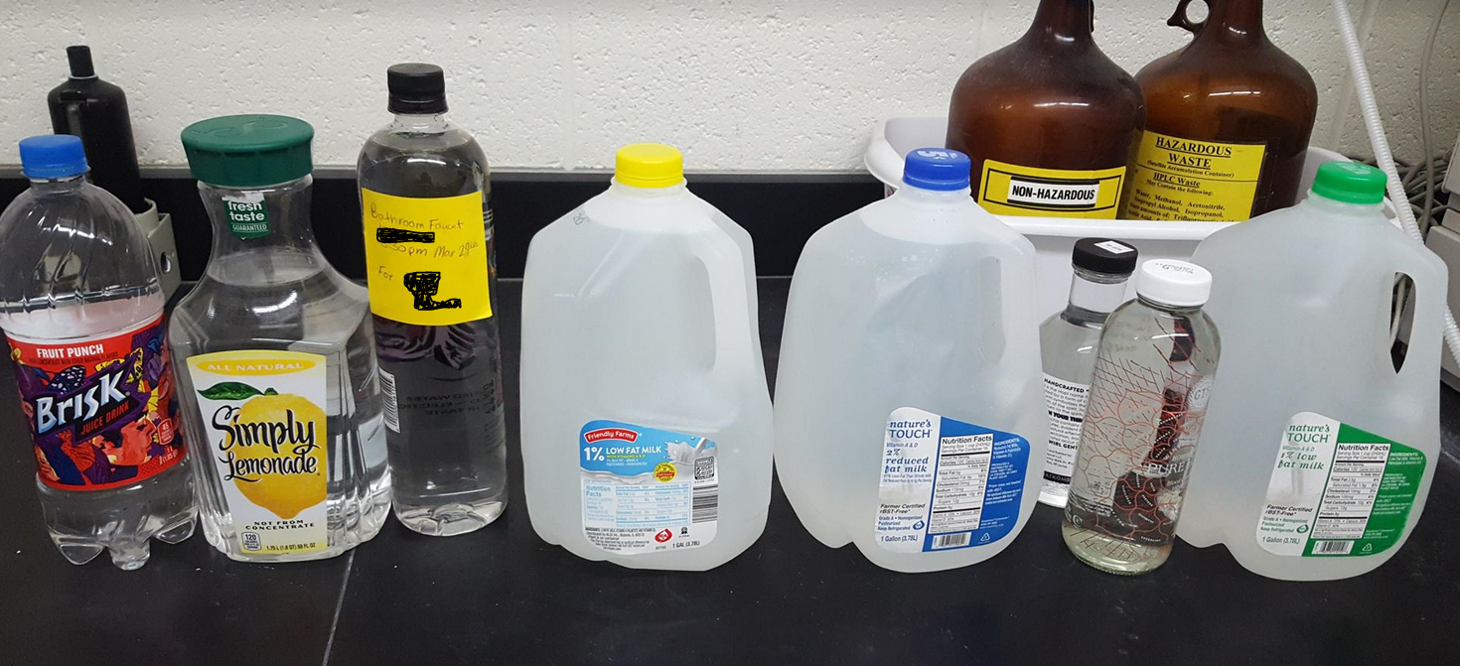
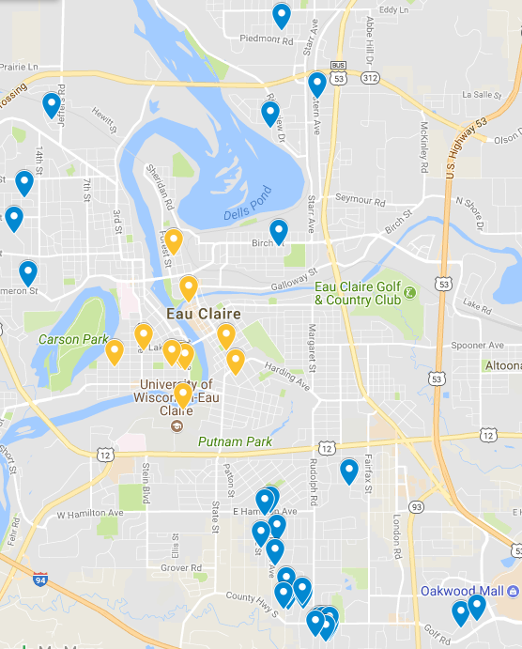
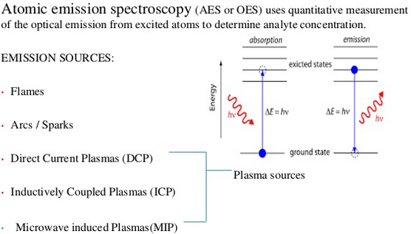
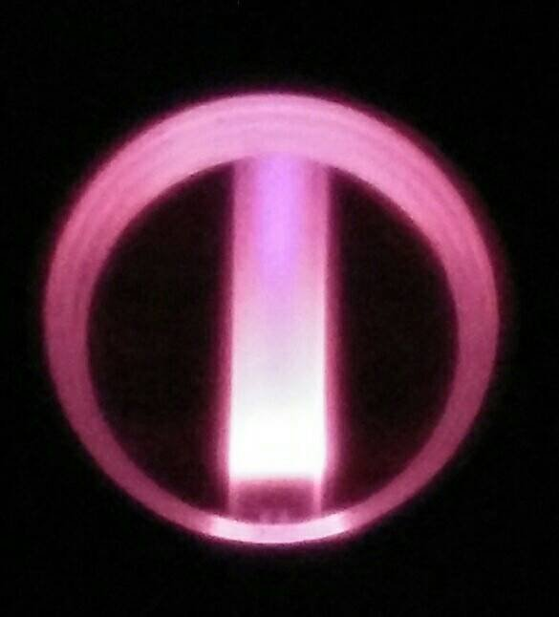
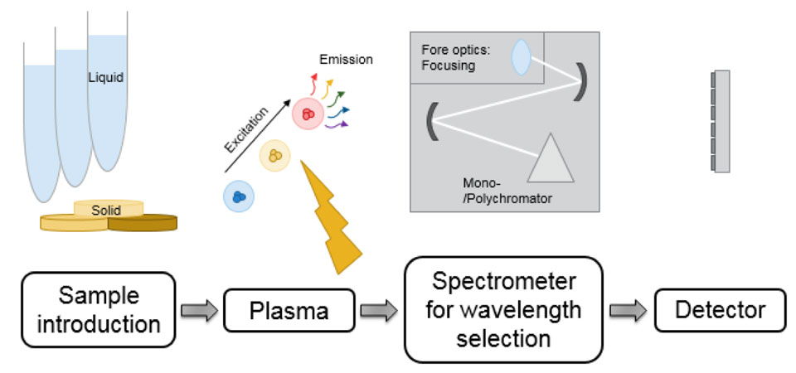
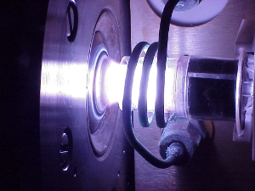
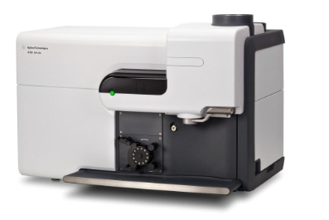
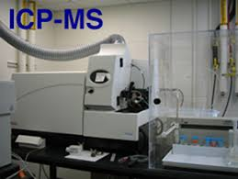
Pushing the Envelope: MP-AES Detection Limits for Pb in Drinking Water
Patricia Cleary | Maria Delgado Gomez, Michael Wenzel
Abstract
Results
An analytical chemistry investigation using a Microwave Plasma-Atomic Emission Spectrophotometer (MP-AES), this project aims to improve monitoring techniques pertinent to lead (Pb) contamination in drinking water. Some studies have indicated that the sampling techniques used to monitor lead may underestimate the risk of lead contamination. First stablishing a method of collection based on the EPA’s, we sampled drinking water from a number of locations. Then, by analyzing samples with the MP-AES, we verify our determined detection limits by comparison with Inductively Coupled Plasma Mass Spectrometer (ICP-MS). Preliminary results should point us to potential changes in lab methodology. With the goal of finding a method that would advance MP-AES detection limits to a place of confidence; where this instrument (a less costly option) could be used to get accurate results comparable to using ICP-MS. The method developed as part of this research project could potentially increase access to testing in communities with higher threats of hazardous exposure to lead from drinking water.
The limits of detection (LOD) of Pb for a 405nm wavelength and 368nm wavelength are shown in Table 1. The Pb concentration in all the samples was lower than the LOD (meant no Pb was detected). Pb concentrations were low enough that they could not be measured on the ICP-MS as well (see table 2).
MP-AES
Sample | 368nm LOD (ppm) | 405nm LOD (ppm)
01 | <0.37 | <0.35
02 | <0.26 | <0.19
03 | <0.07 | <0.06
04 | <0.13 | <0.08
05 | <0.13 | <0.08
06 | <0.13 | <0.08
07 | <0.13 | <0.08
08 | <0.13 | <0.08
09 | <0.13 | <0.08
10 | <0.13 | <0.08
11 | <0.10 | <0.10
12 | <0.08 | <0.06
ICP-MS
Sample | ICP-MS LOD (ppm)/(ppb)
04 | 0.004 ppm or 4 ppb
05 | 0.004 ppm or 4 ppb
06 | 0.004 ppm or 4 ppb
07 | 0.004 ppm or 4 ppb
08 | 0.004 ppm or 4 ppb
09 | 0.004 ppm or 4 ppb
10 | 0.004 ppm or 4 ppb
Fig.1: Sample collection with recycled plastic and glass containers.
Table 2. These seven samples were tested with ICP-MS as well and all had a LOD of 4 ppb. All samples were below the LOD and needed standard addition to find a concentration.
Table 1. Limits of detection using the MP-AES.
We found the detection limit using: (3*S_{b})/m
Where S_{b} is a sample’s y-intercept standard error from the Linest equation, the y-intercept represents the intensity of our standards, and m is the slope of the calibration curve from the instrument.
methods
We found the concentration using : (|intensity value from instrument |+ S)/m​
Where S is the intercept value on the calibration curve.
Sampling Methodology
Sampling locations were selected by with a non-probability sampling technique. This means that our selection was based on convenience accessibility to our research team. Our convenience sample spread throughout areas primarily occupied by students where the no testing had been done previously (Fig. 2). Our sampling procedure was based on EPA methods^{[1][2]}. e.g. selected cold-water faucets for sampling that were free of devices designed to change the water composition: i.e. free of water softeners or point of use filters. All samples and standards were acidified to 5% HNO3 prior to MP-AES testing.
Next, we varied the MP-AES settings and found results shown in Table 3. Flow rate had the largest impact on the limit of detection. Both the increase and decrease of flow rates produced lower limits of detection. Increased flow rate, however, gave the least accurate sample concentration having a value outside of the range of variability (1.517 ppm - 1.602 ppm). ​Increased read time had the next lowest limit of detection with reasonable sample concentration. Decreasing the read time had a lower limit of detection for the 368nm wavelength but caused a larger value for the limit of detection at the 405nm wavelength.
Fig. 2: Geographical distribution of previously sampled households in Eau Claire by the City Chemist (blue) and our samples (gold).
Experiment | 368nm Wavelength LOD (ppm) | 405nm Wavelength LOD (ppm) | Internal Standard (1.5 ppm)
Baseline | 0.1132 | 0.076 | 1.57
Read Time (Increased) | 0.0947 | 0.088 | 1.58
Read Time (Decreased) | 0.1053 | 0.084 | 1.58
Flow Rate (Increased) | 0.0743 | 0.062 | 1.47
Flow Rate (Decreased) | 0.0864 | 0.061 | 1.58
Average | 0.0948 | 0.073 | 1.55
MP-AES vs. ICP-MS
[3]
[4]
Table 3. Experimental results after variation of instrument settings on the MP-AES.
Conclusion
The EPA requires lead not to exceed 15 ppb concentration in drinking water. All samples were below the EPA concentration threshold. From the 12 samples collected, the found LOD of the MP-AES was 0.06 for 405nm wavelength and 0.07 for the 368nm wavelength. The 405nm wavelength gave lower LODs. Lowering the read time of the instrument resulted in a lower limit of detection. All samples analyzed had lower Pb concentrations than the value for the LOD (on the MP-AES and ICP-MS). No Pb could be detected in any of the samples.
Microwave Plasma interfaced to Atomic Emission Spectrophotometer | Inductively Coupled Plasma interfaced to Mass Spectrometer
Simultaneous multi-analyte determination of major and minor elements.
Samples nebulized before passing through nitrogen gas plasma > Atoms emit light> light separated into a spectrum > Instrument detector measures the intensity of the measured light wavelength. | Samples ionized by RF-generated argon gas plasma> Atoms are separated based on their mass/ charge (m/z) isotope ratios > Instrument detector measures wavelength intensity.
Temperature of plasma: 5000 °C | 6000-10000 °C
Lower cost of operation (Nitrogen $) | (Argon $$$)
References
United States, Congress, Office of Ground Water & Drinking Water, and Peter C Grevatt. “Memorandum Clarifying Recommended Tap Sampling Procedures for The Lead and Copper Rule.” 2016.
United States, Congress, Office of Ground Water & Drinking Water. “EPA Quick Guide to Drinking Water Sample Collection.” 2017.
“MP-AES.” ICP-OES System and Technologies | Thermo Fisher Scientific, www.thermofisher.com/us/en/home/industrial/spectroscopy-elemental-isotope-analysis/spectroscopy-elemental-isotope-analysis-learning-center/trace-elemental-analysis-tea-information/icp-oes-information/icp-oes-system-technologies.html.
Anuradha, Parimi. ICP-MS. www.slideshare.net/ParimiAnuradha/inductively-coupled-plasma-atomic-emission-spectroscopy-65578961.
Acknowledgements
WiscAMP Small Grants Program Funding

