Slide 1

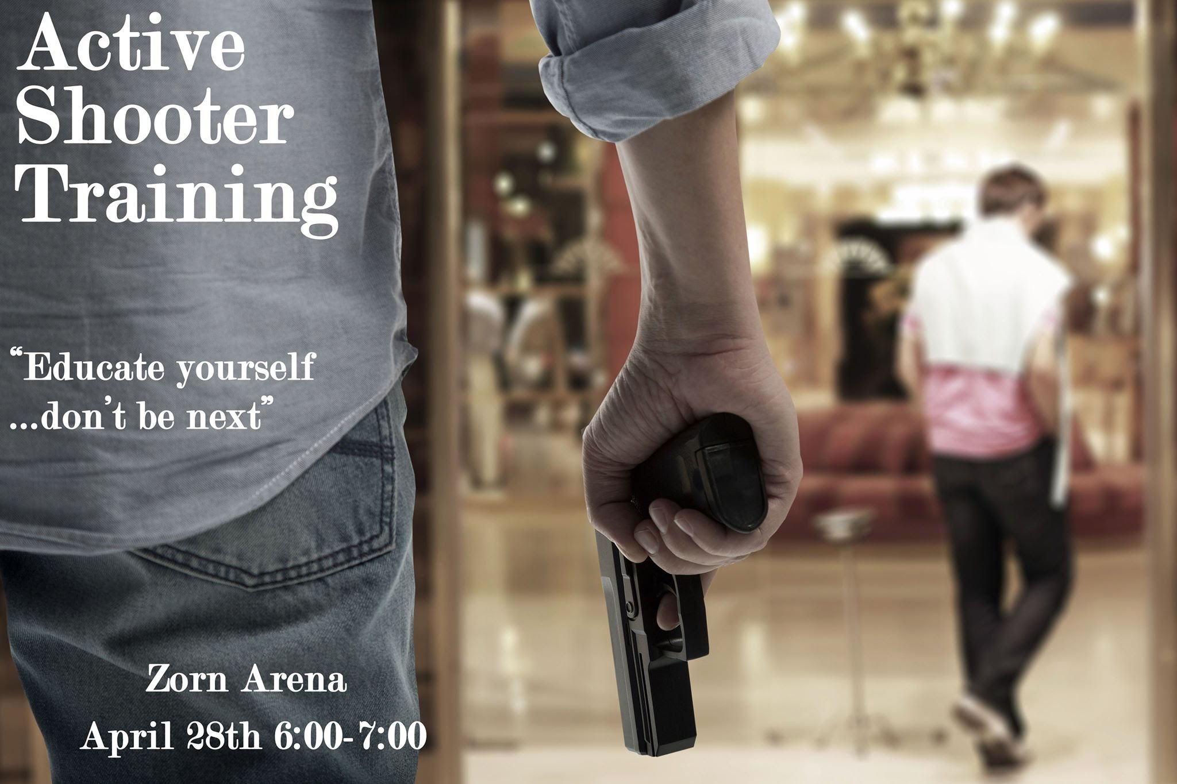
Analysis of Message Framing Regarding Active Shooter Training
Department of communication and journalism
Jenna Matthias, Hannah Kabelitz and Hannah Moen
Abstract
Since 1996, there have been 162 mass shootings that resulted in four or more deaths in the United States alone (Berkowitz, Lu, Acantara, 2019). One result has been an increase in active shooter training programs utilizing an informational approach and a fear based approach for students and faculty members in schools (Johnson, 2017). Previous studies have concluded that students who watched a reenactment training video versus an informational training video said they felt more afraid that an active shooting would occur on campus, while also feeling more prepared to respond to a shooting incident (Peterson, Sackrison, & Polland, 2015). This went against our research as ours shows that people felt more afraid after viewing the fear based poster and didn’t show any significant difference in whether or not they would feel prepared after taking the advertised training. With the knowledge that both fear-based messaging and informational messaging are effective, we are looking to specifically study college students and their reaction to fear-based versus information-based active shooter training advertisements. Students participated in a twenty two question online survey via non-probability sampling, during which they were given one of two poster prototypes, one using the information approach and one using the fear tactic. We then analyzed the students’ responses and determined which tactic makes them more likely to commit to the training. This study provides a better understanding of message framing in regards to active shooter training.
After answering the self efficacy questions, the participants were randomly given one of the two poster prompts and then asked a series of questions in relation to how participants reacted to the poster. The same questions were asked no matter which poster the participant was given and were based on the Hospital Anxiety and Depression scale by Zigmond and Snaith. This scale is more commonly used to measure anxiety and depression for medical patients in clinical practices. Instead of asking how they generally felt at any given time, as they do in the anxiety and depression scale, we asked how participants felt while looking at the specific posters.
Example Questions:
After viewing this poster, I am inclined to attend this event (1.Strongly Agree 2.Agree 3.Neither Agree nor Disagree 4.Disagree 5.Strongly Agree).
After viewing this poster, I feel compelled to educate myself and others about active shooter training(1.Strongly Agree 2.Agree 3.Neither Agree nor Disagree 4.Disagree 5.Strongly Agree).
.
Research Question
RESULTS
When faced with an active shooter training advertisement, which framing technique: informational message framing or fear based message framing, makes college students most likely to agree to go to the training?
Findings
Methods
The fear-based poster (M = 3.58, SD = 0.93) was no more convincing than the information-based poster (M = 3.37, SD = 1.16) in predicting participant’s expectations of preparedness after the training. This tells us that poster design has no effect on the perception of quality of training.
Most significantly, our results showed that there was a significant difference in the scores on intention to attend based on fear messages (M = 3.18, SD = .98) versus informational messages (M = 2.57, SD= 1.09), t(73) = 2.55, p = <.05. The same was true in feeling compelled to educate oneself and others. Participants who received the fear-based message were significantly more compelled (M = 3.35, SD = .92) than information based (M = 2.63, SD=1.09), t(73)=3.11, p=<.01 to educate themselves and others about the training.
We created a randomized survey that was sent out to college students via our social media accounts and to the Communication and Journalism department. We gave a response time of eleven days to collect our data. We received complete responses from 73 people.
82% Female
93% White
This survey first asked participants a series of 10 self-efficacy related questions using the General Self Efficacy Scale (Schwarzer, 1995). Self efficacy is the “general belief in oneself to solve problems and reach goals” (Schwarzer, 1995). The scale proved to have a reliability of ⍺=0.82, M = 31.47, SD = 3.81
discussion
The Elaboration Likelihood Model (Petty, 1950) explains different ways of processing information and outcomes on attitude change. We used the self-efficacy questions as a control variable for general beliefs about one's ability to handle challenges. Results determine that fear plays an important role in motivating individuals. As active shooter training is increasingly becoming more necessary in today's society, it’s important to know how to best get people into active shooter training so they can stay safe when faced with this situation. Because students seem to be motivated by fear, using fear based messages in active shooter training advertisements will get more students to participate and in turn could save lives.
Further research (that would include a wider demographic spread) can look into how message framing around active shooting relates to men versus women, and how different ethnicities respond to framed messages. Advocates of preparedness through training can use this information to create advertisements that will make students more willing to participate.
Example Questions:
I can always manage to solve difficult problems if I try hard enough (Not at all true, hardly true, moderately true, exactly true)
If someone opposes me, I can find the means and ways to get what I want (Not as all true, hardly true, moderately true, exactly true)
References and acknowledgements
Ford, J. L., & Frei, S. S. (2016). Training for the Unthinkable: Examining Message Characteristics on Motivations to Engage in an Active-Shooter Response Video. Communication Studies,67(4), 438-454. doi:10.1080/10510974.2016.1196381
Fox, J. A., & Savage, J. (2009). Mass Murder Goes to College. American Behavioral Scientist,52(10), 1465-1485. doi:10.1177/0002764209332558
Jonson, C. L. (2017). Preventing School Shootings: The Effectiveness of Safety Measures. Victims & Offenders, 12(6), 956-973.
Luszczynska, A., Scholz, U., & Schwarzer, R. (n.d.). The Journal of Psychology, Interdisciplinary and Applied (5th ed., Vol. 139). Taylor & Francis Online. doi:https://doi.org/10.3200/JRLP.139.5.439-457
Peterson, J., Sackrison, E., & Polland, A. (2015). Training students to respond to shootings on campus: Is it worth it? Journal of Threat Assessment and Management, 2(2), 127-138.
Petty R.E., Cacioppo J.T. (1986) The Elaboration Likelihood Model of Persuasion. In: Communication and Persuasion. Springer Series in Social Psychology. Springer, New York, NY
Schwarzer, R., & Jerusalem, M. (1995). Generalized Self-Efficacy scale. In J. Weinman, S. Wright, & M. Johnston, Measures in health psychology: A user’s portfolio. Causal and control beliefs (pp. 35-37). Windsor, UK: NFER-NELSON.
Stern, A. F. (2014, June 28). Hospital Anxiety and Depression Scale. Retrieved from https://academic.oup.com/occmed/article/64/5/393/1436876
Widmer, L. (2018). Rethinking school shooter prevention and response. Risk Management, 65(8), 26-29.
Information Based Training Poster
Fear Based Training Poster
Thanks to our faculty advisors Martha Fay and Kris Knutson
Notes:
Title text: 72-150 pt., arial or helvetica
Subheads: 60 pt.
Body text: 24 pt., times new roman, palatino or garamond
CERCA
Wednesday: 4-6 pm
Thursday: 2-4 pm, reception 4-5 pm

