Slide 1

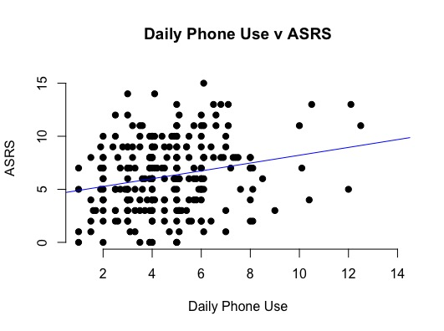
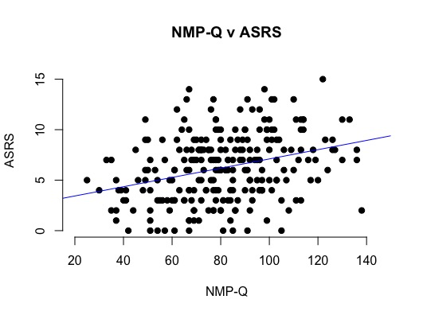
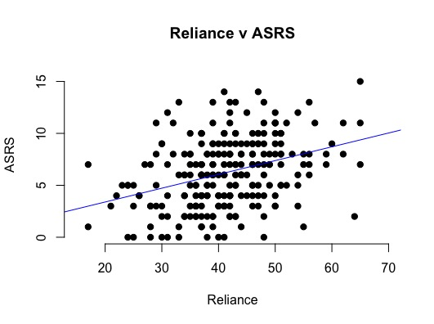
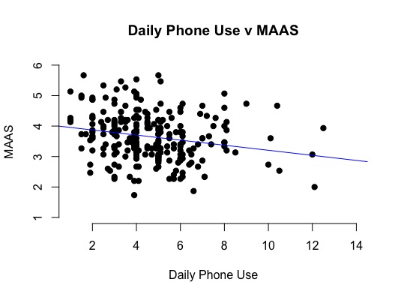
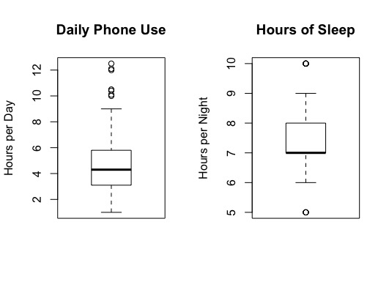
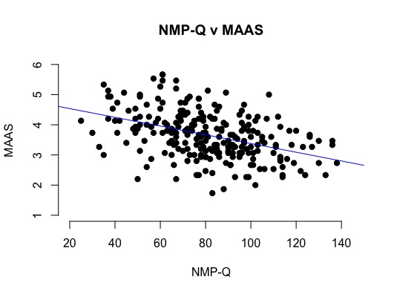
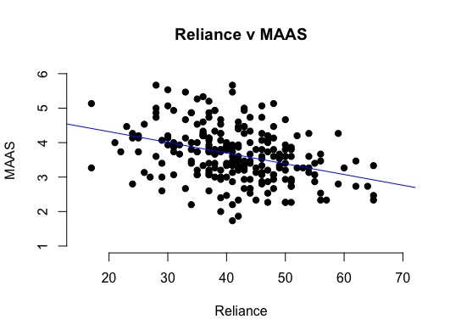
Smartphone Usage: Associations with Cognition, Motivation, and Sleep Patterns
Emily E Hite, Madison D Moeller, Maggie Westerland, Sierra D Dortch, Samuel J Becker, Camryn D Langley, Elisabeth A Lehto, and Margot M Lortie
Psychology Department Faculty Mentor: Dr. David S Leland
Introduction
Results
College students’ smartphone use presents concerns with academic dishonesty, distraction, sleep disturbances, and social withdrawal. We conducted a survey to focus on the relationship between phone use/attitudes and attention. We assessed how much students use their phone, how reliant they are on their phone, and their concerns about not having access to their phone. Regarding attention, we asked them about their difficulties with attention and focusing on the present moment, i.e. mindfulness. We also assessed their motivation to seek mental stimulation, i.e. sensation seeking. We predicted positive relationships between smartphone use/problems and both sensation seeking (Zuckerman, 1978) and ADHD-related difficulties (Adler et al., 2005). We also predicted negative associations between smartphone use/problems and both mindfulness (Brown & Ryan, 2003) and sleep amount/quality.
How do you compare?
Method
Correlations |  | SSS-V | MAAS | ASRS | Hours of Sleep | Sleep Quality | Poor Sleep Effects | Onset of Sleep
Daily Phone Use | Pearson Correlation | -0.025 | -.216 | .224 | -0.039 | -.183 | .212 | .220
 | Sig. (2-tailed) | 0.699 | 0.001 | 0.000 | 0.543 | 0.004 | 0.001 | 0.001
NMP-Q | Pearson Correlation | -0.024 | -.425 | .315 | -.137 | -0.062 | .273 | 0.089
 | Sig. (2-tailed) | 0.712 | 0.000 | 0.000 | 0.032 | 0.334 | 0.000 | 0.164
Reliance | Pearson Correlation | -0.087 | -.352 | .353 | -0.070 | -0.085 | .233 | 0.092
 | Sig. (2-tailed) | 0.177 | 0.000 | 0.000 | 0.273 | 0.185 | 0.000 | 0.151
How to Read A Box-and-Whisker Plot:
These box plots show the distribution of daily phone use and hours of sleep. The dark line in the middle represents the mean. The box includes the middle 50% of respondents, and the whiskers extend out to include 95%. The dots outside the whiskers are outliers in the data.
Participants
257 UWEC students (204 female, 50 male, 3 non-binary; age 18+; 91% White, 4% Asian, 5% Other) completed our survey. 244 were included in analyses after excluding 13 outliers.
Procedure:
Students were recruited through the SONA system, email, and flyers. Participants completed a 20-25 minute online Qualtrics survey. Informed consent was attained at the start of the survey. All instructions were provided in the survey itself. Deception was not involved.
Survey Measures
NMP-Q: Nomophobia Questionnaire (Yildirim, 2015; 20 items)
Fear of being without a phone, e.g. “Running out of battery in my smartphone would scare me”
MAAS: Mindful Attention Awareness Scale (Brown & Ryan, 2003; 15 items)
Rarely exhibiting unmindful behaviors, e.g. “I do jobs or tasks automatically, without being aware of what I’m doing.”
ASRS: Adult Self-Report Scale for ADHD (Adler et al., 2005; 18 items).
Assesses possible symptoms of ADHD, but does not diagnose, e.g. “How often do you have difficulty keeping your attention when you are doing boring or repetitive work?”
SSS-V: Sensation Seeking Scale (Zuckerman, 1978; 40 items)
Assesses thrill/adventure seeking, experience seeking, boredom susceptibility, and disinhibition, e.g. “I sometimes like to do things that are a little frightening.”
Sleep Questions
“Rate your quality of sleep on a typical night.”
“How many hours of sleep do you get on a typical night?”
“Thinking about the past month, to what extent has poor sleep affected your concentration, productivity, or ability to stay awake?”
“How long does it typically take you to fall asleep?”
“Do you typically use your phone in bed just before trying to fall asleep?”
Discussion
Main Findings
Our findings show a relationship between three phone measures (hours of daily phone use, phone reliance, and nomophobia) on the one hand, and ADHD symptoms, mindfulness, and four indicators of sleep-related behaviors and problems on the other hand. We also looked to see if phone use was different for those who do vs. don’t use their phone right before falling asleep, but we found no significant difference.
Correlations involving all three phone measures show positive relationships with ADHD-related difficulties and effects of poor sleep. Hours of daily phone use in particular was correlated positively with time needed to fall asleep. We found negative correlations between all three phone measures and mindfulness. Nomophobia was negatively correlated with hours of sleep and hours of daily phone use was negatively correlated with sleep quality.
Consistent with previous research, we did not find any significant relationships between phone measures and sensation seeking.
Attention and sleep issues could be a cause or consequence of problematic phone use. That is, excessive phone use could have negative impacts on sleep and attention but it is also possible that those who already suffer from attention or sleep problems are inclined to use their phones more or more problematically.
The participants of the survey are predominantly Caucasian and female, this limits our ability to generalize the results to a wider population.
Future Research
To investigate whether phone use and other measures differ by gender
We are planning an EEG study to investigate attention-related brain responses in association with smartphone use/problems.
Acknowledgements: Support provided by Student Blugold Commitment Differential Tuition, TRIO Ronald E McNair Postbaccalaureate Achievement Program, and UW-Eau Claire Learning and Technology Services.

