Slide 1

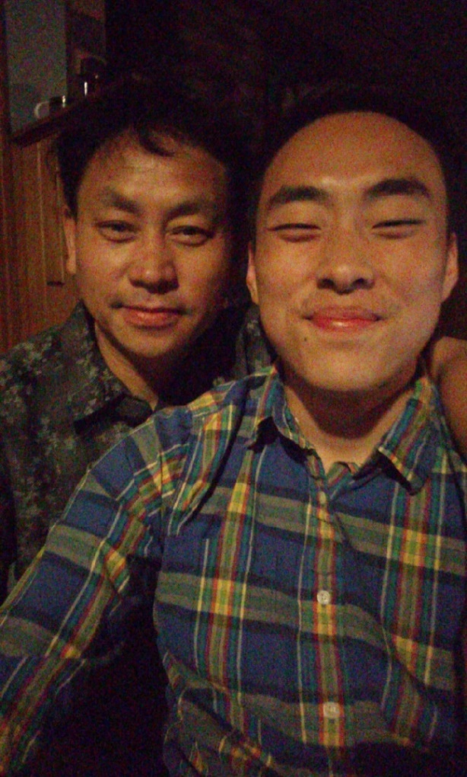
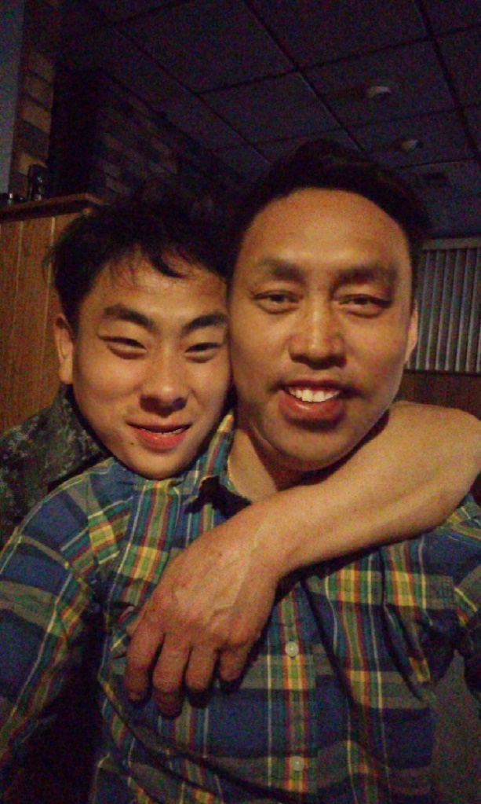
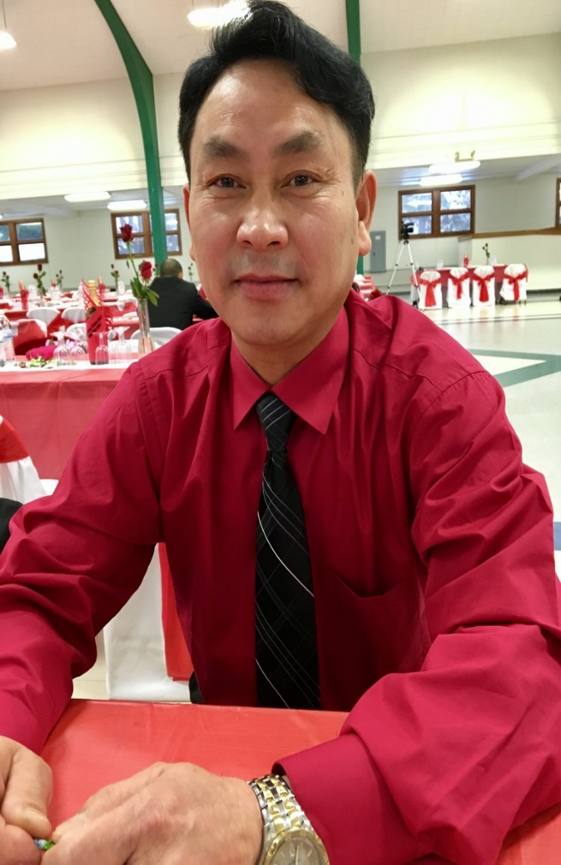



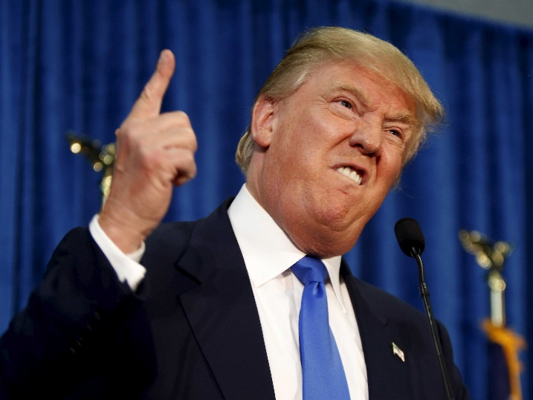
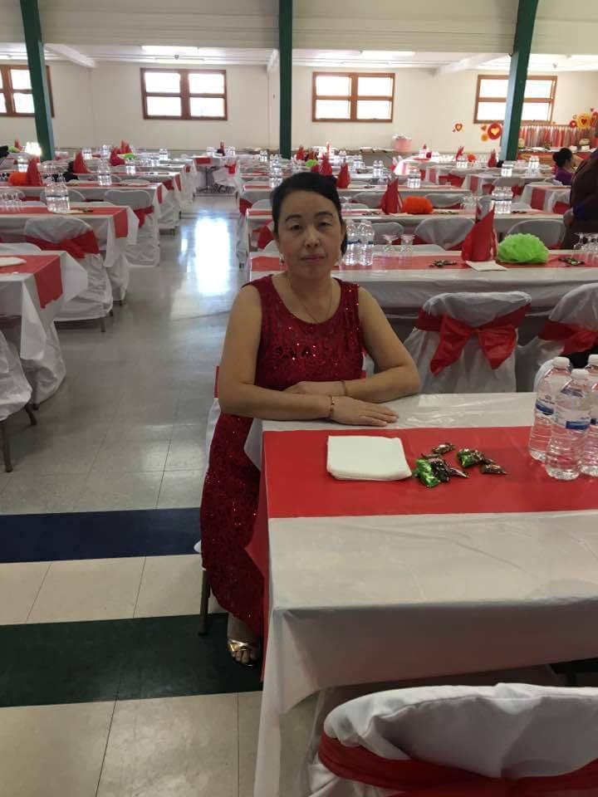
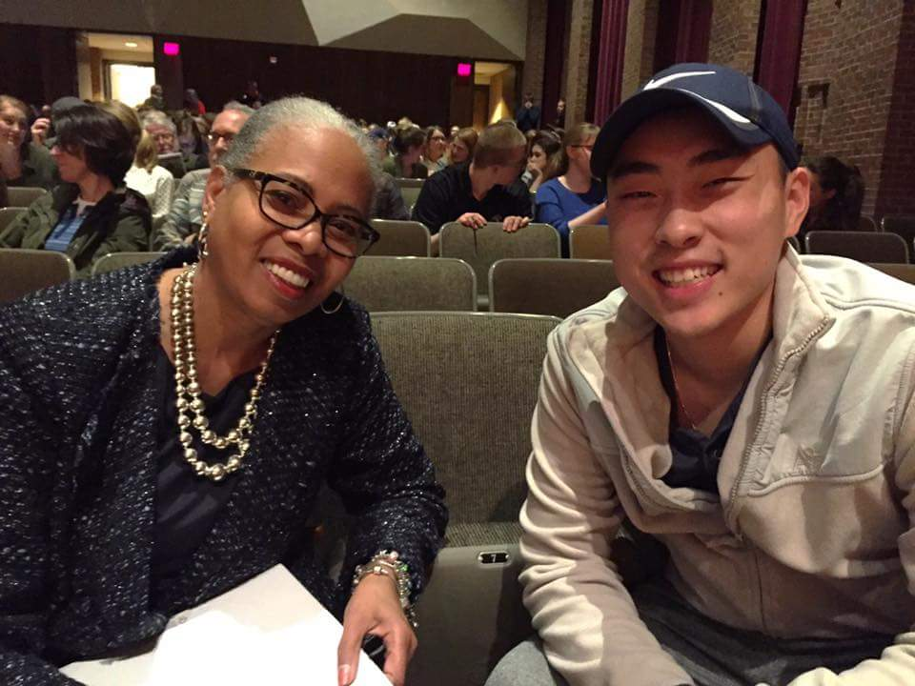
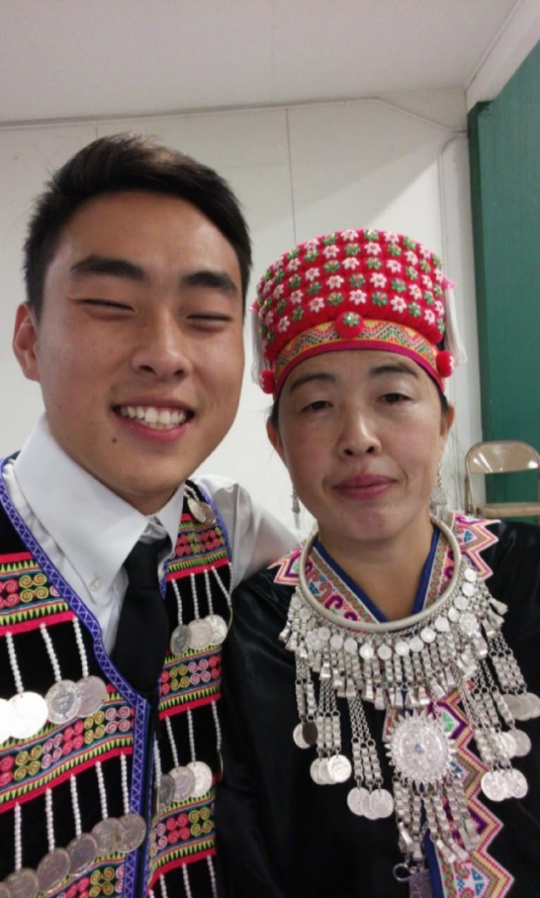
Asian American Masculinity in White Hegemonic Masculine Society: Hmong Men Perspectives
McNair Scholar: Jackson Yang | McNair Mentor: Dr. Anjela Wong
Introduction
Stereotypes of Asian Americans (Shek, 2006; Lu &Wong, 2013; Espiritu, 2008)
Preliminary Findings
Model Minority Myth: Success comes from hard Confucian work ethic
Perpetual Foreigner: “Where are you really from?”
Yellow Peril: Hyper masculine, menacing, villains, liars, traitors, spies, taking over businesses
What messages have you received about being a Hmong man?
Asian American masculinity (S. Lee, 2004; Yang, 1997; Liu, 2002)
Respect Hmong Elders
Paub Kev Cai
Representing your family
There will always be a constant negotiation with Asian American men on what it means to be a man of color in white dominant society (Liu, 2002, p. 116).
Three forms of masculinity in Hmong boys (S. Lee, 2004)
  Traditional Hmong Boys
  “Good” Hmong Boys (new ideal Hmong American masculinity)
  “Bad” Hmong Boys
“Whenever we are with the elders, depending on how old we are, you always have to shake their hands and always greet them with the most utmost respect because they are more wiser what not. It’s all about Hmoob kev cai (practices and manners). You gotta respect who live there and know that you are the guest. Just treat them way. Just have that hospitality.” -Participant
Teng Nkias Teeb Yang
Orphan and refugee of the Secret War
Factory worker for 20 years
Hmong voice and songs flows like silk, strong, and smooth.
Hmong voice outside of the home is silenced and emasculated in white spaces.
Research Question: How is Asian American masculinity affected by White hegemonic masculinity from Hmong men perspectives?
Conceptual framework and methodology
Critical race theory (Stefancic & Delgado, 2012),
Reflections
Civil Rights Legislation
Beyond Black and White Binary
Intersectionality
Storytelling
Racism is normal
Value of property
Skepticism
Critique of liberalism
Spaces for conversations and dialogue
Working together with everyone
Recognition of patriarchy in Hmong communities
Start conversations and dialogue at a younger age
Definitions
White hegemonic masculinity: Connell and Messerschmidt (2005) “presumes the subordination of nonhegemoinc masculinities” (p. 846).
“No matter how much we have use it in a way to empower others and help your community instead to overpower other people.” –Participant
“For me I will talk to my family or my younger brother. Deconstructing his masculinity at a younger age definitely sees improvements.” – Participant
“Having conversations more if informal or formal amongst us guys amongst others as well like our sisters, mother, aunts. For me, it begins a lot with myself.” - Participant
Qualitative (Creswell, 2012)
Semi-structured one on one interviews and focus groups
Location: Midwest University (MU)
Emailed the Multicultural Center at MU asking for a list of Hmong American students
Obtain list of Hmong American students from MU’s Multicultural Center.
Number of Hmong American college men participating: 5
Conducted two focus groups
Conducted 1 one on one interview
Interview Questions Topic
  General questions about themselves
  Family
  K-12 and Higher Education Experiences
  Media
  Community
  Reflection
All images in this section are from Google Images
Future research
Literature Review
Pa Nhia Xiong
Orphan and refugee of the Secret War
Hmong American Women
Factory and manual laborer 15 years
Asian American history and experiences (Takaki, 1989 & E. Lee 2015)
Cheap Labor and Exclusion Laws and Policies
1875: Page Law-First restrictive law which banned immigrants who seemed “undesirable”.
1882: Chinese Exclusion Act- Ten year ban on Chinese labor immigration.
1907: Gentlemen's Agreement: To deny passports to laborers intending to enter the United States and recognizing the U.S. right to exclude Japanese immigrants holding passports originally issued for other countries.
1924: Immigration Act- Limited the number of immigrants allowed entry into the U.S. through origins quotes.
1965: Immigration Act- Abolished an earlier quota system based on national origin and established a new immigration policy based on reuniting immigrant families and attracting skilled labor to the United States.
Perspectives
Hmong masculinity from Hmong women perspectives
Hmong masculinity from LGBTQIA+ perspectives
Hmong masculinity from Hmong youth perspectives
Hmong masculinity from Hmong elders perspectives
Dr. Ladson-Billings and I at the Diversity Expo Fall 2017
Semi-structured one on one interviews and focus
Location: Midwest University (MU)
Emailed the Multicultural Center at MU asking for a list of Hmong American students
Obtained list of Hmong American students from MU Multicultural Center.
Number of Hmong American college men participating: 5
Conducted two focus groups
Conducted one one on one interview
Interview Questions topic
  General questions about themselves
  Family
  K-12 and Higher Education experiences
  Media
  Community
  Reflection

