Slide 1


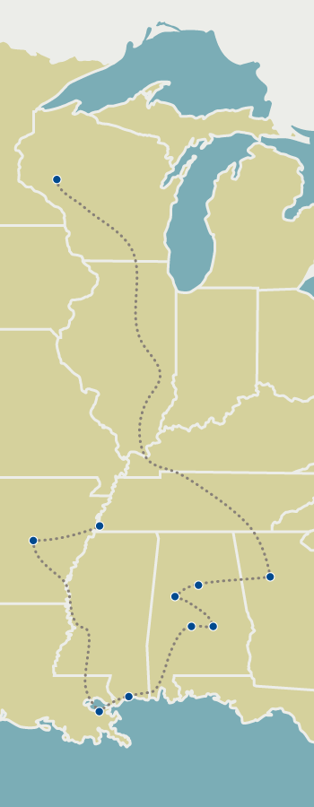
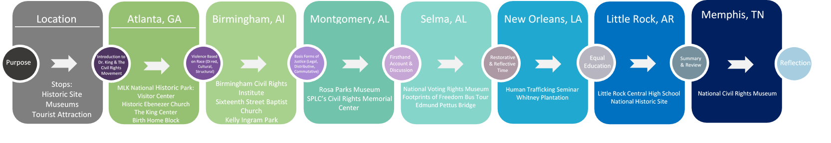
Educational Practice Outcomes Resulting from Intercultural Immersion Experience
Jacie Jones, Nicholas Walkowiak, Lynnea Lee, Emily Cheasick, and Faculty Advisor Jodi Thesing-Ritter
University of Wisconsin-Eau Claire
IRB Number: WALKOWNJ7536142582019
Background
Findings
Discussion
Discussion
Research shows that simply raising awareness for social inequality doesn’t guarantee that participants feel responsible for working towards equality or social justice. Prior research has noted that prejudice reduction interventions containing one-on-one or small group discussions that also span across multiple sessions are most effective at bias reduction (McKown, 2005). These results are congruent with other research on the impact of immersion experiences and service learning when it comes to social justice, multicultural competence, and civic engagement. Consistent findings in this area of research have been an increased ability to empathize with those they serve, along with an increase in awareness of privilege, and a stronger sense of empowerment (Einfeld & Collins, 2008). The interviews conducted with educators who have gone on the Civil Rights Pilgrimage, either in the past or during the spring break of 2019, have shown that educators feel a sense of empowerment from the immersion experience that has helped them apply social justice into their curriculum, their relationships with their students, and within administration.
Our research shows that educators who have the opportunity to attend this immersion experience often implement culturally relevant curriculum and further provide resources for their students to engage in social justice issues within their curriculum. Resources in the classroom were operationalized as literature regarding social justice issues, infographics hung where students can see them, and lecture aids or assignments that are available for student use during engagement in curriculum. Researchers found that the literature within the classrooms contained social justice issues and topic of discussion for previous movements as well as present movements. Infographic resources displayed for students to see included timelines of the civil rights movements as well as informational flyers and posters outlining relevant events in the community. Lecture aids included different programs that educators implement into their curriculum such as book challenges or papers pertaining to the issues surrounding the Civil Rights Movement. The resources above were implemented into the classroom and the curriculum after the immersion experience and after the educator gained the resources to do so.
One of the main obstacles reported for educators applying culturally relevant curriculum into their course work was successful implementation without backlash or repercussions from outside sources. Several educators admitted issues that they were having implementing this curriculum into their classroom with parents and “higher-ups” within their school district voicing their opinions. This was not only an actual occurrence but also a fear that many educators expressed during their interview.
One limitation for this study is that the majority of participants went on the trip spring of 2019, meaning that they haven’t been fully able to implement the changes they talked about into their educational setting. Another limitation is that the most participants are from the Eau Claire Area School District, and a small sample size may not be replicable throughout a generalized population of educators. Nevertheless, the findings of this research point to the Civil Rights Pilgrimage as being a source of empowerment and awareness of multicultural competence for educators who have attended the immersion experience. Further research on immersion experiences as a source of multicultural competence and prejudice reduction are imperative to better understand their effects in mitigating curriculum that is not culturally responsive.
For the past three years, the University of Wisconsin-Eau Claire has sponsored an educator scholarship to engage regional educators in a nine-day intercultural immersion experience. This immersion experience takes participants to sites of historical significance to the Civil Rights Movement. Educators participating in this scholarship are required to incorporate different aspects of the immersion experience into their educational practices to increase culturally responsive pedagogy. This study is a qualitative analysis of the different ways educators integrate learning from the immersion experience into their educational practices. Furthermore, researchers strive to analyze teacher perceptions of student outcomes impacted by changing educational practices.
Educators may avoid practicing culturally responsive curriculum because they do not know how and do not have the experience in facilitating discussions about topics like race, class, gender, etc. “The very topics of race and racism have historically been at the center of arguments, violence, and protest - all of which most teachers believe have no place in the classroom. Educators have very few models of how such conversations might look different, so why would we expect anything different from teachers who are already working hard to ensure that their students learn, behave appropriately, and pass standardized exams?” (Castagno, 2008). This silence on the sensitive topic of race upholds and enforces the ethnocentric education system that erases cultural identities. Without any other models on the discussion of race, educators may avoid these conversations. In avoiding these topics, educators create a silence that perpetuates the ignorance of inequalities, and maintains an ethnocentric status quo of whiteness.
Research shows that an interculturally competent teacher encourages students achievement. A teacher who respects cultural differences teaches students to think critically. Students learn to see views from multiple perspectives, which prepares them for life in a democracy (Villegas & Lucas, 2002). Teachers must not only be open and willing to have conversations about culturally relevant content in the classroom, but they must reflect on their personal and professional lives (Gay & Kirkland, 2003). It is not enough to have a conversation; teachers must be willing to understand multicultural beliefs and traditions and challenge themselves in their teaching (Gay & Kirkland, 2003).
An immersion experience like the University of Wisconsin - Eau Claire’s Civil Rights Pilgrimage provides participants with the opportunity to learn about the ways in which these discussions can be implemented into not only their classrooms, but into their overall educational and administrative practices. Within social justice immersion experiences, many participants report a sense of empowerment that can be likened to a ‘ripple effect,’ whereby the impact of one action is felt in widening circles (Einfeld & Collins, 2008). The discussions and experiences that teachers are involved in during the Civil Rights Pilgrimage give them the space and ability to create culturally responsive and relevant academic goals. “Opportunities to learn should be integrated into the school curriculum on a long-term basis, so that teachers could combine academic information along with anti-bias training. However, for anti-bias education to be a part of a continuing set of academic activities, school administrators, teachers, and researchers need to work together to integrate these goals into their strategic plans and lesson plans while monitoring their effects on student learning” (McKown, 2005). Immersion experiences for educators can promote and inspire a change in their educational practices that can create a widespread transformation throughout the institution of education.
Culturally responsive curriculum should be integrated on a long-term basis that combines academic goals with anti-bias training. Educators, school administrators, and researchers have to collaborate to integrate anti-bias education into their lesson plans and activities while monitoring the impact of these changes on student learning. Individuals must have the opportunity to hear from underprivileged groups in order to comprehend the social injustices in our society (Bennett, & Salonen, 2007). Immersion experiences for educators can promote and inspire a change in their educational practices that can create a widespread transformation throughout the institution of education.
The intent of this research is to use the data collected from educators who have participated in the University of Wisconsin-Eau Claire Civil Rights Pilgrimage, pertaining to the potential impacts of the immersion experience on their curriculum and educational practices. We will use this data to inform future immersion experience activities, scholarship program grant reports, and contribute to the body of knowledge surrounding educational immersion experiences.
Lack of media representation on social justice topics
Educators discussed some difficulty integrating social justice content into their curriculum
Misconception that racism only occurs in the south
Pre-Interview
Past-Interview
Desire for increased knowledge on students of color’s experiences
Desire for educators to improve themselves through the immersion experience
Acknowledgment of the lack of diversity within the school district
Desire to share experiences with others with other educators
Expressed a fear of backlash in presenting social justice focused information
Participants expressed genuine excitement to take part in the experience
Desire to enhance knowledge base
Some educators described wanting to go on the trip to experience it with friends and coworkers
Before partaking on this immersion experience participants often:
  Contributed race or ethnicity to socioeconomic status
  Discussed African American Culture as a foreign body that is vastly different from their own
Striving to enhance their classroom setting
Social justice application in to curriculum
Conversations about social justice and race in the classrooms are more frequent
Acknowledgments of the lack of prior diversity training
Perceptions that curriculum and administration are restrictive on culturally relevant curriculum
Current political climate isn’t satisfactory for participants
Past-Interview
Pre-experience: Misconceptions and the Desire to Learn
“I want to become a better person, to become a better educator to children of color, and to be able to share that information and that growth with my colleagues”
“In this district we haven't had a lot of diversity training, so I'm hoping that I can share this experience and go beyond with helping our district”
“When [the trip] was opened up to teachers, I thought oh my gosh, it's my chance to go. I’ve never been south, I don’t have any background, I just want to learn more about different experiences”
“I don’t think we’re a very diverse population here, but respect rules my classroom, we treat everyone the same no matter the color of their skin or their religious background or their sexual orientation”
Transformative Experience
“I’m a better human being for knowing more, and that is always going to make be a better teacher”
“There’s just so much within our current world and situation that I think is misunderstood. And some denial that this still exists. You know, discrimination, racism, oppression, it’s still here. It’s more systematic and implicit but I think it’s so important for us to understand the history so that we can figure out why are we here. How do we move on?”
“I used to be afraid to do [social justice]. What if parents get upset? After the Civil Rights Pilgrimage, I knew I needed to. It matters, and it’s really important, and we need to have those conversations”
“How can I position myself to make that kind of a ripple effect? How can I continue to pay it forward, how can I make a difference?”
“This has definitely been the bridge that I needed to push forward with how I teach civil rights, human rights, and human justice”
“[This trip] is exactly what I needed. Because I needed to be uncomfortable. And it did it for me. It is such a learning experience it was just… unbelievable”
References
Bennett, J. M., & Salonen, R. (2007). Intercultural communication and the new American campus. Change: The Magazine of Higher Learning, 39(2), 46-50.
Braun, V., & Clarke, V. (2006). Using thematic analysis in psychology. Qualitative Research in Psychology, 3,77–101.http://dx.doi.org/10.1191/1478088706qp063oa
Castagno, A. E. (2008), “I Don't Want to Hear That!”: Legitimating Whiteness through Silence in Schools. Anthropology & Education Quarterly, 39: 314-333. doi:10.1111/j.1548-1492.2008.00024.x
Einfeld, A., & Collins, D. "The Relationships between Service-Learning, Social Justice, Multicultural Competence, and Civic Engagement." Journal of College Student Development, 49.2 (2008): 95-109. Web.
Gay, G., & Kirkland, K. (2003). Developing cultural critical consciousness and self-reflection in preservice teacher education. Theory into practice, 42(3), 181-187.
Maguire, M., & Delahunt, B. (2017). "Doing a thematic analysis: A practical, step-by-step guide for learning and teaching scholars.." AISHE-J: The All Ireland Journal of Teaching and Learning in Higher Education, 9(3).
Mahoney, S., & Schamber, J. (2004). Exploring the Application of a Developmental Model of Intercultural Sensitivity to a General Education Curriculum on Diversity. The Journal of General Education, 53(3), 311-334
McKown, C. (2005). Applying ecological theory to advance the science and practice of school-based prejudice reduction interventions. Educational Psychologist, 40(3), 177–189
Villegas, A. M., & Lucas, T. (2002). Preparing culturally responsive teachers rethinking the curriculum. Journal of teacher education, 53(1), 20-32.
Effects in Educational Environment
“I’m in grad school right now, and my action research is social justice instruction in the middle school classroom and its impact on engagement. Like, do students actually feel more motivated to go out and make a difference in the world?”
“After I’d been on the civil rights pilgrimage, in my food unit, we really focused on the right to food. And then we did a French micro-loan website, and the kids selected a person from somewhere in the world, and did a presentation in French about who the person is and why they gave them their loan”
“As a building, we don’t do enough for our students of color. And looking at, even Black history day, I think it’s given a lot of teachers, especially those who have gone on the trip, to just say wait a minute, we can do so much better. Putting up books in the library, that’s not enough”
“I can start with that in my classroom but then my other colleagues will come to me and say what is it that you’re doing in your classroom? Well, let me tell you… “
“I’ve noticed that we have a disproportionate amount of students of color in our principles office and it's been bothering me for years, and so in order to understand how to help our school have a better climate and culture for those students, I felt like I needed to know more”
“We've had a lot of conversations about how we’re not a racist school, But if kids are perceiving that, that's the truth. We have to figure out why is it their truth, what is it we're doing, and what do we need to do different”
“There are still people who are being targeted and marginalized and oppressed. And if we don’t educate ourselves and see that happening then… it’s gonna keep happening”
Method
Importance of Conversations and Diversity Training
“I just need to have more conversations, because I think sometimes we let things gloss by and ignore them. It’s like no, we need to pause and have a conversation and discuss things rather than ignore them and go by”
“I remember somebody saying I don’t see color. And the person said, well if you don’t see color, you’re not honoring our culture. And I never really got that until this pilgrimage. I think you can’t look at a black student and not acknowledge that they’re black because their experiences are different”
“I feel like I’m more open to conversations about race in the classroom. I will freely admit that they terrified me, I was afraid that they would call me racist. So I’d be anxious about it instead of just talking about it”
“I took classes on multiculturalism, but it wasn’t what we need. And I’m still looking for more, I still don’t have enough, you know? I just hit the tip of the iceberg”
Twenty-eight past and current educator participants were invited by formal email to participate in this study. Volunteers participated in one or two face-to-face or telephone interviews consisting of 15-20 questions about their experience before and/or after participating in the Civil Rights Pilgrimage. The interviews lasted approximately 10-45 minutes. Each interview included one investigator from the University of Wisconsin-Eau Claire. Investigators recorded the interview using a portable digital recorder. Investigators transcribed interview recordings. Data was coded and then analyzed for themes using thematic analysis. Thematic analysis is a method that allows investigators to identify, code, and analyze patterns within the data. The patterned responses, as well responses that were deemed as important to the research question, became the themes. It is important to note that there can also be sub-themes, which are themes within the broader theme. Investigators chose to do an inductive thematic analysis which means they coded themes that were driven by the data rather than the research questions (Maguire & Delahunt, 2017). Inductive analysis allowed the investigators to code the data without fitting the codes into a pre-existing frame. Thematic analysis allows the data to be described in detail in a minimally organized way, leaving space for unexpected findings (Braun & Clarke, 2006).
Phases of thematic analysis:
Familiarize yourself with the data
Generate initial codes
Search for themes
Review themes
Define and name themes
Produce the report
To ensure confidentiality, no participant names were attached to interview responses. Confidentiality of the data will be maintained by de-identifying verbal responses from educators and educator information. All files will be stored on a secure server and deleted following a three-year required period.
Acknowledgements
We would like to thank the University of Wisconsin-Eau Claire and the Office of Research and Sponsored Programs. We are also thankful for all of the participants we had on the Civil Rights Pilgrimage this year and in previous years. Additionally, special thanks to the wonderful educators and student teachers that participated in the immersion experience. We are grateful for the guidance of many mentors on this project and feel privileged to share the experience of the pilgrimage with others. We would also like to thank Dr. Carmen Manning, Dean of the College of Education and Human Sciences, and Kimera Way, Executive Director of the UW-Eau Claire Foundation, for their commitment to providing scholarships for educators to participate in this immersion experience. Lastly, we would like to thank Learning and Technology Services for the printing of this poster.

