Slide 1
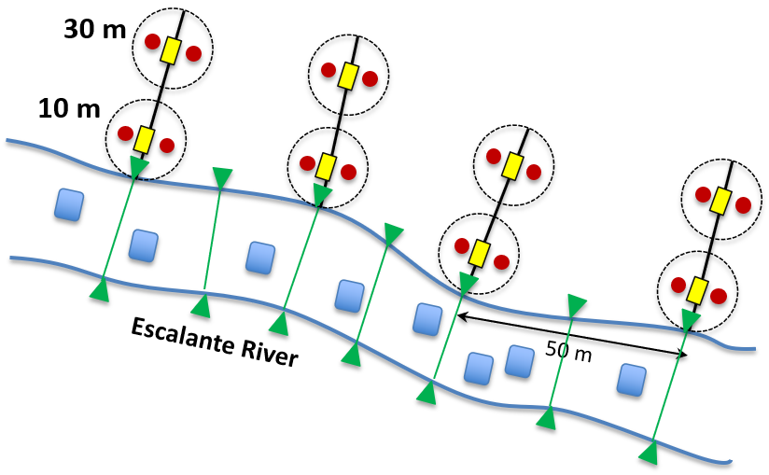
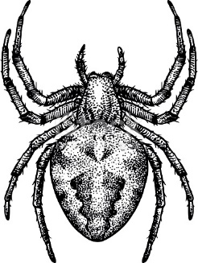
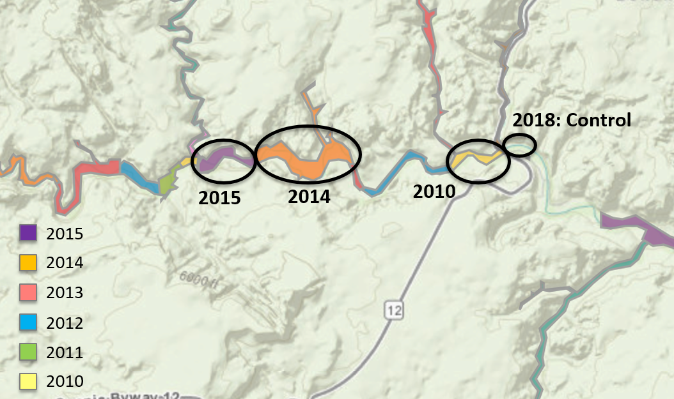
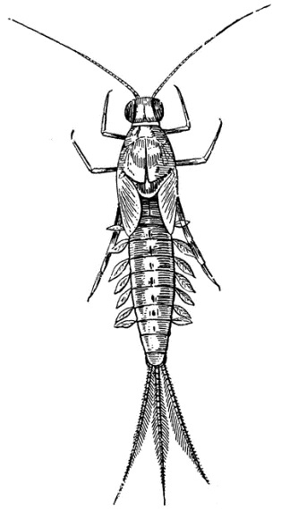
Does habitat restoration work? A case study from Utah's Escalante River
Dana Lind, Sonja Cook, Mikayla Chadbourne, Emma Frenn, Samantha Edwards, Kevin Kasza & Garrett Miller, with Todd Wellnitz (mentor)
Background
Experimental Design
Bank length and height were taken at 7 points at each site to calculate the angle of the river bank. The data show a trend of greater bank variability in 2010 to less variability in 2018, which is consistent with our hypothesis.
The Escalante River ecosystem, like many across the southwestern United States, is threatened by invasive Russian olives trees (Elaeagnus angustifolia) ¹. Russian olives are drought-tolerant nitrogen-fixers that form dense stands that can alter bank-side, or riparian, communities by outcompeting native willows and cottonwoods ². These invasives also change rivers by preventing bank erosion, which leads to channelization and degradation of the streambed habitat ³. In addition, Russian olive leaf litter falling into streams can alter nutrient cycling rates and shift food availability for some aquatic invertebrates ^{4,5}.
To control Russian olives and prevent their spread, in 2009 the Escalante River Watershed Partnership (ERWP) began removing these trees from Escalante Canyon to restore the river to its natural state.
In 2015, students in Collaborative Research in Biology (Biol-423) assisted ERWP in removing Russian olives and conducted a pilot study to assess the effects of removal on riparian and stream invertebrates. Results from that study suggested that invertebrate richness and abundance increased as time since removal increased.
To see if this trend was consistent over time, this past March (2018), a second group of Biol-423 students returned to do a follow-up study. Their objective was to resample the original sites and sample the last remaining Escalante River site with living Russian olive trees. This poster shows the results of this 3-year research project.
The more time since Russian olive removal, the fewer flying insects were found. These data contradict our hypothesis that the presence of Russian olive decreased the riparian invertebrate abundance.
Eight sampling plots were established at each Russian olive removal site (dotted circles). Each plot had 2 pitfall traps (red dots) and 2 sticky traps (yellow rectangles) to collect terrestrial invertebrates and flying insects. The traps were left in place for 1-week. Eight aquatic invertebrate samples (blue squares) were collected from the adjacent streambed on the last day of the study. In addition, stream bank slope was measured at seven spots along the river (green lines) to assess bank erosion.
Discussion
Results
Our results support the hypothesis that Russian olive removal benefits the stream invertebrate community. By contrast, riparian invertebrates appear to be responding to the stream gradient, not the removal treatments.
The trend for aquatic invertebrate seen in 2015 was affirmed by the 2018 follow-up study. As predicted, invertebrate abundance at the 2018 control site was lowest, while the former 2015 control site was not different than the other removal years.
The bank angle data further support this hypotheses because bank morphology showed greater variability as removal time increased, suggesting an improvement in stream habitat.
That riparian invertebrates responded to site location instead of Russian olive removal is bolstered by the sticky trap data. Flying insects increased going from upstream to downstream, matching the stream gradient but not the removal year gradient.
The data were analyzed using ANOVAs with Tukey’s post-test. Bars having different letters show means (± SE) that differ. If a bar series has no letters, then means were not different for that year’s study.
Riparian Invertebrates
Hypothesis & Prediction
A
B
Riparian and aquatic invertebrate richness and abundance should increase with time since Russian olive removal. If this is true, invertebrate richness and abundance from the 2015 control site should be greater than the 2018 control site.
a
a
ab
Abundance
b
Richness
b
b
Study Sites
Terrestrial invertebrate abundance (A) and richness (B) from pitfall traps left for 1 week at each Russian olive removal site. Compared to the 2015 pilot study, invertebrate abundances seen in the 2018 follow-up study were 10X lower, which may explain why no differences were seen among sites in 2018.
Acknowledgements
We thank the ERWP volunteer crew for their professionalism, expertise and comradeship. Special thanks to Alex Engel, who made sure we didn’t work too hard but worked hard helping us set up our research. Also, a big shout-out to Nate Waggoner for sharing with us his vast knowledge of Escalante history and geology, and to Escalante Outfitters for providing the amazing pizza that fueled our work and play, not to mention the showers that cleansed our bodies and soothed our souls. The Ralph Duxbury Fund helped everyone afford the trip to Utah. And finally, Gus Chiggens, for getting the fire started on all those cold, cold mornings, thanks yo.
2015: Control
Aquatic Invertebrates
C
a
a
a
D
a
Abundance
Richness
a
ab
b
Stream flow
Literature Cited
b
Reynolds RV, Cooper DJ. 2010. Environmental tolerance of an invasive riparian tree and its potential for continued spread in the southwestern US. J. Veg Sci 21: 733-743.
Collette KD, Pither J. 2016. Russian-olive (Elaeagnus angustifolia) biology and ecology and its potential to invade northern North American riparian ecosystems. Invasive Plant Sci Manag 8:1-14
Gaddis M, Sher A. 2012. Russian olive (Elaeagnus angustifolia) removal in the western United States: Multi-Site findings and considerations for future research. Sustainability 4: 3346-3361.
Mineau MM, Baxter CV, Marcarelli AM, Minshall GW. 2012. An invasive riparian tree reduces stream ecosystem efficiency via a recalcitrant organic matter subsidy. Ecology 93: 1501-1508.
Moline, A.B. and N.L. Poff. Growth of an invertebrate shredder on native (Populus) and non-native (Tamarix, Elaeagnus) leaf litter. Freshwater Biol 53: 1012-1020
Aquatic invertebrate abundance (C) and richness (D) from 8 Surber samples collected from sections of the Escalante River immediately adjacent to Russian olive removal sites. In the 2018 follow-up study, invertebrate abundance and richness was lowest at the control site. Note that data from the 2015 pilot study mirrored this pattern, although the means were not significantly different.
Location of Russian olive removal sites along the Escalante River color-coded by the year of removal. Circled are the original three Russian olive removal sites used in the 2015 pilot study that were also sampled in 2018 follow-up study, as well as the 2018 control site.

