Slide 1
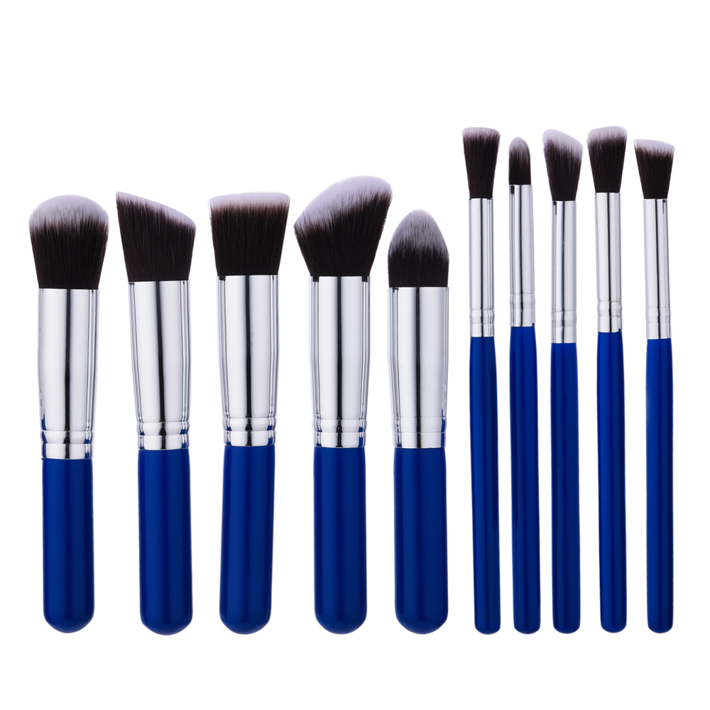
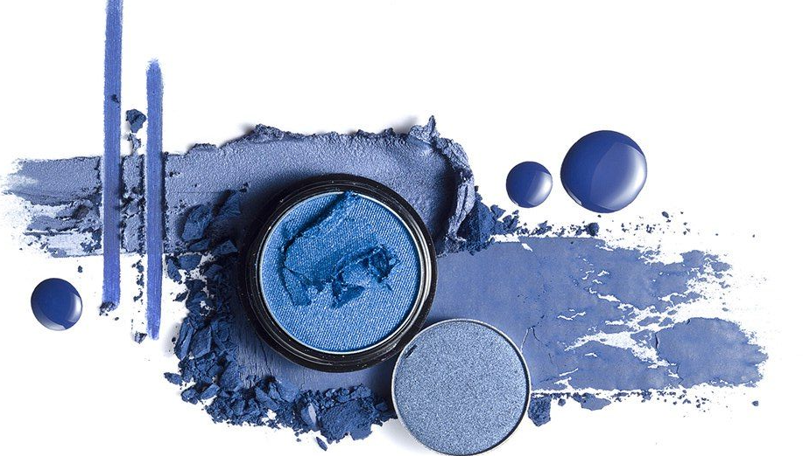
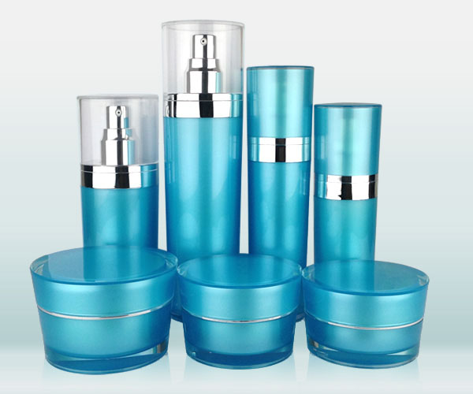
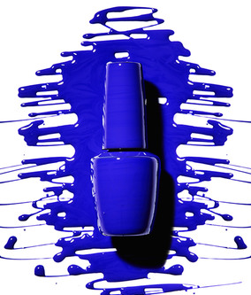
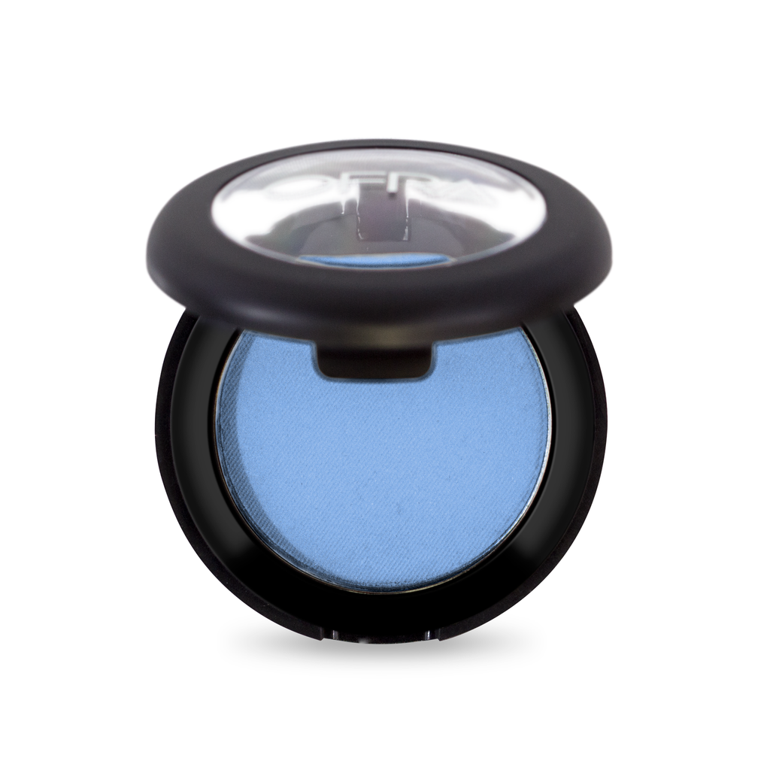
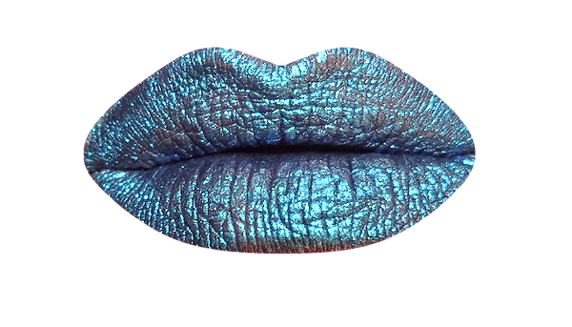
Beauty Today
Understanding Female Cosmetic Related Behaviors and consumption drivers
Sydney Livingston, Stephanie Symons, & Dr. Scott Swanson | Management & Marketing Department
Introduction
The $350 Billion Cosmetic Industry changes frequently with shifts in consumer preferences and innovations. To keep up with the changes, cosmetic companies must understand the motivations and behaviors of women today when it comes to purchasing cosmetics. The literature currently provides little understanding regarding cosmetic consumption.
Purpose
The purpose of this research was to analyze the phenomena of female cosmetic consumption. We investigated attitudes towards cosmetics, usage patterns, behavioral and personality inventories, as well as demographics. Cosmetics are used in nearly all societies around the world, and refers to any of the several preparations that are applied to the human body for beautifying, preserving, or altering the appearance.
Factors & Traits
Factors Created
Using SPSS we conducted factor analysis with Varimax rotation which identified 6 different factors based on respondent psychographics, motivations, and behaviors. The 6 factors identified were Self-esteem, Risk, Innovation, Variety, Control, and Extrovert.
The factor Self-Esteem measures the role that cosmetics plays in portraying the respondents self-image. Higher numbers indicate the more that cosmetics are used to portray an image of self to others. Risk is based on questions about taking chances, where a higher number indicates greater risk taking. Innovation was created using influence, confidence, and knowledge questions. High innovation would indicate high confidence, knowledge about cosmetics, and influence on social group’s behaviors.
Variety is a factor created with questions about change, with a high number indicating they prefer change and not consistency. The factor Control was created with questions about attention to detail and control of their environment. A high score on Control means they prefer to have more control over their environment. Lastly, the factor Extrovert. A high number indicates the respondent is more extroverted, and a low number indicates they are introverted.
Findings
Self-Esteem, Confidence, Influence, and Knowledge Are Big Factors in Cosmetic Usage
Age of Participants
As noted previously, we identified several statistical differences between the factors with the behaviors and motivations for cosmetic use. The factors focused on in this poster were for the Self-Esteem and Innovation factors.
Findings suggest that the identified factors all have a significant effect on cosmetic usage. We conclude that self-esteem, confidence, influence, and knowledge of cosmetics are important constructs to be investigated by researchers and practitioners interested in cosmetic use by women.
In addition to exploring relationships between constructs, we conducted additional descriptive analysis. Additional insights were identified, some of which are shared next.
Motivations to purchase a cosmetic product was most driven by perceived product quality, followed by ease of purchase, price, and recommendations from friends and family. It was also found that the average person spends 13.88 minutes per day applying makeup and an average of $30.82 a month on cosmetics. Almost a third (29.8%) of respondents indicated using cosmetics 7 days a week, with 29.3% reporting that they stock up on cosmetics every 2-3 months.
Self-Esteem & Innovation
Conclusions
Analyzing the different factors against the investigated behaviors with cosmetics, it was found that the most significant differences and influences were with the Self-Esteem and Innovation factors. We will now go more in-depth into each of these factors.
There were many significant findings with the Self-Esteem factor, including motivations for using cosmetics, usage behaviors with cosmetics, and purchasing. Women that use cosmetics to improve how they feel about themselves report that cosmetics make them feel good, help them to be more fashionable, as well as help them to be more confident, make positive improvements to their appearance, and to allow them to be more accepted by others. In addition, respondents that enhance their sense of self esteem with cosmetics were found to spend more time applying makeup everyday, stock up more frequently, use cosmetics more often (7 days per week), and were more likely to purchase cosmetics on the internet.
The second factor we report on here is Innovation. Innovators were found to primarily use cosmetics for facial care, report that cosmetics are fun, and that cosmetics help the respondent appear to be more fashionable. Similar to our findings regarding Self-Esteem, Innovators also like the creativity that cosmetics provide. Innovators stock up on makeup frequently (i.e., weekly to monthly). Innovators were also found to purchase more in cosmetic stores, and use cosmetics frequently with many reporting using cosmetics up to seven days a week.
Our analysis identified several statistically significant relationships in the data. In this poster we focused on findings related to just two of the factors identified, as well as some general information on female cosmetic usage. These findings were very interesting to discover, and could be used in a variety of different ways. They provide insights into cosmetic users at a personal level and, most importantly, can be used in helping businesses better understand their customers. In particular, aiding in better targeting frequent cosmetic users such as Innovators, women high in confidence, cosmetic knowledge, and influence. This would help the company better target users, and in the end create more profit.
Income of Participants
Introductory findings
We conducted an on-line study that recruited female respondents (n = 410) via social media. The questionnaire examined the motivations, behaviors, and psychographics of females in terms of cosmetic use. Respondent ages ranged from 18 to 73 years. The mean age for the participants was 30 years old. Most of the respondents were from Wisconsin (63.4%) and had never married (64.4%). In terms of education, 46.1% reported having some college but no degree, and 28.5% had obtained a Bachelor’s degree. The annual household income of this sample was mixed, with 32% making less than $20,000/year, and 28.8% making over $96,000/year.
Future research
In terms of additional research for this topic, we believe there are many avenues to further our understanding of cosmetic use by women.
The main thing we would want to do to further our research would be to specifically look at millennials versus Gen X and older generations, to identify potential differences in motivations and behaviors.

