Slide 1

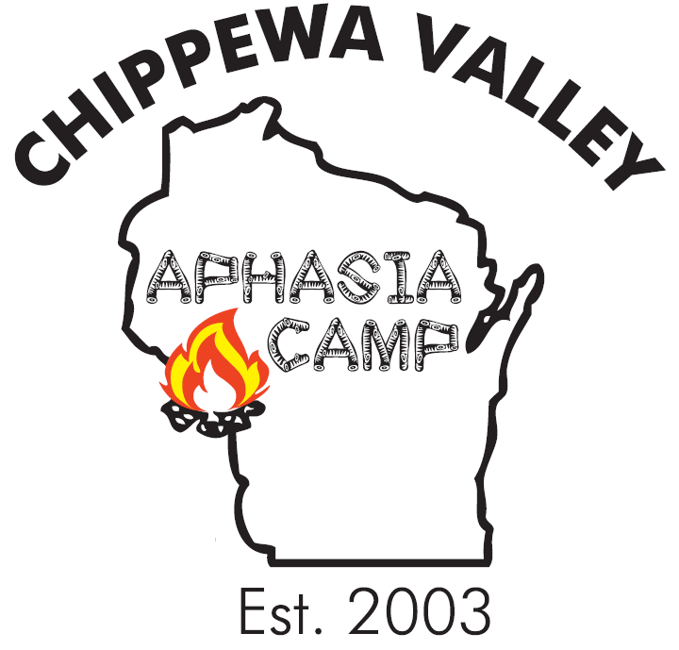
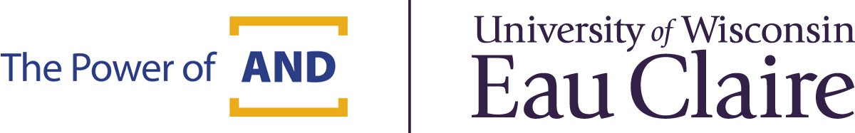

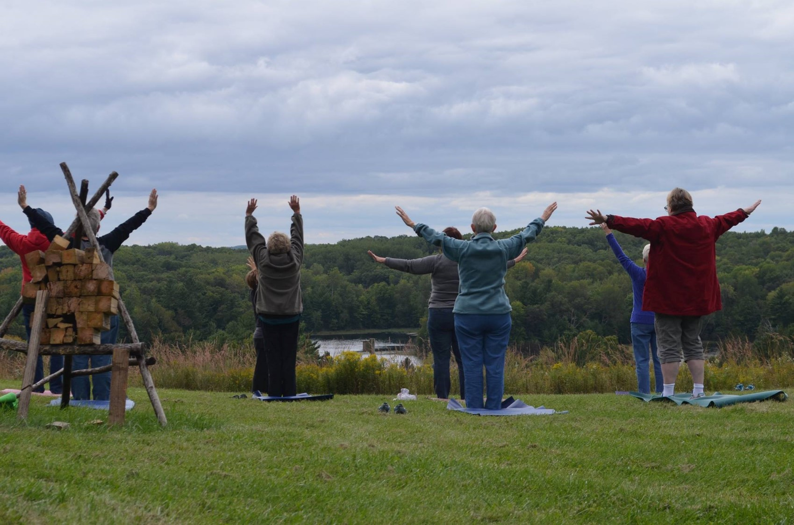
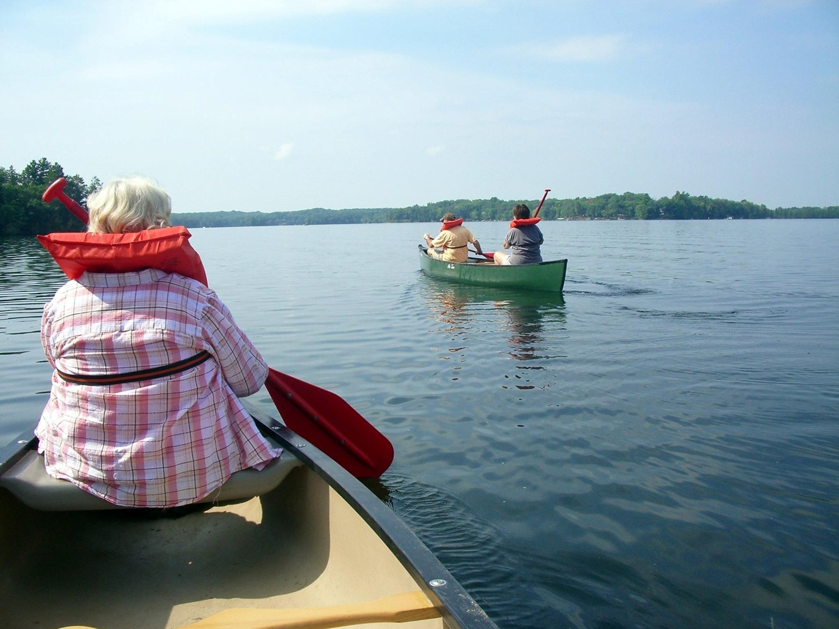
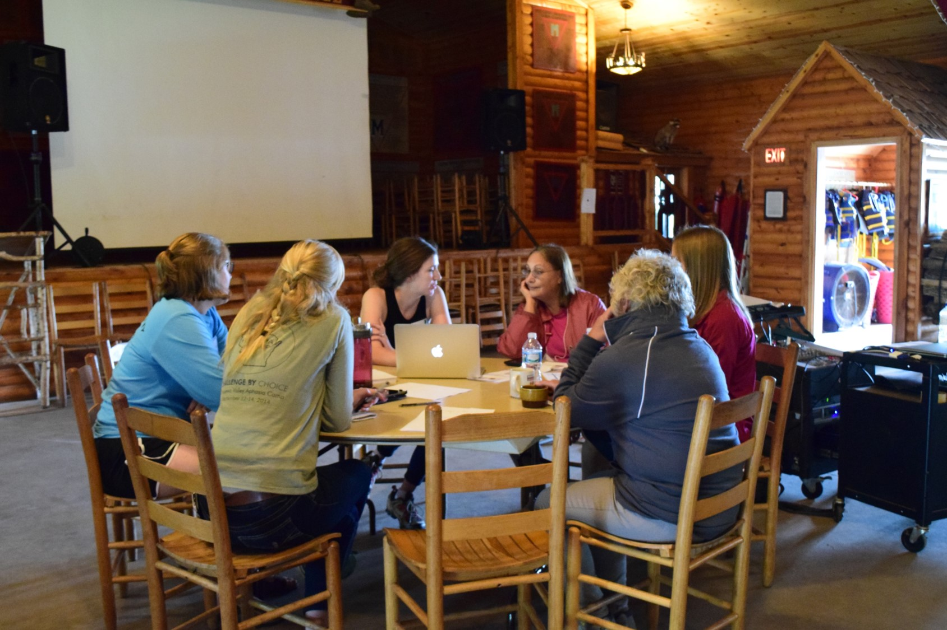
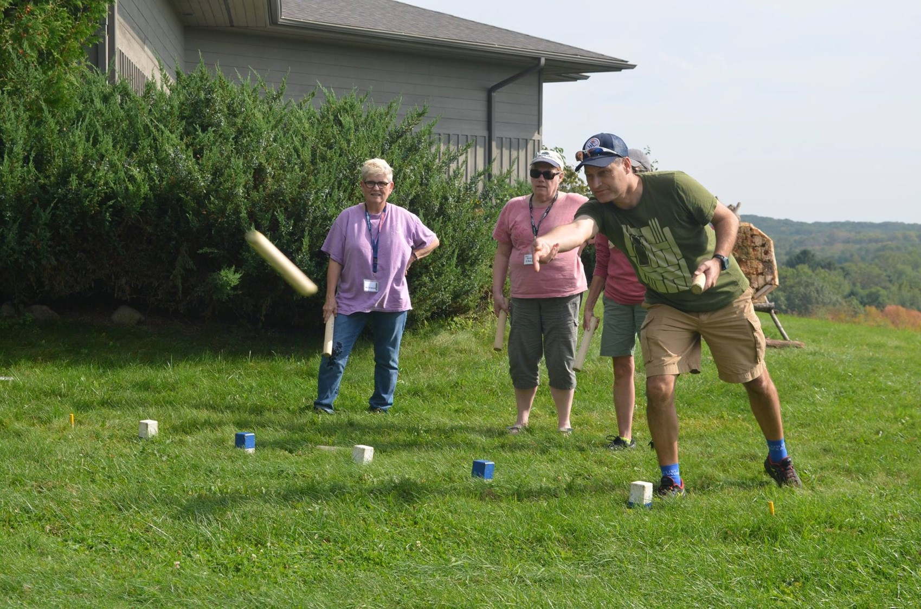
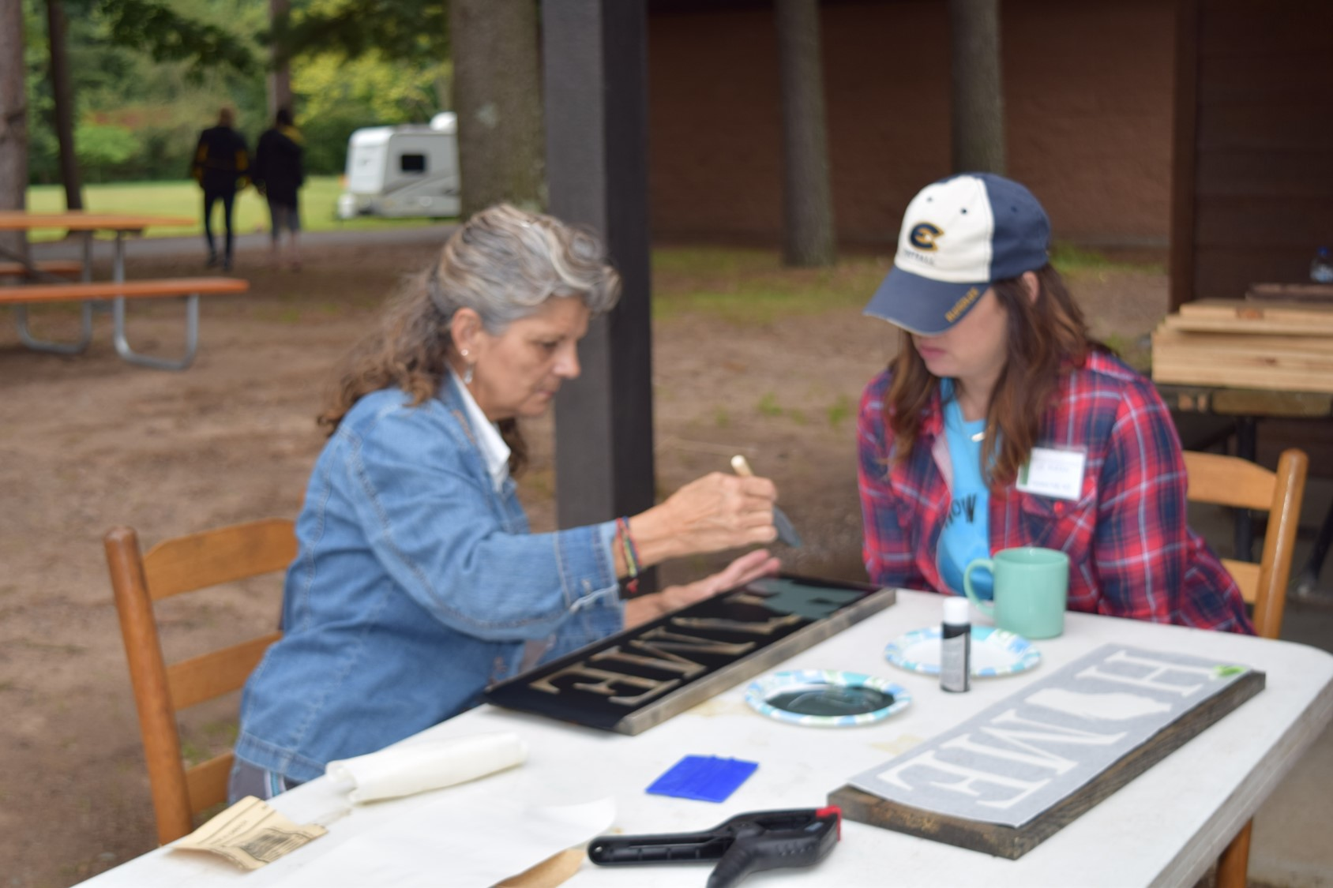
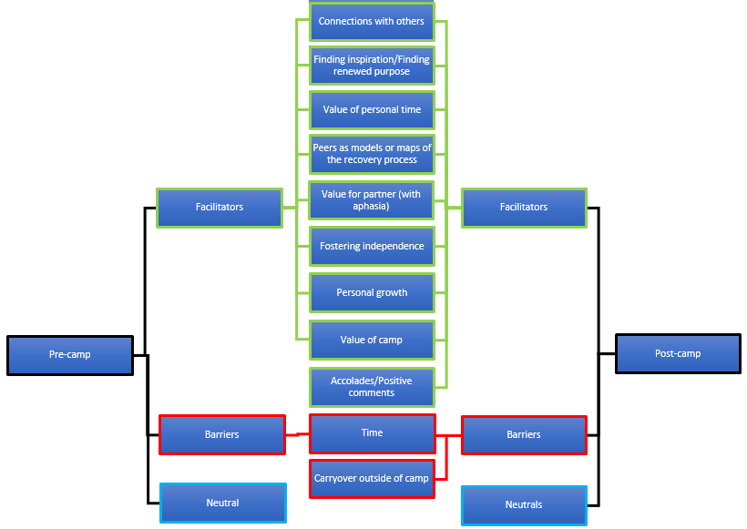
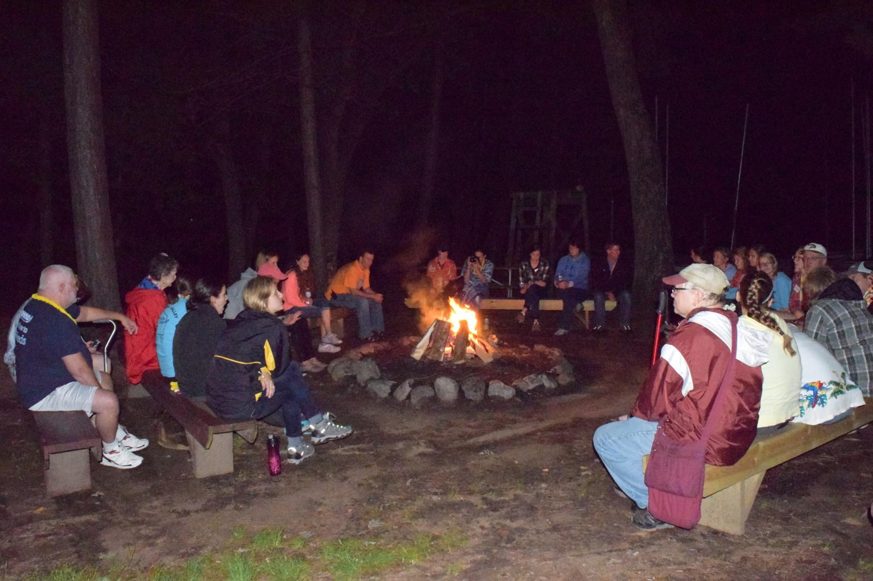
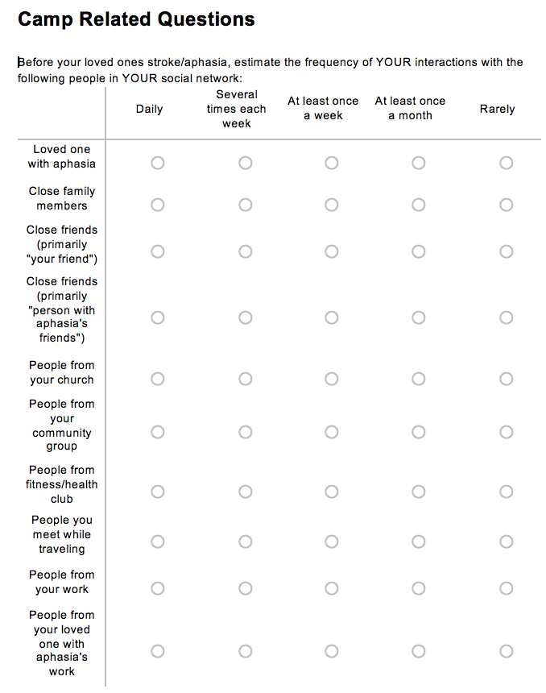

The Impact of Aphasia Camp on Partners of Persons with Aphasia
Anna Selchow & Jerry Hoepner ⎜Communication Sciences and Disorders
Aphasia Camp: What is it?
Purpose: to study the experiences of partners at Chippewa Valley Aphasia Camp.
Aphasia camps are an alternative service delivery model for chronic phase of recovery
Camps are designed to increase engagement in participation as a springboard to social communication in home community
Survey
Pre‐ and Post‐ online Qualtrics survey.
Questions examined demographic information and nature of interactions outside of camp
Quantitative data includes tallies of the types of social interaction experiences before and after camp.
Written responses yielded 10 pre-camp themes and 12 post-camp themes
Post-camp
Partners at Camp:
Both individuals with aphasia and their partners are at risk for social isolation (Adelman et. Al. 2014).
Therefore, partners also experience loss of identity and need for peer support.
Fox and colleagues (2009) examined the effects of an aphasia camp experience on partners.
The present study investigated partner outcomes at the Chippewa Valley Aphasia Camp.
Implications:
Value for partners as well as campers with aphasia
Relationships forged can foster ongoing peer support
It is helpful to see people at different stages of recovery
It is helpful to see models of living successfully with aphasia
Personal time to decompress and take care of self
Partners learn to give up (reduce) control of camper with aphasia and thus nurture independence
Pre-camp
Post-camp
Facilitators: 29
Neutrals: 12
Barriers: 1
Facilitator: 32
Neutrals: 10
Barriers: 0
Participants
Nine partners completed the online survey.
Attended the Chippewa Valley Aphasia Camp in 2017 with their spouse with aphasia.
7/9 partners completed the pre-camp survey.
6/7 partners who completed the pre-camp survey completed the post-camp survey.
Mean age of 63.3, range of 47 to 72 years.
Acknowledgments:
Dr. Tom Sather
Mary Beth Clark
Chippewa Valley Aphasia Camp
Mayo Clinic Health Systems – Eau Claire
Dr. Lynn Fox, Aphasia Camp Northwest
Camp Manitou – Eau Claire Area YMCA
Qualitative Methods and Coding Framework:
Open-ended survey responses were coded using Granenheim & Lundman’s (2006) dichotomous coding scheme.
References:
This allowed high inter-rater reliability (>90%) for initial binary coding (barriers and facilitators).
Adelman, R. D., Tmanova, L. L., Delgado, D., Dion, S., & Lachs, M. S. (2014). Caregiver burden. Clinical Review and Education, 311(10), 1052-1059. Retrieved April 30, 2017.
Fox, L.E., Poulsen, S.B., Bawden, K.C., and Packard, D. (2004). Critical elements and outcomes of a residential family-based intervention for aphasia caregivers. Aphasiology, 18(12), 1177-1199.
See authors for full reference list.
“It's a terrific opportunity to socialize and be around people that understand the daily struggles of having Aphasia or being a caregiver of someone with Aphasia.”
Categories were identified thematically, based upon nature of content.
Note overlap between pre- and post camp barriers and facilitators.
“This is a great opportunity for her to flourish and be herself without fear of judgement or worry.”
“We (both of us) have a connection through these people the caregivers, the aphasia people, the staff and we each have our connections for different reasons in different ways.”
My spouse with aphasia comes home each year (this year was no different) with so much renewed energy and focus to be able to handle more of life with a gusto approach
“For me as a caregiver, this weekend allows me to relax and not have to worry about her as much because I know that when we aren't together, there will always be someone there to help her.”
“I look at life not as we can no longer do this, but as if I'm going to do this, than I need to do it myself.”
“We continue to return to camp because I feel that it is the single best thing we have found for her.”

