Slide 1

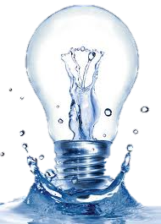
WATER WITHDRAWAL AND CONSUMPTION REDUCTION ANALYSIS FOR ELECTRICAL ENERGY GENERATION SYSTEMs by
Narjes Nouri
Under the Supervision of Professor
Hamid Seifoddini
Adel Nasiri
The University of Wisconsin-Milwaukee
December 2015
Notes:
Hello everyone
Welcome to my thesis defense and thank you for coming here today
My study is about
As it is clear from the topic we are going to analyze and quantify water withdrawals and consumption of various electricity generation sources
by identifying best energy generating technologies in case of water consumption through formulating a basic linear model and then we investigate different energy generating mix for califonia state that is our target for this study

Slide 2
Conclusion
Energy generation technologies
Literature review
Water-energy nexus
Why California
Cooling technologies
Different electricity generation technologies
Applicable cooling technologies
Relevant water consumption and withdrawal
Modeling
Parametric model for reducing water consumption
Different scenarios
Investigates different scenarios for California
Discusses pros and cons
Concludes the result with a quick discussion
Modifications to proposed different scenarios
Notes:
Now this is what this study goes over throughout this presentation.
It starts from a quick lit review of water energy nexus, why we chose California and different cooling technologies
It reviews all energy generating sources, their conversion and cooling technologies and their associated water withdrawal and consumption
It formulates a linear model to reduce water consumption
Investigates different scenarios that california might go through in the coming decade
Offers some modifications to the proposed scenarios

Slide 3
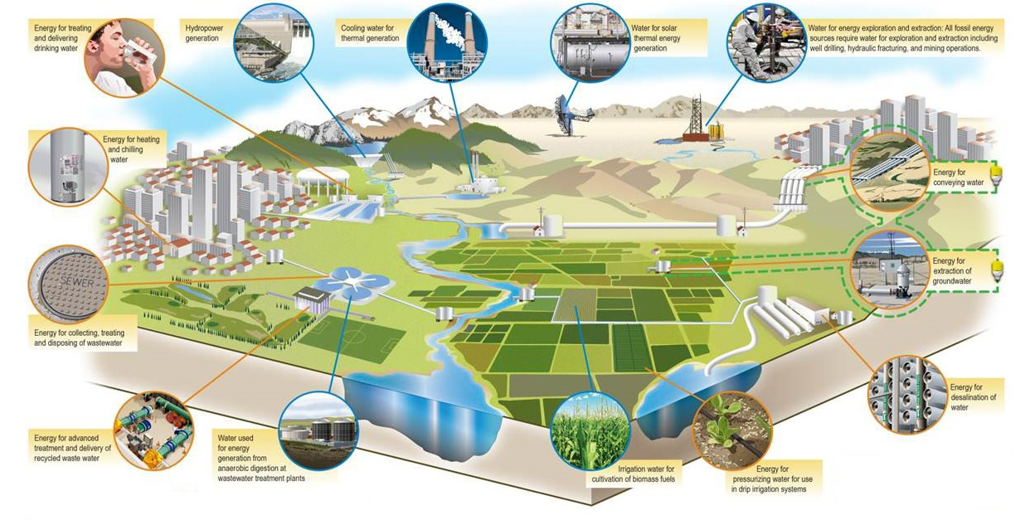
Water Energy Nexus
Notes:
Traditionally water and energy have been addressed to be as two separate issues. However they are deeply interdependent and a successful management, requires consideration of both.
The most important reason behind this mutual dependency is that producing energy requires a large share of available water starting from the extraction of the fuel and constructing the power plant to the cooling process in electricity generating phase. On the other hand collect, treat, transfer and storing water consume a large amount of energy

Slide 4
Water for Energy
With 14 percent share of total water consumption in US, energy sector ranks in the second place after agriculture.
Power plants that are built in areas with limited water resources, threaten the quality and availability of freshwater for other essential needs
Water consumption in energy sector raise water temperature that can harm aquatic organisms as well as posing water quantity problems
Notes:
Recent drought emergency throughout the entire US especially in 2012 was an alarm for the power sector of vulnerability of this sector to water shortage.

Slide 5
Water for Energy
Water use in the energy sector primarily occurs in two areas:
Fuel production
coal mining
natural gas extraction
growing crops for biofuels
purifying fuels transportation of fuels
Electricity generation
Generate steam to drive electricity generating turbines
Cooling systems
Notes:
Purifying coal from sulfur
Transported in mixed with water and transfer through pipes
Other water consuming processes like washing turbines and solar cell surfaces that are negligible

Slide 6
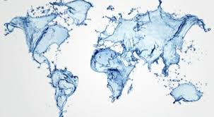


Dependency Factors
1) Location of power plants: Water rights and energy policies vary in different states of United State as well as many other nations.
2) Climate change: any change in precipitation patterns and temperature reduces the efficiency of thermoelectric generation and increases the demand for electricity.
3) Population growth and migration patterns: more population leads to more demand for both electricity and water
Notes:
Some of the most important factors that can effect water energy nexus are
Rising temperature can lead to less efficiency in the thermoelectric cooling and generation as well as more demand for electricity
While decreasing precipitation can effect the quantity of water supplies

Slide 7




Dependency factors
4) Technology options: A power plant’s thermal efficiency and cooling system determines the amount of water withdrawal and consumption. Some of the technologies might withdraw a tremendous amount of water while only a small percentage is evaporated.
Notes:
although there are a lot of options for generating electricity, considering water-energy nexus, options would be limited to those that have less water intensity.
Electricity providing source determines the amount of water needed for the process
Lower efficiency of the plant means less electricity is being generated with same amount of process being done and that means more water for generating same amount of energy
Of the all four factors that have an effect on the annual amount of water used in energy sectors, climate change and population growth are the hardest to manage, if any control on these were possible, it would take a long time for California to implement it. Moreover, the location of power plants cannot have great impacts on the final results since this study is investigating all the power plants within California’s borders. Therefore, technology options for electricity generation is the only factor left to be discussed.

Slide 8
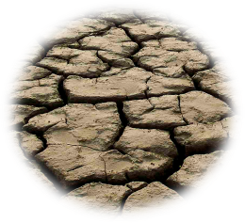

Why California !!!
Recent drought emergency throughout the entire US especially in 2012 was an alarm for the power sector of vulnerability of this sector to water shortage.
Between all 50 United States, California is facing a the worst water shortage
Notes:
Although water is an abundant resource, wise utilization of this precious source must be considered since, water is not always available in the place and time needed.
For the purpose of this study after discussing with my advisors I decided to focus on water consumption and withdrawal in the energy sector in california

Slide 9
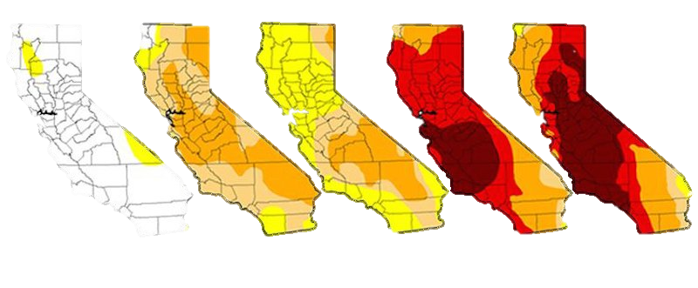
California Drought
Based on drought statistics 2015 was California’s fourth consecutive dry year and it has been forecasted that 2016 will be even drier.
They started water saving regulations in 2012 and added a lot of restricted laws and limitations in water consumption for various sectors since then
2011 2012 2013 2014 2015

Slide 10
Water Savings in Energy Sector
Using less electricity by making buildings, and vehicles more efficient
Using renewable energy technologies such as wind and photovoltaics
Retrofitting old plants with more water-efficient cooling technologies
Notes:
There are also some actions regarding less water consumption being done in the energy sector such as these that have been done in the recent years but they need a lot of detailed modifications to save more water

Slide 11
Energy Sector
Water intensity for electricity generation strongly depends on:
energy source: hydro vs coal vs wind and etc
conversion technology: combined cycle vs single cycle
cooling system: once-through vs dry and etc
Notes:
Water is the base component for Hydro
Coal use water for fuel extraction as well as cooling system
Wind use water for washing the turbines
Combined cycle is more efficient than single cycle so it generates more energy with same amount of water consumed
once through uses water in the entire process while dry cooling uses air instead of water

Slide 12
Once - through
Water is withdrawn from a natural water source, goes through a steam condenser and then pumps back into the boiler, slightly heated usually about 10-30ºF and then comes back to the source again
The amount of water consumption is estimated to be 0.5–2% of the withdrawn amount
Water consumption is highly dependent to the type of the power plant and the temperature of the returned water

Slide 13
Wet - Recirculating
Water will be pumped to a cooling tower to be cooled instead of going back to the source
Withdraw less water from the source compare to once through cooling, about 2-3% but, consumes most of it and the temperature of returned water is higher
Prevents from pouring high temperature water back into the reservoir that can kill a lot of marine creatures and change their habitat
Notes:
Works just like once through but

Slide 14
Dry Cooling
Two Types:
Direct Cooling: steam is being transferred to an air cooled condenser, it will be cooled and pumped back again to the steam condenser
Indirect Cooling: Heated steam will transfer to a water cooled condensers and the water itself will be cooled in an air cooled condenser

Slide 15
Hybrid Cooling
Dual cooling systems with both wet and dry cooling components
In hot days of summer hybrid cooling can use more wet cooling components to increase the efficiency compare to dry cooling and in other times of the year more dry cooling components can be used to reduce the amount of water needed in the process.

Slide 16
Comparison of Cooling Systems
Cooling Technology | Average Water Consumption | Average Water Withdrawal
Once-Through | 0.38 | 142.69
Wet-Recirculating | 4.16 | 4.54
Dry | Less than 5% of wet cooling | Less than 5% of wet cooling
Hybrid | Variable between wet and dry | Variable between wet and dry

Slide 17
California Energy Generation Mix
Fuel Type | California In State Generation (GWh) | Percent Of California In State Generation
Natural Gas | 121,934 | 61.3%
Nuclear | 17,027 | 8.6%
Large Hydro | 14,052 | 7.1%
Wind | 12,997 | 6.5%
Geothermal | 12,186 | 6.1%
Solar | 10,557 | 5.3%
Biomass | 6,721 | 3.4%
Small Hydro | 2,426 | 1.2%
Coal | 1,011 | 0.5%
Notes:
Natural gas fulfills the largest portion of demand and coal has the lowest percentage since California doesn’t have coal mining
Wind and solar percentage are considerable

Slide 18

Natural Gas
Conversion technology
Steam Turbine
Combined Cycle
Single Cycle
422
Generation technology | Natural gas steam turbine | Natural gas steam turbine | Natural gas combined cycle | Natural gas combined cycle
Cooling technology | Withdrawal | consumption | withdrawal | consumption
Once through | 10000-60000 | 95-291 | 7500-20000 | 20-100
Wet-Recirculating | 950-1460 | 662-1170 | 150-283 | 130-300
Dry cooling | 0-4 | 0-4 | 0-4 | 0-4
Notes:
61%
it is basically the first process of the combined-cycle technology and there are a limited number of power plants that are currently using it

Slide 19

Nuclear
Nuclear power cycle uses water in extracting uranium and controlling waste as well as cooling process
Federal regulations require that a nuclear power plant needs to have an emergency supply of water that can cool the reactor for 30 days after it shuts down that is about 10,000 to 30,000 gallons per minute.
1
Notes:
8.6%
Nuclear plants produce heat by splitting the atoms of uranium. Then water inters to reactor vessels and will be heated at about 300 ͦ C. To prevent from boiling at this stage it should be pressurized. Pressurized hot water goes into steam generator and will be converted to steam. In the last step this steam spins a series of turbines and generate electricity

Slide 20
Nuclear Water Intensity
Waste storage needs either a water based storage pool or air cooling systems to cool down uranium fuel bundles. This stage can last as long as 15 years
Cooling technology | Withdrawal | Consumption
Once through | 25,000-60,000 | 100-400
Wet-recirculating | 800-2,600 | 600-800
Dry cooling | N/A | N/A

Slide 21

Hydroelectric
Conversion Technology:
Dams: water is elevated to a height and then released over a turbine to produce the amount of pressure needed
Run of River: divert the flow of river toward a turbine and then return it back to the stream
Pumped Storage: storing water in a higher level reservoir in off peak hours and use it in peak hours
365
Notes:
8.3%
Large and small hydro depending on their capacity compare to 30 mw

Slide 22
Hydroelectric Water Intensity
Most intensive renewable source in case of water
Water is actually the basis of the process and there is no cooling
Factors effecting water consumption:
Reservoir location and size
Dam type
Climate
Generation Technology | Withdrawal | Consumption
Small hydro | 55000 | 48-3800
Large hydro | 20000 | 10-660
Notes:
Therefore facilities with a large hydraulic head, consume less water while generating more energy

Slide 23

No Pollutants
No Mining
Wind
Cheap and Easy
Low Water Intensity
No Greenhouse Gases
Location of the farm determines the water intensity.
Water is only needed for washing the blades for higher efficiency so, dry and dusty lands aren’t qualified for a water efficient wind farm.
165
Notes:
6.5%

Slide 24
Wind Water Intensity
Some regions with high volume of precipitation may not need water to wash the blades.
Generating energy with wind power in 2013 prevented the consumption of more than 35 billion gallons of water equal to saving 120 gallons per person annually.

Slide 25

Geothermal
Geo = Earth and Thermal = Heat
Conversion Technologies: Steam, Flash Steam and Binary
All U.S. geothermal power facilities use wet-recirculating technology
Geothermal power plants consume water in two parts of the process: 1) Extracting water from the source and 2) cooling process.
45
Notes:
6.1
Steam: such as Geysers draw steam directly from underground
flash steam: pulls up hot water with temperatures greater than 360°F through wells. The pressurized water loose its pressure on its way up, so it causes the water to boil into steam
Binary: use water at lower temperatures of about 225°-360°F. It uses hot water to boil a fluid, with a low boiling point and use the steam to spin the turbine

Slide 26
Geothermal Water Intensity
Power plants inject water back to the earth to make it a renewable source. But, since the reservoir water is dirty power plants like Geysers are using non-potable treated water
Technology | Steam | Flash | Binary
Water Consumption | 1796 | 5-19 | 1700-3963
Water Withdrawal | 5300 | 5300 | No Information
Notes:
Geothermal plants can use either geothermal fluid or fresh water for cooling processes.

Slide 27

Solar
California accounted for more than 75% of U.S. utility-scale solar capacity installed in 2013” and had a 3.15 percent growth from 2013 to 2014.
Conversion Technologies: Photovoltaic, Thermal
There are two source of water consumption for solar thermal plants: Cooling, Washing collector’s surface
Photovoltaic facilities use only a negligible amount of water for washing the PV cells to increase the efficiency of reflecting.
158
Notes:
5.3

Slide 28
Solar Water Intensity
In both technologies using non potable water is possible and preferred for washing cells
Energy generation | Water Consumption | Water Withdrawal
Solar photovoltaic | 0-33 | 50
Solar thermal wet cooling + washing | 740 | 660-830
Solar thermal Dry cooling + washing | 36 | 80

Slide 29

Biomass
Conversion Technologies: Steam, Biogas
Californians create more than 2,900 pounds of household garbage and industrial waste every second
There are different feed stocks that a biomass facility can use such as wood, agricultural crops or wastes. Keeping these wastes out of landfills and reducing gas emissions are the most important advantages of biomass.
122
Notes:
3.4

Slide 30
Biomass Water Intensity
Biomass plants using crops as feedstock need a substantial amount of water for irrigating the crops as well as cooling. The amount of water needed is dependent to the type of crops, the location of the farm and precipitation rate in that region.
Reclaimed water may be applicable for irrigating the crops if it doesn’t have any impact on the quality of land.

Slide 31
Biomass Water Intensity
Cooling technology | Energy generation technology | Water consumption | Water withdrawal
Once-through | Steam | 300 | 20,000-50,000
Wet-recirculating | Steam | 480-965 | 500-1460
Wet-recirculating | Biogas | 235 | 250
Dry cooling | Biogas | 35 | 50

Slide 32

Coal
Water Consumption:
Cooling: similar to Natural gas plants
Washing and Transporting: The amount of water needed for washing is dependent to the method which it was mined and the amount of sulfur in it. Coal can be transferred either in the solid form by trucks or by slurry pipelines while it is mixed in the water.
12
Cooling Technology | Once-through | Wet-recirculating | Dry cooling
Withdrawal | 20,000-50,000 | 500-1200 | N/A
Consumption | 100-317 | 480-1100 | N/A

Slide 33
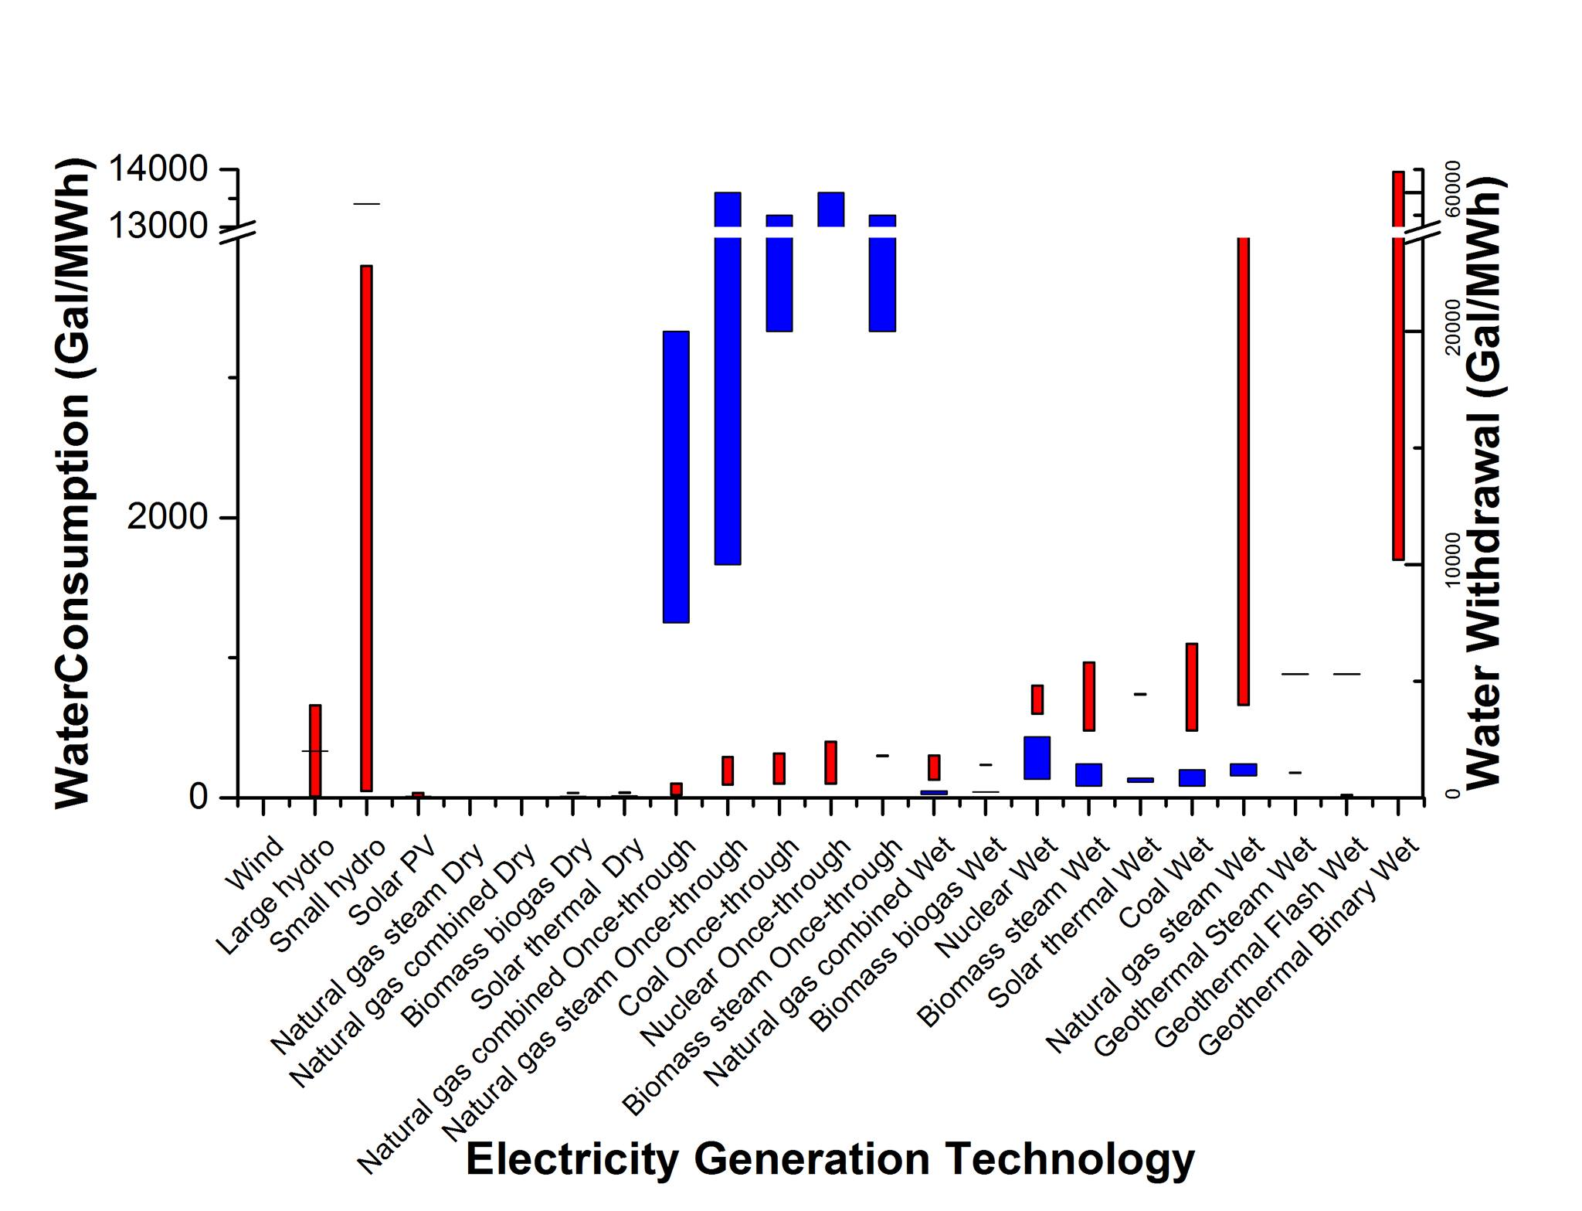
Water Intensity
Notes:
This is a chart for energy consumption and withdrawal for different technologies
It is showing how different they are
Having these information we only need the capacity and demand for california to start formulating the problem

Slide 34
Capacity and Demand
Neither of energy generating technologies can produce unlimited electricity
Capacity factor is a number between zero and one defined as “the ratio of the electrical energy produced by a generating unit for a period of time considered to the electrical energy that could have been produced at continuous full power operation during the same period”
Capacity factor is dependent to the energy source of the power plant.

Slide 35
Capacity and Demand
Energy Source | Coal | Biomass | Geothermal | Nuclear | Natural gas | Large hydro | Small hydro | Solar PV | Solar Thermal | Wind
In-state Capacity | 1,463 | 11,151 | 23,678 | 20,349 | 404,860 | 108,291 | 14,217 | 40,637 | 11,388 | 51,649
Capacity Factor % | 60.9 | 60.5 | 68.8 | 91.7 | 47.8 | 37.5 | 37.5 | 27.8 | 19.5 | 33.9
The average demand for 2014 was forecasted to be 295,661 GWh

Slide 36
Parameters
Xij = Amount of electricity that must be generated by electricity generation i and technology j (GWh)
Wij = Average water consumption for electricity generation i and technology j (gal/GWh)
Ci = Capacity for energy source i (GWh)
Cf_{i}= Capacity factor for energy source i
D = Average demand in the state of California (GWh)

Slide 37

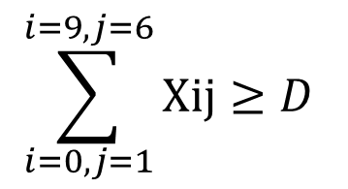
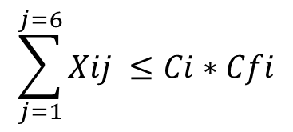
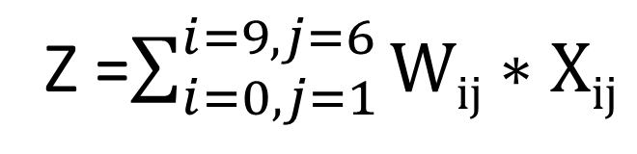
General Model
Z =$\sum_{i=0, j=1}^{i=9, j=6}{Wij∗Xij}$
$$\sum_{j=1}^{j=6}{Xij} ≤Ci∗Cfi$$
1)
$$\sum_{i=0,j=1}^{i=9,j=6}{Xij}≥D$$
2)
3)
$$Xij≥0$$

Slide 38
Results and Discussion
Energy Source | Variable | Production GWh
wind | X₀₁ | 17,509
Large hydro | X₁₁ | 28,523
Solar PV | X₃₁ | 11,297
Natural Gas Steam Turbine dry cooling | X₄₁ | 193,523
Biomass Biogas Dry Cooling | X₅₁ | 6,746
Solar Thermal | X₆₁ | 22,20
Coal Once-Through | X₇₁ | 44,792
Nuclear Once-Through | X₈₁ | 18,660
Geothermal Flash | X₉₁ | 16,290
Total electricity generation | 295,661 = demand
Electricity shortage | 0
Total Water Consumption | 15,492,000 gallon
Notes:
Total demand is satisfied by california in sate electricity generating capacity
All sources except hydro need to generate electricity at their maximum capacity
Large hydro still need to generate more than half of it’s real capacity
This result is also showing the best technology among all, for each energy source. For example geothermal flash is the best technology between all the methods using geothermal as a source. Although there are various technologies in different power plants but, the best way to save water is to change the facilities to those methods with lowest water consumption

Slide 39
Problem and Solutions
Problem
Dry cooling
aging
water-intensive Hydro and Nuclear plants
Solution
Hybrid Cooling
Different Scenarios
Notes:
most of fossil fuel power plants must switch all their cooling technologies to dry cooling. The efficiency of dry cooling is less than wet cooling and that’s because the heat capacity of air is less than water, so the temperature of steam after being cooled in air dry cooling is always higher than any type of cooling that water is involved in the cooling process.
Using hybrid cooling can solve this problem by using wet components in the hot days to increase the efficiency
there are a lot of aging water-intensive plants in California that are approaching their lifetime end session in this coming decade and the world is going toward more water and energy efficient methods.

Slide 40
Hydro Disadvantages
Although hydro account as a renewable source of energy and has a lot of leverages over fossil fuel plants, the problem is that Hydro facilities are
Disturbing the ecosystem
Destroying a lot of creature’s habitat
Emit a large amount of carbon dioxide and methane
Have effect on agriculture
Notes:
Recently four hydro power plants on the Klamath River have been shut down by environmentalists to rescue the salmon that migrate upstream in this river and to solve the irrigation problem close to these dams for farmers

Slide 41
Nuclear Disadvantages
California is planning to phase out its nuclear facilitie because, the benefits of nuclear power to California are much slighter than its risks.
Several earthquake faults
Radioactive waste
High probability of catastrophic nuclear accidents
Fuel availability

Slide 42
Scenario 1 and discussion
No-Hydro-Nuclear plant
Energy Source | Variable | Production GWh
Wind | X₀₁ | 17,509
Solar PV | X₃₁ | 11,297
Natural Gas Steam Turbine dry cooling | X₄₁ | 193,523
Biomass Biogas Dry Cooling | X₅₁ | 6,746
Solar Thermal | X₆₁ | 22,20
Coal Once-Through | X₇₁ | 44,792
Geothermal Flash(fresh water) | X₉₁ | 16,290
Total Electricity Generation | 248,478 < demand
Electricity shortage | 47,183
Total Water Consumption | About 1 million gallon
16 percent or 50,000 GWh less demand would cut the water consumption by 94 percent or 14 million gallons
Notes:
Going forward to the next step we investigate what would happen if California shut down all its nuclear and hydro plants
The problem that would rise is that all other sources can not satisfy the demand
There is about 50000 GWh shortage

Slide 43
Scenario 2 and discussion
Energy Source | Variable | Production GWh
Wind | X₀₁ | 17,509
Solar PV | X₃₁ | 11,297
Natural Gas Steam Turbine dry cooling | X₄₁ | 193,523
Biomass Biogas Dry Cooling | X₅₁ | 6,746
Solar Thermal | X₆₁ | 22,20
Coal Once-Through | X₇₁ | 44,792
Nuclear Once-Through | X₈₁ | 18,660
Geothermal Flash | X₉₁ | 16,290
Total Electricity Generation | 267,138 < demand
Electricity shortage | 28,523
Total Water Consumption | Almost 6 million gallon
No-Hydro
10 percent or 28,000 GWh less demand would cut the water consumption by 60 percent or
9 million gallons
Notes:
Next scenario is considering a case when nuclear plants are still on to see if nuclear capacity is enough to fulfill the shortage and how much more water it consumes.

Slide 44
  Modifications to proposed scenarios
Importing electricity from Pacific Northwest and U.S. Southwest
Cost: including the electricity price and transportation cost which are dependent to the distance between two states and the source of the energy
Energy Loss: a fraction of the transported electricity may be lost in the transportation and all of these can increase the price of electricity

Slide 45
  Modifications to proposed scenarios
    2) Scenario including some hydro plants
    There is no set up cost or capital investment.
    Forbestown power plant that has the lowest capacity between large hydro plants has the ability to fulfill the shortage with about 95 thousand GWh capacity.
    Determining the best hydro plant to fit this scenario need a lot of information
    about their efficiency, age, location and etc.
Notes:
California cannot shut down and destroy all its large hydro facilities because it might cause a flood
California energy commission has a list of California hydro plants from 2014. According to this list Forbestown power plant that has the lowest capacity between large hydro plants has the ability to fulfill the shortage with about 95 thousand GWh capacity.
Next scenario is showing a case when all the nuclear and small hydro plants are shut down and only one out of 71 large hydro plants are working.

Slide 46
Scenario 3 and discussion
    Scenario including some hydro plants
all the nuclear and small hydro plants are shut down and only one out of 71 large hydro plants is working.
Total Electricity Generation | 295,661 = demand
Electricity shortage | 0
Total Water Consumption | About 17 million gallon
Notes:
The 2 million gallon difference between water consumption in this scenario and the general scenario is because large hydro is making up for nuclear and it consumes more water than nuclear

Slide 47
  Modifications to proposed scenarios
    3) Increase the capacity of wind and solar
    Well-designed wind and solar farms in California can reduce the reliance of electricity generation to water with satisfying the demand without wasting water for cooling processes.
    Too many parameters can effect a power plant location decision. Available land is the most important in case of solar and wind since, it must be rich in wind or sunshine and it must be large enough to fit an impressive number of panels or turbines.
Notes:
One way to reduce the effects of this problem is to establish wind- solar hybrid farms
Solar-wind hybrids are common in backyard setups in the U.S. In locations where there is no grid service or to minimize grid reliance, a combination of solar panels and a small wind turbine may be useful
But if we want a hybrid system in a large scale the configuration of the farm would play an important role

Slide 48
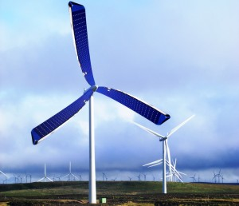
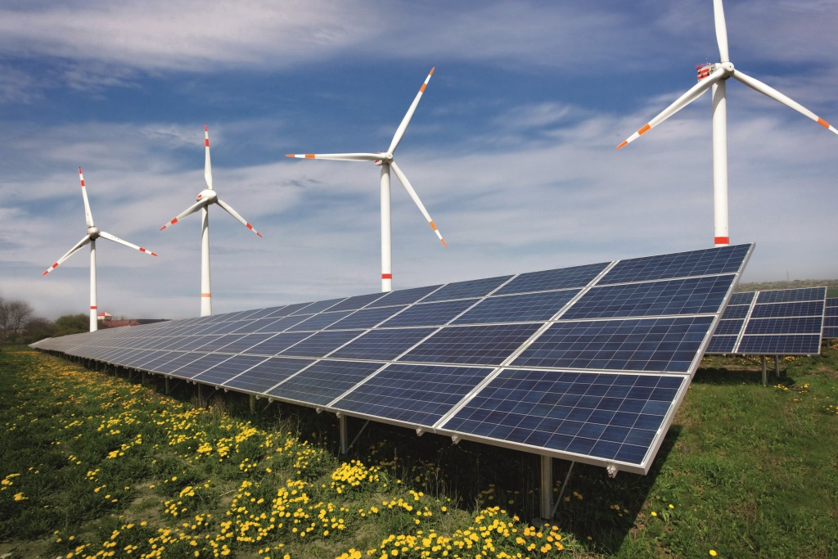
  Wind-Solar Hybrid Farms
Different Configurations
Notes:
First image that comes to mind regarding the combination of solar and wind is a turbine with solar panel blades. Although there are some problems associated with this type of turbines that stops researchers from applying it in the real world.
The most important issue is that the blades are located vertically, so panels would only get solar power with the Sun low in the sky at sunrise or sunset while Solar panels need to be pitched at an angle 30 - 45 degree for optimum performance. Also, the reflection of the blades can send blinding beams of light to the airplanes
On the other hand, sharing land between wind and solar sources in the configuration of picture leads to a lot of benefits.

Slide 49
  Benefits
Twice the amount of electricity being generated across the same surface area and it means two times more efficiency.
There is no need for grid expansion because, the plant generates wind and solar in different times of a day and during complementary seasons

Slide 50
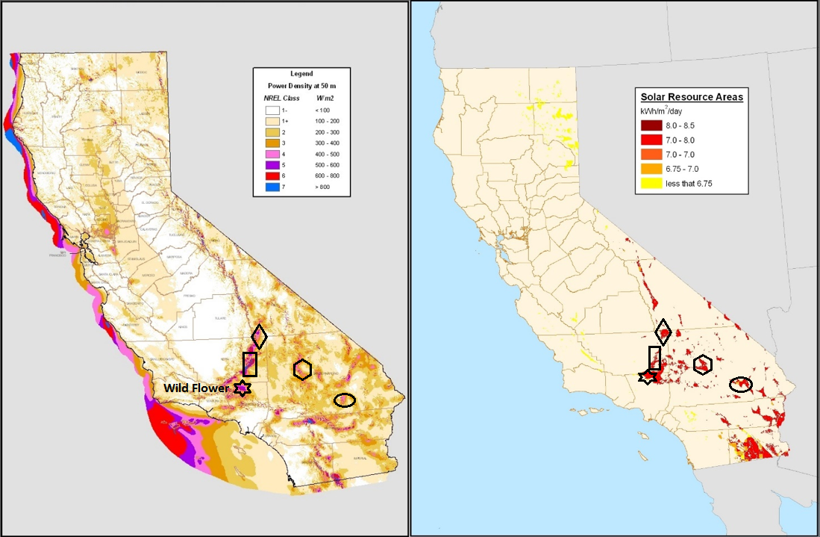
  Potential Lands
Notes:
most of the potential lands are located in southern California. Kern, San Bernardino and a portion of Inyo County have the best opportunities to launch a new hybrid wind-solar plant. Water availability is not the same all over through California. Two third of California’s water is happened to be in the northern parts of the California while two third of state’s population is located in southern parts, consequently there is a complexity in the water distribution system. State water project uses 12.2 billion kWh annually to transfer water to southern California and this average will increase as the population growth occurs in California [7]. Establishing new hybrid renewable farms helps southern California to produce its own electricity without relying on water.

Slide 51
  Drawbacks
Energy Storage
Reliability
Energy Loss
Notes:
Using solar and wind in a large scale for providing electricity has some drawbacks
Reliability and energy loss are the most important disadvantages of wind and solar
Energy storage systems can not fix it 100% but they can reduce their effects

Slide 52
  Reliability and Energy Loss
Wind and solar PV are both variable and intermittent in nature. The exact amount of generation varies even minute to minute and therefore a utility may need to have backup power available to satisfy the demand for periods when wind or solar generation are lower than expected.
Mechanical nature of the wind turbines and materials used in a solar panel lead to high ratio of energy loss in wind and solar PV sources
Notes:
About energy loss as it was clear from capacity factors, wind and solar have high ratio of energy loss

Slide 53
  Energy Storage Systems
Save energy for future uses when the sources of energy are not available
Energy Storage Systems lose small amount of stored energy in each cycle
Energy Storage Systems can help the hybrid system to compensate the loss of energy occurred in each phase.
Increase the reliability and efficiency of the system.
Notes:
absorb energy, Store it for a period of time and then release it to the energy suppliers or power services.
when the demands or the prices are higher or

Slide 54
  Conclusion
Wind and solar alongside all the fuel based methods with dry cooling systems
Alternating Dry cooling with Hybrid cooling
phasing out all nuclear and hydro facilities is a possible plan to reduce water intensity but it needs a huge expansion in both wind and solar farms
constructing new hybrid wind-solar farms
Potential places in southern California
Solving The problem of reliability and energy loss for wind and solar
Notes:
Concluding all the materials we covered in this presentation
We started gathering all the data for different cooling and conversion technologies for each energy source and their associated water consumption and withdrawal and formulate a model with the objective of reducing water consumption

Slide 55
  Future Studies
Water-Energy-Land nexus
Water-Energy-Food nexus
Exact location of the farms
How much a hybrid farm can generate

Slide 56

  Acknowledgement
Professor Adel Nasiri
Professor Hamid Seifoddini
Professor Wilkistar Otieno
Farhad Balali
Afsaneh Dorri

