Slide 1

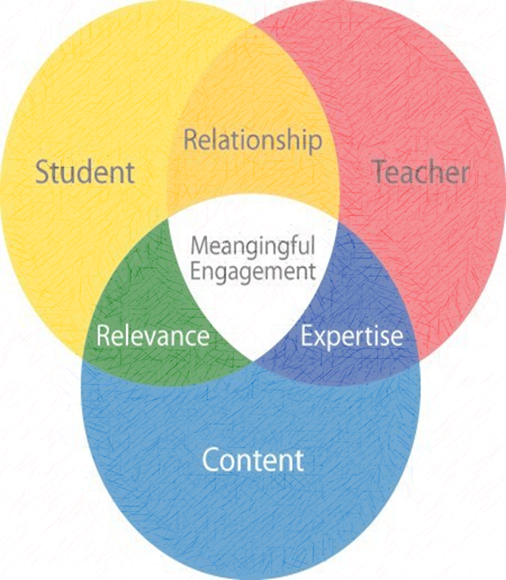

Self-reflections on Teaching and Learning Experiences in Science Education Dr. Tanzeem Iqbal Ali Department of Education
ABSTRACT
Utilizing Bracketing and Constructivist Grounded theory, this study looks into self-reflections on teaching and learning experiences in Science Education and reports on the emerging themes through preliminary analysis using the lens of principles of effective teaching and learning.
Introduction
Methodology
Preliminary Results
Self-reflection is a critical component for both teacher educators and in the field of teacher education (Brookfield, 1995). It allows one to be 1) mindful of one’s actions, 2) offer quality instruction to prepare future teachers and 3) practice reflexivity (Mruck & May 2019). According to Carnegie Mellon University; the best practices aligned to Principles of Teaching (2020) and Principles of Learning (2020) highlighting effective teaching must include the seven characteristics in each.
Bracketing was utilized with caution to not taint the analyses of data with the researcher’s preconceptions. In distilling the core themes for the study Constructivist Grounded Theory (CGT) by Charmaz (2017) was utilized. The researcher’s self-reflections and student self-reflections are analyzed post content delivery using the lens of both teaching and learning principles to reflect on creating effective teaching and learning opportunities.
(Step 1): Bracketing & Self-reflections
Each of the seven components of effective teaching and learning experiences were embedded in the coursework.
Deeper meaningful learning, can be assessed when their schemas are updated through their interaction with the materials from the coursework.
Students who actively made a connection to the content and set a personal goal for themselves as they progressed with the course materials, were motivated to learn and pay it forward to their future students.
Emerging themes:
Teaching & learning experience,
Love-hate relationship with Science
Pedagogy,
Innovative Science Teaching strategies
References:
Brookfield, S. D. (1995). Becoming a Critically Reflective Teacher. San Francisco: Jossey Bass. Charmaz, K. (2017). The Power of Constructivist Grounded Theory for Critical Inquiry. Qualitative Inquiry, 23(1), 34–45. https://doi.org/10.1177/1077800416657105 Mruck, K. & Mey, G. (2019). Grounded theory methodology and self-reflexivity in the qualitative research process. In Bryant, A., & Charmaz, K. The SAGE Handbook of Current Developments in Grounded Theory (pp. 470-496). 55 City Road, London: SAGE Publications Ltd doi: 10.4135/9781526485656 Principles of Teaching. (2020). Retrieved from https://www.cmu.edu/teaching/principles/teaching.html Principles of Learning. (2020). Retrieved from https://www.cmu.edu/teaching/principles/learning.html
Principles of Teaching and Learning
(Step 2): Application of Constructive Grounded Theory
Effective teaching involves:
acquiring relevant knowledge about students and using that knowledge to inform our course design and classroom teaching.
aligning the three major components of instruction: learning objectives, assessments, and instructional activities.
articulating explicit expectations regarding learning objectives and policies.
recognizing and overcoming our expert blind spots.
effective teaching involves prioritizing the knowledge and skills we choose to focus on.
adopting appropriate teaching roles to support our learning goals.
progressively refining our courses based on reflection and feedback.
Effective learning occurs when:
it is acknowledged that students’ prior knowledge can help or hinder learning.
it is understood how students organize knowledge influences how they learn and apply what they know
it is acknowledged that students’ motivation determines, directs, and sustains what they do to learn.
goal directed practice coupled with targeted feedback enhances the quality of students’ learning.
one understands to develop mastery, students must acquire component skills, practice integrating them, and know when to apply what they have learned.
students’ current level of development interacts with the social, emotional, and intellectual climate of the course to impact learning.
one becomes self-directed learners, students must learn to monitor and adjust their approaches to learning.
(Step 3): Emerging Themes from Analysis
Examples of Course activities
Science education courses in fall 2019
Weekly discussions, activities and final project each were designed to:
Help set goals for students (week 1 assignment)
Teach skills needed to succeed in meeting goals
Provide opportunities to practice and gain mastery (Peer to Peer Teaching
Provide opportunity to be self directed learners (PDA)
This Photo by Unknown Author is licensed under CC BY-SA-NC

