Slide 1

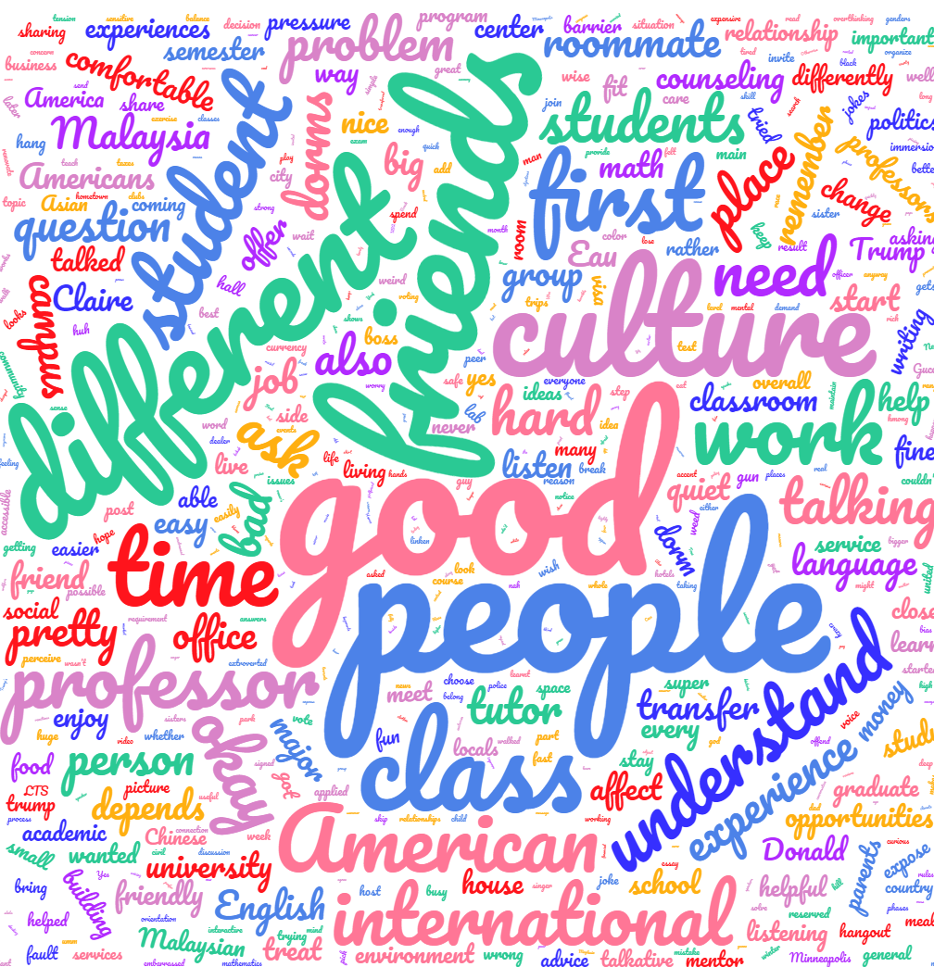
International Students’ Challenges and Opportunities
Charissa B. Cable, Saudamini Agarwal, & Shing Yee Bay
Faculty Mentor: Jeffrey Goodman
University of Wisconsin-Eau Claire
Introduction
Results
Results
International students are important to the US because they bring in revenue ($30.5 billion 2014-2015) in tough economic times, and greatly enhance the educational and cultural experience of US domestic college students (Gold, 2016).
However, they face challenges in pursuing their education which may begin as early as obtaining a visa (Lee & Rice, 2007). International students report experiencing hardship and discrimination/prejudice on the basis of race, country of origin, and language proficiency (de Araujo, 2011). Some research has revealed factors that are predictive of greater belonging and academic success, such as social support and establishing relationships with Americans (de Araujo, 2011). In essence, many factors may serve as both stressors and buffers for international students’ outcomes.
In the present study, we attempted to gain insights into the particular challenges and opportunities for success for international students at UW-Eau Claire. We conducted focus groups in an effort to obtain rich information and to uncover themes common to international students on our campus.
To analyze our data, we evaluated participants’ responses to identify instances that fit within themes identified by de Araujo (2011). Subsequently, we identified unique themes addressed by our participants. Themes that have emerged among our initial participants include:
Language:
Among a sub-set of students, language was noted as a barrier when it comes to communicating with American students and understanding professors in classroom settings
“Having a talkative roommate helps.”
Counseling:
Attitudes towards counseling were brought up during multiple sessions of the focus group by both participants who had and had not sought out mental health services
Cultural attitudes towards mental health constitute a barrier to seeking counseling
Some concerns over benefits were noted, others expressed positive experiences related to counselling
“I received the brochures for counseling services and decided against it which stems from my culture believing that counseling is for mentally ill people.”
Politics:
Political issues were mentioned by most participants
Immigration
Fluctuating immigration policy; hard to find jobs and people who are willing to pay for visas
Countries affected by travel ban
Parents of students feared for their safety
Affects economic outcomes, currency exchange
Several were uninterested, uninformed, or ambivalent
“It didn’t sway my mind to come here; however, my parents were worried about my safety
and obtaining a visa.”
“If America falls everything falls especially the currency exchange rate.”
Friendship:
Finding friendships with American students was noted as being difficult by several participants
Lack of trust, real connections, and ability to confide were frequently mentioned
Age, personality and value differences were offered as explanations for difficulty making friends
“Easy to make superficial friends, difficult to make deeper, long lasting friendships.”
Feeling “othered”:
The majority of participants noted at least one instance of feeling isolated because of being an outsider
Feelings of otherness were experienced in Housing and Residence Life, student organizations, interactions with professors, and during group projects
“She is different…
maybe I want to be more careful when I talk to her.”
Other Themes:
Classes are much more interactive than in home country
International students need reliable housing options
Immersion trips, college and departmental workshops, and Career Services were commonly noted as opportunities
High usage of academic resources (e.g., office hours, Center for Writing Excellence)
Method
Focus group questions were created on the basis of both previous research and the current researchers’ observations and experiences. Eight question were formulated in an effort to obtain well-rounded responses to allow us to identify themes related to challenges and opportunities for success.
Focus Group Questions:
Has finding American friends on this campus been easy or hard for you? What are the problems you face in making friends with Americans?
Please describe your experiences in the classroom? Do you feel comfortable?
Are you treated differently because of your cultural background?
Does American politics affect you? How?
Have you ever thought of transferring to a different university? Why or why not?
Describe your experience with housing? What could housing do differently?
What has helped you succeed at UWEC? Has anything inhibited your success?
Is there anything else you’d like to add to the discussion? Do you have any questions?
Future Research
We intend to continue to conduct focus groups through the summer
Themes uncovered in this project will inform the creation of a valid and culturally relevant survey that will be administered to all international students at UW-Eau Claire
We hope that findings from these projects will provide the University with better data to inform the improvement of services for international students
Ultimately, results of our research may contribute to an understanding of how to provide optimal support for international students’ well-being and success
UW-Eau Claire’s Center for International Education sent out an invitation through email to all international students.
Students who were interested contacted us, and were then scheduled for a 90-minute focus group
Upon completion of the study, participants were given a mug as a token of appreciation
This poster reports on 13 participants (9 female; 4 male) from six countries (China, Vietnam, Malaysia, Latvia, Austria and South Korea)
Special Thanks
We thank UW-Eau Claire’s Office of Research and Sponsored Programs for providing funding for this project
We thank UW-Eau Claire’s poster printing service maintained by Learning and Technology Services and funded in part by Differential Tuition
We also thank the University Bookstore–Eau Claire for generously donating mugs for use as participation incentives

