Slide 1

Iranian Women and the Islamic Revolution of 1979
UWM 2020 Religious Studies Conference
Intersectionality of Religion and Contemporary Global Issues
Presented By Thomas Grobben
Research conducted at the university of Wisconsin-parkside
Notes:
Hello everyone. Welcome to the UWM 2020 Religious Studies Conference. My name is Thomas Grobben, I am an undergraduate student at the University of Wisconsin Parkisde, and my presentation is called “Iranian Women and the Islamic Revolution of 1979” Briefly explain the Revolution.

Slide 2
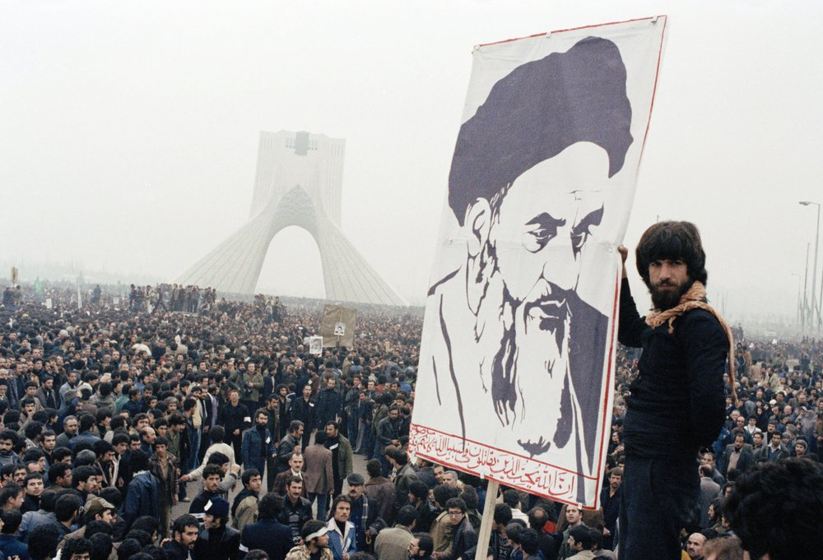
Why the Islamic Revolution?
Contemporary relevance
Popular memory
Role of women
Notes:
The first question to ask is, “why the Islamic Revolution?”
Contemporary Relevance -> Iran is a country that is often discussed as an object of US foreign policy, bipolar political relationship between the US&Israel on one side, and Iran on the other. What are the foundations of this conflict?
Popuar memory -> I believe there is an issue with popular memory here. We tend to think of the revolution as a geopolitical event, as the start of the conflict between nation states. I wanted to look more deeply at the social aspects of the Revolution, at the diverse groups that fought to overthrow the government of the Shah.
Role of Women -> This leads me to the role of women. Women were among the most active and effective groups during the revolution. This may seem contradictory in hindsight, but the idea of an Islamic Revolution varied group to group. Women were fighting against the corruption and westernization of the Shah’s government, not to surrender their rights.

Slide 3
Outline
Focus →
Structure
Pre-Revolutionary Period (1941-1979)
Revolutionary Period (1979-1981)
Post-Revolutionary Period (1981-1989)
Iranian women, despite being the main losers of the Islamic Revolution of 1979, played an integral role in the movement that eventually toppled the government of Mohammad Reza Shah, solidifying themselves as one of the most influential groups of twentieth century Iran.

Slide 4
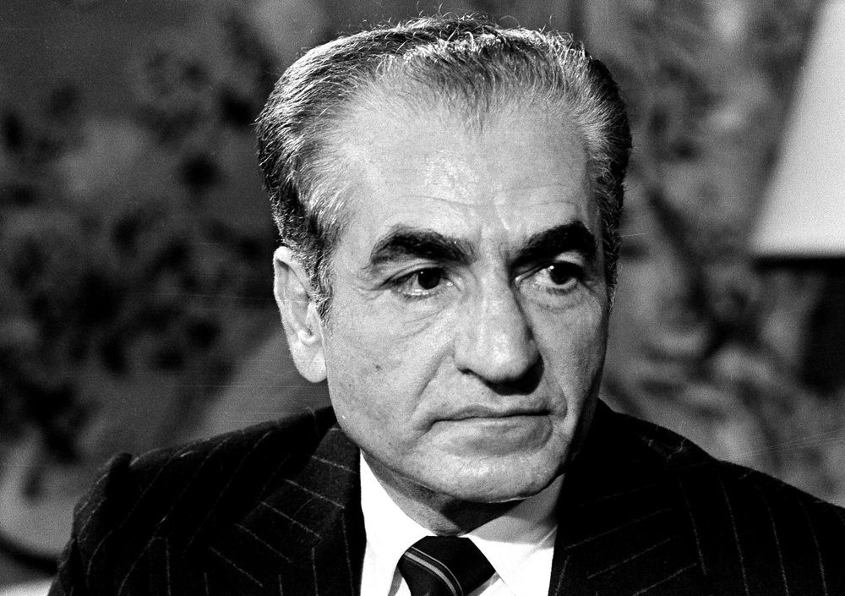
Pre-Revolutionary Period (1941-1979)
Shah Mohammad Reza Pahlavi (r. 1941-1979)
Authoritarian modernizer
Modeled reforms on the West
Unpopularity
Mohammad Reza Shah

Slide 5
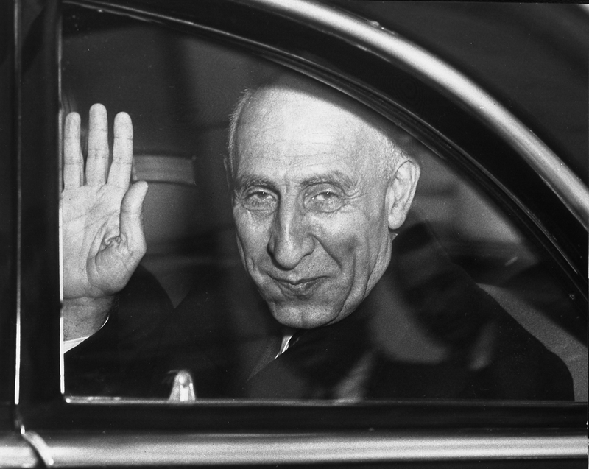
1953 Coup d'état
Mohammad Mossadegh
Photo credit: Truman Library

Slide 6
Women’s Organization of Iran (WOI)
State-sponsored feminism
Progressive but ineffective
Hijacked the women’s movement
Notes:
The WOI was the main platform of the Shah’s state feminism.
The WOI consolidated all women’s groups in Iran, effectively monopolizing the women’s movement into the state agenda.
The WOI ran women’s centers, created committees that focused on women’s health, education, political status and social welfare.
It was progressive, but ineffective. Most of the reforms did not reach lower classes. TOP DOWN problem in HISTORY.
The Shah hijacked the women’s movement as a means of improving his reputation abroad and emulating the West.

Slide 7
Women and Islam
Islam became the symbolic platform for resistance
Most groups wanted democratic reform
Many women set their issues aside in order to overthrow the Shah
Role of the clergy

Slide 8
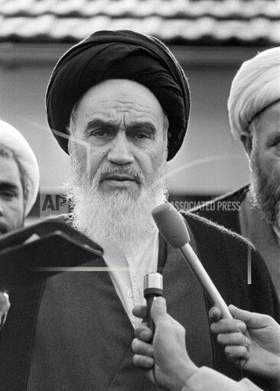
Revolutionary Period (1979-1981)
Revolution broke out in January of 1979
Diverse coalition of activist groups
Supplanted by Khomeinists
March 8, 1979: International Women’s Day
“Birth” of the independent women’s movement
Ayatollah Khomeini

Slide 9
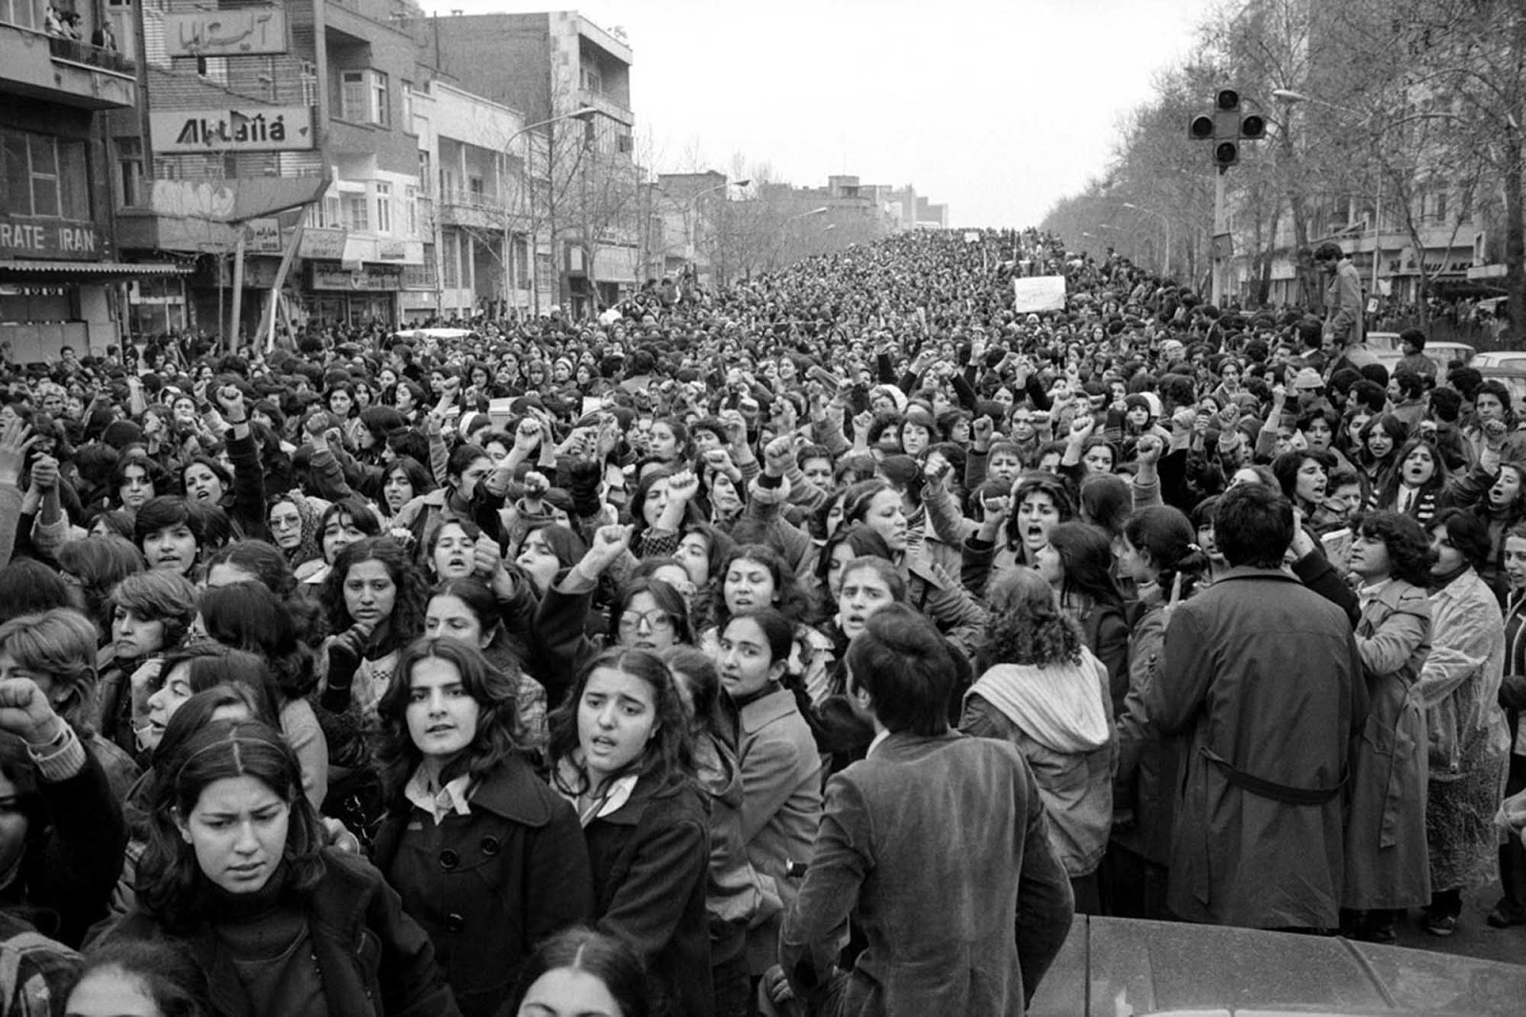
1967 Family Protection Laws (FPL)
Provided women with avenues for divorce, child custody, and alimony
Struck down in August of 1979
International Women’s Day Protests
Photo credit: Hangameh Golestan

Slide 10
Post-Revolutionary Period (1981-1989)
Iraqi invasion of Iran in 1980
Hostage crisis of 1979-1981
Women’s issues sidelined
Gradual deterioration of rights
Notes:
Two key events affirmed Khomeini’s power: The Iran-Iraq war meant that Iranian politics were defined by foreign policy, which drew attention away from women’s issues.

Slide 11
Conclusions
Iranian women, who consistently fought for their rights throughout the twentieth century, were taken advantage of by both the Shah and the Ayatollah
Islam was adopted as a symbolic form of resistance against the Shah. Most Iranian women had a more liberal, inclusive interpretation of Islam that included maintain their democratic rights.
The far-right fundamentalist wing of the revolution consistently misrepresented itself and seized control once the Shah was overthrown.
Geopolitical events in the 1980s reaffirmed the Ayatollah’s grip on power, effectively sidelining women’s issues.

Slide 12
Bibliography
Algar, Hamid. Islam and Revolution: Writings and Declarations of Imam Khomeini. Berkeley: Mizan Press, 1981.
Beck, Lois and Nashat, Guity. Women in Iran: From 1800 to the Islamic Republic. Chicago: University of Illinois Press, 2004.
Ferdows, Adele K. “Women and the Islamic Revolution.” International Journal of Middle East Studies 15, no. 2 (1983): 283-298.
Kandiyoti, Deniz. Women, Islam and the State. Philadelphia: Temple University Press, 1991.
Keddie, Nikki R. Modern Iran: Roots and Results of Revolution. New Haven: Yale University Press, 2003.
Moghissi, Haideh. Populism and Feminism in Iran: Women’s Struggle in a Male-Defined Revolutionary Movement. New York: St. Martin’s Press, 1994.
Shaheed, Farida and Shaheed, Aisha Lee. Great Ancestors: Women Claiming Rights in Muslim Contexts. Oxford: Oxford University Press, 2011.

