Slide 1


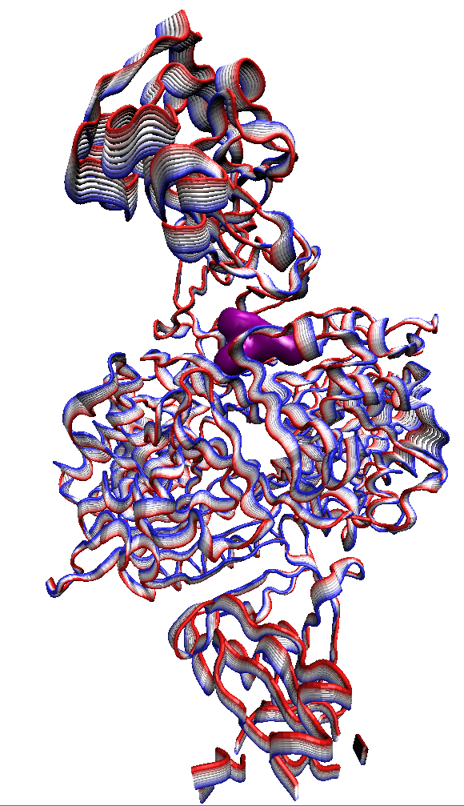
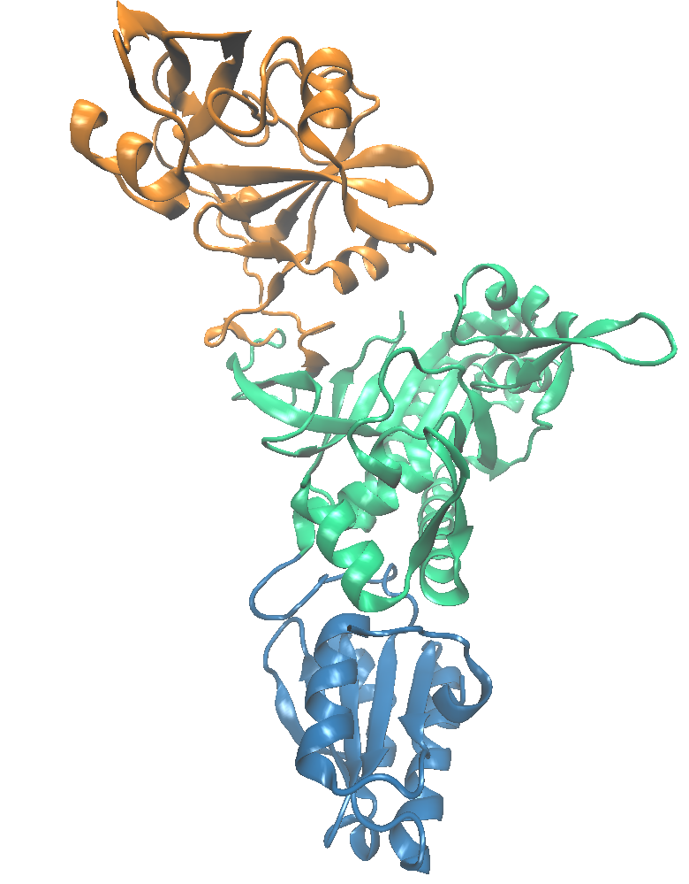
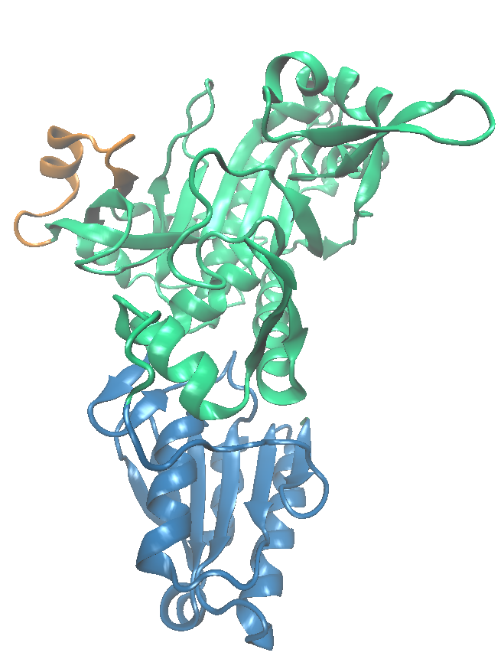
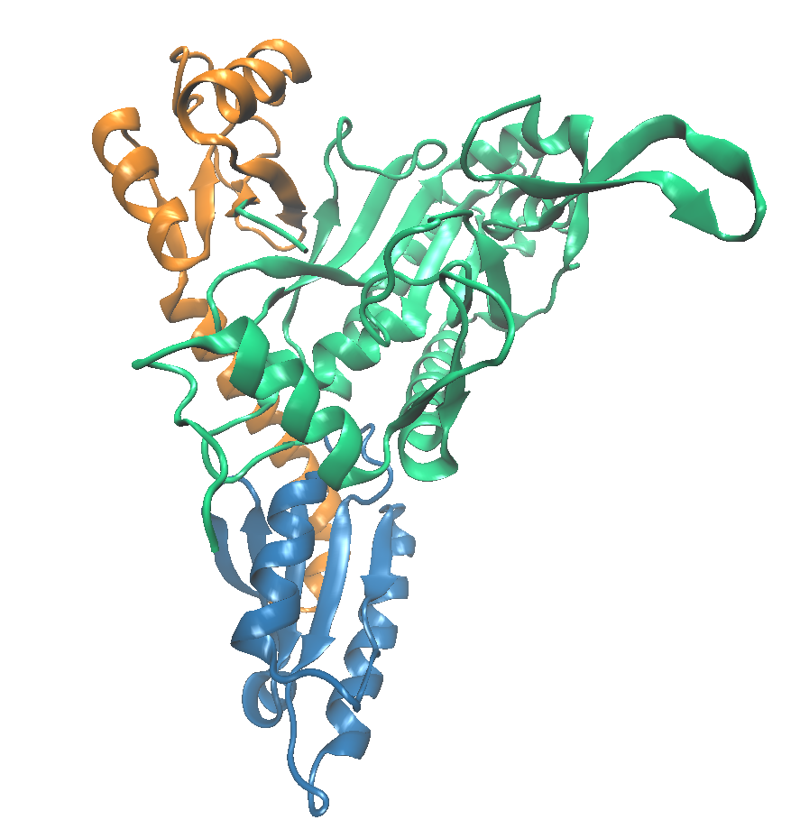
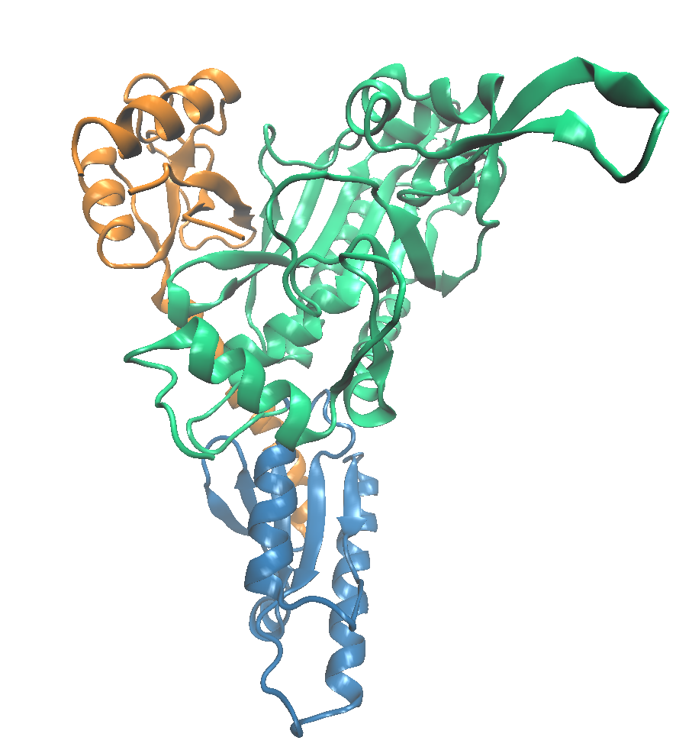
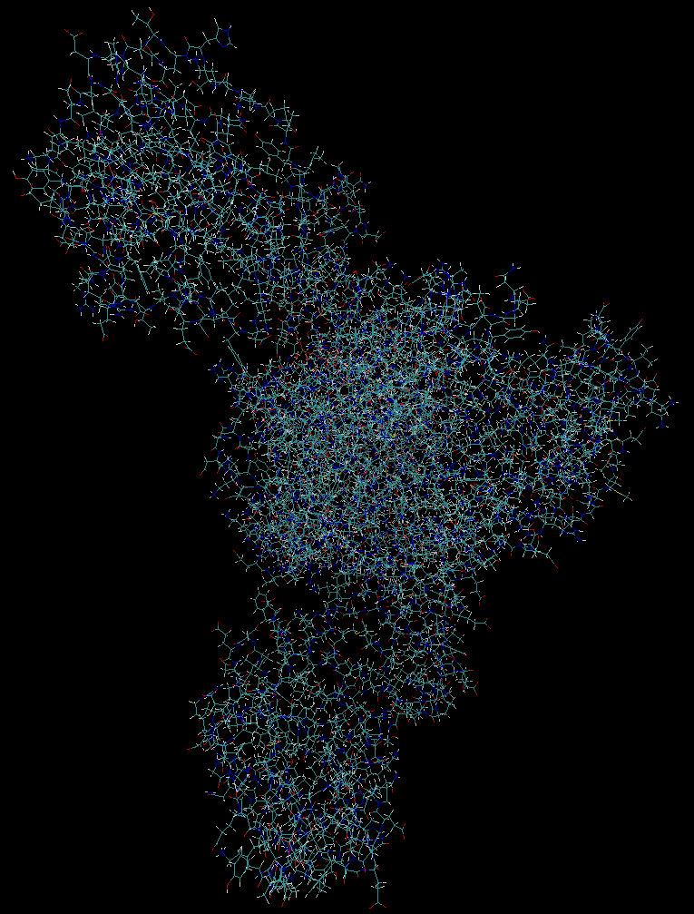
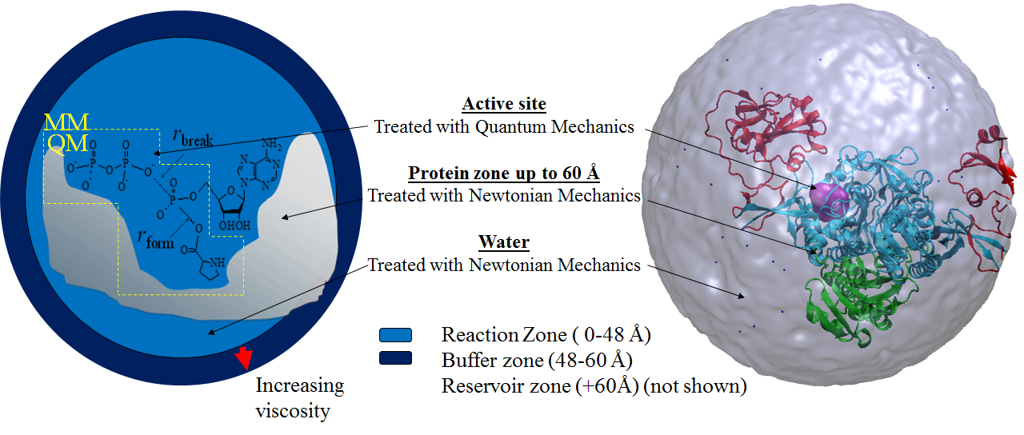
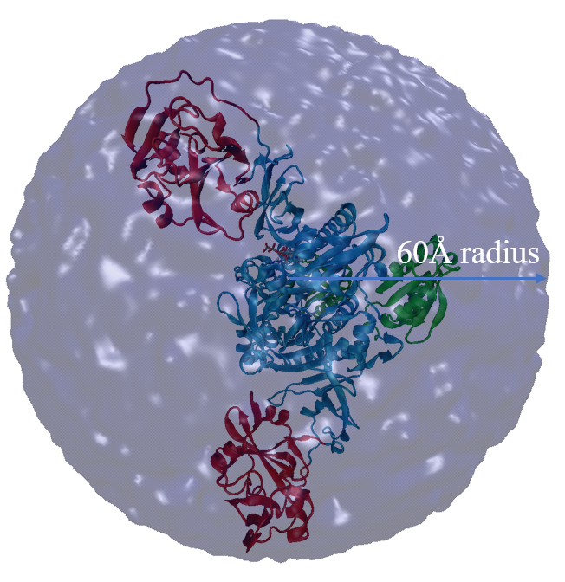
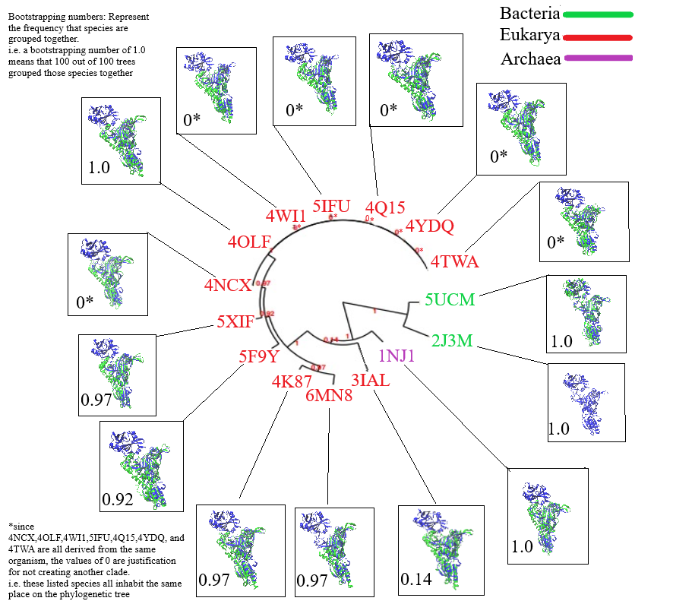
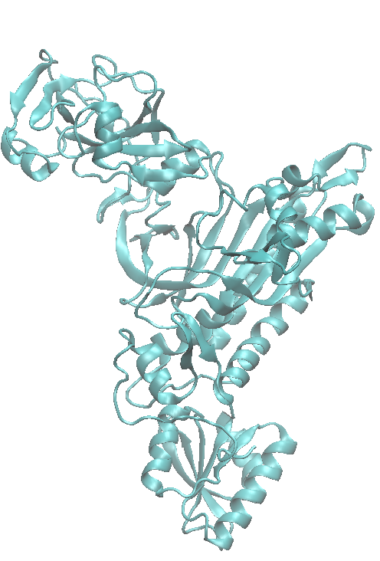
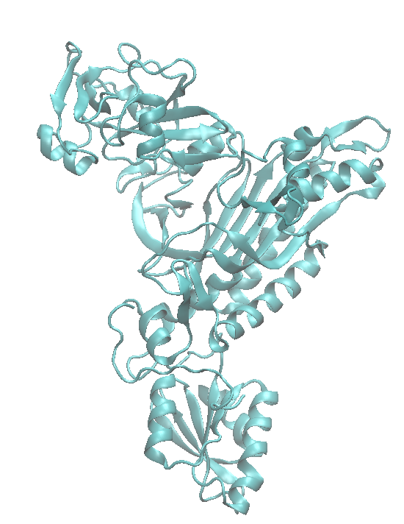
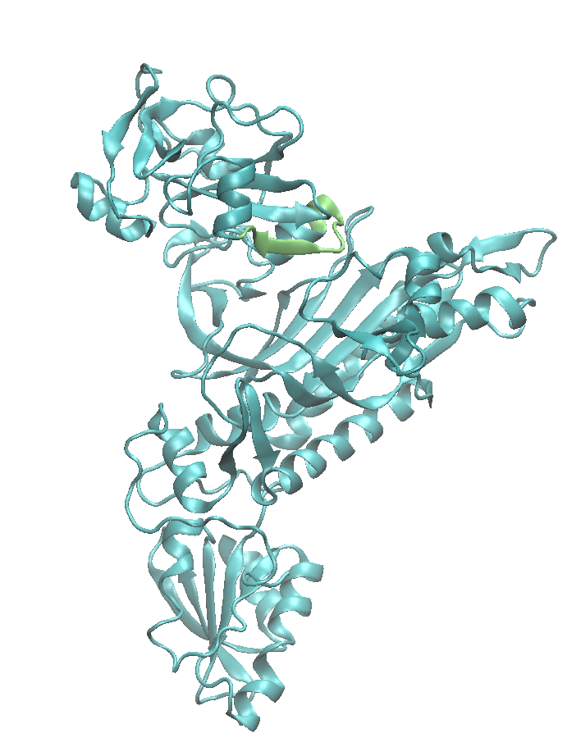
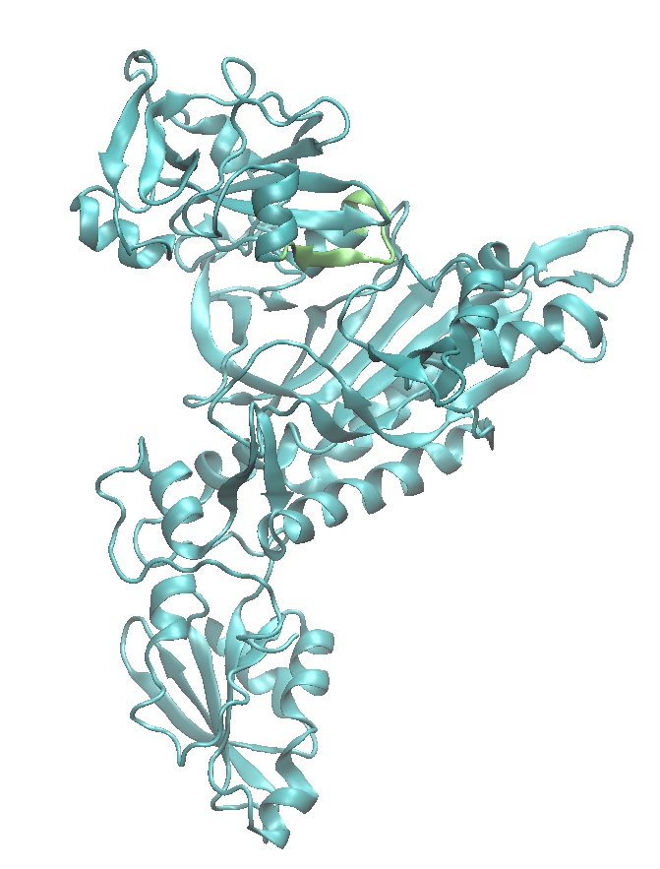
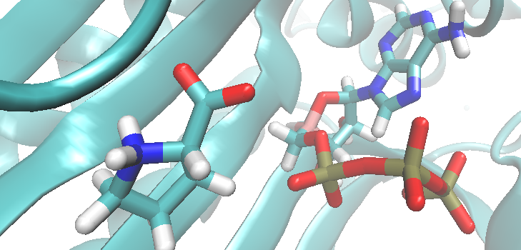
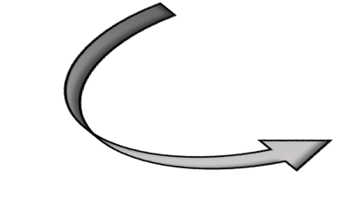

Investigating Structure-Dynamics-Function Differences Among Various Species of Proyl-tRNA Synthetase Using a Hybrid QM/MM Computational Technique
Murphi Weinzetl, Carl Fossum, Alex Narkiewicz-Jodko, Sanchita Hati, and Sudeep Bhattacharyya
Chemistry, University of Wisconsin-Eau Claire, Eau Claire, WI, United States.
Abstract
Background and Significance
All living organisms contain amino-acyl tRNA synthetases (AARSs) ‒ a family of enzymes critical for protein synthesis. They are responsible for the covalent ligation of proline to its specific tRNA molecule, called tRNA^{Pro}, using ATP. The structures of prolyl-tRNA synthetases (ProRSs) have been found to contain a number of domains. The “eukaryote-like” species of ProRS consist of a zinc-binding domain instead of the insertion domain (INS domain) present in “prokaryote-like” proteins. These domains are in constant motion and work in a concerted manner to facilitate the catalytic reaction step. Coupled domain dynamics have been found to be necessary for the catalysis. This calls into question the differences in structure and dynamics between the two non-catalytic domains and how it influences the catalytic steps. A comparative study of the structure-dynamic-function relationship among various species of ProRS is being investigated using molecular simulations. In parallel, a computational study of the sequence homology amongst various species of ProRS using the Dali server for the comparison of proteins is being performed. In order to further investigate the evolution of the ProRS protein family, the similarities and differences of different ProRS species are being studied. The preliminary results for this investigation will be presented.
Function
Aminoacyl-tRNA Synthetases (AARSs)
  Catalyze the covalent attachment of an amino acid (AA) to its cognate tRNA to form aminoacylated-tRNA
  Two-step reaction:
AA + ATP + AARS AARS•AA-AMP + PP_{i} (1)
AARS•AA-AMP + tRNA^{AA} → AARS + AA-tRNA^{AA} + AMP (2)
    Prolyl-tRNA Synthetases (ProRSs) attach proline to tRNA^{Pro}
Structure
Two conserved domains with conserved functions:
  Catalytic domain where covalent attachment of proline to tRNA^{Pro} takes place in the presence of ATP
  Anticodon binding domain responsible for recognition of correct tRNA (tRNA^{Pro})
Variable third domain:
  “prokaryotic-like” ProRSs typically possess INS that edits misacylated tRNA^{Pro} (Ala-tRNA^{Pro})
  “eukaryotic-like” ProRSs use free-standing homologous enzymes for editing and possess zinc binding domain instead
  Rhodopseudomonas palustris (Rp) ProRS: “prokaryotic-like” but possesses neither domains and is found as a trimer instead of a dimer like other ProRSs considered in this study
“Eukaryote-like” ProRSs
(T. Thermophilus)
INS Domain
Dynamics
Protein dynamics and conformational changes are critical for their function
Role of coupled-domain dynamics on catalysis is underexplored in large, multi-domain enzymes (3)
Previous studies demonstrated the removal of the INS domain in Escherichia coli ProRS resulted in drastic decrease in catalytic efficiency (1000-fold decrease) possibly due to the absence of INS domain dynamics
Wild-type E. facium ProRS studies illustrated a movement of the INS domain toward the catalytic domain critical for efficient catalysis
Linker Region
Zinc-Binding Domain
Catalytic Domain
Catalytic Domain
INS Domain
Catalytic Domain
Anti Codon Binding Domain
Anti Codon Binding Domain
Species:
PDB code:
E. faecium
2J3M
R. palustris
2I4O
T. thermophilus
1H4Q
H. sapien
4K87
Objective: Investigate the role of structurally distinct domains on catalysis.
Evolutionary development
Theory
Materials and Methods
Quantum Mechanics/Molecular Mechanics(QM/MM) Hybrid Technique
Why use the hybrid QM/MM technique?
  Quantum theory is required for simulating bond breaking and bond forming but computationally too expensive to be utilized for the entire enzyme system, so the rest is treated with molecular mechanics
Different regions of the solvated enzyme-substrate complex are treated with different levels of theory describing atoms and atom-atom bonding (4)
  Atoms directly involved in bond breaking and formation are treated with approximate quantum mechanics
    Self-Consistent-Charge Density Functional Tight-Binding (SCC-DFTB) theory is used to perform electronic structure calculation (5)
    Atomic charges are calculated each time the structure changes
    Atom-atom bonds and bond orders are obtained from overlap of orbitals generated by electronic structure calculation method
  The rest of the protein and the water molecules are treated with classical Newtonian Mechanics
    Atoms possess fixed partial charges
    Bonds are modeled as balls and springs
    Harmonic potentials are used to treat charges in the potential energies of bonds and angles
    Non-covalent (Coulombic and van der Walls) interactions are treated as demonstrated in Equation 1 where k_{i}’s are force constants, Ɛ_{ij} is the depth of the potential energy surface, and Ɛ is the dielectric constant
X-ray Crystallographic data of each protein's structure was taken from the Protein Data Base (PDB)
Structure was analyzed for segments lost in crystallographic process and built in Visual Molecular Dynamics (VMD) program using the mutator plug-in
ATP and proline were docked as needed
Structure was then re-centered at the active site and truncated to a 60 Å radius sphere
Four layers of water were added with a dynamic simulation in between each step for the protein to adjust to each addition using CHARMM program (version C4061)
Superimposition
The DALI server for protein structure comparison was used throughout all superimpositions
PDB files were generated by the superimposition of different ProRS species over the query base species, 2J3M.
Using the generated PDB files and VMD simulations, images of 2J3M were superimposed by images of several other ProRS species in order to accentuate possible evolutionary changes and general structural differences, especially the fluctuating presence of an insertion domain, amongst different species of ProRS.
Phylogeny
In order to support the super imposed images, and thus evidence of relation between different species of ProRS, a phylogenetic tree between the different proteins was created.
Using Phylogeny.fr, all FASTA sequences of the surveyed ProRS species were aligned and analyzed for similarity.
Several trees were computed and compounded into a final tree
The phylogenetic tree produced supports the grouping of organisms into their respective kingdoms and even further by individual species relation.
Results and Discussions
Conclusions and Future Directions
Overall Structural Dynamic Changes
Root Mean Square Deviation Throughout Catalysis
Root mean square deviation in each frame for the backbone C_{α} atoms was calculated with respect to the first frame of the simulations:
RMSD =
Ef ProRS exhibits a greater overall change in structure, possibly due to the large fluctuation of the INS domain
Conclusions
All species exhibit similar structural dynamics in precursor complex formation.
The RMSD measurement exhibited reduced backbone flexibility for both active sites of Rp ProRS compared to Ef ProRS
In previous studies, the removal of ATP and Proline from the active site pocket has been shown to correlate with INS domain movement away from the active site pocket
Removal of ATP and its associated charge resulted in minimal interference to the INS domain movement. This indicates Proline play a significantly greater role in INS movement than initially thought
Phylogeny suggests a significant difference between eukaryotic and bacterial/archaic ProRS
The insertion domain is exclusive to bacterial species of ProRS in the given sample
Future Directions
Finish umbrella sampling with Tt and Hs ProRS with cysteines in Zn binding domain de-protonated for proper Zn²⁺ binding
Compare the dynamics between the variable third domains from different species
Investigate the role of net dipole moment through the active site pocket
Observe the changes to electric fields through the active site pocket during simulation
Investigate the significance of the insertion domain present in bacterial ProRS
INS domain
Edited Ef ProRS species
Zeroed ATP charge
Edited Ef ProRS species
Removal of ATP
Active site pocket
Active site pocket
(Orange)
In comparison to the original structure, activity in the precursor complex for all analyzed species shows distinct movement of the INS domain in towards the active site pocket. The precursor complex is the most stable conformation before the reaction between ATP and Proline occurs.
Movement of the INS domain in modified species of Ef ProRS remained similar to that of unedited species. In each simulation, the INS domain was observed to move in a corkscrew manner in towards the active site pocket.
Acknowledgements
National Institute of Health
UWEC Office of Research and Sponsored Activities
American Chemical Society
UWEC Blugold Supercomputing Cluster
UWEC Chemistry Department
UWEC Learning and Technology Center
Hati-Bhattacharyya lab group
References
“Prokaryote-like” ProRSs
(E. faecium)
1. Crepin, T., Yaremchuk, A., Tukalo, M., Cusack, S., Structures of Two Bacterial Prolyl-tRNA Synthetases with and without a cis-Editing Domain. Structure. 2006, 14, 1511–1525.
2. Yaremchuk, A., Cusack, S., Tukalo, M., Crystal structure of a eukaryote/archaeon-like prolyl-tRNA synthetase and its complex with tRNA^{Pro} (CGG). The EMBO Journal. 2000, 19, 4745-4758.
3. Sanford, B.L., Cao, B.V., Johnson, J., Zimmerman, C., Strom, A. S., Mueller, R. M., Bhattacharyya, S., Musier-Forsyth, K. M., Hati, S., Role of coupled-dynamics in the catalytic activity of prokaryotic-like prolyl-tRNA synthetases. Biochemistry. 2012, 51, 2146-2156.
4. Mueller, R. M.; North, M. A.; Yang, C.; Hati, S.; Bhattacharyya, S., Interplay of flavin's redox states and protein dynamics: an insight from QM/MM simulations of dihydronicotinamide riboside quinone oxidoreductase 2. J. Phys. Chem. B 2011, 115, 3632-3641.
5. Cui, Q.; Elstner, M.; Kaxiras, E.; Frauenheim, T.; Karplus, M. A QM/MM Implementation of the Self-Consistent Charge Density Functional Tight Binding (SCC-DFTB) Method J. Phys. Chem. B 2001, 105, 569-585.
6. Brooks, B. R.; Bruccoleri, R. E.; Olafson, B. D.; States, D. J.; Swaminathan, S.; Karplus, M., CHARMM: A program for macromolecular energy, minimization, and dynamics calculations. J. Comp. Chem. 1983, 4, 187-217.
7. Dereeper A., Audic S., Claverie J.M., Blanc G. BLAST-EXPLORER helps you building datasets for phylogenetic analysis. BMC Evol Biol. 2010 Jan 12;10:8. (PubMed)
8. Dereeper A.*, Guignon V.*, Blanc G., Audic S., Buffet S., Chevenet F., Dufayard J.F., Guindon S., Lefort V., Lescot M., Claverie J.M., Gascuel O. Phylogeny.fr: robust phylogenetic analysis for the non-specialist. Nucleic Acids Res. 2008 Jul 1;36(Web Server issue):W465-9. Epub 2008 Apr 19. (PubMed) *: joint first authors
9. Edgar RC. MUSCLE: multiple sequence alignment with high accuracy and high throughput. Nucleic Acids Res. 2004, Mar 19;32(5):1792-7. (PubMed)
10. Castresana J. Selection of conserved blocks from multiple alignments for their use in phylogenetic analysis. Mol Biol Evol. 2000, Apr;17(4):540-52. (PubMed)
11. Guindon S., Gascuel O. A simple, fast, and accurate algorithm to estimate large phylogenies by maximum likelihood. Syst Biol. 2003, Oct;52(5):696-704. (PubMed)
12. Anisimova M., Gascuel O. Approximate likelihood ratio test for branchs: A fast, accurate and powerful alternative. Syst Biol. 2006, Aug;55(4):539-52. (PubMed)
13. Chevenet F., Brun C., Banuls AL., Jacq B., Chisten R. TreeDyn: towards dynamic graphics and annotations for analyses of trees. BMC Bioinformatics. 2006, Oct 10;7:439. (PubMed)
1
Motif 1
Motif 2
INS Domain (171 aa)
Motif 3
Anticodon Binding Domain
572
1
Motif 1
Motif 2
Motif 3
Anticodon Binding Domain
Zn-Binding Domain (~80 aa)
477
“Eukaryote-like” ProRSs
(T. Thermophilus)

